Slide 1
TechCred.Ohio.gov

Slide 2
TechCred.Ohio.Gov
Why TechCred?
TechCred is a win-win for Ohio – Employers get the talent they need to grow, and Ohioans get the opportunity to expand their skills.

Slide 3
TechCred.Ohio.Gov
After 18 Application Periods:
57,233 credentials will be funded.
2,173 unique Ohio employers awarded funding
1,091 employers have received awards in multiple rounds.
Over 2,000 credentials are approved on the TechCred list.

Slide 4
TechCred.Ohio.Gov
Round 18 (January) Application Award Data:
345 Ohio employers and 4,237 credentials were approved for funding.
Over 2,000 credentials are approved on the TechCred list.
Current Application Period: May 1 – May 31 at 3:00 p.m.

Slide 5
TechCred.Ohio.Gov
What is a credential?
Credential
Certificate
Certification

Slide 6
TechCred.Ohio.Gov
What makes a credential eligible?
Industry-recognized
Technology-focused
Short-term (12 months or less)

Slide 7
TechCred.Ohio.Gov
Adding credentials to the approved list:
TechCred is designed to be responsive to the dynamic workforce needs of employers. When filling out the TechCred application, employers will choose “Credential Not Listed” and be prompted to provide:
Name of Credential
Identification of the Credential as a Certificate or Certification
Link to Credential Website or Uploaded Syllabus/Brochure
You must include this information or your credential will be deemed ineligible.
Evidence that the credential is short-term
Evidence the competencies/skills taught or measured in the credential are technology-focused
Evidence the credential has value beyond the submitting employer and is not exclusive to one organization

Slide 8
TechCred.Ohio.Gov
Award Amounts:
Up to $2,000 per credential
MULTIPLE credentials can be earned by one employee each funding round
$30,000 per employer, EACH funding round
UP TO $180,000 PER YEAR!

Slide 9
TechCred.Ohio.Gov
Employer Size Classification (Application & Fund Distribution)
Businesses of all sizes have the same opportunity to receive funding through TechCred. Each size category receives an equal amount.
1-50 Employees:
Small
51-200 Employees:
Medium
201+ Employees:
Large

Slide 10
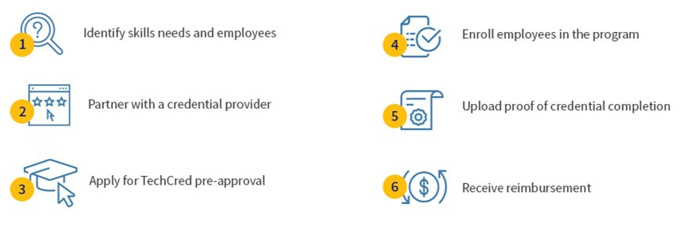
TechCred.Ohio.Gov
How do businesses get started?

Slide 11
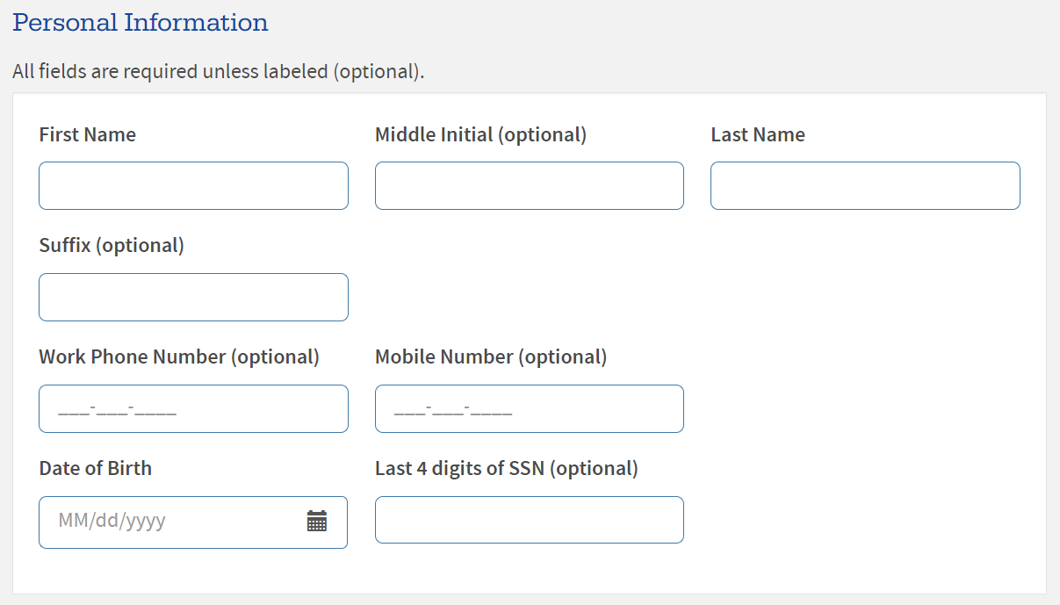
TechCred.Ohio.Gov
Application Log In
When a business applies for TechCred, they are required to create or log in to their OH|ID account.

Slide 12
TechCred.Ohio.Gov
Application Requirements
Payee ID Number
To register as a new supplier or update an existing account with the State of Ohio, visit Supplier.Ohio.gov to receive a ten-digit State of Ohio Payee ID number.
Ohio Charter Number
Businesses can search and find their Ohio Charter Number at BusinessSearch.OhioSOS.gov.
Federal Tax ID Number
The Federal Tax ID, or EIN, is used to identify a business entity. If you do not know your business’s number, it can be found on previous tax returns.

Slide 13
TechCred.Ohio.Gov
TechCred Updates
Grant agreements will now be incorporated into the online application. Upon receiving an award announcement, awardees will be directed to log into their application to provide an electronic signature certifying and acknowledging the Grant Agreement, Terms and Conditions, and the Program Guidelines.
To be eligible for reimbursement, training for approved credentials may start on or after the first day of the month immediately following the last application period. Training programs must still be completed 12 months from the award date.

Slide 14
TechCred.Ohio.Gov
Reimbursement Process:
To initiate reimbursement, employers will utilize the online portal found at TechCred.Ohio.Gov. Employers will be required to submit the following:
Proof of credential completion​
​
Invoices for costs incurred and proof of payment​
Info about each credential earner​
Name​
Last 4 digits of Social security number​
Date of birth​
County of residence​
Wage before and after credential

Slide 15
TechCred.Ohio.Gov
TechCred.Ohio.Gov for information on TechCred.
Office of Workforce Transformation
Workforce@OWT.Ohio.Gov
Derek.Chancellor@governor.Ohio.gov
Current Application Period:
May 1 – May 31 at 3:00 p.m.

