Slide 1

CIN-DAY CYBER CORRIDOR Regional Consortia Approach to Cybersecurity Education and Workforce Readiness
March 9, 2017
Cybersecurity workforce market needs and opportunities analysis aligned with NICE Framework and Cybersecurity Jobs Heat Map
Cybersecurity Regional Educational Program Inventory and Gap Analysis
vellaINC

Slide 2
RESEARCH OVERVIEW
Partners / Resources
Technology First - Ann Gallaher / Marcia Albers: Executive Directors
Center for Workforce Development: Cassie Barlow, PhD: Executive Director, WSU Aerospace Professional Development Center and; Chad Watchorn: Director of Operations, Aerospace Professional Development Center
Richard Stock, Director, Business Research Group, University of Dayton
David Snipes, Montgomery County Business Solutions Center
Dr. Mary Haley: Director, Office of Small Business, AF Life Cycle Management Center
Jane Dockery: Assistant Director, Applied Policy Research Institute, WSU
Richard Harknett, PhD: Professor/Political Science Department Head, UC
REDI Cincinnati - Kimm Coyner: Vice President, Business Development & Project Management
The Circuit, Cincinnati via Technology First and REDI Cincinnati

Slide 3
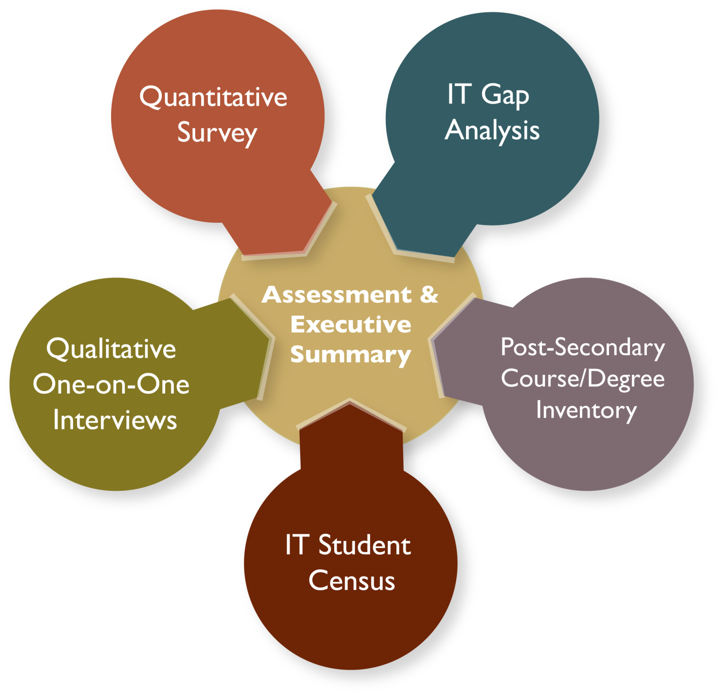
PROJECT STATUS

Slide 4
IT GAP Analysis JobsOhio Southwest (Cincinnati) and West (Dayton) Regions
After “double-counting” has been eliminated, more completions (graduates) than (job) openings
15-1134 – Web Developers
15-1131 – Computer Programmers
15-1122 – Information Security Analysts i.e.

Slide 5
JobsOhio IT Occupation Growth Projections
2015-2025
WEST/Dayton
2015
2025
# / +
% / +
RATIO
3.28
SOUTHWEST/Cincinnati
WEST + SOUTHWEST

Slide 6
HIGHER EDUCATION INVENTORY
Schools, Programs, Certificates and Degrees
vellaINC

Slide 7
West and Southwest Colleges and Universities with IT Programs and Degrees
AFIT
Antioch College
Cedarville
Central Michigan University
Central State
Cincinnati State Technical and Community College
Clark State
Edison Community College
Miami University
Mount St Joseph University
Northern Kentucky University
Sinclair Community College
Southern State Community College
Thomas Moore College
University of Cincinnati
University of Dayton
Urbana University
Wilberforce
Wilmington College
Wittenberg
Wright State
Xavier University

Slide 10
Qualitative Research
vellaINC

Slide 11
Qualitative Research
Technology First
+/- 12 one-on-one, in-depth interviews
Senior IT execs, Cincinnati & Dayton markets
Purpose: In-depth conversations and tool to guide development of quantitative research instrument, identify and explore current & future issues of:
Workforce, recruitment, & hiring
Budgets & corporate culture
Knowledge & understanding of higher T&E capabilities and offerings

Slide 12
Qualitative Research
Findings / Verbatims
“…disconnect: most companies want/need more security professionals but company culture and/or budget hasn’t caught up yet.”
“Only organizations with FTE’s dedicated to security are:
mid- to large-size organization in range of several 1,000’s employees and/or…
…in heavily regulated industry and/or…
…provide security as a service to other companies”

Slide 13
Qualitative Research
Findings / Verbatims
“Most companies instead have blended professionals that might do application development but security is part of their job.”
“May be more interest in MIS major with security minor than pure security grad.”
Many companies spoke to their interest in hosting interns or co-op students but also mentioned that they haven’t or don’t hire new graduates for Cybersecurity.

Slide 14
Qualitative Research
Findings / Verbatims
Many companies interested in interns or co-op students but also stated they have not or do not hire new grads.
Interest in and ability to host interns and co-ops can infuse the students into the local workforce.
“Hiring new grads: Needing security pro’s vs hiring new grads can be two different situations.”

Slide 15
Qualitative Research
Findings / Verbatims
Frustration around training: constant, on-going need for training in security but many respondents found it unaffordable. Focused on tools / certificates.
Conversely comments that too much focus on tools: broader problem solving-type thinking was missing in training offerings
Important to understand how they want current staff trained – either affordably, on-line, or broader problem solving

Slide 16
Qualitative Research
Findings / Verbatims
Certificate (4-5 classes) vs. Master’s Degree: Many times a company will pay for university (masters) fees before they will pay for training
Alternative may be university-sponsored certificate program: may be more amenable to companies’ policies

Slide 17
Quantitative Research
vellaINC

Slide 18
Quantitative Research
On-line survey distributed by Technology First, The Circuit, AF Lifecycle Management Ctr, and Wright State Research Inst.
Target: organizations’ members and relevant contacts
November, 2016 – January 2017
n = 75

Slide 19
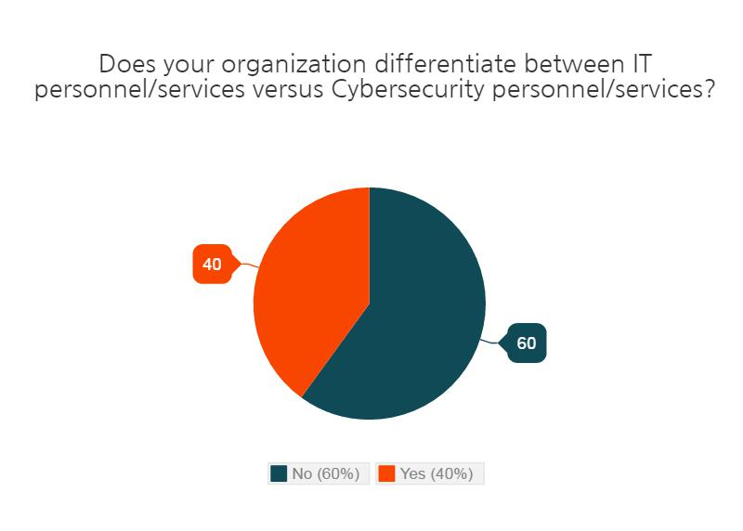

Slide 20
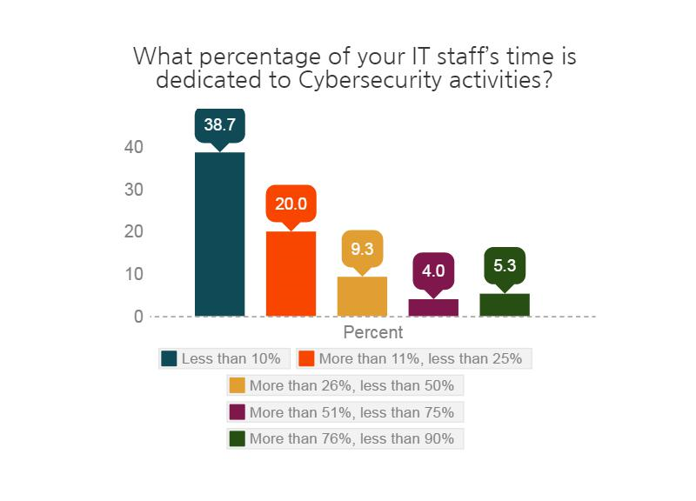

Slide 21
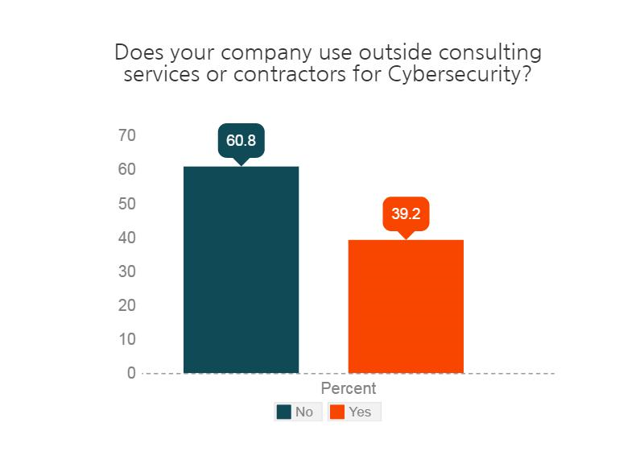

Slide 22
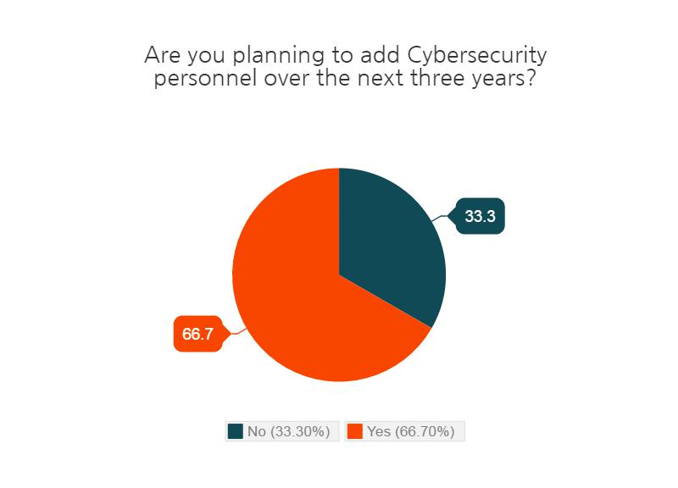

Slide 23
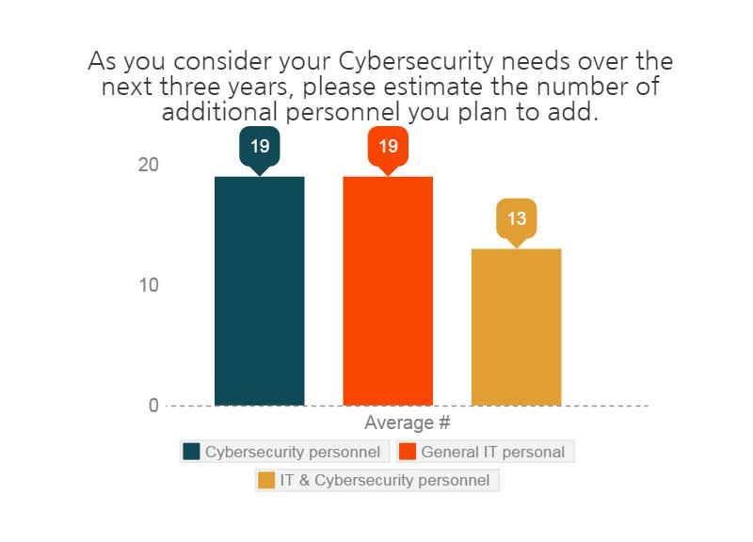

Slide 24
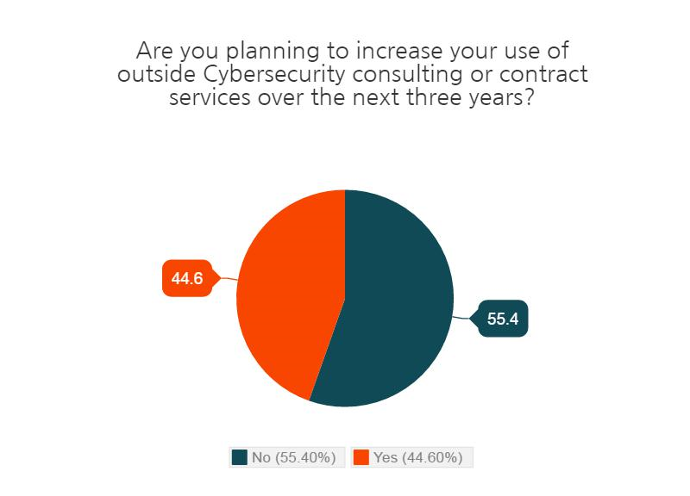

Slide 25
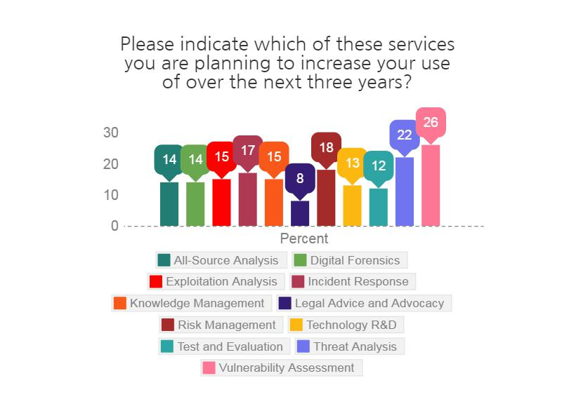

Slide 26
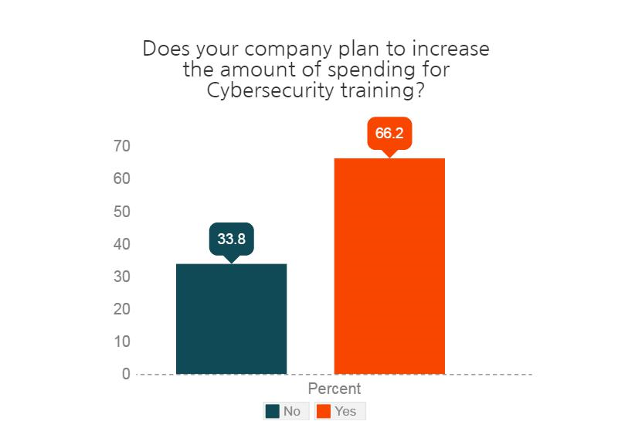

Slide 27
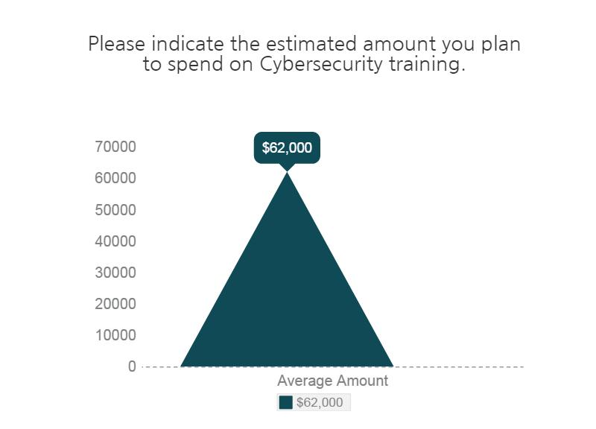

Slide 28
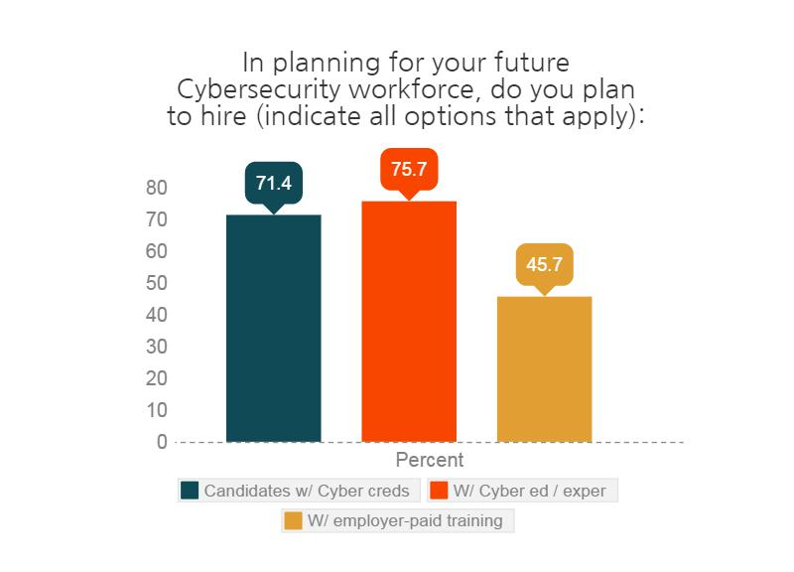

Slide 29
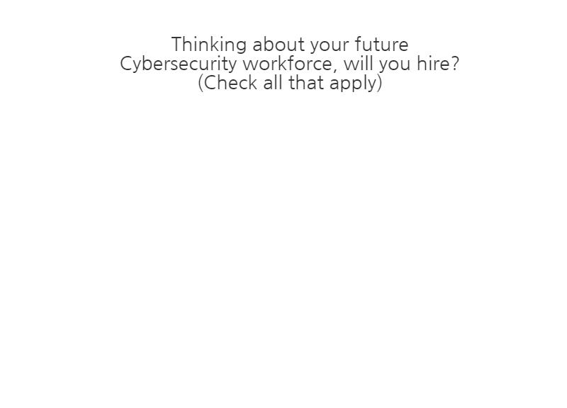

Slide 30
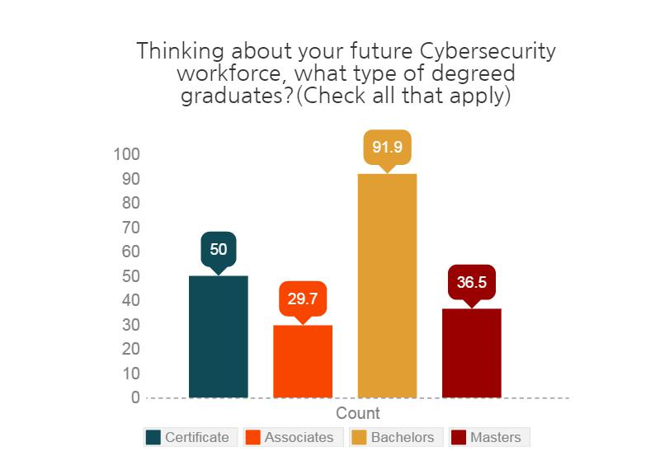

Slide 31
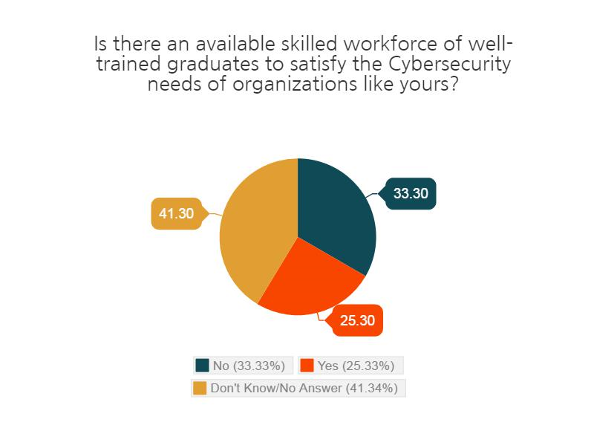

Slide 32
SUMMARY
vellaINC

Slide 33
IT GAP Analysis
Gap analysis: Important but not infallible
JobsOhio estimates look backward in time to project the future
Intense focus on cybersecurity may create more demand than estimated now
Assumption that “completions” are staying in region may not be correct
Especially if demand, compensation, other factors are greater, more attractive in other regions

Slide 34
QUALITATIVE ANALYSIS
Culture eats strategy. So do budgets.
Disconnect: most companies want/need more security professionals but company culture and/or budget hasn’t caught up yet
Many companies spoke to their interest in hosting interns or co-op students but also mentioned that they haven’t or don’t hire new graduates for Cybersecurity

Slide 35
QUALITATIVE ANALYSIS
Cybersecurity is special.
Too much focus on tools: broader problem solving-type thinking was missing in training offerings
Important to understand how they want current staff trained – either affordably, on-line, or broader problem solving

Slide 36
QUALITATIVE ANALYSIS
College & Universities Traditional Structure
On one hand: Many times a company will pay for university (masters) fees before they will pay for training
On the other…. Alternative may be university-sponsored certificate program: may be more amenable to companies’ policies

Slide 37
Quantitative ANALYSIS
Hiring vs. Training Current Staff
Companies indicate plans to hire Cybersecurity personnel over next especially Bachelors-degreed
Training budgets appear to be reasonable
Use of outside consulting appears to be stable and comparable to current levels of usage

Slide 38
Quantitative ANALYSIS
The “Wildcard” Forces of Talent Retention and Demand Growth
Cybersecurity virtually dominates daily news reports: need may spiral upward
Demand for talent could
decimate regional retention
Industry and academia may need
improved regular and formal
planning

