Slide 1
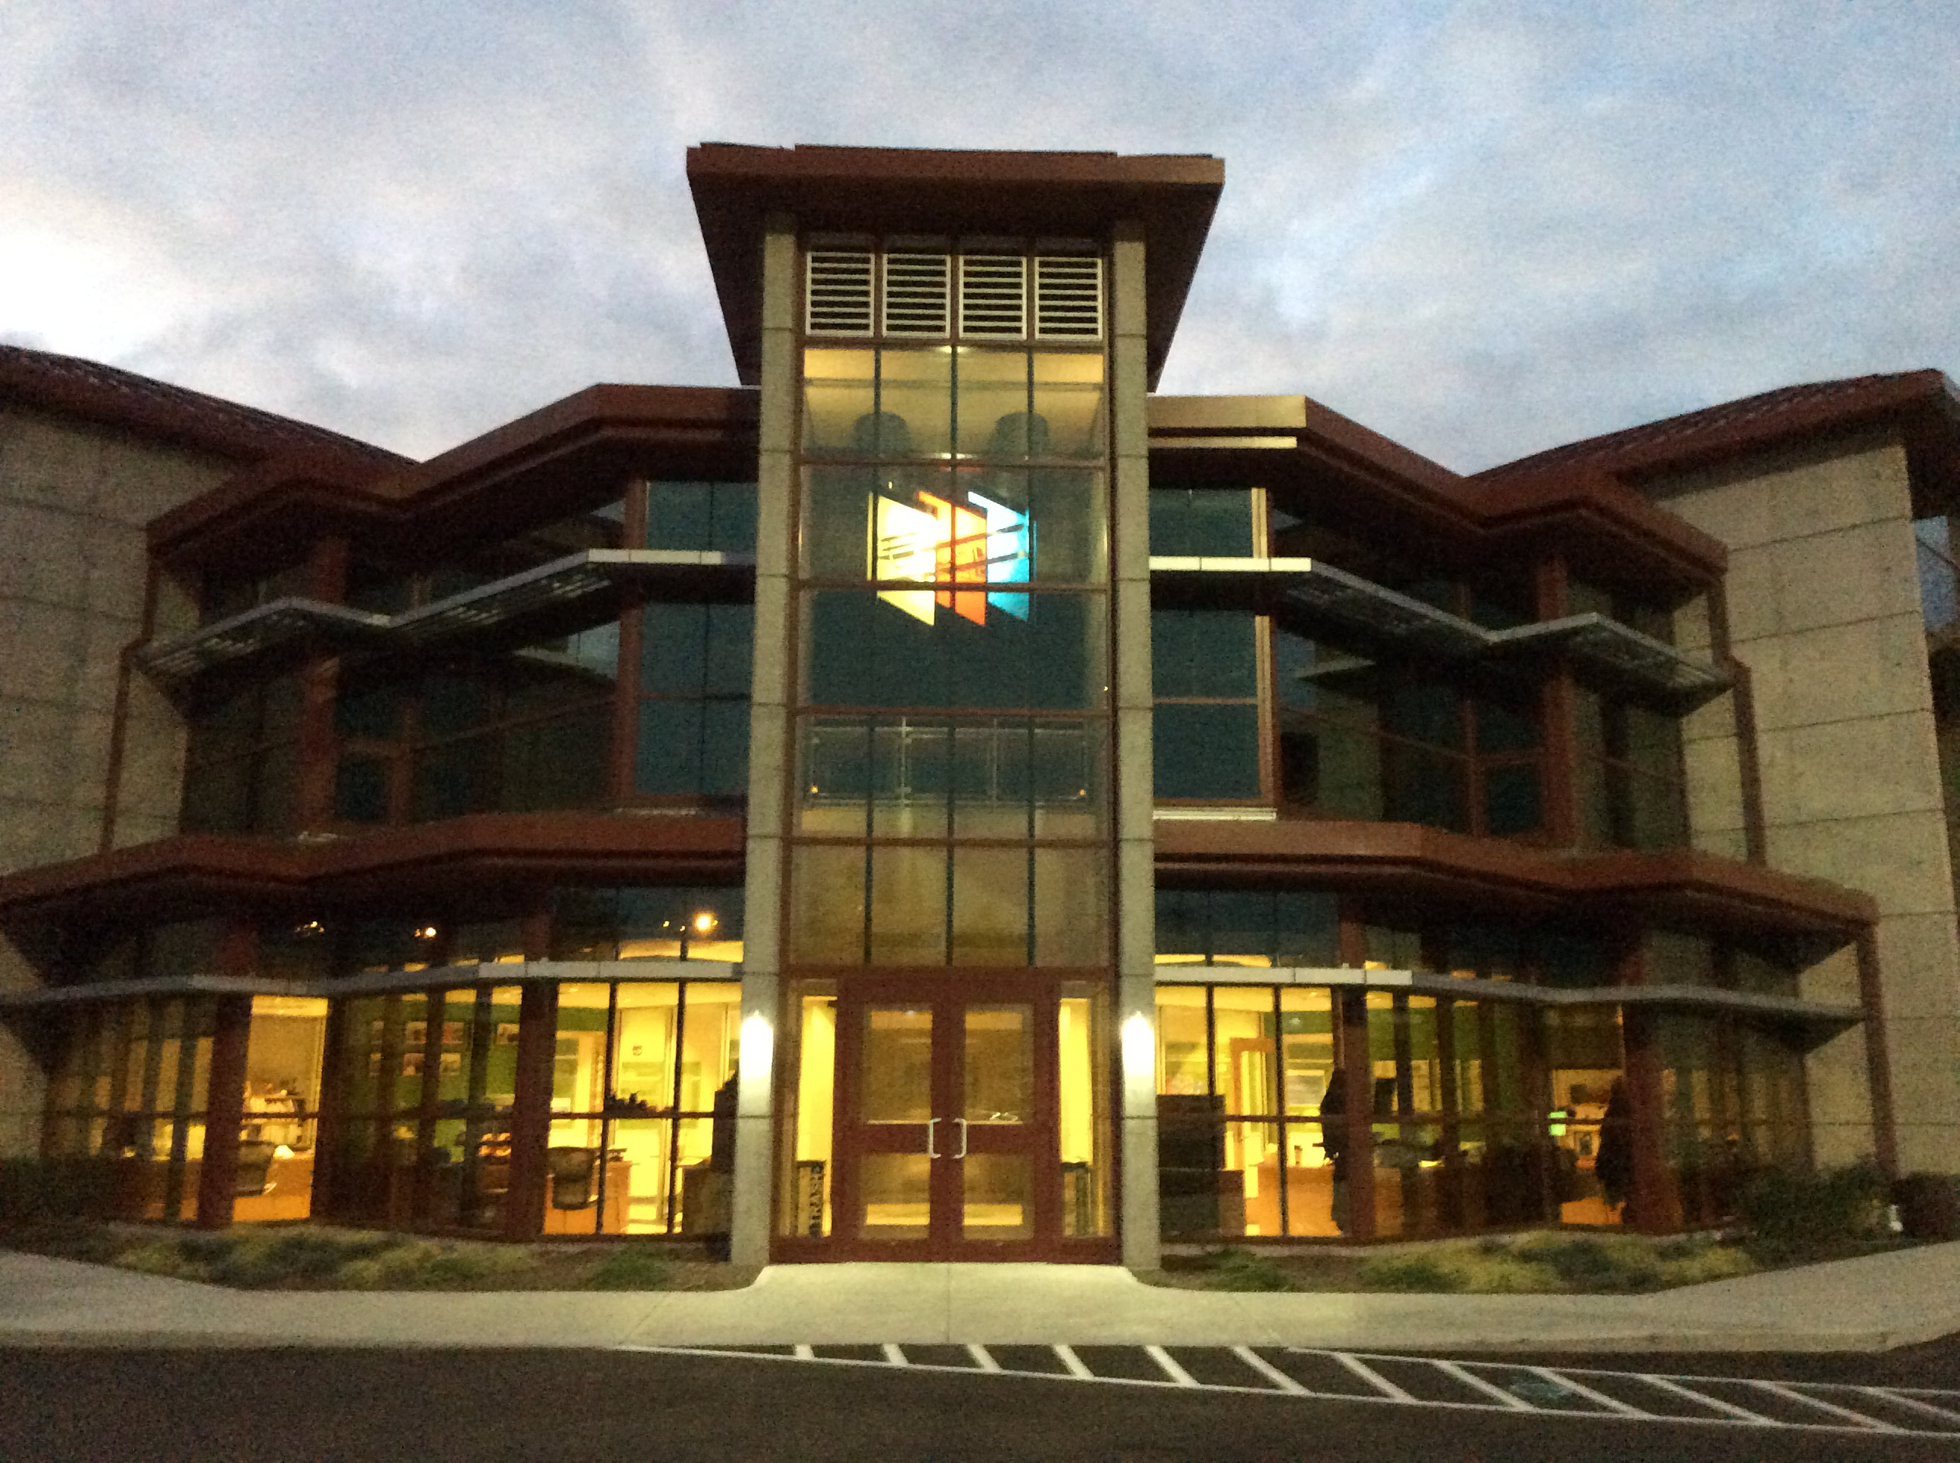
Miami Valley Planning & Zoning Workshop
“Equity in Foodshed Production, Distribution and Consumption”
Presented by: Partners for the Environment
Montgomery County Environmental Learning Center
Explore, Discover, and Participate

Slide 2
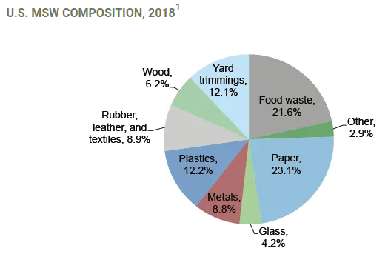
National Statistics
National & Local Food Waste Statistics

Slide 3
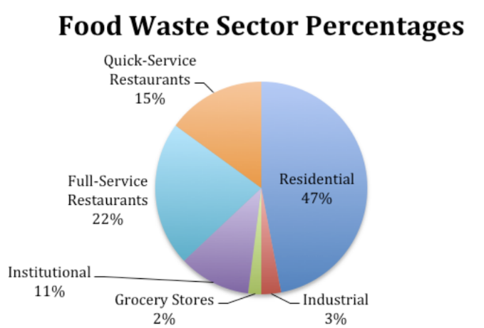
National Statistics
National & Local Food Waste Statistics

Slide 4
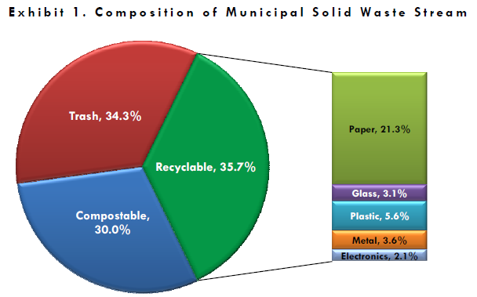
Montgomery County Statistics
National & Local Food Waste Statistics

Slide 5
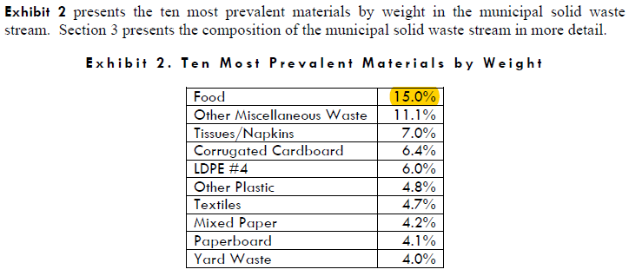
National & Local Food Waste Statistics

Slide 6
Montgomery County: Food Waste Programs

Slide 7
https://www.compostdayton.com/
Leadership: Institutional and Jurisdictional

Slide 8
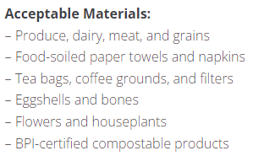
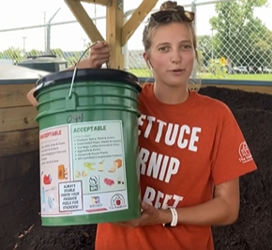
https://thefoodbankdayton.org/learn/urbangarden/compost/
Leadership: Institutional and Jurisdictional

Slide 9
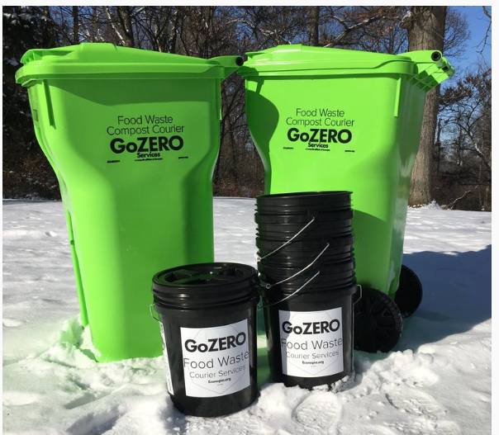
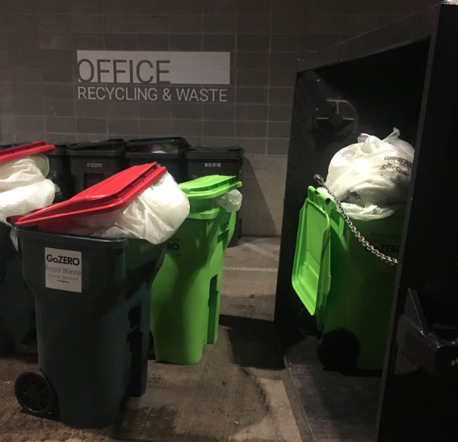
At Home
At Work
https://gozero.org/
Regional Programs/Initiatives

Slide 10
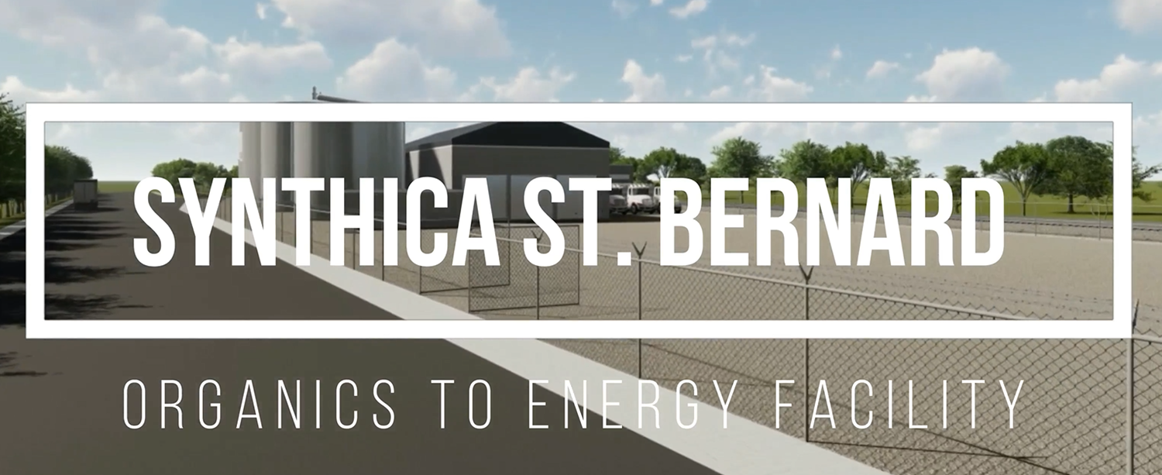
https://synthica.com/
At Work
Regional Programs/Initiatives

Slide 11
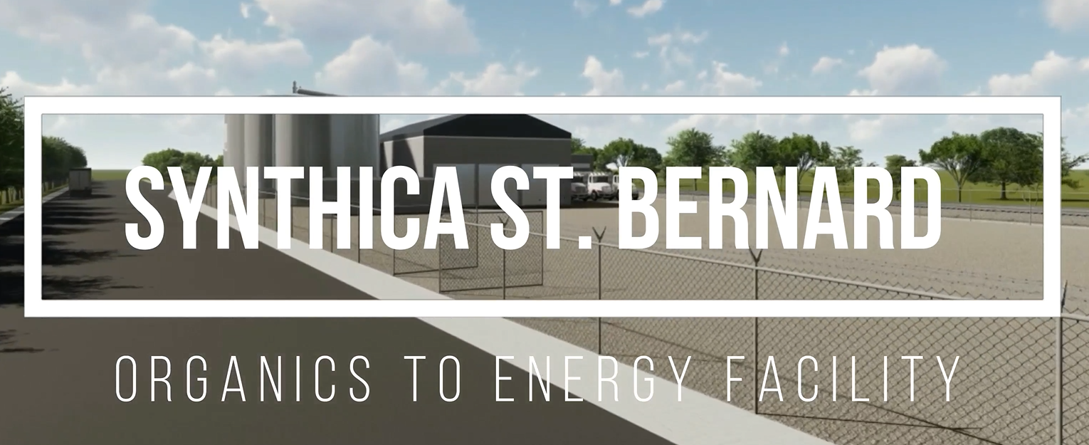
Grant Funding: Infrastructure, Collection & Processing

Slide 12
QUESTIONS?
Montgomery County SWMD
John Minear, Manager, Community Outreach and Education
937-781-3060
minearj@mcohio.org
Montgomery County Environmental Learning Center
Explore, Discover, and Participate

