Slide 1
Detection of Medical Inhaler Use via Terahertz Spectroscopy
Student:
Student Email:
Faculty:
Faculty Email:
AFRL Sponsor:
AFRL Directorate:
Daniel Tyree
Tyree.14@wright.edu
Ivan Medvedev
ivan.medvedev@wright.edu
Dr. Steve Kim
AFRL/RH
PA #:
AFRL-2022-4750

Slide 2
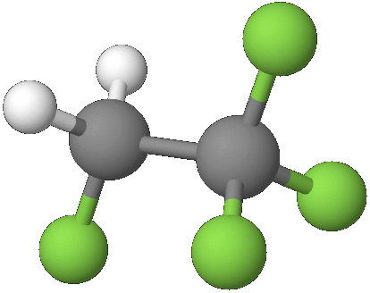
Background and Motivation
Detection/Validation of use of medical inhaler use can be challenging.
Time between administration and metabolic effects is short.
Time between administration and detection in typical drug screening like urinalysis is relatively long.
In screening applications, testing generally focuses on specific targets.
This leads to arms race to find and use new medications to evade detection.
Identification of common element of medical inhaler enables flagging of wide range of medications.
HFA134a Molecular Structure
Many medical inhalers use 1,1,1,2 – tetrafluoroethene (Norflurane, HFA 134a) as a propellant due to is palatable and inert nature.
As HFA 134a is not naturally occurring, it is a strong candidate as a marker of inhaler use.
Gaseous detection in a breath sample is an simple and convenient method for flagging inhaler use.
Optical detection methods provide highly specific determination in relatively short operation times.

Slide 3
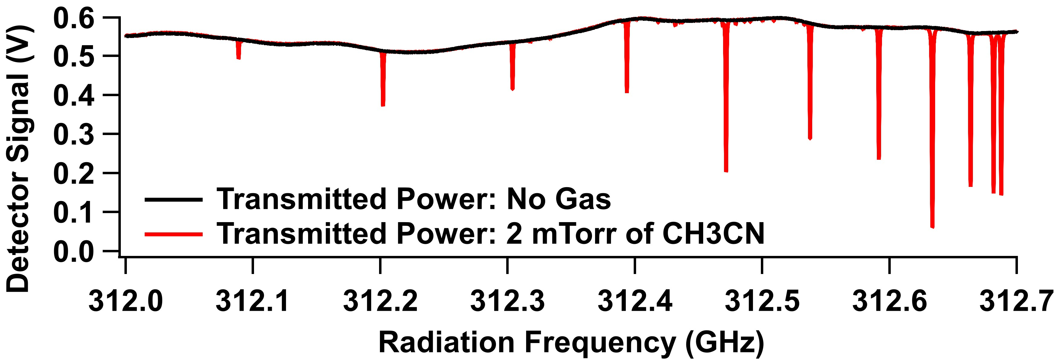
Detection Technique: Terahertz (THz) Rotational Spectroscopy
Rotational absorption spectroscopy is an optical method to detect and measure a gaseous compound by probing the quantized rotational energies dependent on molecular structure.
Rotational absorption features are narrow regions of radiation frequency where the gas absorbs the incident radiation reducing the power measured at a detector. These narrow features are commonly referred to as absorption lines.
Molecules have rotational absorption lines at frequencies in the range a few GHz (10⁹ Hz) to several THz (10¹² Hz)
Ingoing Power
Outgoing Power
Radiation
Source
Absorption Cell with Gas Sample
Radiation
Detector
Absorption lines at precise frequencies
Microwave absorption spectra of HFA 134a was first measured by Ogata and Miki in 1985 [1] over a range of 8-26 GHz.
The measured frequency range was later expanded by Bizzocchi in 1998 [2] and later investigated in higher resolution by Ilyushin in 2000 [3].

Slide 4
Method
HFA134a detection was performed on breath collected from 10 subjects 5, 15, and 30 minutes after having used an albuterol medical inhaler containing HFA 134a as a propellant.
Subjects were not instructed on sample collection and were encouraged to breath normally.
Breath samples were collected into 2L metalized FlexFoil gas sampling bags.
Metalized bags minimize interactions between HFA 134a and the bag extending sample storage time.
Sample analysis was completed within a few hours of collection.
Breath samples were analyzed by gas chromatography mass spectrometry (GC-MS) and a novel THz chemical sensor built by our group [4].
HFA 134a in breath was quantified in both modalities and the concentrations were fitted to an exponential decay curve.
Prior to breath analysis, the THz sensors response to HFA 134a was characterized.
<0 min
Baseline Breath
Collected
0 min
Inhaler
Administered
THz Analysis
GC-MS Analysis
5 min
Breath
Collected
HFA 134a
Quantification
HFA 134a
Quantification
15 min
Breath
Collected
HFA 134a Breath Decay Constant
HFA 134a Breath Decay Constant
30 min
Breath
Collected

Slide 5
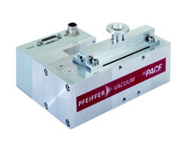
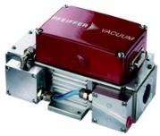
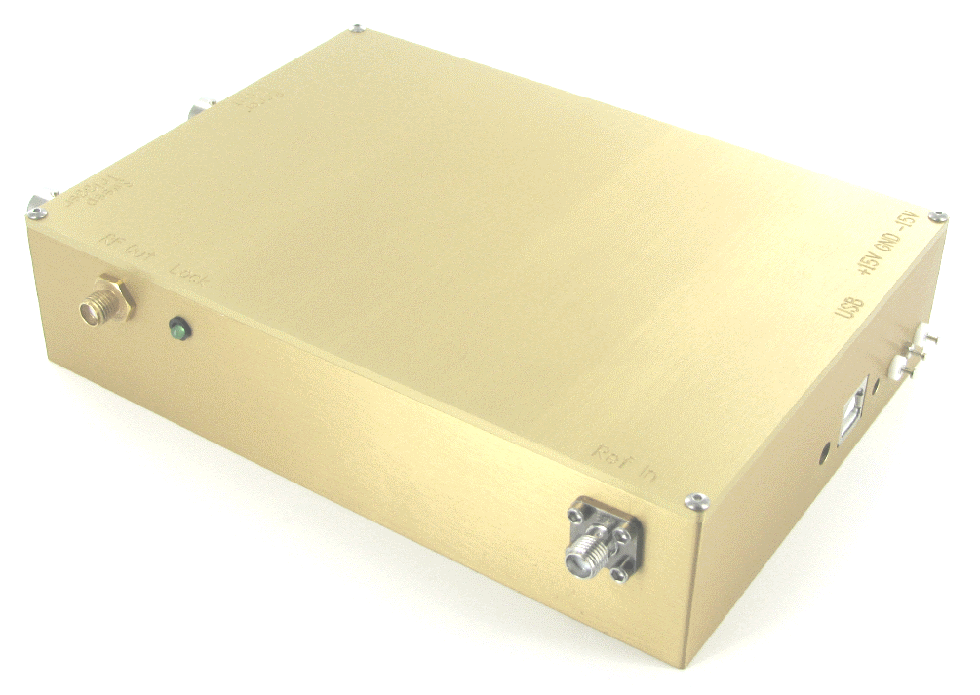
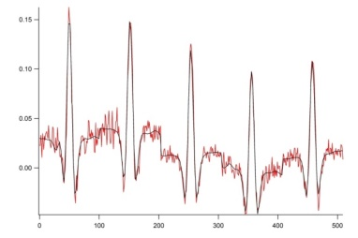
Pressure
Gauges
THz Sensor Processing Overview
Coiled Absorption
Cell
Dual Output
Microwave
Synthesizer
Turbo Pump
A 0.5 L volume of breath was passed though three Tenax GR/Cargograph 5TD sorbent tubes cooled to 15 C prior to gas flow.
The tube headspace and the absorption cell were evacuated.
The trapped HFA 134a was released into vacuum by heating and maintaining the tubes at 140 C for two minutes.
After delivery, the sorbent tubes were reconditioned in preparation for the next sample by heating to 220 C under dry nitrogen flow for 10 minutes.
Parallel to conditioning, the sample was interrogated by the THz source-receiver pair generating radiation in the 220-330 GHz range.
Measured spectra were fitted to a prerecorded absorption library to determine the partial pressure of HFA 134a in the absorption cell and the concentration in the source sample.
f₂
RX
TX
Diaphragm
Pump
f₁
f_{if}=(f₁-f₂)*18
Vent
Amplifier
Sample Inlet
Detector
Sorbent
Tubes
Inert Gas Inlet
Flow
Mass
Controller
Data Acquisition
3 sorbent tube
Preconcentration Module
Water pumps
Calculation of dilution
based on a fit of Library (black)
Spectrum (red)
Sorbent Water Cooling
Total Sampling time ~30 minutes

Slide 6
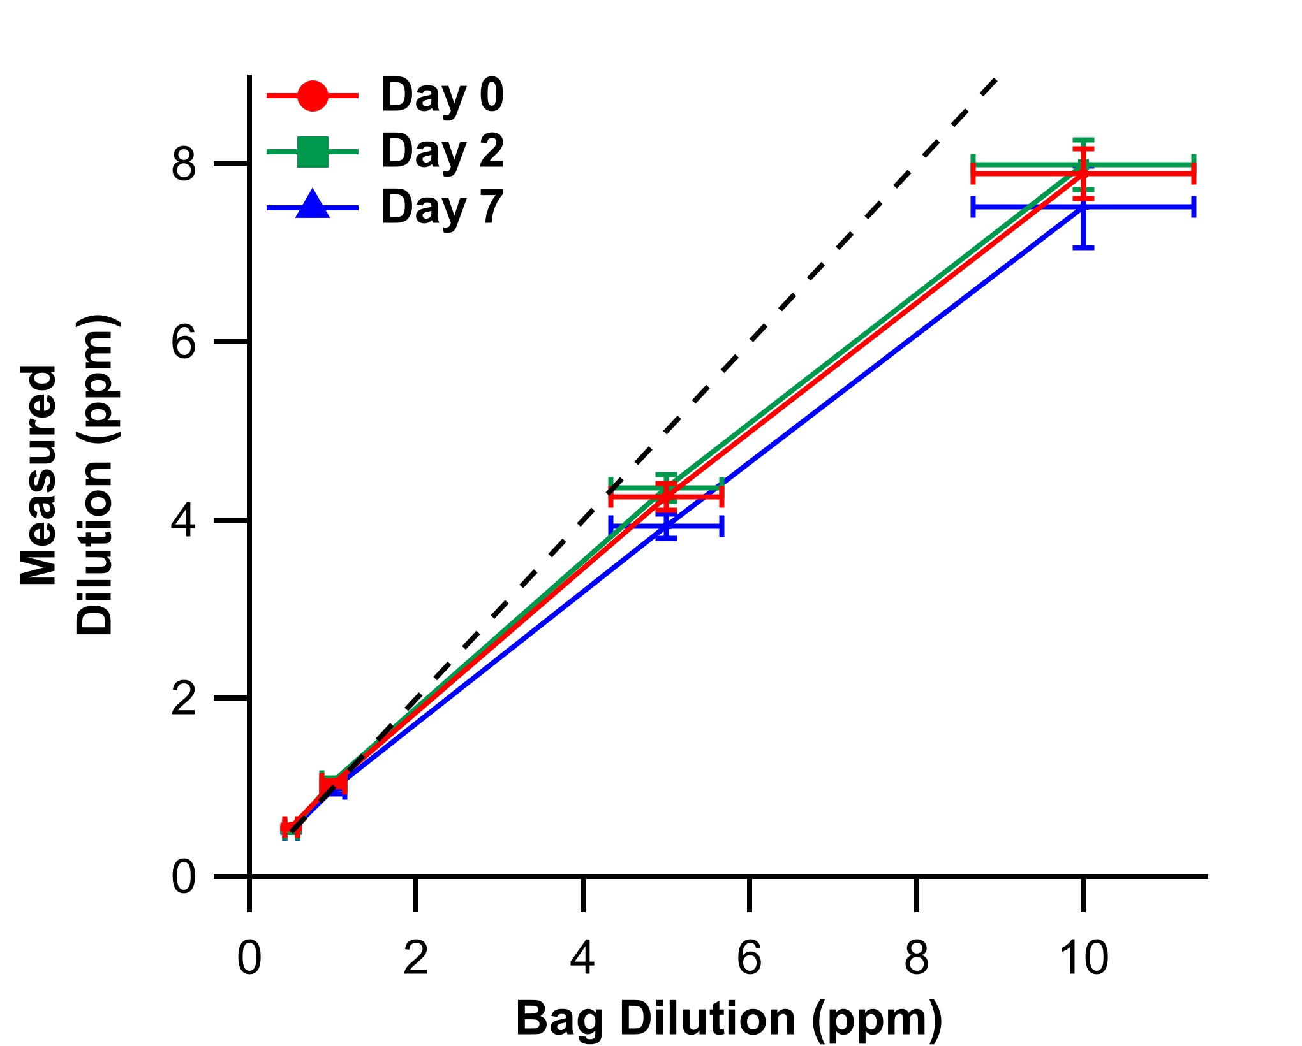
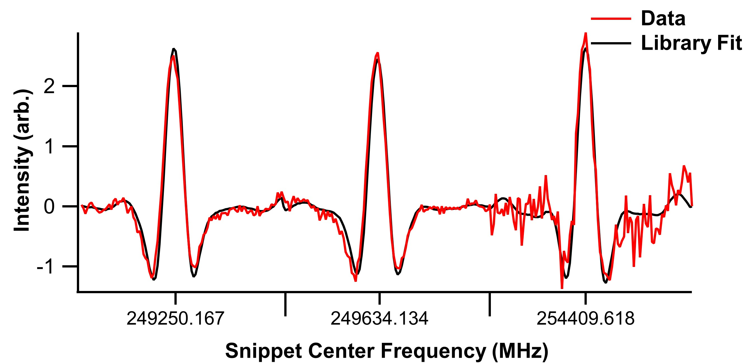
Characterization of HFA 134a: Library Creation, Sample Retention, Linearity, and Storage
From a broad spectrum of pure HFA 134a, three absorption lines were selected to serve as the reference library for detection and quantification.
Lines selected for library use
1 ppm HFA 134a Spectra and Library Fit
Preconcentration Efficiency Determined from Library Fit
Calibration Standard | 1 ppm
Fitted Concentration | 9.1 ppb
Efficiency | ~9%
Calibration measurements were repeated over a week to assess sample degradation
Preconcentration efficiency enabled the assessment of the linearity of the sensor response over a range of concentrations

Slide 7
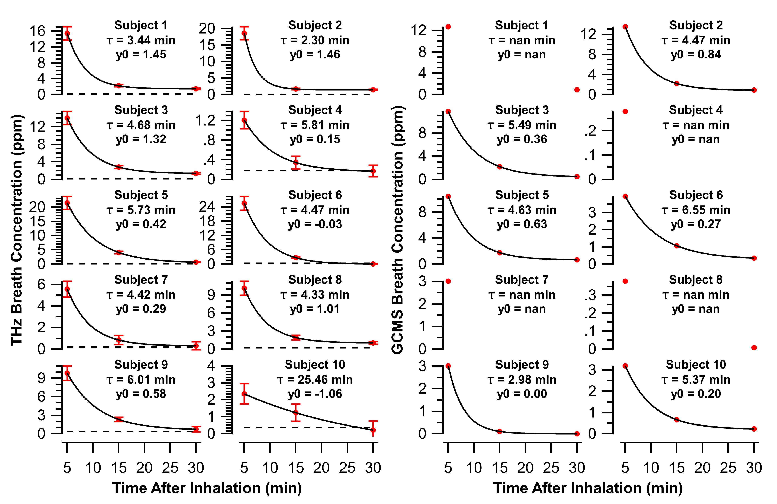
Dashed lines represent the baseline library fit to baseline breath.
Concentrations above this indicate positive detection of spectra lines.
Results: Quantification of HFA 134a in Breath
GC-MS detection was successful though suffered from missing measurements at low concentrations for several subjects.
THz sensing reliably detected HFA 134a in breath at nearly all time points post inhaler use.
HFA 134a was still detectable in small quantities even 30 minutes after use.
Measured gas concentrations differed between modalities indicating incomplete accounting of preconcentration efficiencies in the THz sensor.
Exponential decay curves fitted to the THz and GC-MS concentrations returned comparable time constants.
These time constants reflect the rate of HFA 134a exhalation and dilution during normal respiration.
Time constant across both modalities are reasonably consistent (in 2-7 min range) with exception of subject 10.
Vertical offsets in the fit indicate longer lasting presence of HFA 134a in breath.

Slide 8
Looking Forward: Inhalers Containing Alternative Propellants
HFA 134a and other polyfluorinated propellants are currently been phased out in favor of new compounds with less green house gas warming potential.
One such replacement for HFA 134a is 1,1-difluoroethane HFA 152a
Using rotational constants from Villamanan [5] a synthetic spectrum of HFA 152a was generated and compared to a simulated spectrum of HFA 134a generated from constants provided by Ilyushin [3].
The green trace shows HFA 152a has nearly 10x stronger absorption compared to HFA 134a and the frequency pattern is distinct.
HFA 152a Molecular Structure

Slide 9
Conclusions
Detection of HFA 134a via THz chemical sensing is capable of detecting quantities present in breath.
Breath samples can be rapidly processed with results generated ~30 minutes of collection.
Detection is possible in breath collected up to 30 minutes post inhaler use.
The offset of the fitted exponential suggests detection might be possible past 30 minutes.
Possibly demonstrates a second exponential decay of HFA 134a in the body.
Quantification of HFA 134a is nearly consistent with quantification via GC-MS.
In some cases, THz sensing exceeded in detecting lower concentrations in breath.
Variation in overall concentrations for THz vs GC-MS may be due to variations in breath humidity between subjects.
Relatively consistent exponential time constants suggest that this inconsistency may be due to a global factor (variance in preconcentration efficiency) rather than sample to sample variation.
As HFA 134a is phased out in favor of HFA 152a, detection via THz will still be viable and would likely improve due to the greater dipole and stronger absorption.

Slide 10
Acknowledgements and References
Thanks to
Michael C. Brothers^{1,3}, Daniel Sim^{1,3}, Laura Flory^{1,3}, Miranda Tomb⁴, Kraig Strayer^{1,3}, Anne Jung^{1,3}, Jaehwan Lee¹, Christopher Land¹, Barlow Guess¹, Cody Chancellor⁴, Jeremy Zelasko⁴, Rosa Linda Alvarado⁴, Rhonda Pitsch¹, Sean Harshman¹, Dara Regn⁴, Ivan Medvedev², & Steve S. Kim¹
¹ 711th Human Performance Wing, Wright Patterson Air Force Base, Dayton OH 45433
² Wright State University Department of Physics, Dayton OH 45435
³ UES Inc. Dayton OH, 45432
⁴ United States Air Force School of Aerospace Medicine, Wright Patterson Air Force Base, Dayton OH 45433
References
[1] Ogata, T. & Miki, Y. Microwave spectrum, barrier to internal rotation, structure, and dipole moment of 1,1,1,2-tetrafluoroethane. J. Mol. Struct. 140, 49–56 (1986).
[2] Bizzocchi, L., Degli Esposti, C. & Dore, L. Centrifugal Distortion Analysis of the Millimeter-Wave Spectrum of 1,1,1,2-Tetrafluoroethane. J. Mol. Spectrosc. 188, 251–252 (1998).
[3] Ilyushin, V. V., Alekseev, E. A., Baskakov, O. I. & Dyubko, S. F. High-precision millimeter-wave spectrum of CF 3 CFH 2. 13th Symp. Sch. High-Resolution Mol. Spectrosc. 4063, 177 (2000).
[4] Medvedev, I. R. et al. Tabletop Terahertz Chemical Sensor for Breath Analysis and Analytical Gas Sensing. in 2019 44th International Conference on Infrared, Millimeter, and Terahertz Waves (IRMMW-THz) 1 (2019). doi:10.1109/IRMMW-THz.2019.8874534.
[5] Villamanan, R. M. et al. Rotational Spectrum of 1,1-Difluoroethane: Internal Rotation Analysis and Structure. J. Mol. Spectrosc. 171, 223–247 (1995).

