Slide 1
Characterization of Printed Silver Thin Films Sintered by a Scanning Laser Technique
Student:
Student Email:
Faculty:
Faculty Email:
AFRL Sponsor:
AFRL Directorate:
William A. Metzger
Metzger.70@wright.edu
Dr. Ahsan Mian
ahsan.mian@wright.edu
Dr. Emily Heckman
AFRL/RYDI
PA #:
AFRL-2022-4369

Slide 2
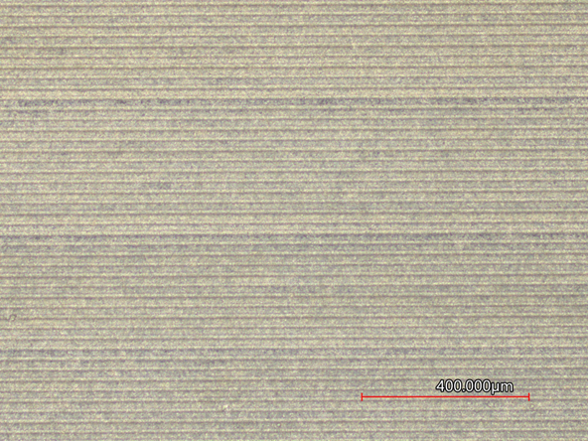
Objectives
Use of AutoCad to design samples for testing
Aerosol Jet Printing of a selected metal ink (ElectronInks 616 Formulation) patches on selected substrates
Definition of Conductive patterns by laser scanning and solvent washing
Determination of effect of laser power on resistivity, work function, and temperature coefficient of resistance
Investigation of short-term aging on sintered thin films
Optimization of parameters for development of strain gauges
Print and Laser Path from developed AutoCad toolpath.

Slide 3
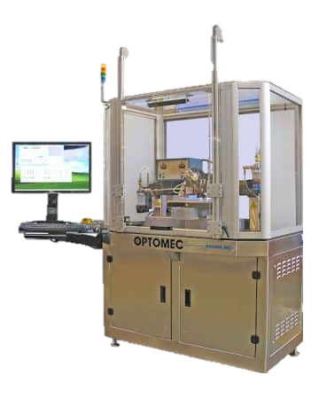
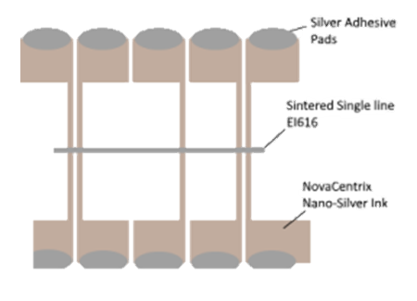
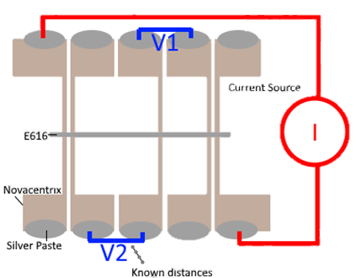
Resistivity Measurements
Using AJ300, Was able to successfully create thin film electrodes using Novacentrix nano-silver ink using a thermal sintering process.
EI-616 single traces were added post thermal sintering using laser sintering at varying laser powers. (40mW, 60mW, 80mW, 100mW, 120mW, and 140mW)
Found early on that 40mW was not enough power to reliably generate samples for testing, replaced with samples sintered with 140mW laser.
Additionally adopted a batch printing process to ensure consistency with printing.
Sample setup (left) and Circuit diagram (right) used for resistivity measurements

Slide 4
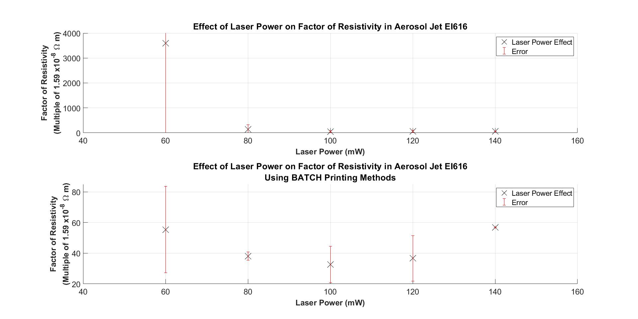

Slide 5
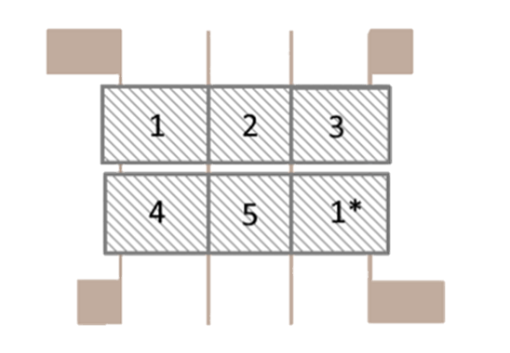
Work Function Measurements
Created new toolpath for use in work-function study.
Similar process to resistivity study, electrodes printed using Novacentrix, area of interest printed using EI-616.
Sample was then laser sintered with varying laser powers (60mW – 140mW) in larger areas, then sent to Wright State for work function study.
Layout of work function samples
Initial Results from Singular Sample Submission. Work function appears to be the highest at 100 mW laser power

Slide 6
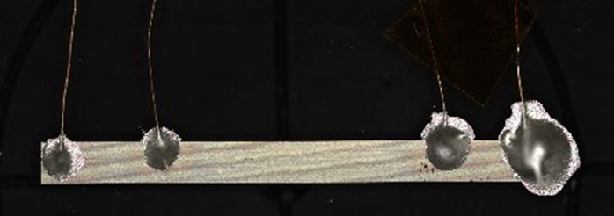
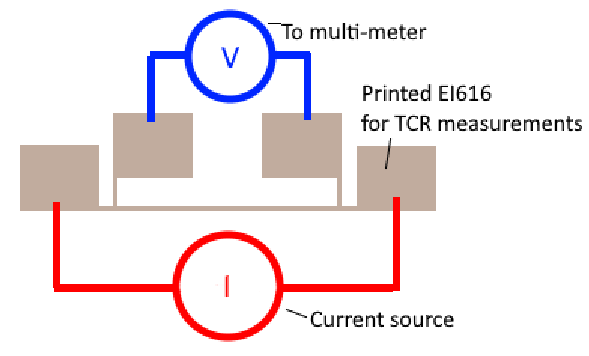
Temperature Coefficient of Resistance Measurements
Created new toolpath for use in TCR study.
Samples were produced using only EI-616 and 100mW laser power for on glass substrates, reducing to 50mW laser power when switching to FR4 substrates.
Temperature ramp under constant current (20 - 100°C under 1.0mA current) in ambient conditions
Example TCR circuit setup (bottom) and physical sample (top)

Slide 7
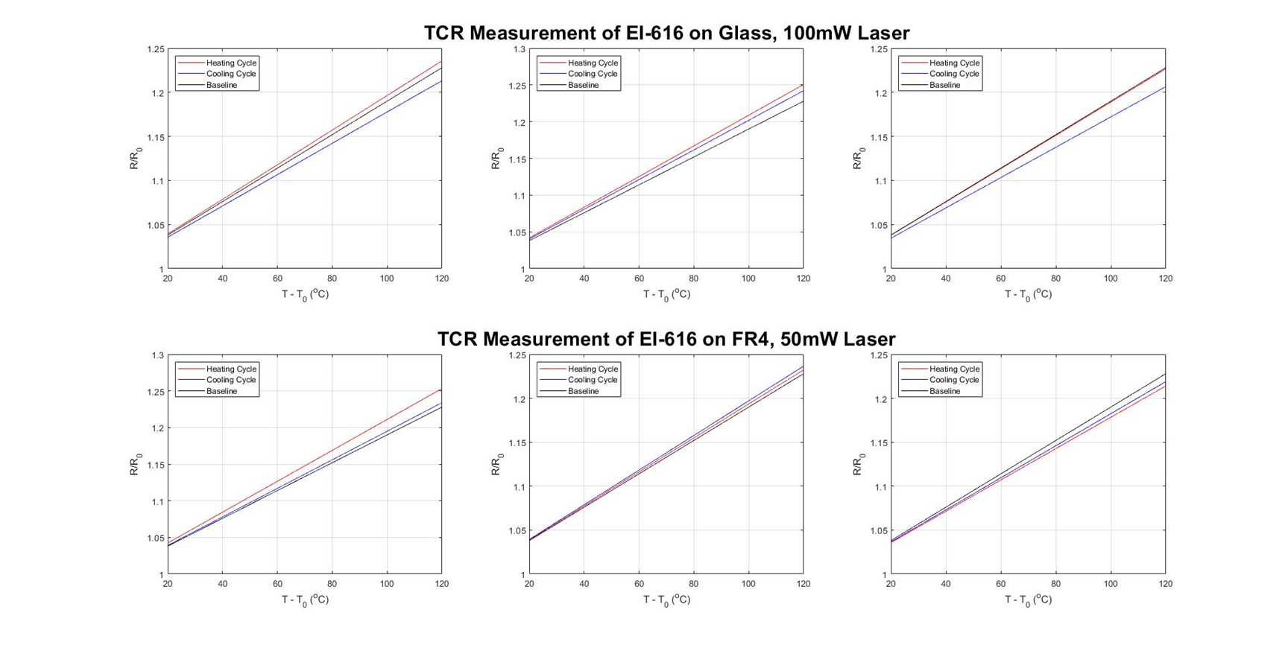

Slide 8
Ongoing Work
Increase sample size for resistivity study to have statistically significant data.
Increase sample size for work function study.
Continue testing TCR samples using different substrates to generate comparison data.
Permitting, add new variable (Laser speed) to testing to generate process maps for selected ink.
Implement optimized parameters to produce strain gauges for study.
SEM imaging and characterization

Slide 9
Summary
The factor of resistivity is minimized with laser power set to 100mW on glass.
Work function is maximized with laser power set to 100mW on glass.
Temperature coefficient of resistance (TCR) is consistent at both 50mW and 100mW on FR4 and Glass substrates respectively
Ongoing work to continue gathering data to support current findings.

Slide 10
Acknowledgements and Cited Literature
Aga, R., Jordan, C., Aga, R. S., Bartsch, C. M., & Heckman, E. M. (2014). Metal electrode work function modification using aerosol jet printing. IEEE Electron Device Letters, 35(11), 1124–1126. https://doi.org/10.1109/led.2014.2355142
Thank you to the AFRL and Wright State faculty for the assistance as well as the DAGSI program for the continued support to complete this study.

