Slide 1
Improvement of Exploration of Patch Generation Search Spaces Using Software Metrics in the Context of Bug Generation
Student:
Student Email:
Faculty:
Faculty Email:
AFRL Sponsor:
AFRL Directorate:
Dr. Tyler Westland
westlatr@mail.uc.edu
Dr. Nan Niu / Dr. Rashmi Jha
niunn@ucmail.uc.edu / jhari@ucmail.uc.edu
Dr. David Kapp
AFRL/Sensors
PA #:
AFRL-2022-4828

Slide 2
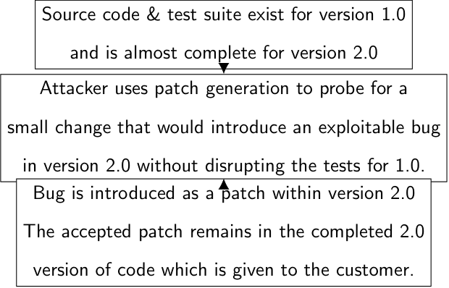
Threat Model
The military often contracts third parties to construct code for projects. This model suggests a developer in that third party purposefully adds buggy code. The issue is that Anti-Virus systems are not meant to detect such problems.
Exploring this will help reveal what such an attack might look like and how to mitigate it.
An example of this is unethically inserting a buggy commit into the Linux Kernel to test if maintainers would catch them [1]. Our project remains ethical by not testing humans or production systems.
[1]: SeventhQueen. “Researchers Secretly Tried To Add Vulnerabilities To Linux Kernel, Ended Up Getting Banned.” Accessed April 22, 2021. https://fosspost.org/researchers-secretly-tried-to-add-vulnerabilities-to-linux-kernel/.
PA #:
AFRL-2022-4828

Slide 3
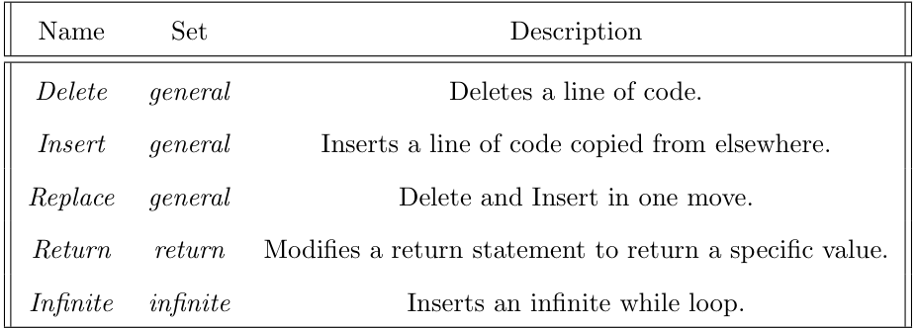
Patch Generation
Patch Generation [2] exploits the fact that bugs are made of code that is almost correct. This means a small change can be applied to fix it. We explored an attacker using this to instead create bugs.
We explored a specific type of Patch Generation called Patch Search, which uses Transformation Operators to define a search space of patches to explore.
Transformation Operators we used as part of Darjeeling [3] (delete, insert, replace). Return and infinite created by us.
[2]: Long, Fan, and Martin Rinard. “An Analysis of the Search Spaces for Generate and Validate Patch Generation Systems.” In Proceedings of the 38th International Conference on Software Engineering, 702–13. ICSE ’16. New York, NY, USA: Association for Computing Machinery, 2016. https://doi.org/10.1145/2884781.2884872.
[3]: https://github.com/squaresLab/Darjeeling
PA #:
AFRL-2022-4828

Slide 4
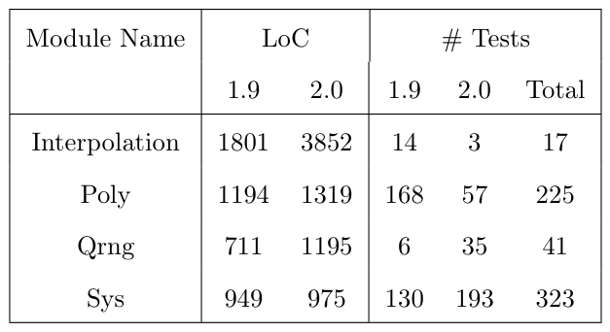
Studied Programs
This is information about the four modules within GSL [4]
[4] M. Galassi et al., GNU Scientif ic Library Reference Manual, 3rd ed.
PA #:
AFRL-2022-4828

Slide 5
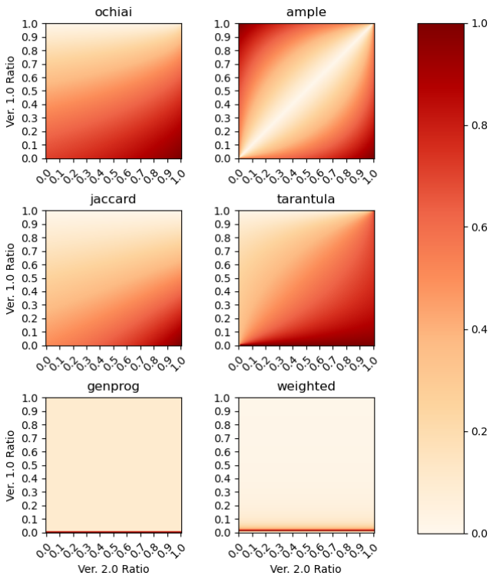
Experiment Procedure
Pseudo code
base_line_bugs = {}
for m in modules:
bugs[m] = darjeeling(sus=test_coverage_based_susser(m))
metrics = {}
for m in modules:
metrics[m] = software_metrics(m)
naive_bugs = {}
for m in modules:
nb = NavieBayes(filter(m, bugs), filter(m, metrics))
naive_bugs[m] = darjeeling (sus=naive_bayes_susser(nb, m))
perform_analysis(base_line_bugs, naive_bugs)
PA #:
AFRL-2022-4828

Slide 6
Normalized Results: Scaling Factor
PA #:
AFRL-2022-4828

Slide 7
Normalized Results: Estimator
PA #:
AFRL-2022-4828

Slide 8
Normalized Results: Metrics
PA #:
AFRL-2022-4828

