Slide 1




Temporal Convergence and Stability Assessment of the Generalized Finite Element Method for Multi-Scale Field Problems
Student:
Student Email:
Faculty:
Faculty Email:
AFRL Sponsor:
AFRL Directorate:
TJ Miller
Miller.8306@buckeyemail.osu.edu
Jack McNamara
Mcnamara.190@osu.edu
Pat O'Hara
AFRL/RQ
Distribution Statement A: Approved for public release;
Distribution is unlimited. PA# AFRL-2022-4616 .

Slide 2
Objectives
Goal: Expand research on multi-scale numerical modeling strategies to transient heat transfer problems with highly localized loading conditions through establishing implementation strategies and characterizing the temporal convergence behavior of GFEM
1. Assess the temporal convergence and accuracy of GFEM applied to a model problem in multiple dimensions
2. Assess temporal stability of the GFEM in heat transfer analysis
3. Investigate computational savings compared to standard methods
4. Shed light on nuances and implementation strategies of the GFEM

Slide 3
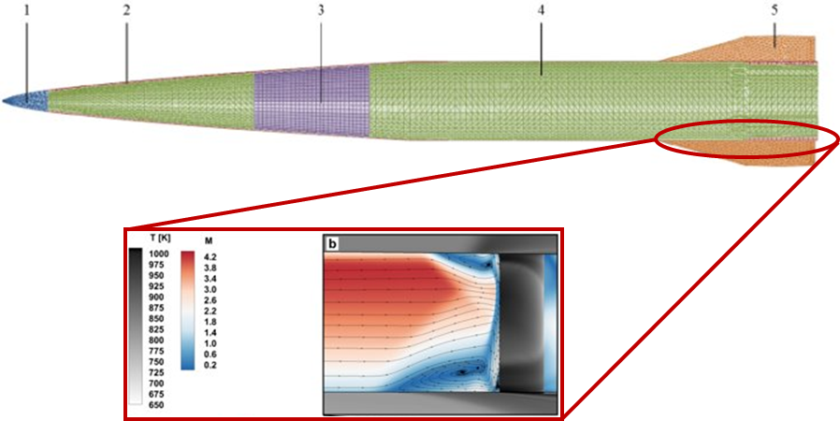

Challenges with Hypersonic Analysis
Modern day engineering problems in hypersonic vehicle design are dominated by heat transfer
Fine-scale and transient loading conditions
Coupled, multi-physic interactions
Current multi-scale modeling strategies lack power to resolve all spatial-temporal scales on a global level
Fine meshes needed for spatial gradients
Broad regions of refinement for transient features
Small time steps to maintain temporal stability
High-fidelity solutions often require large amounts of CPU power, time and memory
[Witeof and Neegard et al 2014]
Image courtesy if Jon Willem, The Ohio State University
Above is the flow and temperature field over a torque tube experiencing sharp thermal gradients on a small scale due to shock-boundary layer interactions
Accurately resolving local features across all spatial-temporal scales, while avoiding local mesh refinement and advanced multi-scale methods, is essential for practical modeling of multi-physic simulations
Question: How can we simultaneously capture fine-scale features and global phenomena within a multi-physics simulation?

Slide 4
Motivation
Heat transfer in extreme environments is multi-scale and coupled with fluids and structural analysis
Mathematically, heat transfer is a scalar equation
Implementation differs from vectoral analysis of fluids and tensorial analysis of structures
Enabling solutions of heat transfer problems in extreme conditions is essential for high-speed vehicle design
The GFEM incorporates solution-tailored shape functions to alleviate the need for local mesh refinement
Current work has focused on ability for GFEM to capture localized features efficiently and stabilization of fluids and structural problems in multi-scale environments
Lack of research to extend these concepts to heat transfer analysis leads to a gap in knowledge
Stability
Fluid dynamics: Incompressibility and stabilizing advection dominated problems [Shilt et al. 2020, 2021]
Structural Dynamics: Reduction of critical time step [Sanchez-Rivadeneira, Duarte 2021]
Knowledge Gap
Handling sharp thermal gradients [O'Hara, Eason, Duarte 2011]
3D fatigue crack propagation [Pereira et al. 2009]
Retain expected convergence criterion [O'Hara, Eason, Duarte 2011, 2009]
Accurate solutions on coarser meshes and larger time steps [O’Hara, Eason, Duarte 2009]
Handling localized features
Computational efficiency
Hypothesis: GFEM can enable high-fidelity solutions of extreme multi-scale heat transfer problems that are currently prohibitive in the context of multi-physics simulations

Slide 5
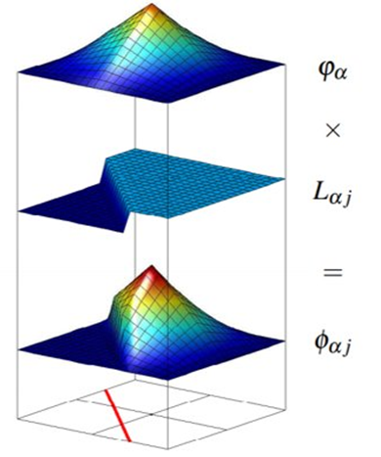

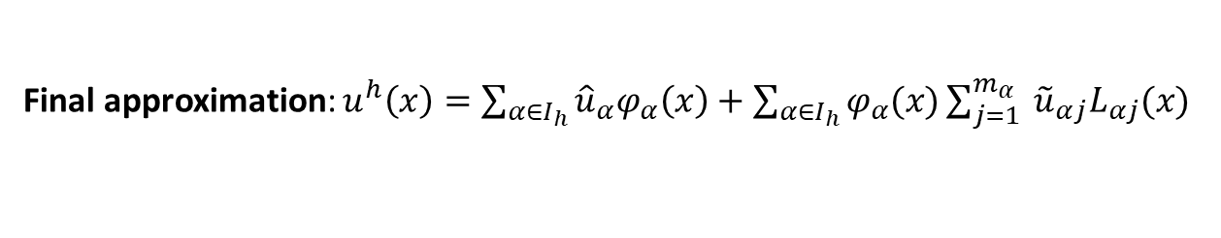
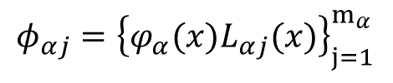

Overview of the GFEM
Modifies FEM framework to introduce solution tailored “enrichments”
into standard FEM space
FEM Approximation Space
$${\left\{φ_{α}(x)\right\}}_{α=1}^{N}$$
GFEM Enrichment Space
*
${φ_{αj}=\left\{φ_{α}(x)L_{αj}(x)\right\}}_{j=1}^{m_{α}}$
Enrichment Space
${\left\{L_{αj}(x)\right\}}_{j=1}^{m_{α}}$
GFEM shape functions formed through a product of standard FEM shape functions and enriched trial space
Can be any function; typically derived from a priori knowledge
Final approximation: $u^{h}\left(x\right)=\sum_{α∈I_{h}}{{{\hat{u}}_{α}φ}_{α}\left(x\right)}+\sum_{α∈I_{h}}{φ_{α}(x)}\sum_{j=1}^{m_{α}}{{ {\tilde{u}}_{αj}L}_{αj}(x)}$
Includes discontinuity into shape function
GFEM elegantly handles fine-scale features by directly introducing these features into the computational domain, alleviating local mesh refinement

Slide 6
Challenges with GFEM
GFEM shape functions inherently linearly dependent
Singular matrices, even after boundary condition application →Leads to difficulties in solving the system and potential errors
Ill-conditions matrices due to close to singular matrices → Leads to errors in the solution
Implementation rarely straightforward
Difficult to apply boundary conditions due to enrichments → Enrichments not necessarily zero at the nodes
a priori information not always available →Difficult to derive proper enrichment functions
Need: Development of GFEM to confidently expand its use cases and identify technical challenges that must be overcome

Slide 7
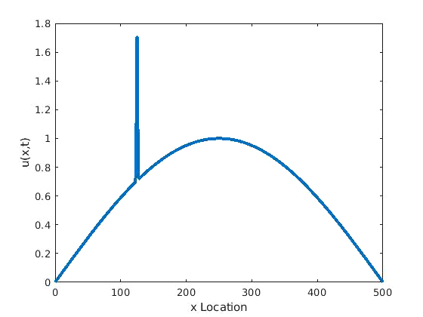

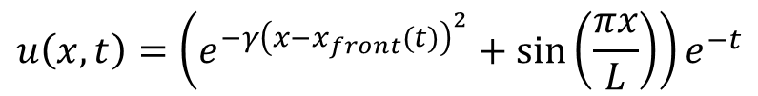


Model Problem from Merle and Dolbow 2002
$$u\left(x,t\right)=\left(e^{−γ{\left(x−x_{front}(t)\right)}^{2}}+\sin\left(\frac{πx}{L}\right)\right)e^{−t}$$
$$Q\left(x,t\right)=ρc\frac{∂u}{∂t}\left(x,t\right)−k\frac{∂^{2}u}{∂x^{2}}\left(x,t\right)$$
$$x_{front}=x_{0}+Vt$$
Property Definitions:
$ρc={\left(\frac{π}{L}\right)}^{2}\frac{J}{K∗mm^{3}}$
$k=1\frac{W}{K∗mm}$
$L=500mm$
$x_{0}=125mm$
$γ=1$

Slide 8
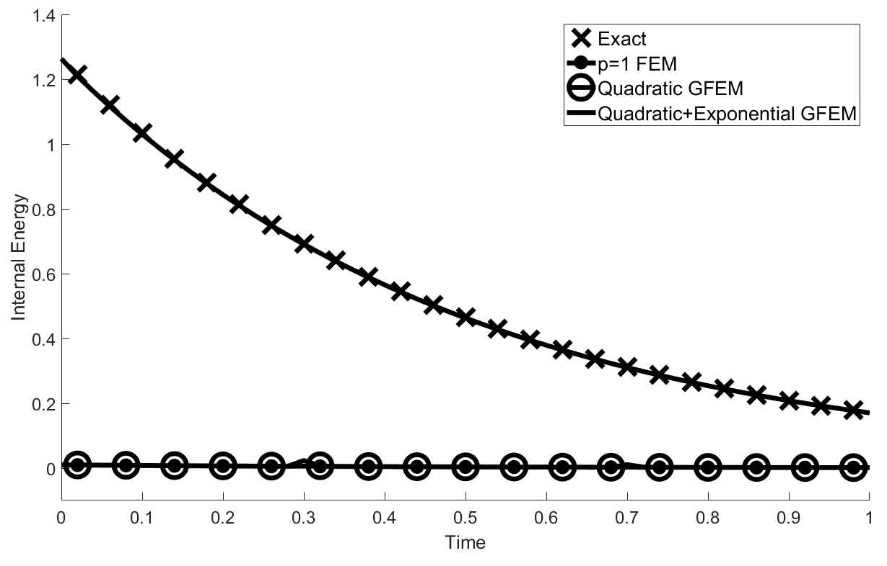
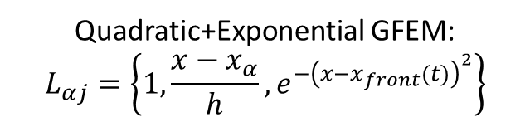
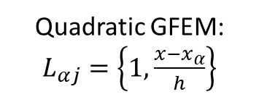
Time Evolution of Internal Energy for Different Approximation Spaces
Element Size | Spike Width | Time Step
100mm (5 elements) | 5mm | 0.20s (50 time steps)
Energy evolution prediction depends on ability for approximation space to capture the spike in loading/temperature
Low order FEM and GFEM cannot capture this fine-scale feature (5mm) on a coarse mesh of 100mm elements
Exponential GFEM does capture the gradient without mesh refinement
GFEM enables accurate multi-scale solutions on coarse meshes
Quadratic+Exponential GFEM:
$$L_{αj}=\left\{1,\frac{x−x_{α}}{h},e^{−{\left(x−x_{front}(t)\right)}^{2}}\right\}$$
Quadratic GFEM:
$L_{αj}=\left\{1,\frac{x−x_{α}}{h}\right\}$

Slide 9
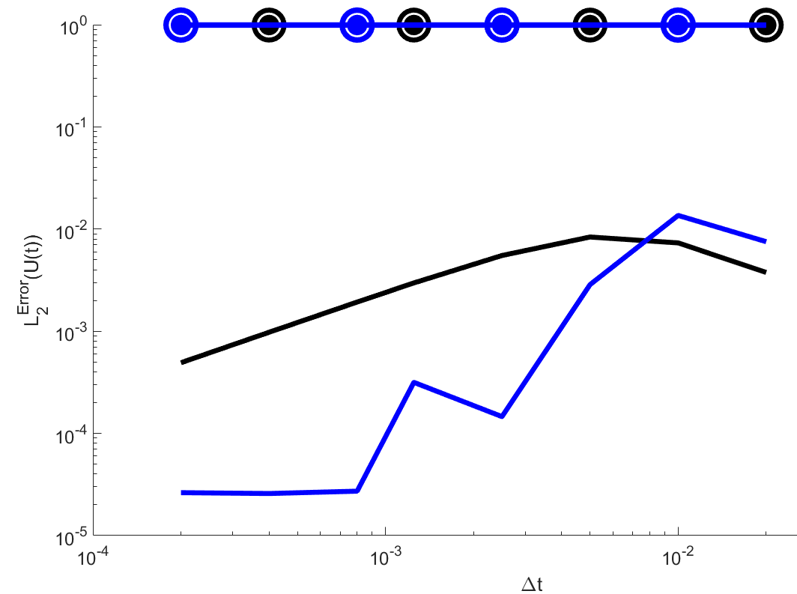
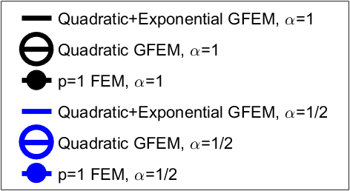
Temporal Convergence of GFEM for the Model Problem with Different Time Integrators
Shown left are accurate multi-scale solutions with larger time steps
GFEM using solution-tailored, exponential enrichments obtains temporal convergence
Lower order approximations obtain no temporal convergence
Spatial error dominates due to not capturing the spike
GFEM enables temporally convergent multi-scale solutions
Quadratic+Exponential GFEM
Quadratic GFEM
p=1 FEM
Backwards Euler
Crank-Nicholson
0.9565

Slide 10
Conclusions and Future Work
Temporal convergence obtained with time-dependent, solution tailored enrichments on coarse grids
Convergence study demonstrates GFEM can achieve accurate solutions on coarse meshes and larger time steps
Results provide improved confidence in the ability of GFEM to enable simulations of design critical multi-scale, multi-physics problems of hypersonic systems
Initial stability study (not shown) and convergence results indicate potential for GFEM to increase critical time steps with solution-tailored enrichments
Future Work
Expanding analysis to higher dimensional space
Explore different types of enrichments for the model problem
Conduct an in-depth stability analysis to determine how the choice of approximation effects critical time steps

