Slide 1




Maturation of Generalized Finite Element Technology for
Multi-Scale Solid and Fluid Mechanics Applications
Student:
Student Email:
Faculty:
Faculty Email:
AFRL Sponsor:
AFRL Directorate:
Rohit Deshmukh
deshmukh.17@osu.edu
Jack J. McNamara
mcnamara.190@osu.edu
Patrick O’Hara
AFRL/RQ
Distribution Statement A: Approved for public release;
Distribution is unlimited. PA# AFRL-2022-4807

Slide 2
Vision: Develop efficient, scalable, and accurate computational tools to enable multi-scale fluid-thermal-structural interactions analyses
Project Goal: Introduce and advance fluid solver capabilities in a well-established, scalable, multi-scale computational solid and thermal mechanics tool ISET
Objective #1: Implement steady-state advection diffusion equation solver
Objective #2: Implement steady-state Burgers’ equation solver
Objective #3: Assess the potential of a multi-scale approach Generalized Finite Element Method for solving full Navier Stokes equations

Slide 3
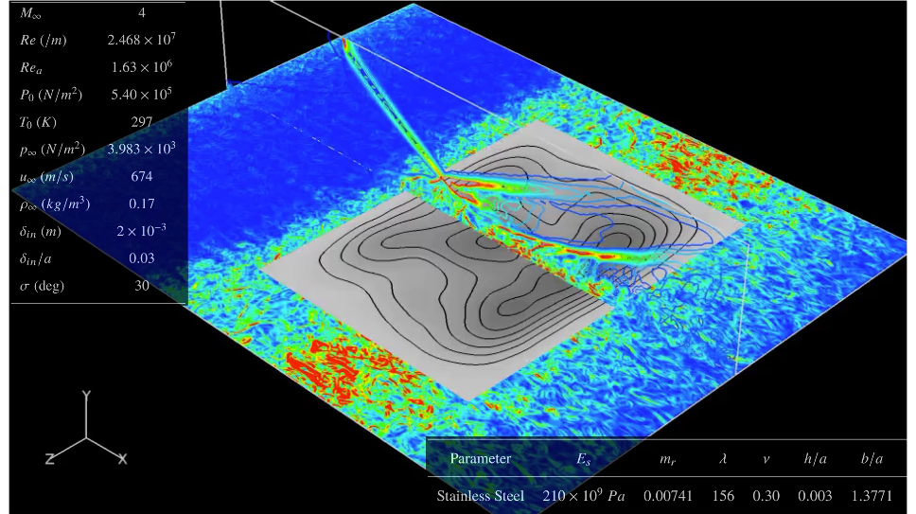
Fluid-Structure Interactions under high-speed flows
Key Features:
Large number of DOFs for high-fidelity analysis
Parameter rich
Nonlinear coupled systems
Highly multi-scale
Challenge: How do we solve this large and complex multidisciplinary problem at scale with comprehensive computational tools?
Proposed Solution: Leverage an efficient multi-scale approach called Generalized Finite Element Method (GFEM) to simultaneously model fluid, structural and thermal components. A well-established C++ library, ISET exists for structural and thermal modeling with GFEM.
[Shinde et al. 2021]
High-fidelity simulation of fluid-structure interaction
under high-strength shock impingement.
Both structural and fluid responses are
highly spatially and temporally multi-scale.
Gap: GFEM based tools need to be further developed and evaluated for fluid problems.

Slide 4
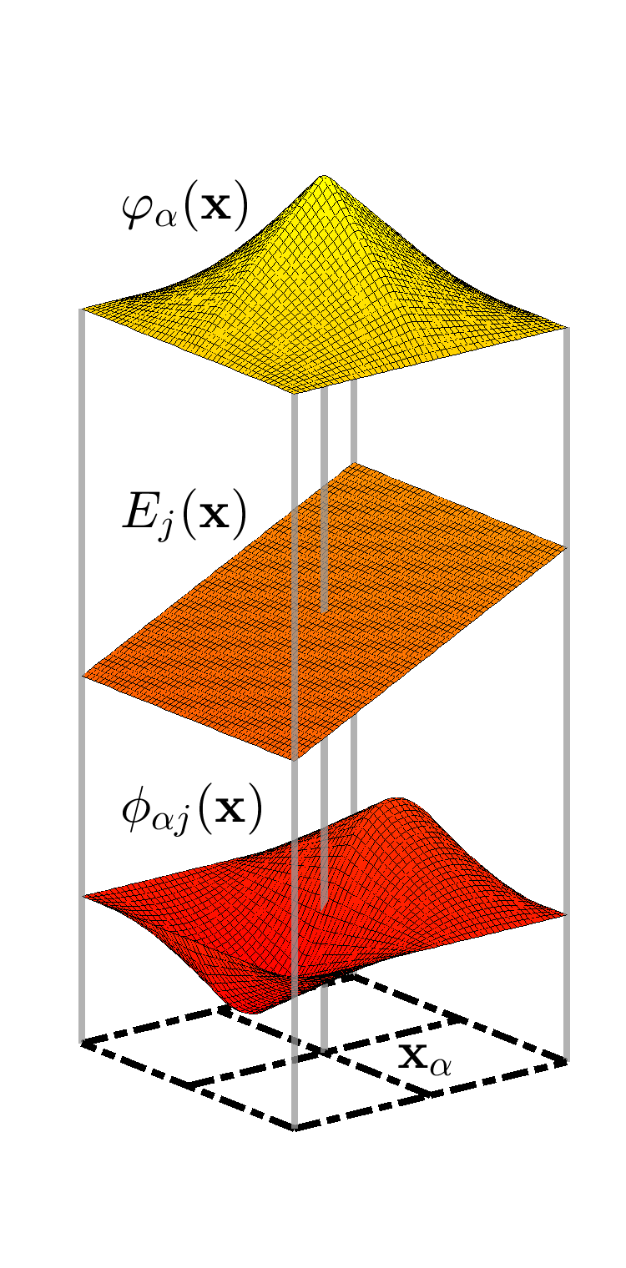
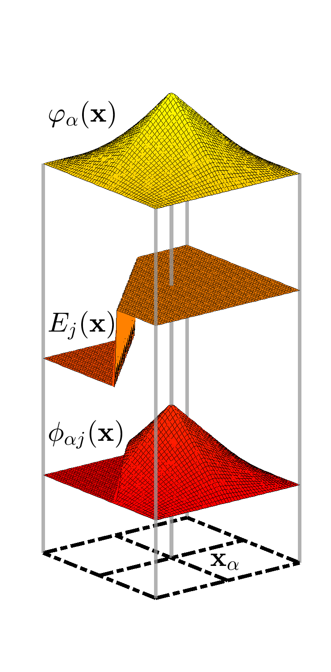
Generalized Finite Element Method
[Babuska et al., 1994; Duarte and Oden, 1995]
Maintains C0 continuity
Allows incorporation of solution-specific, non-polynomial/arbitrary enrichment functions
Hypothesis: solution-specific enrichment functions will improve stability and accuracy of fluid mechanics models
Bilinear FEM shape function
FEM approximation space
Enrichment
of FEM
Enrichment function
GFEM shape function

Slide 5
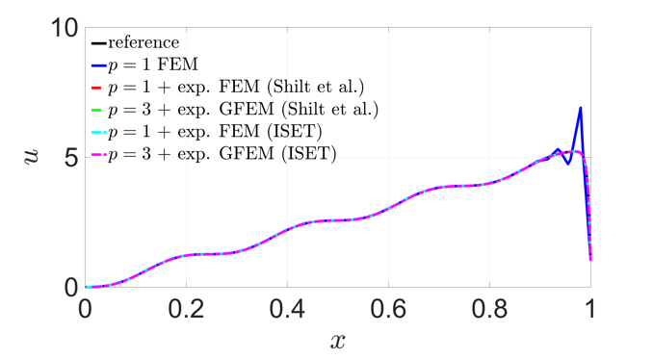
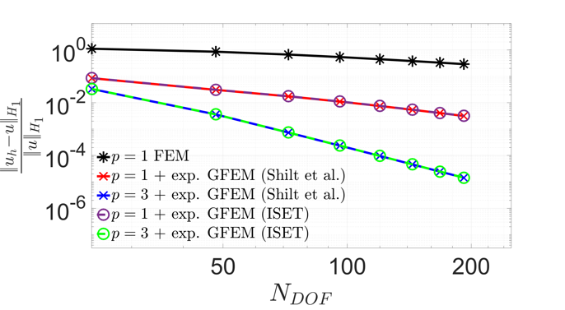
Steady-state advection-diffusion equation
Problem: Linear, one-dimensional, steady state advection-diffusion equation:
Body force:
Key challenge: stabilization of the standard FEM model on coarse grids for high advection ( ) values
Contributions: Shilt et al. (2021) addressed this issue in a MATLAB version; this work extends the implementation to a scalable C++ library
Implemented a user-defined body force implementation for advection-diffusion
Developed a user-defined function for solution-specific exponential enrichment function
The exponential enrichment stabilizes the GFEM model
Solutions
Convergence
The GFEM models are stable with solution-specific exponential enrichment function, whereas the FEM model is inaccurate for similar #DOFs. The ISET (C++) convergence rates are also in agreement with Shilt et al. 2021.

Slide 6
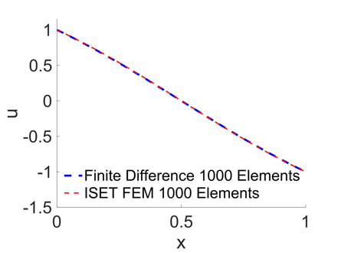
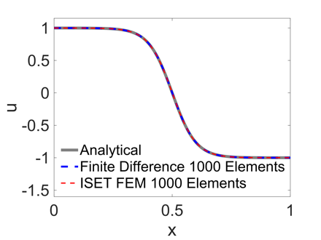
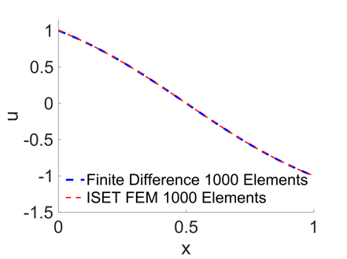
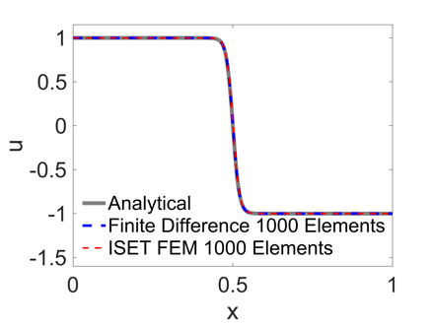
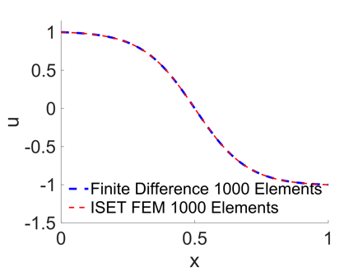
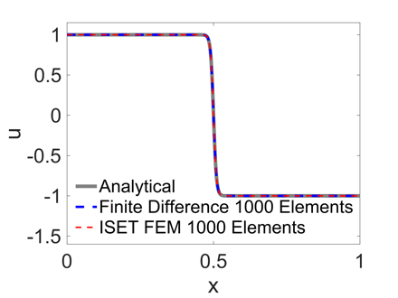
Steady-state Burgers’ equation
Problem: Nonlinear steady state Burgers’ equation:
Key challenges: Nonlinearity introduces complexities in formulation and implementation. Shock sharpness increases with decreasing viscosity (ν), requiring more DOFs to stabilize the standard-FEM model.
Analytical solution:
Contributions:
Nonlinear Burgers’ implementation in C++
Newton’s approach for nonlinear systems
MATLAB finite difference implementation for verification at ν > 0.05 where the analytical solution is invalid
ν = 1
ν = 0.05
ν = 0.5
ν = 0.01
ν = 0.1
ν = 0.005
1000-element FEM Solutions from the newly developed ISET (C++) Burgers’ module are compared against the analytical and finite difference solutions.

Slide 7
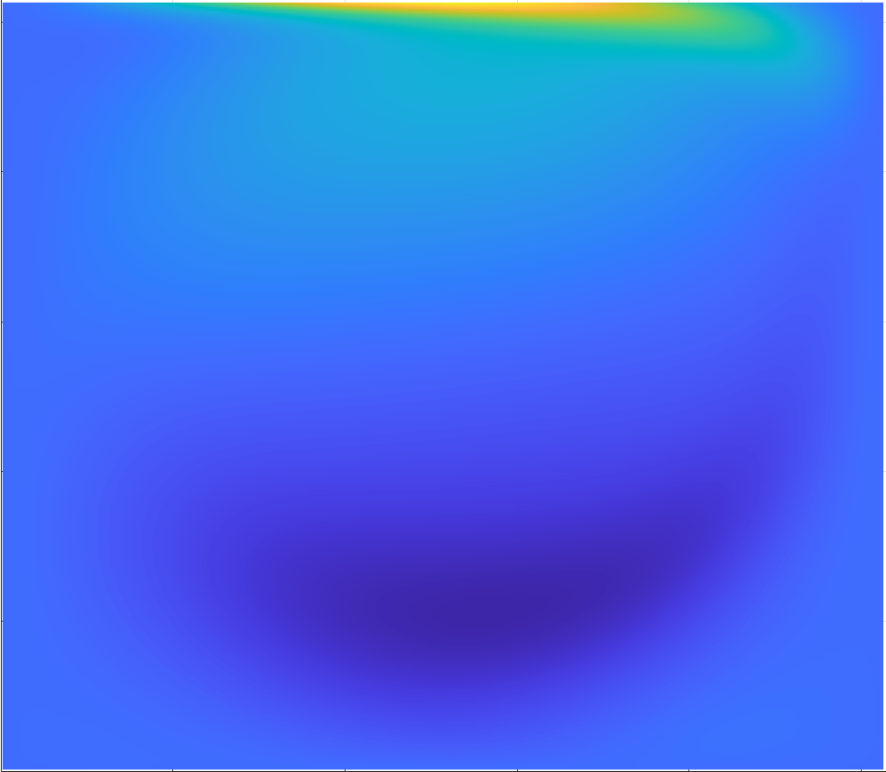
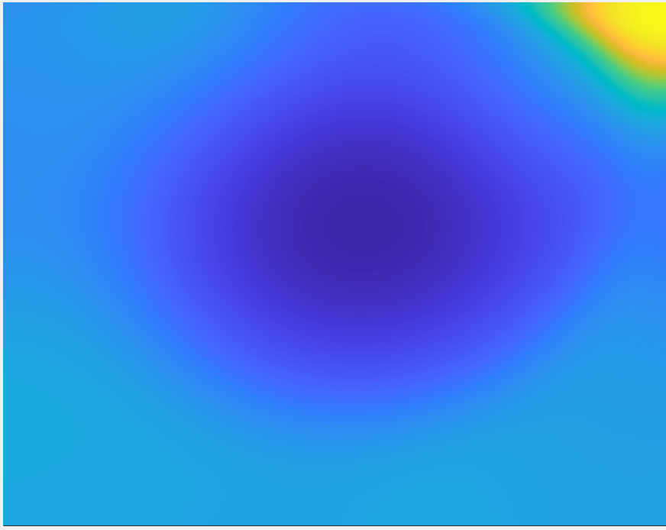
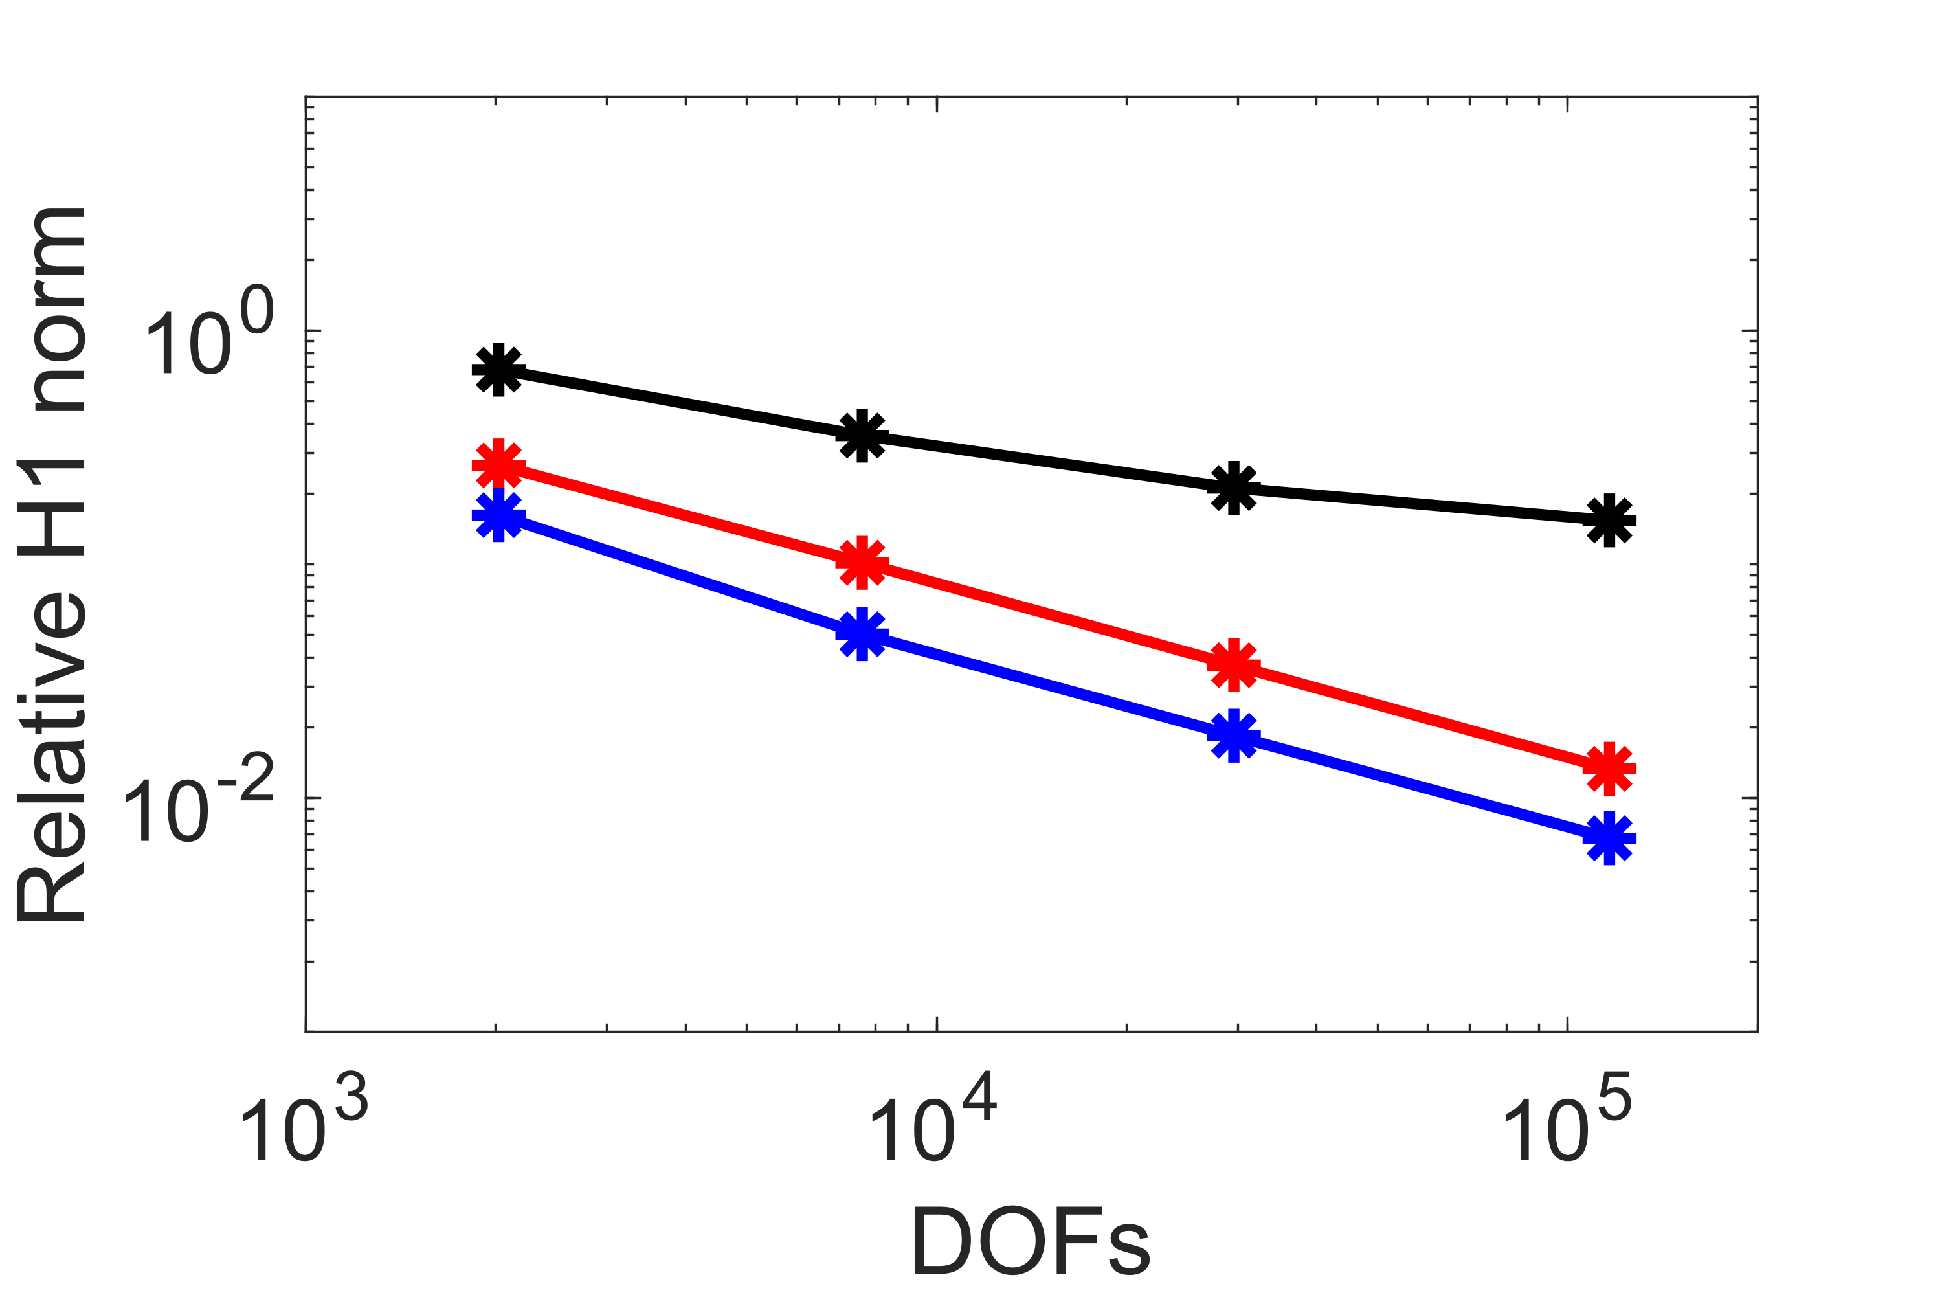
Low Reynolds number Navier Stokes solver in MATLAB
Problem: Incompressible Navier Stokes equation
Key challenges:
Nonlinearity
Multi-scale at medium to high Re
Unsteadiness
Stability → appropriate dissipation required
Contributions:
Developed an unsteady incompressible Navier Stokes (low Re) solver in MATLAB
Demonstrated stabilization properties of GFEM for medium Re values
Configuration: 2D lid-driven cavity at Re 1000
u component
Pressure
Stable models with with quadratic velocity enrichment and linear pressure

Slide 8
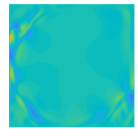
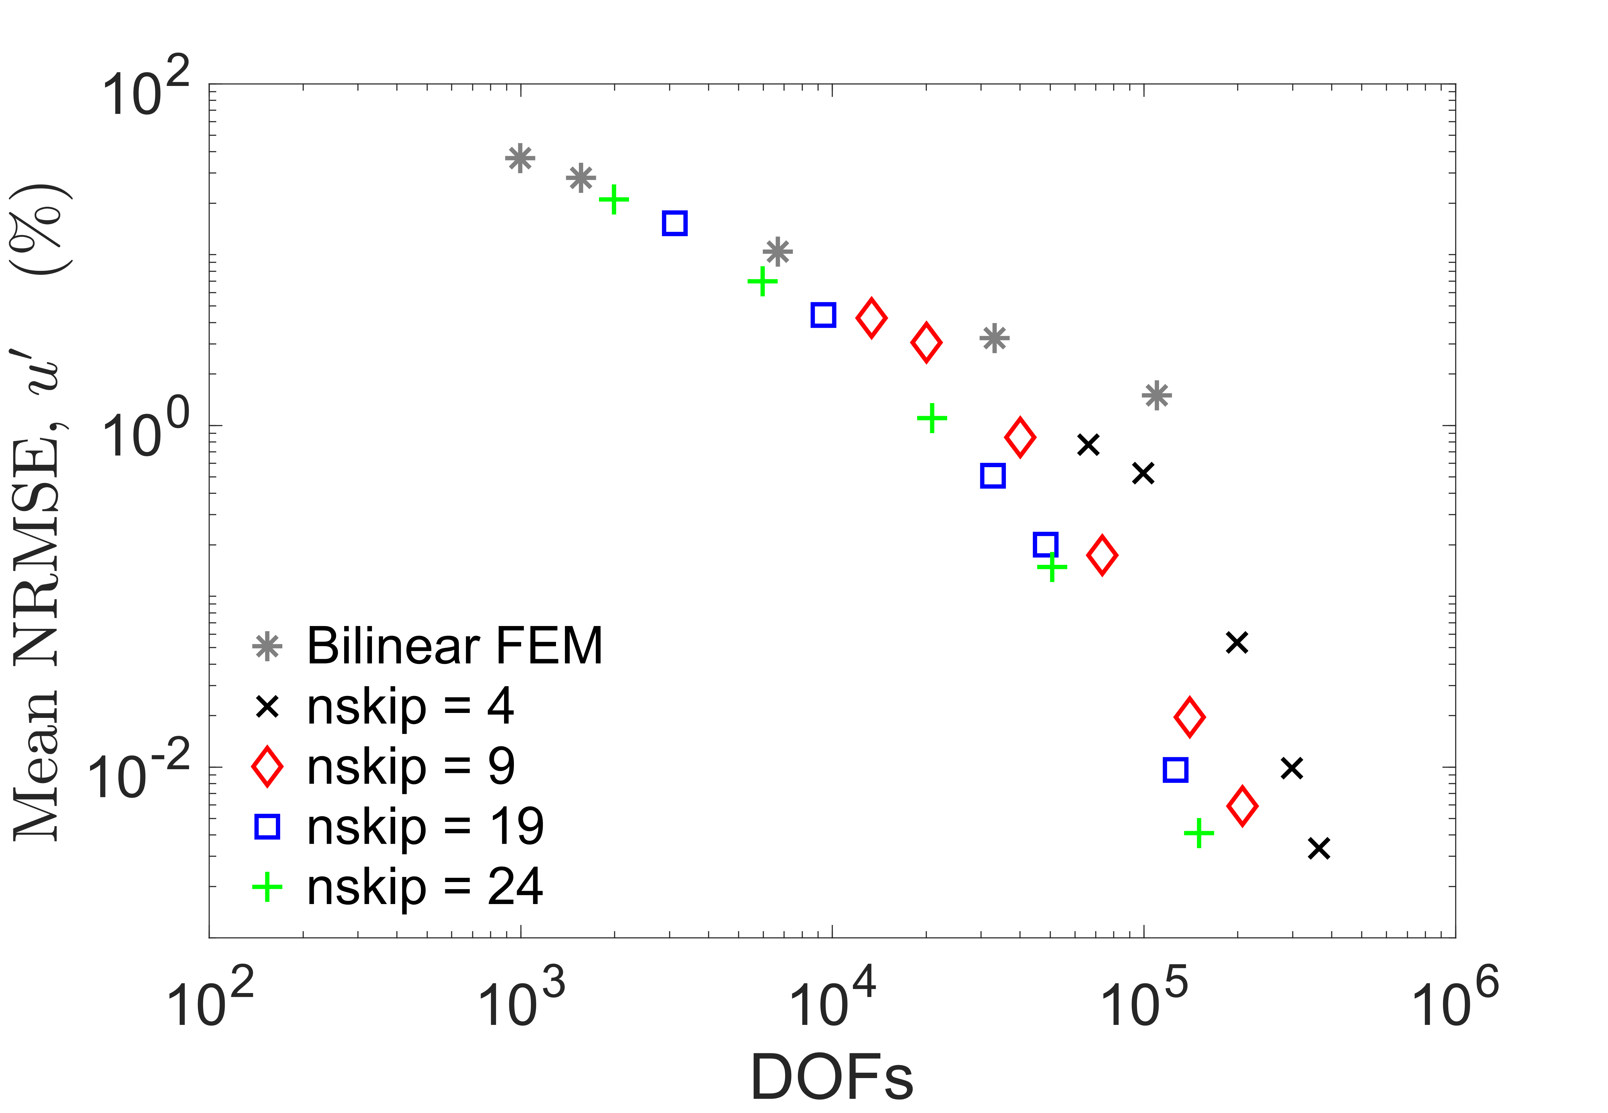
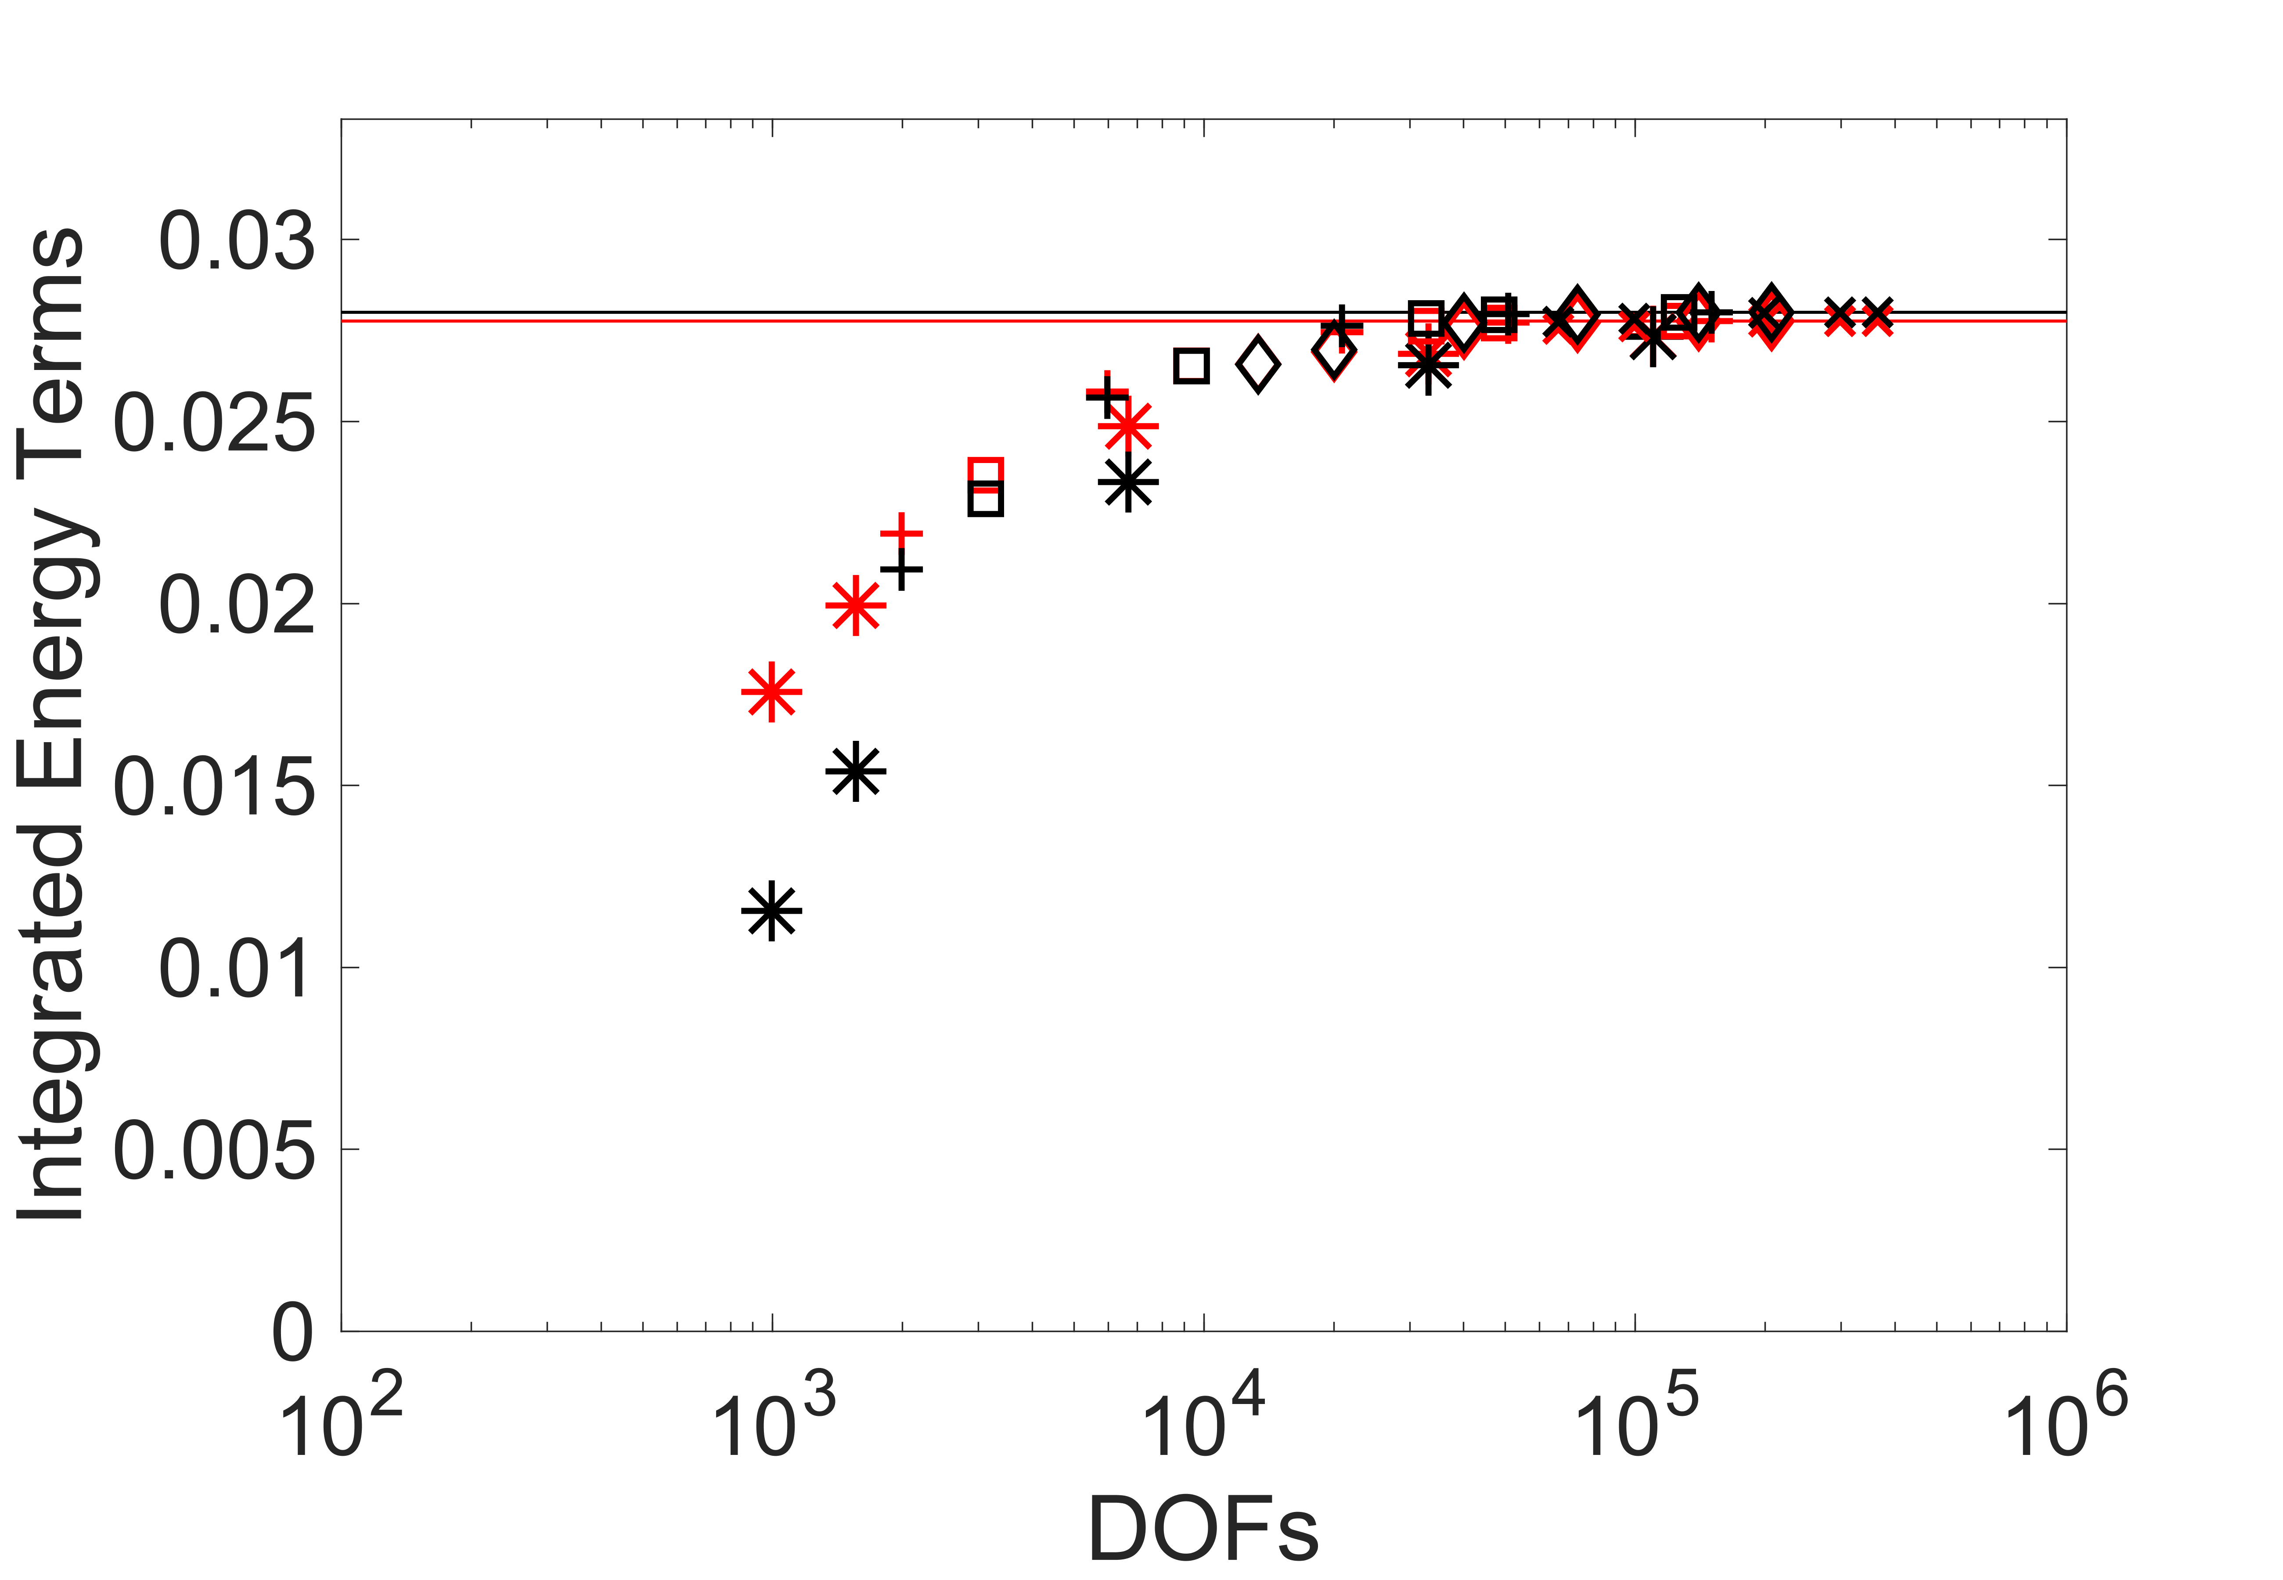
Balance of energy production and dissipation rates
Numerical enrichment functions in GFEM accurately reconstructs the flow
Energy balance is better maintained by GFEM representations compared to the standard FEM representations at the same number of DOFs
This shows potential of GFEM for development of stable fluid models
Re 30,000
: mean velocity
: fluctuating velocity
DNS, production
DNS, dissipation
FEM, production
FEM, dissipation
Remaining markers are GFEM

Slide 9
Conclusions, future work, and acknowledgements
Achievements:
Solution-specific enrichment functions efficiently stabilize coarse GFEM models of advection diffusion. This formulation is successfully implemented in a large C++ ISET library for scalability.
Nonlinear Burgers’ equation is successfully implemented in the C++ library. The shock feature is accurately captured for a range of viscosity values.
A prototype code is developed for 2D incompressible Navier Stokes equations. A quadratic velocity enrichment based GFEM formulation stabilizes the developed model for low-Re values.
Demonstrated improved energy balance in GFEM based representation of chaotic flows at medium-Re.
Future work:
Short-term: The Burgers’ equation FEM framework needs to be updated with a GFEM formulation.
Long-term: Develop GFEM based frameworks for more complex fluid systems.
Acknowledgments:
Lishen He (UIUC): GFEM solver formulation, nonsymmetric systems, and guidance on ISET library
Prof. C.A. Duarte (UIUC): Guidance on GFEM and ISET library
Dr. Patrick O’Hara (AFRL): AFRL sponsor and guide on the project
Dr. Troy Shilt (OSU, Sandia Nat. Lab): Prototype MATLAB code and advection-diffusion formulation

