Slide 1




Investigation of Surface Roughness Effects on Additively Manufactured Metals Under Dynamic Loading
Student:
Student Email:
Faculty:
Faculty Email:
AFRL Sponsor:
AFRL Directorate:
Rachel Tullis
evans.382@wright.edu
Dr. Joy Gockel and Dr. Nathan Klingbeil
joygockel@mines.edu / nathan.klingbeil@wright.edu
Dr. Onome Scott-Emuakpor
RQ
PA #:
AFRL-2022-4872

Slide 2

Background and Motivation
Surface roughness is a driving factor in the overall fatigue life of a component
The high surface roughness in as-built AM parts makes them prone to undesirable fatigue properties
  Highly dependent upon contour processing parameters [Gockel et al., 2019 & Evans et al., 2021]
Vibration bending fatigue testing has only been performed on polished AM specimens
  As-built AM specimens are expected to exhibit lower fatigue lives
How does the surface roughness affect vibration bending fatigue life in as-built AM components?

Slide 3
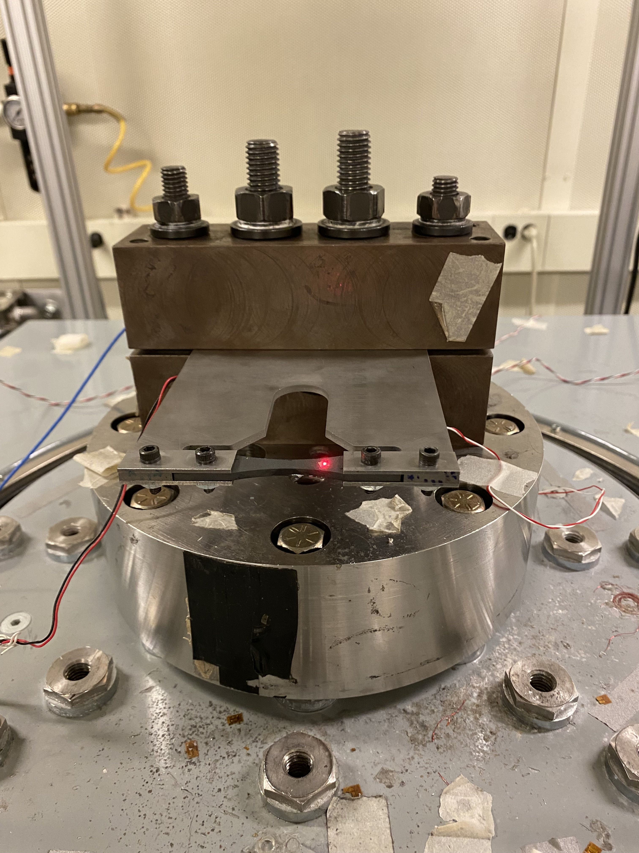
Vibration Bending Fatigue
Unique testing capability developed at the Air Force Research Laboratory (AFRL) Turbine Engine Fatigue Facility (TEFF) [George, 2002]
Analyzes the fatigue behavior of materials at resonant frequencies
Hourglass-shaped insert specimen is positioned into a clamped plate and excited at a specific mode, causing bending stresses within the gage section of the insert specimen
Allows for relatively quick testing in the high cycle fatigue regime
Does not test for complete fracture
  “Failure” is defined as the instance when the dynamic behavior of the insert specimen rapidly changes
Despite these differences, vibration bending results have been shown to be comparable to traditional fatigue testing methods
[Bruns, 2015]
Insert specimen

Slide 4
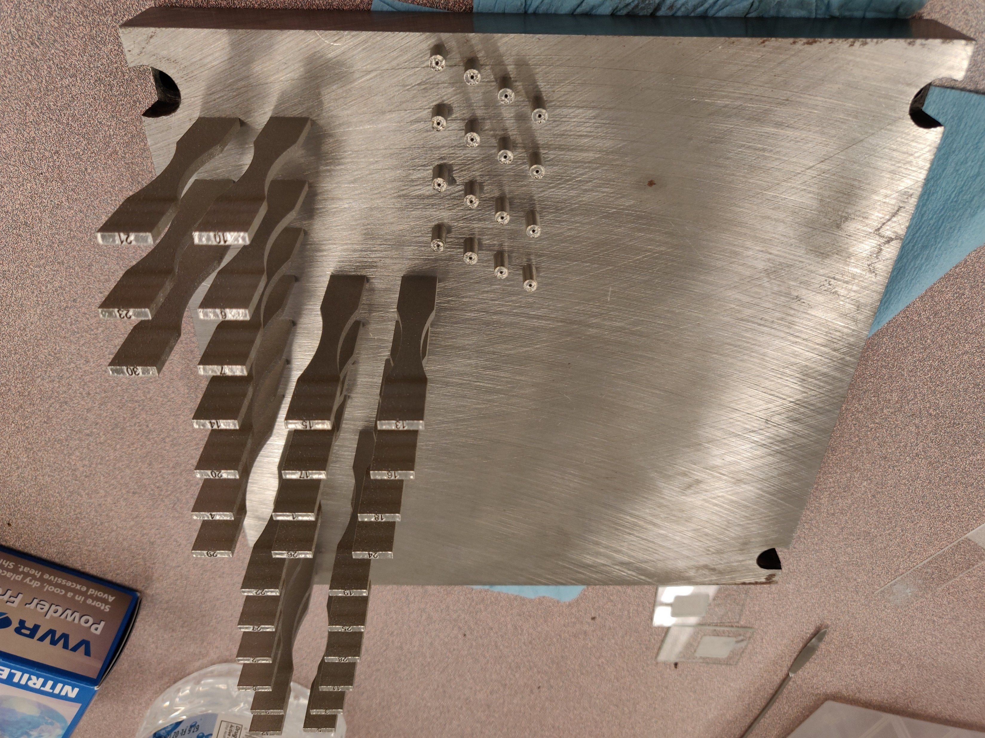
Additive Build
30 alloy 718 bars printed vertically on EOS M280
3 sets of contour parameters
Constant default bulk parameters
Hatch spacing: 110 μm
Layer thickness: 40 μm
Heat treatment
  Stress relieved at 1065°C for 90 minutes; air-cooled at room temperature (~20°C)
  Solution and precipitation heat treated in accordance with AMS 5663
Parameter Set | Contour Laser Power (W) | Contour Scan Speed (mm/s)
High | 120 | 560
Mid | 100 | 560
Low | 80 | 560

Slide 5
Surface Measurements
Line roughness metrics use the data from one column
Rv = |min(column) – mean(column)|
Ra = mean(|height(y) – mean(column)|)
3.7 μm
Build Direction
3.7 μm
Height is obtained for each point on grid
Area roughness metrics use the data from the entire scan
Sv = |min(all points) – mean(all points)|
Sa = mean(|height(x,y) – mean(all points)|)

Slide 6
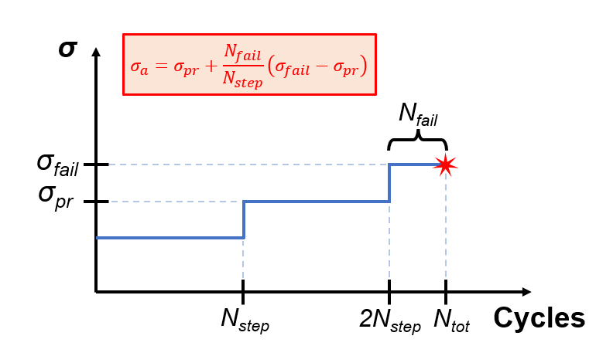
Fatigue Testing Method
Step test method [Scott-Emuakpor et al., 2014]
  Specimens are excited at resonant frequency (~1060 Hz) for a pre-defined number of cycles at each stress level
  Ends abruptly due to a change in dynamic response, which corresponds to a 0.1% shift in natural frequency
σ_{a} is then calculated, representing the failure stress amplitude for N_{step} cycles

Slide 7
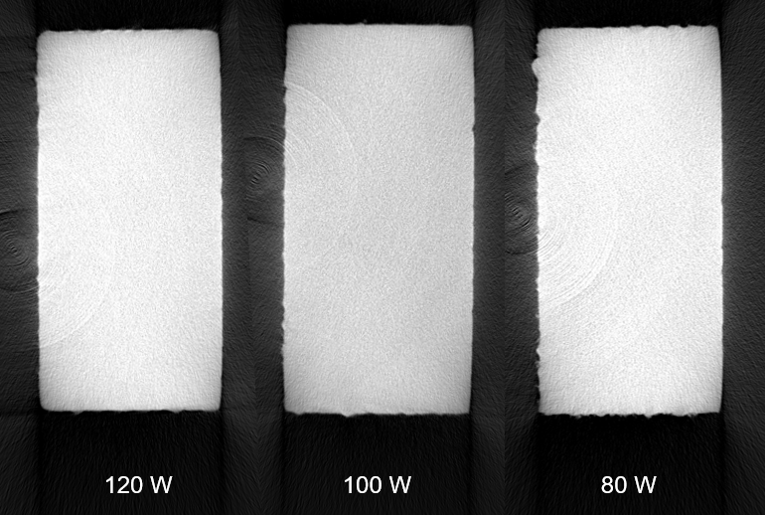
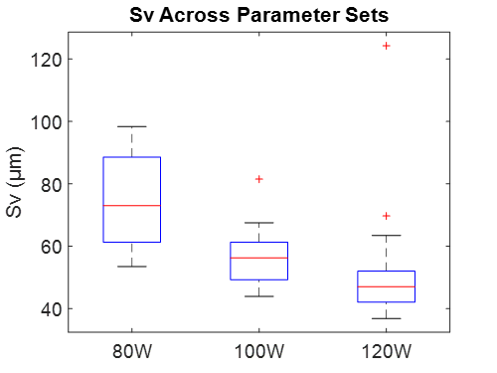
Surface Roughness Results
Increasing contour power decreases both the average roughness (Sa) and maximum valley depth (Sv)
  These differences are statistically significant, as seen through analysis of variance (ANOVA) tests
Increased roughness in low-power samples are expected to cause weaker fatigue performance

Slide 8
Vibration Bending Test Results
Current as-built tests are compared to results by Scott-Emuakpor et al. (2014) and Eidt (2020) for polished alloy 718 specimens
  As-built surface roughness does not appear to have much of an effect on fatigue life
Lower cycle fatigue region appears to be influenced by contour laser power
  Relationship falls apart after ~10⁶ cycles
Many of these specimens failed at the corners of the cross section

Slide 9
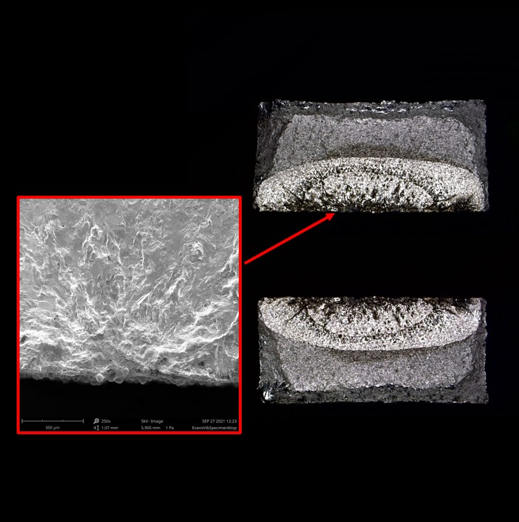
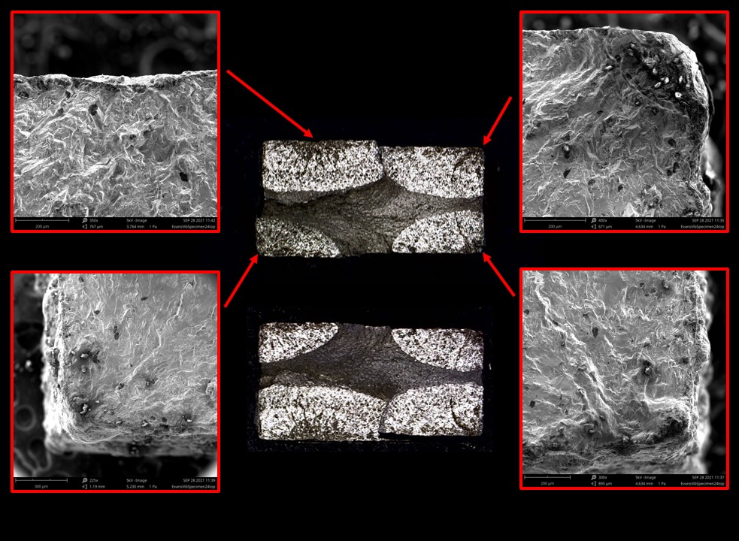
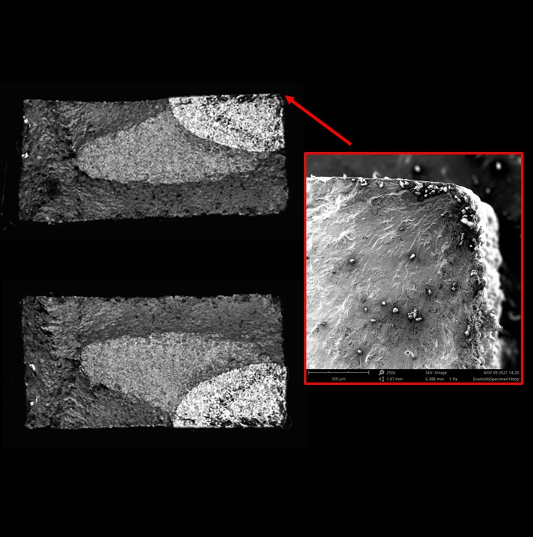
Fracture Surface Analysis
Three failure behaviors typically seen in as-built specimens
Face Initiation
Multiple Cracks
Corner Initiation
>75% of failures
Fatigue failures tend to initiate on corners in rectangular specimens due to the large SIF from corner flaws

Slide 10
Conclusions
Contour laser power was shown to influence surface roughness in AM specimens with statistical significance
In linear region on S-N plot (<10⁶ cycles), specimen life appears to be affected by changes in the contour laser power due to the different surface features present
  This relationship is not seen in the higher cycle region, where other factors may influence the fatigue life in a larger capacity
Crack initiation is commonly seen at sharp corners on the cross-section
  Likely due to large SIF from flaws found on specimen corners
Future work:
  Further investigate SIFs from corner defects compared to face defects in rectangular specimens
  Compare surface measurements and fatigue results
  Determine the effects of microstructure and other factors in high cycle fatigue

