Slide 1




Pre-ceramic Polymer-Assisted Nucleation and Growth of Cu₂S Nanoplates
Student:
Student Email:
Faculty:
Faculty Email:
AFRL Sponsor:
AFRL Directorate:
Patricia Loughney
loughney.4@osu.edu
Dr. Vicky Doan-Nguyen
doan-nguyen.1@osu.edu
Dr. Timothy Pruyn
AFRL/RX
PA #:
AFRL - 2022 - 4818

Slide 2

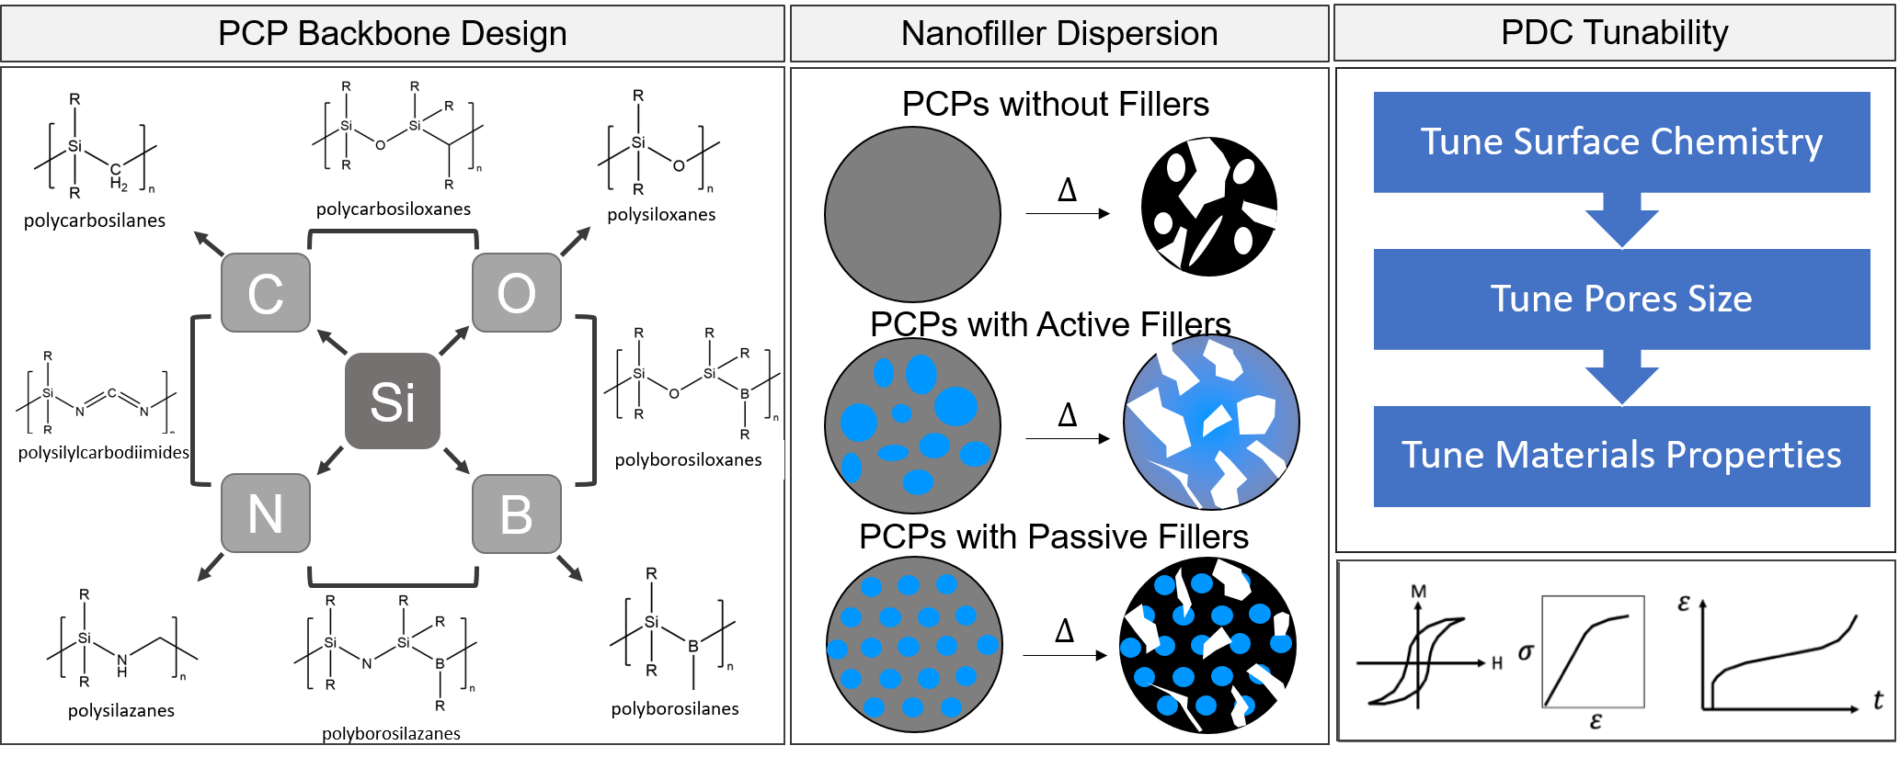
Functionality of Polymer-Derived Ceramic Materials
Polymer-derived ceramics offer advantages over traditional ceramics: decreased processing temperatures, ease in production of various form factors, more control over microstructure, and more avenues for tailoring through backbone design and dispersion of functional nanoparticle filler.
Despite these advantages, maintaining control over PDC precursors through processing is not trivial.
PA #:
##### - #### - ####

Slide 3
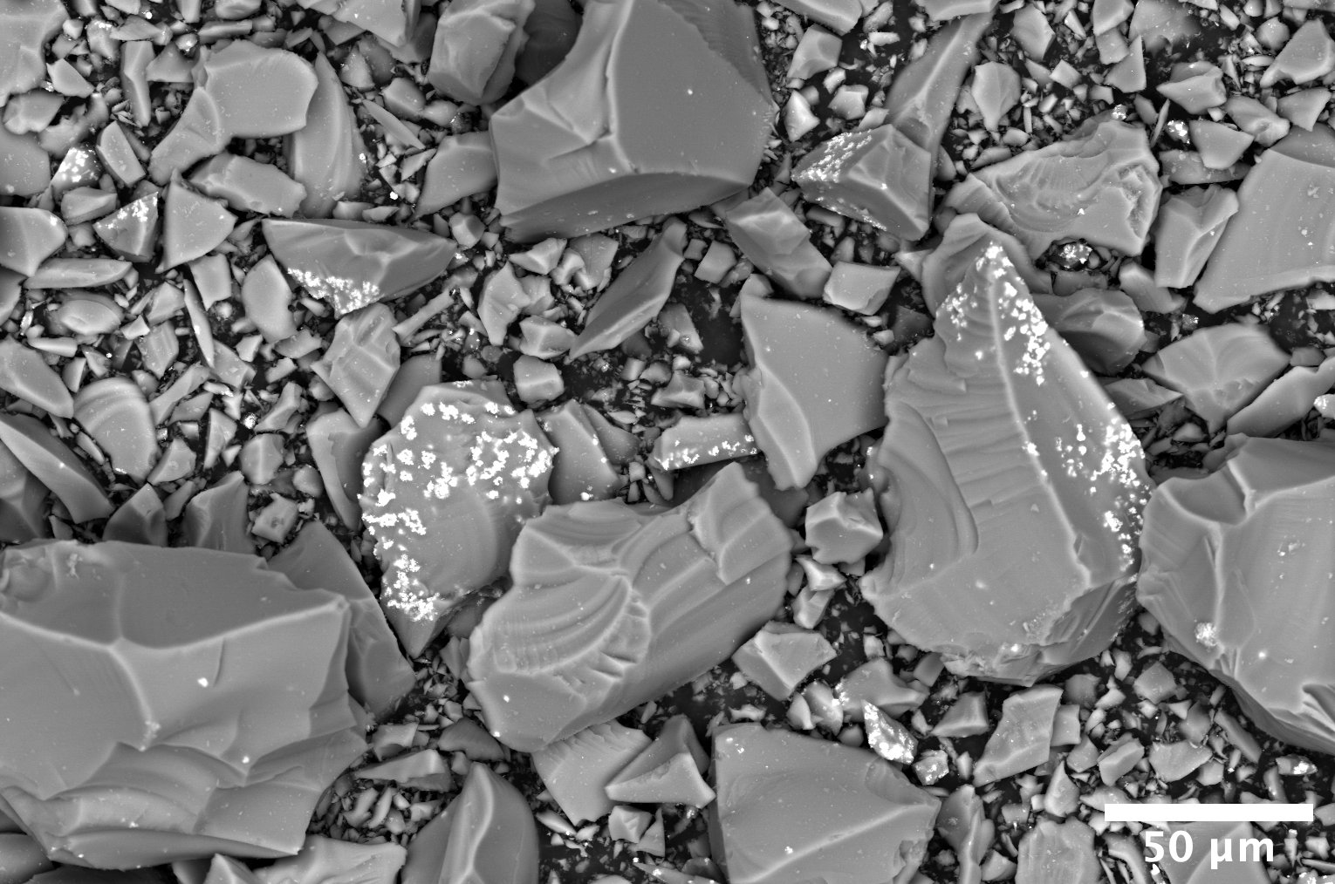
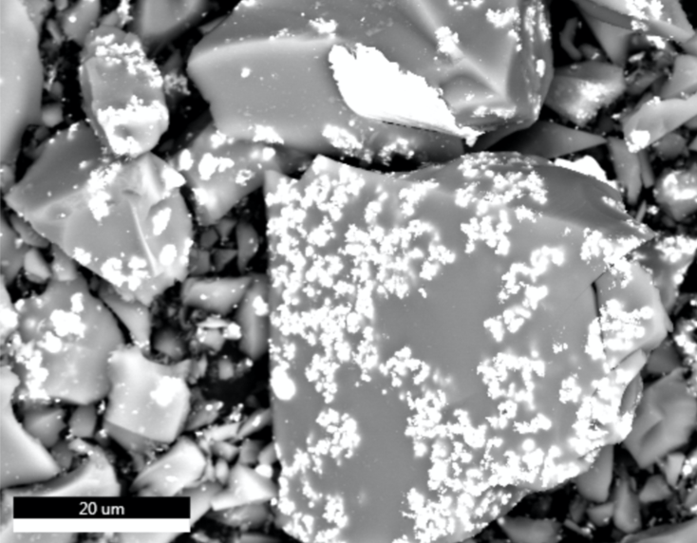
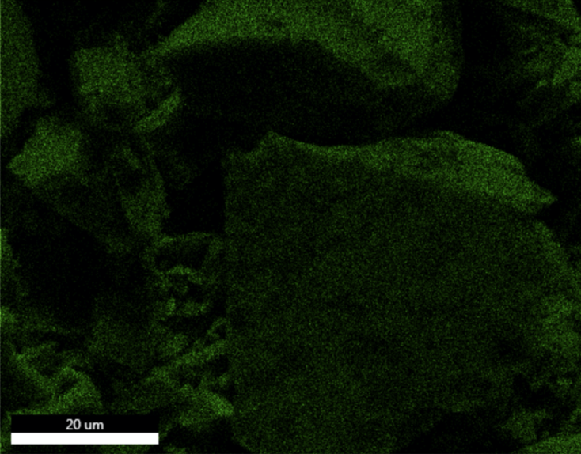
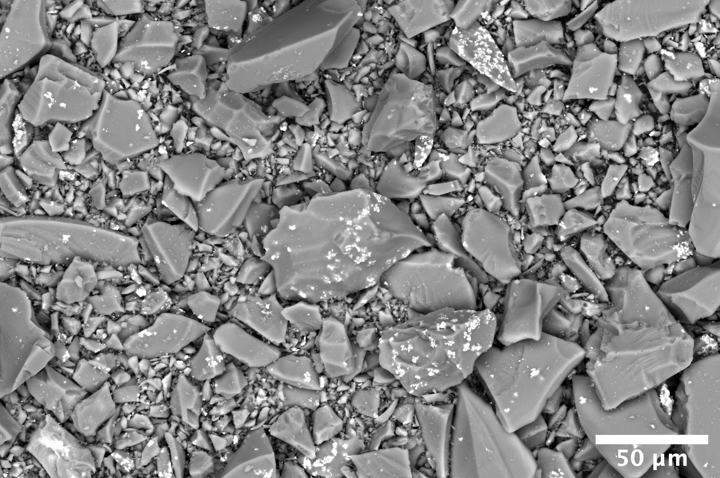
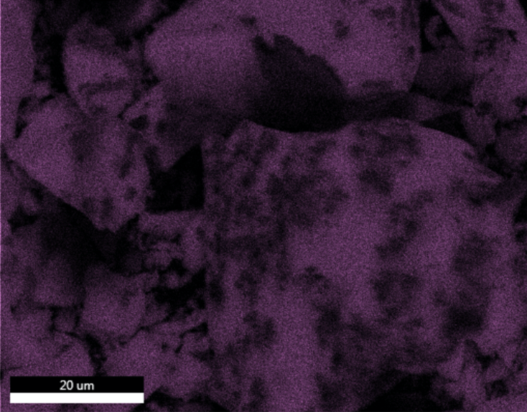
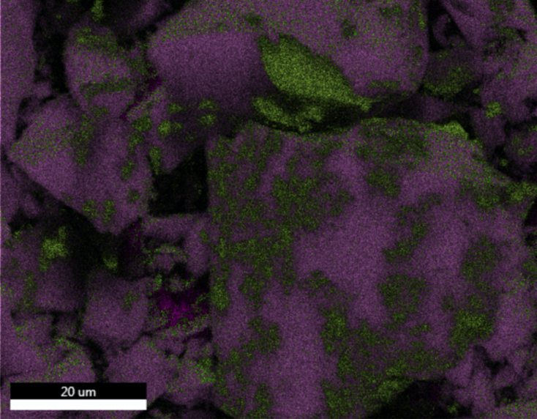
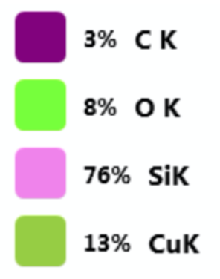
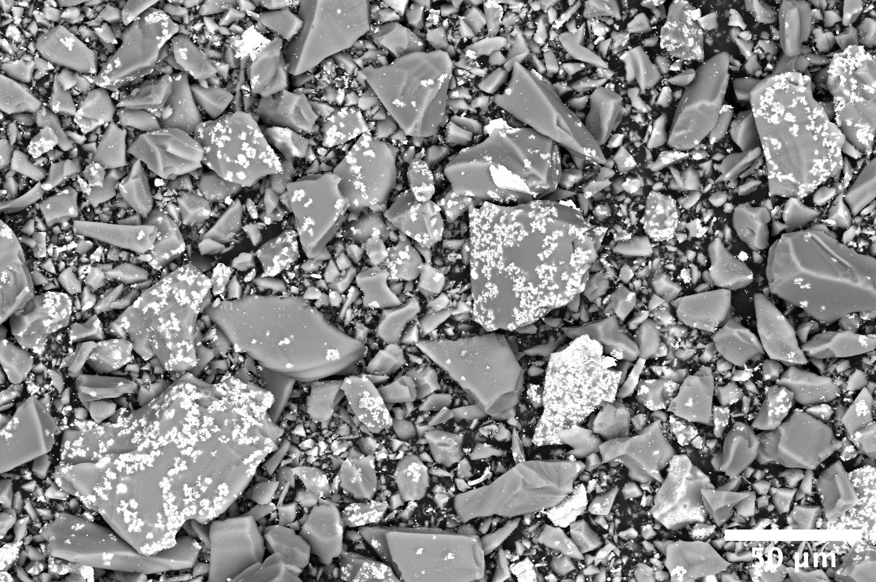
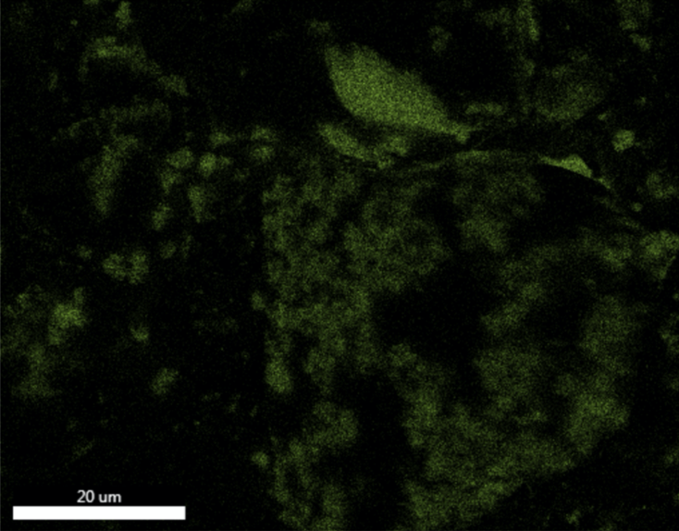
Challenges Interfacing Nanoparticles with PCPs
Conventional capping ligands used in nanoparticle synthesis do not have favorable mixing with pre-ceramic polymers. This leads to widespread aggregation and ineffective dispersion of NP functional properties, as shown below for Cu NP starting at 20 nm dispersed in polysiloxane and heated to 1000°C.
Elemental Mapping
2 wt% Cu NP
O
4 wt% Cu NP
Si
EDS
8 wt% Cu NP
Cu
Widespread Cu aggregates >1 µm despite starting at 20 nm
PA #:
AFRL - 2022 - 4818

Slide 4
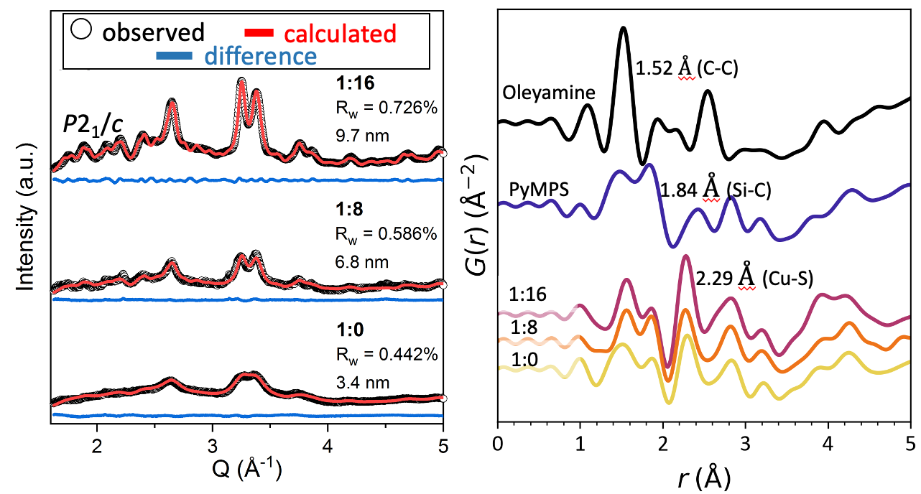
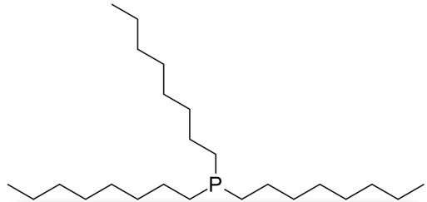
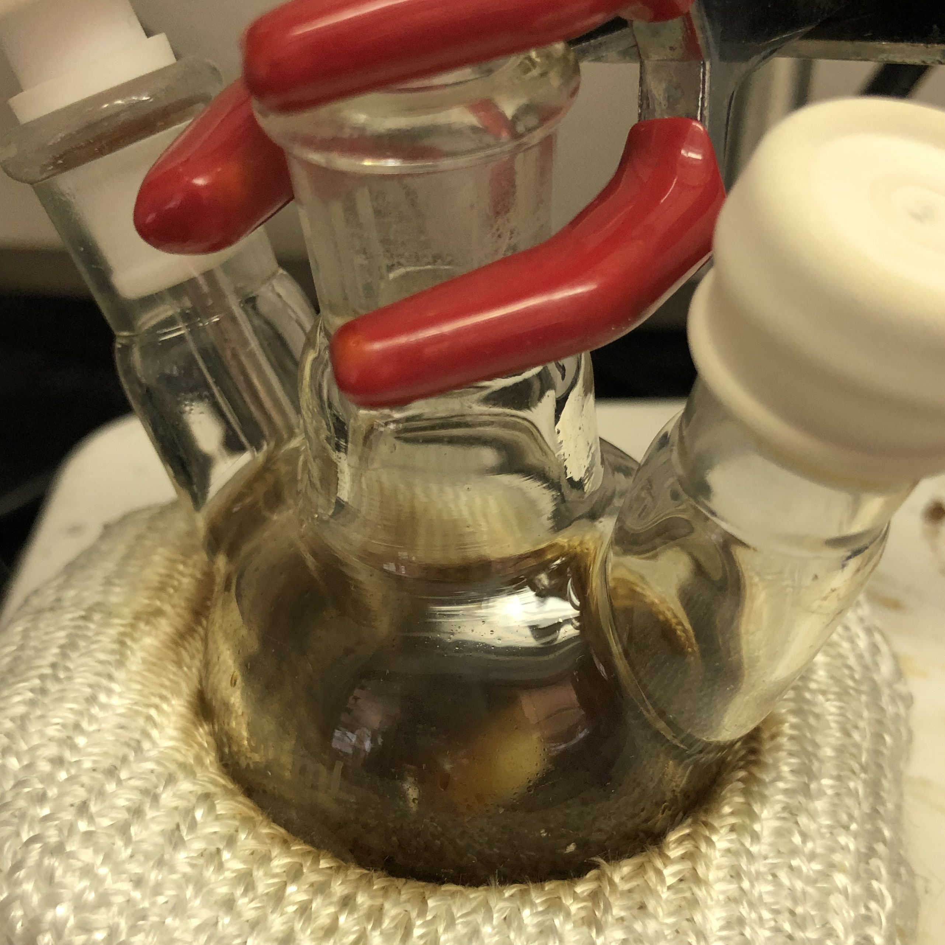
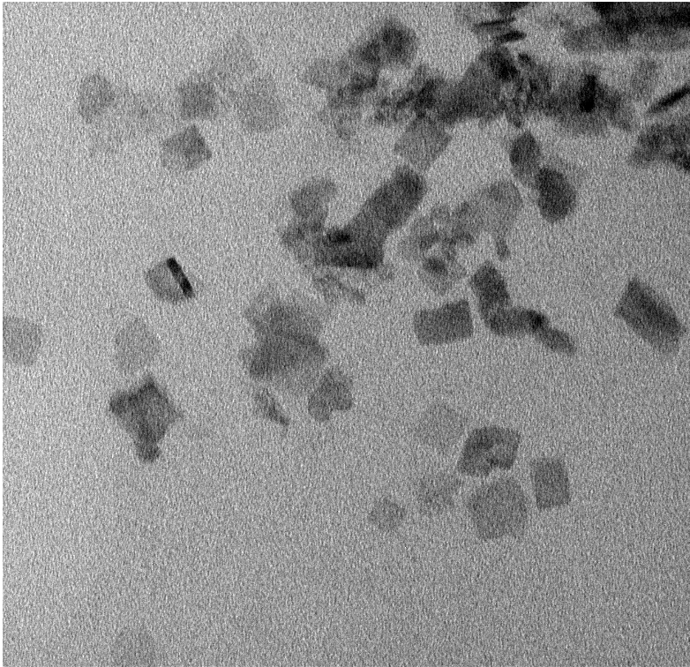
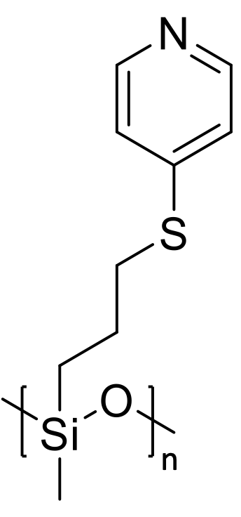
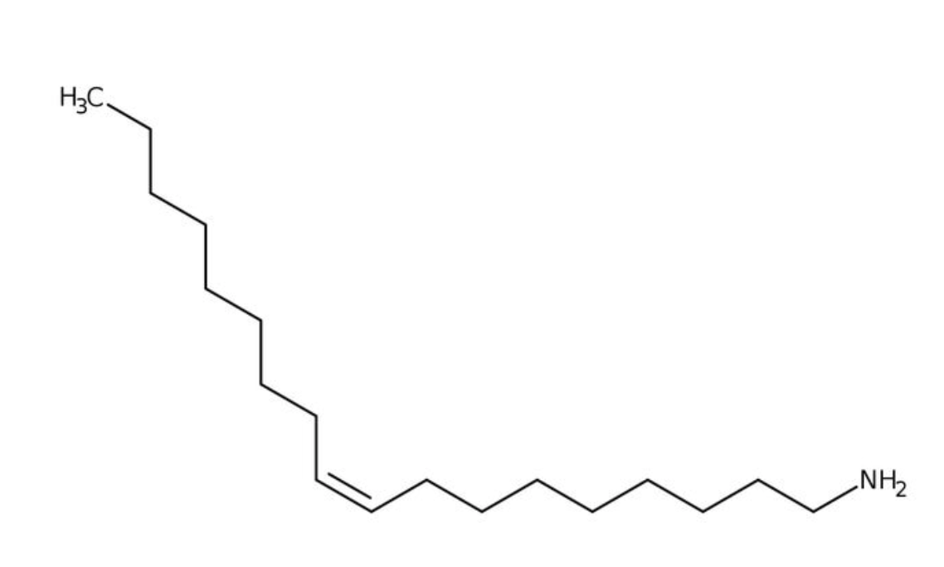
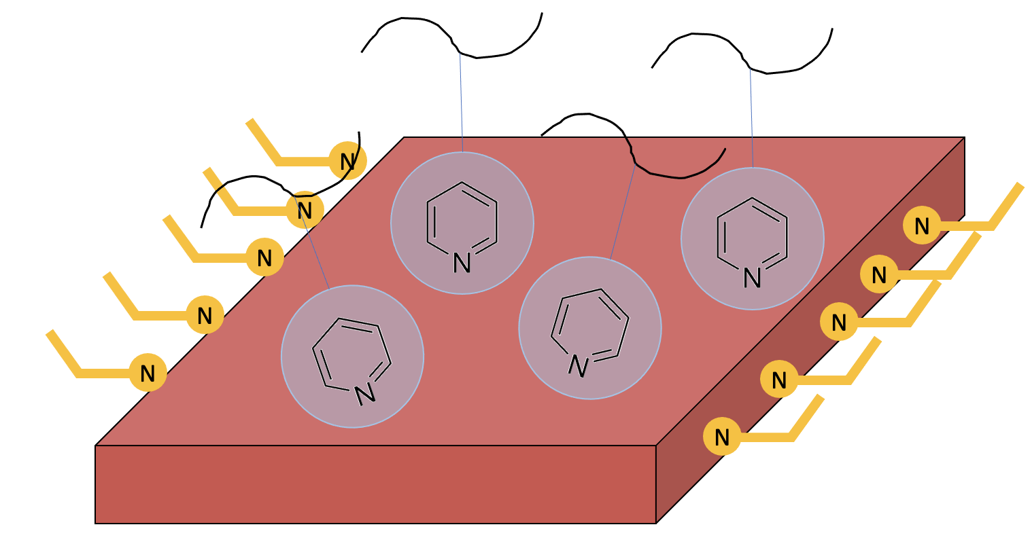

One-pot Synthesis of a PCP-Grafted and PCP-Dispersible Nanoparticle
Synthesis
Characterization
Synthesis of Graft Monomer (K. Martin, M. Dickerson)¹
XRD*
PDF*
PyMPS
Initiator, $∆$
Graft-through thermolysis in high boiling point solvent
metal-salt
reducing agent
*PDF and XRD analysis by Paul Cuillier
TEM
X-ray data and fitting show formation of Cu₂S (>10nm) with tunable size
ligands
TEM shows widespread anisotropy along the same size scale
NH₂
10 nm
PyMPS acts as a S-source and shape director
PyMPS
oleylamine
10 nm
PA #:
AFRL - 2022 - 4818
¹Martin, K. L.; Parvulescu, M. J. S.; Patel, T. A.; Mogilevsky, P.; Key, T. S.; Thompson, C. M.; Dickerson, M. B. Bioinspired Cross-Linking of Preceramic Polymers via Metal Ion Coordination Bonding. J. Eur. Ceram. Soc. 2021, No. June.
Notes:
Poly(mercaptylpropyl)methylsiloxane polymer is converted to poly(pyridyl-mercaptylpropyl)methylsiloxane
The synthesis of PyMPS-capped Cu NPs is done in a “graft-through” method where particles are formed in solution with graft molecule acting as a capping ligand. The synthesis we developed largely mirrors that of our traditional Cu NPs (reported 1 slide earlier), but with PyMPS taking the place of oleylamine in the reaction. It is our hypothesis that PyMPS will link to the particle surface through the backbone-functionalized pyridine group, similar to the linkage between PVP and several Au NP syntheses in literature. We’ve found that a small amount of oleylamine does improve yield of particles (probably aiding in reductiveness of environment), though we are careful to add a small enough amount of oleylamine so as to not dominate the particle capping, and allow for PyMPS graft formation (oleylamine linkage is more facile than pyridine linkage).
We hypothesize that the use of PyMPS over oleylamine will produce smaller particles due to a much higher degree of steric hindrance in the PyMPS polymer.
I’ve included Lab XRD (Miniflex) to highlight that we are unable to see crystalline peaks. Good Segway for necessary other forms of characterization. My background subtraction is not great here, due to sucha high backgrowund with no present. It makes it look like there coulf be a very broad peak between 2-2.5 Q. This is not present in the plot without the background subtraction. Let me know if you would like me to switch the plots out.

Slide 5
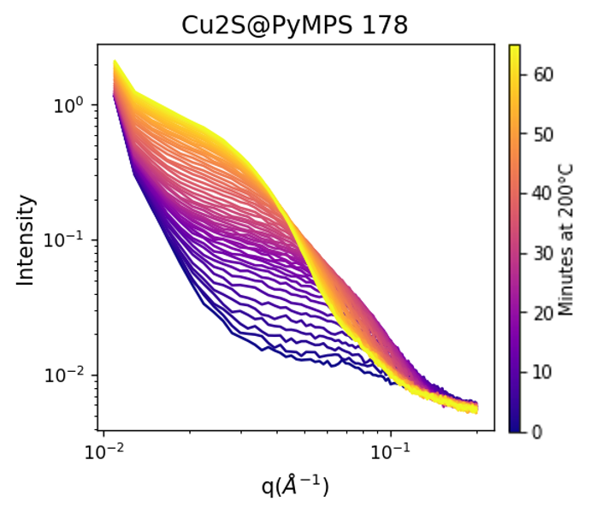
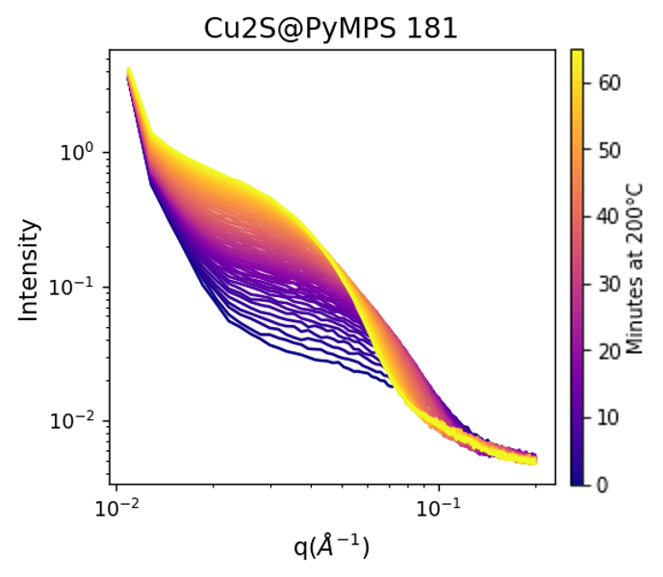
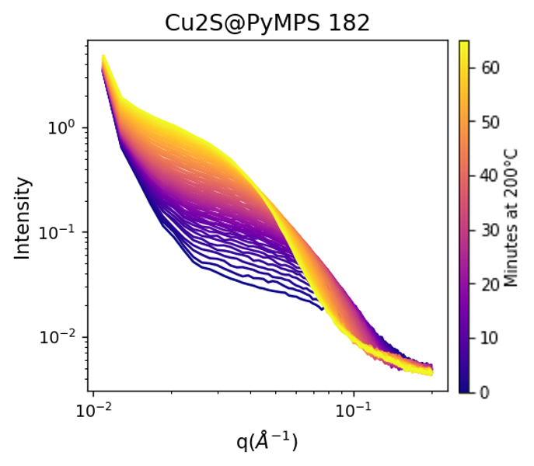
Monitoring Nucleation through in-situ SAXS
In-situ SAXS carried out by taking precursors loaded into glass capillaries through heating profile required for particle formation. Success in particle nucleation is shown for varied PyMPS:oleylamine ligand ratios, even for a sample with no loaded oleylamine.
Decreasing oleylamine
1:16 PyMPS:Olam
1:8 PyMPS:Olam
1:0 PyMPS:Olam
PA #:
AFRL - 2022 - 4818

Slide 6
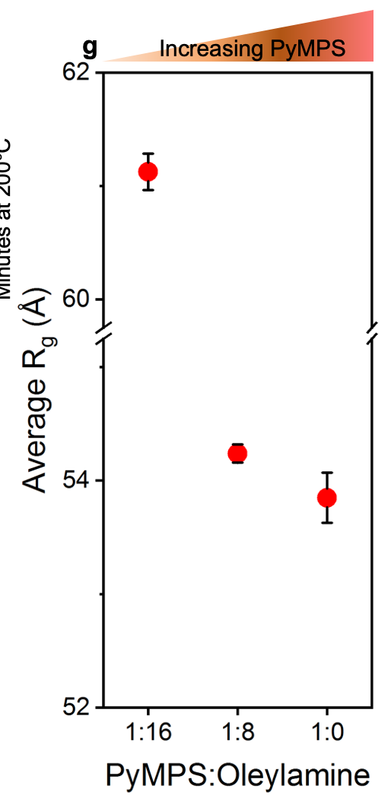
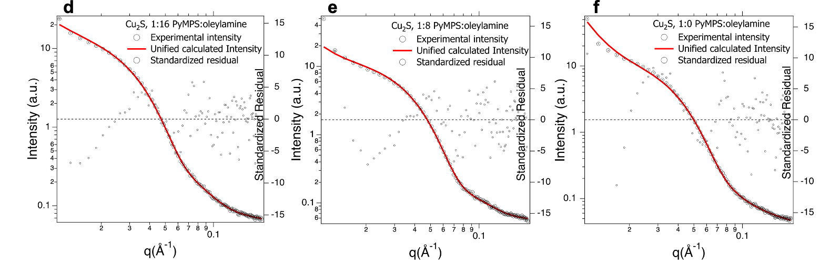
Tunable Size with Changing Ligand Loading
By decreasing oleylamine loading, we effectively increase the ratio of PyMPS:oleylamine and see a decrease in average particle radius. This provides a pathway for tunable size when using PyMPS.
Also, PyMPS forms a stable Cu₂S nanostructure without aid from oleylamine
(1:0 ratio). PyMPS is able to fill the protective capping and reductive effects
that oleylamine normally provides in NP syntheses.
Decreasing Oleylamine
PA #:
AFRL - 2022 - 4818

Slide 7
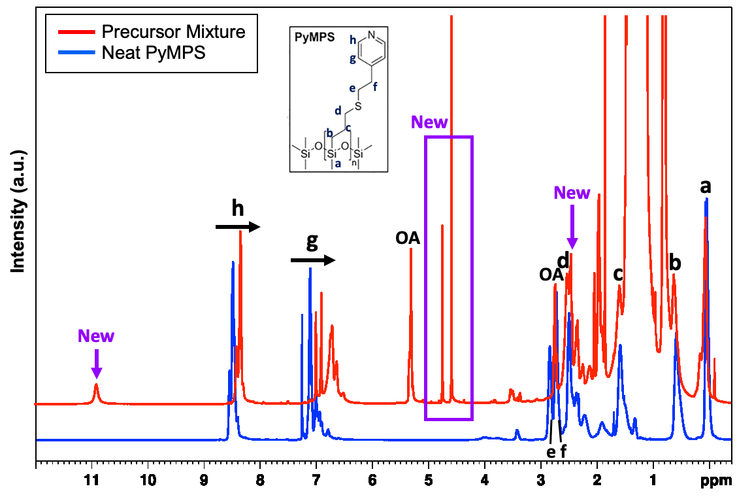
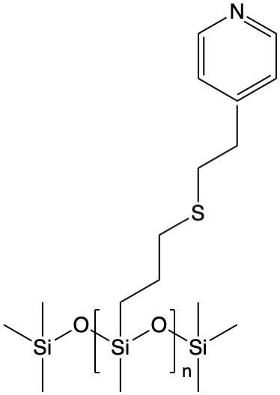
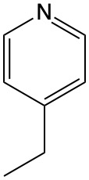
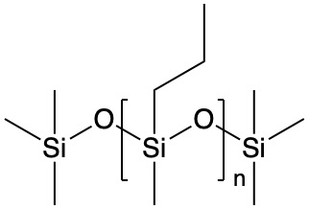
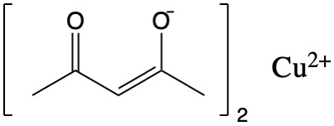


Mechanism of Sulfur Incorporation
Preliminary NMR (right) has found that PyMPS reduces Cu²⁺ to Cu¹⁺ by way of an oxidative insertion of Cu²⁺ on the nonterminal S—C bonds. This gives off Cu₂S and cleaves ethyl pyridine from the side chain within the PyMPS repeating unit (see below mechanism).
XRD, PDF back this up by proving Cu₂S formation.
Preliminary LC-MS has revealed that ethyl pyridine does remain in the nanoparticle supernatant after cleaning steps.
C-S bond cleavage
$$2$$
PA #:
AFRL - 2022 - 4818

Slide 8
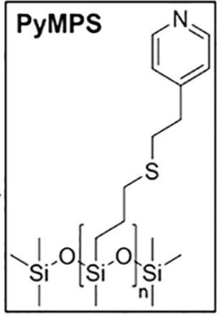
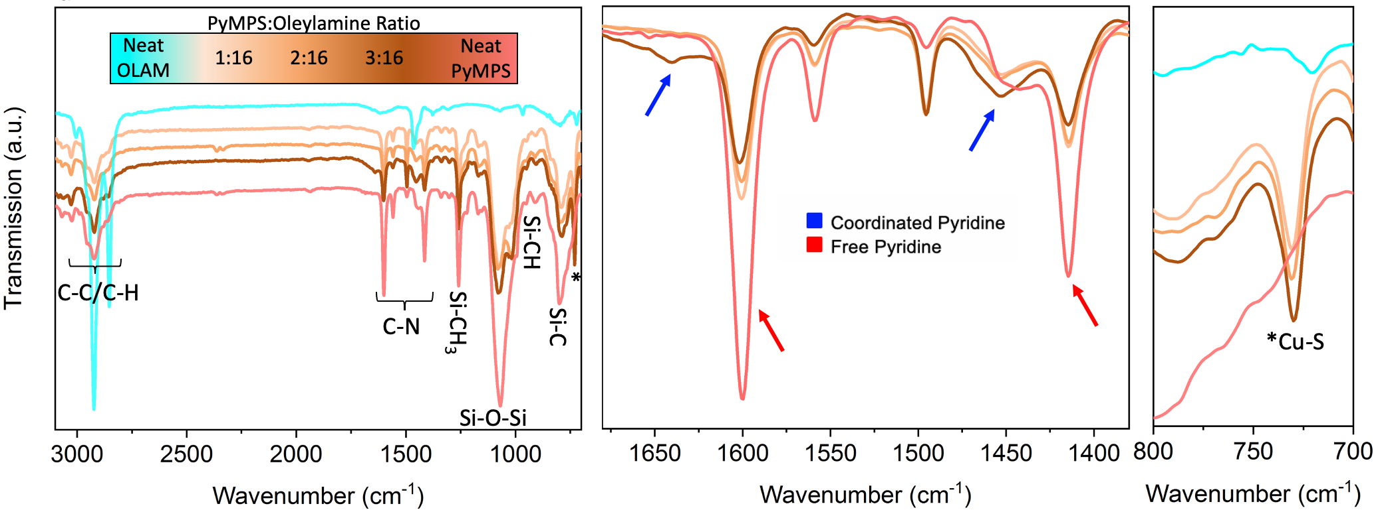
Evidence of Polymer Grafting
PyMPS remains intact in all nanoparticle samples despite sulfur donation and remains attached to nanoparticle surfaces through cleaning. Pyridine coordination from PyMPS is monitored and only appears at high PyMPS loadings. Cu-S vibration from NP core is visible.
Pyridine capping is possible, though likely is not the main/only capping mechanism from PyMPS. More characterization is necessary.
PA #:
AFRL - 2022 - 4818

Slide 9
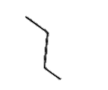
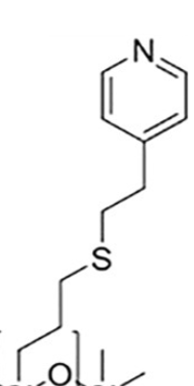
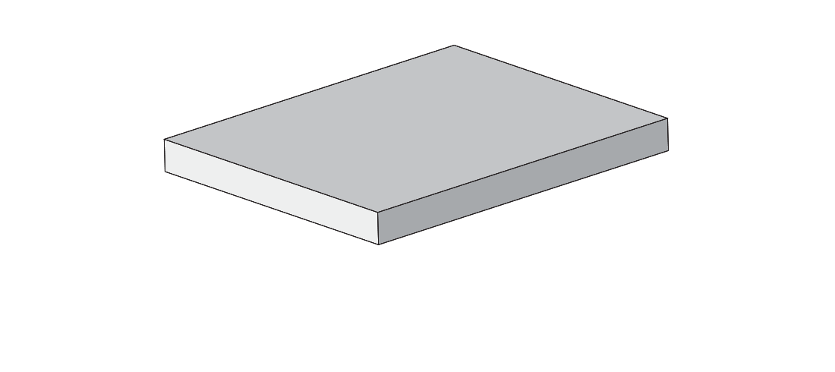
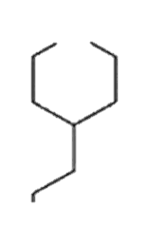
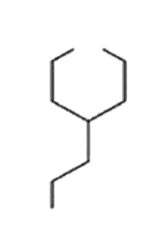

Proposed Graft Mechanism
For amount of added Cu-salt, we have way more S-groups in PyMPS left behind than stoichiometrically necessary to produce Cu₂S. Remainder of unreacted PyMPS can aid in capping following the below proposed mechanisms, or a mixture of all those presented.
Amine likely bonds to Cu in NP
Cu²⁺ insertion to form Cu₂S
Cu²⁺
*
N
N
N
N
N
N
N
Thiol could either form M—S or S—S bonds with NP
*
= repeating PyMPS backbone
Si-O-Si-O
N
N
N
More characterization is necessary to verify this mechanism.
S
S
S
PA #:
AFRL - 2022 - 4818

Slide 10
Conclusions and Future Work
Role of PyMPS in NP Synthesis
  PyMPS acts reactant, possible shape director, and even gives tunable size based on loading
  Oleylamine is not necessary to produce Cu₂S nanoparticles, suggesting PyMPS acts as a capping ligand and adds to the reductive environment allowing for nucleation
  Majority of PyMPS remains intact despite sulfur incorporation and adhered to particle through several cleaning steps, suggesting a strong graft mechanism
Future directions
Further analysis to understand morphological tunability for this system
More characterization of surface graft mechanism
Dispersion of Cu₂S@PyMPS nanoparticles into SPR-212 to compare resulting particle size through pyrolysis to those of nanoparticle with conventional capping ligands
Increased pre-ceramic polymer assisted nucleation and growth (PPANG) synthesis development for other PDC and nanoparticle systems.
PA #:
AFRL - 2022 - 4818

