Slide 1




Automated topology optimization of PBF via state estimation and control of internal temperatures
Student:
Student Email:
Faculty:
Faculty Email:
AFRL Sponsor:
AFRL Directorate:
Nathaniel Wood
wood.863@osu.edu
David Hoelzle
Hoelzle.1@osu.edu
Andrew Gillman
Materials and Manufacturing
PA #:
AFRL-2022-4784
Replace with University Logo

Slide 2
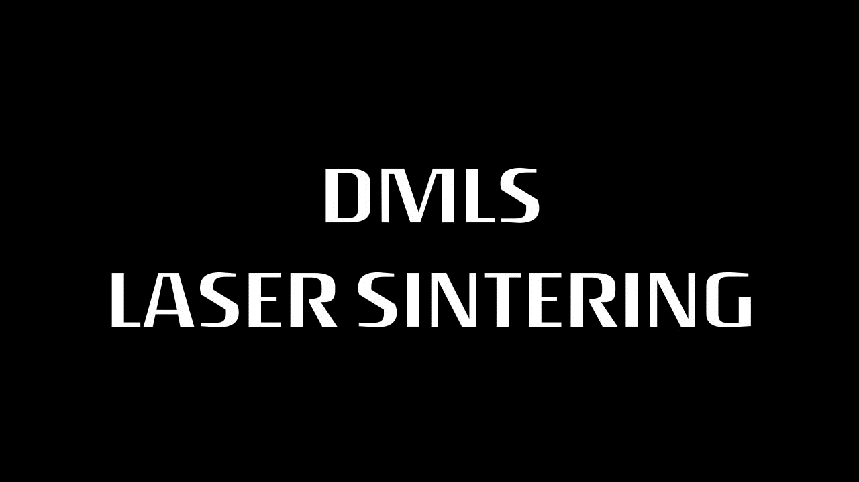
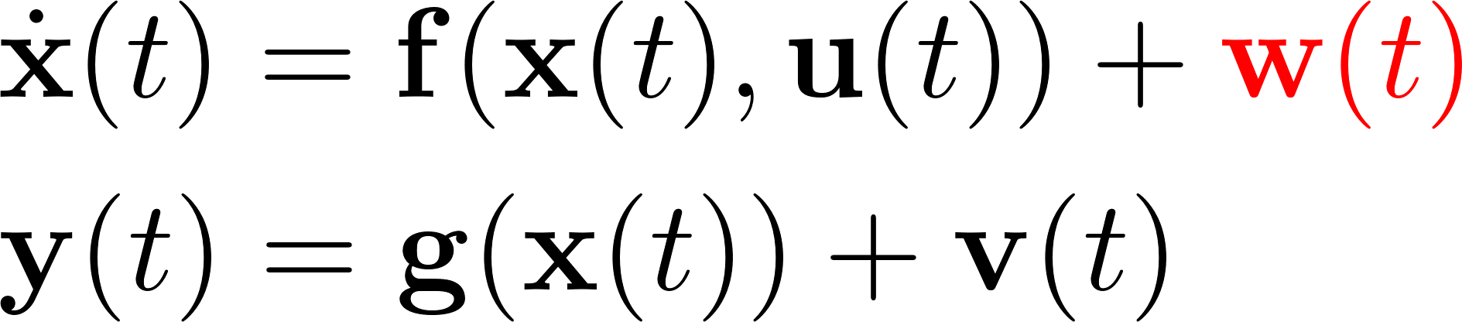

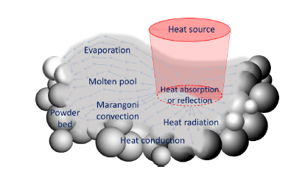
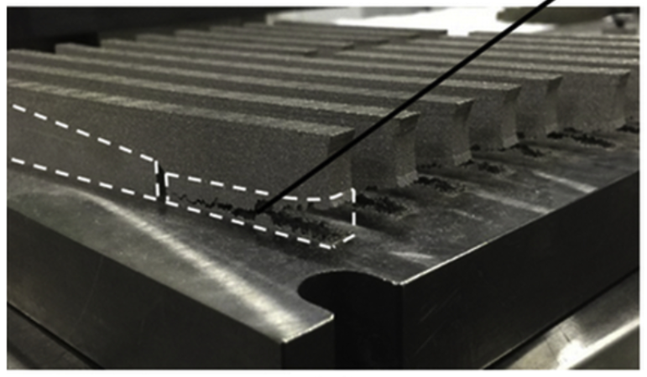
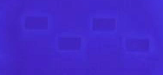
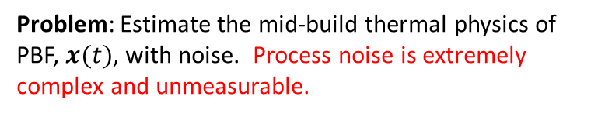
Motivation
[1] “DMLS Direct Metal Laser Sintering by FORECAST 3D”.
[4] DeBroy et. al. Progress in Material Science, 2018
[2] L. Cheng et. al., Additive Manufacturing, Vol. 27, 2016
[5] Gaikwad et. al. IISE Transactions, 2020
[3] Wood et. al. SFF 2019, pp. 1445-1481
Problem: Estimate the mid-build thermal physics of PBF, $x(t)$, with noise. Process noise is extremely complex and unmeasurable.
DMLS = Powder Bed Fusion (PBF)
[1]
Process noise
Measurement noise
[4]
Process monitoring: State estimation.
Design of $K(t)$?
Defect: residual stresses
Measurement: IR cameras
ML techniques [5]: burden of extensive training data
[2]
[3]
Project goal: Estimate PBF thermal physics without using training data.
PA #:
AFRL-2022-4784

Slide 3
Strategy: Ensemble Kalman filter
[1] Evensen, G. Ocean Dynamics, 2003
Measured
Measurement Noise $v(t)$
Thermal camera
$$output\left(t\right)=y\left(t\right)=\left[\begin{matrix}x_{1} \\ x_{2} \\ x_{3} \\ x_{4}\end{matrix}\right]$$
input(t)=u(t)
$$\hat{y}\left(t\right)=\left[\begin{matrix}{\hat{x}}_{1} \\ {\hat{x}}_{2} \\ {\hat{x}}_{3} \\ {\hat{x}}_{4}\end{matrix}\right]$$
Estimation feedback strategy: Ensemble Kalman filter [1]
IDs Gaussian distributions closest to $w(t)$ and $v\left(t\right)$
$\hat{x}(t)$ is 2-norm optimal estimate wrt to this noise estimate
No a priori knowledge needed
1
2
3
4
Output estimation error
Isolate output estimates
z
input(t)
Model
x
$$\hat{x}(t)$$
Mathematical model predicts unmeasured temperatures
Estimates at all nodes
Use feedback action to guarantee convergence of estimates to unknown true values
Process Noise $w(t)$
PA #:
AFRL-2022-4784

Slide 4
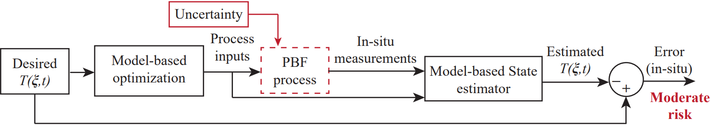


Project thrusts
Simulation-based validation of state estimation algorithm
  True process measurements replaced by simulated measurements from a more accurate process model than that used by state estimator
  Assess accuracy with respect to simulated ground truth, in terms of 2-norm and $∞$-norm error signals.
  Rapid algorithm testing and refinement.
$ξ:$ 3D spatial coordinate
Gathering experimental data of PBF internal temperature response, associated input/output signals
  Utilization of open architecture PBF machine at ARCTOS, Dayton OH.
  Validation of state estimator algorithm with experimental data.
  Gathering microstructural data to test correlation of estimated temperature field to features of interest.
2750-A Indian Ripple Rd, Beavercreek, OH 45440
PA #:
AFRL-2022-4784

Slide 5
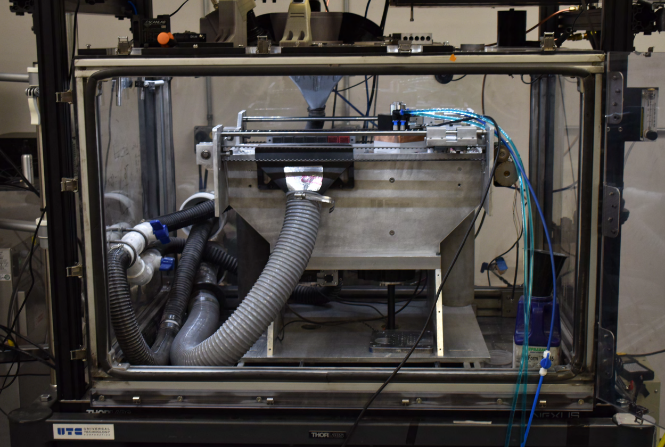
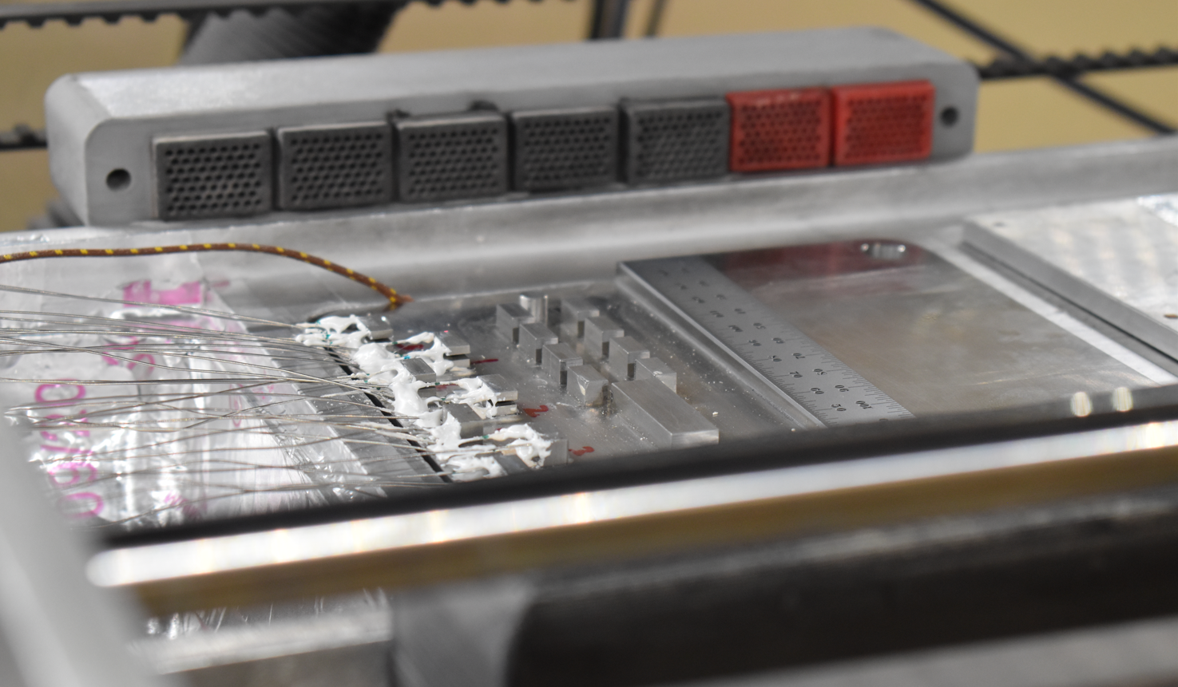
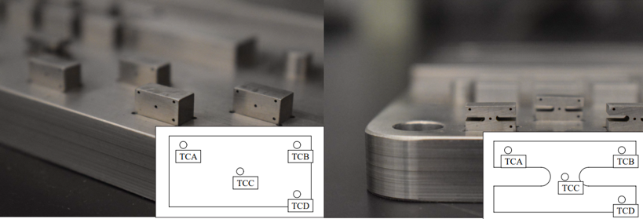
Open architecture machine, sample geometries
ScanLab intelliSCAN 20 galvanometers + RTC5 card
IPG YLR-500-SM laser source
Optris PI 640i off axis IR camera
Custom-filtered Sony IMX174 coaxial camera
PA #:
AFRL-2022-4784

Slide 6
Summary: collected data streams
Thermocouple (TC) signals, embedded within test samples (x4 per sample)
TC signal, embedded within build plate
Micrographs of generated build footprints, and of single scan tracks
Real-time X,Y galvanometer commanded positions
Real-time laser power
Real-time laser trigger signal
Set point of beam diameter
Images from off-axis IR camera
Images from coaxial camera
Ground-truth validation data for PBF thermal models.
Real-time process inputs, used to generate accurate process models.
Real-time process outputs, used in process monitoring algorithms.
PA #:
AFRL-2022-4784

Slide 7
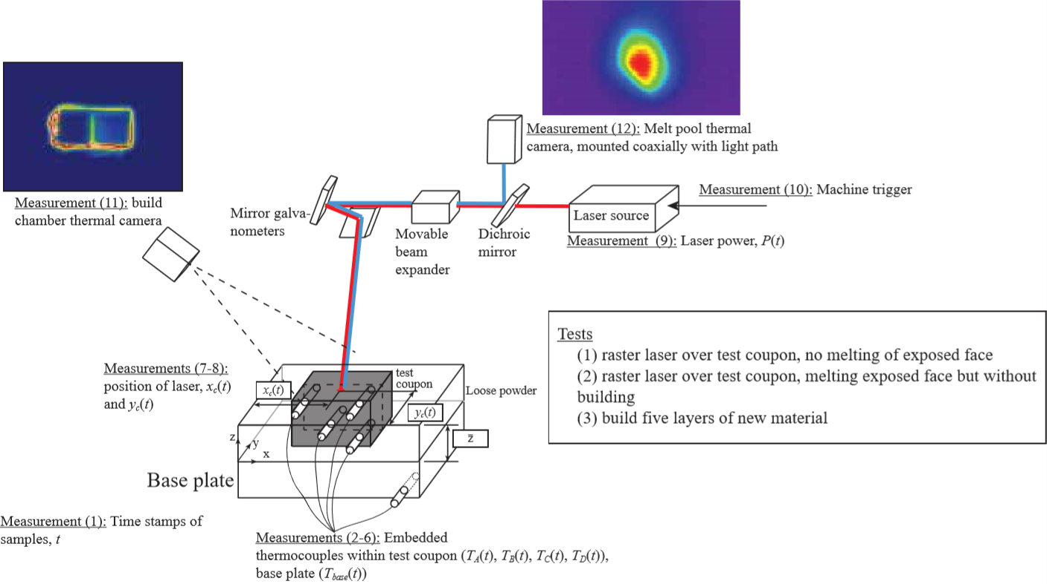
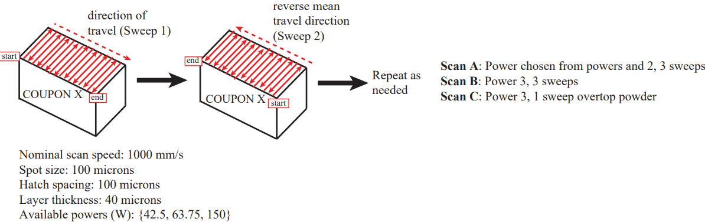
Experimental procedures
42.5 and 63.75 W, 3 sweeps
150 W, 3 sweeps
150 W, 1 sweep
PA #:
AFRL-2022-4784

Slide 8
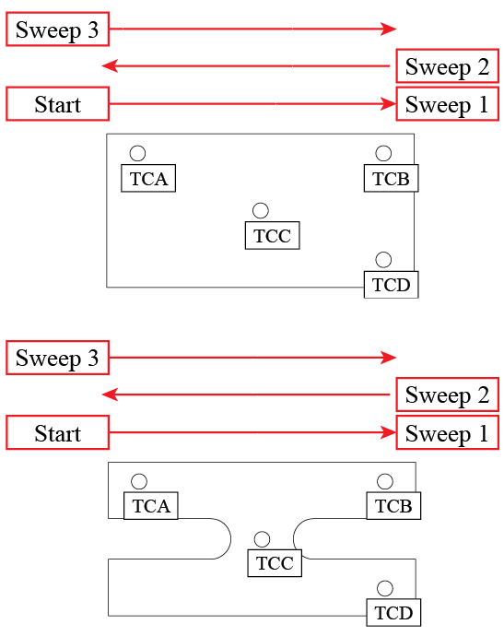
Sample TC data
Sample 1
Sample 6
Net motion of laser across the sample lengths between multiple sweeps is what produces 2 local maxima for TCA, and one local maximum for TCB.
PA #:
AFRL-2022-4784

Slide 9
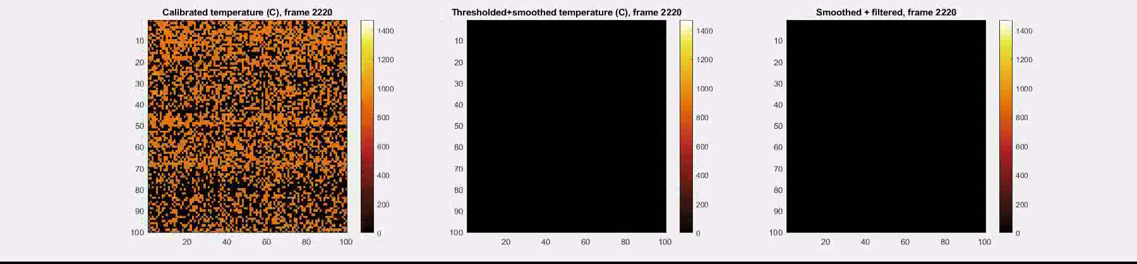
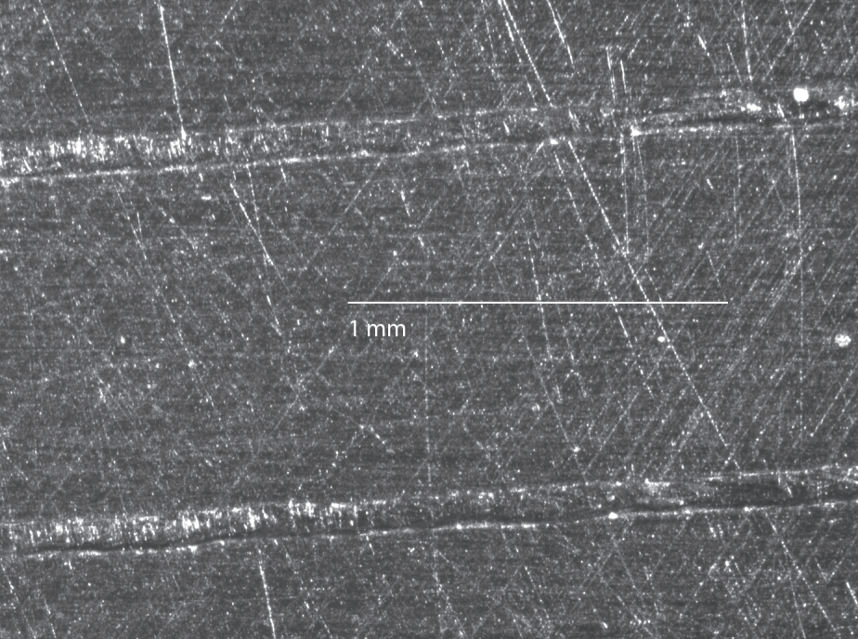
Sample on axis camera data
Colormap: K. Moreland, Proceedings HVEI, 2016
Camera calibrated by comparing imaged melt pool widths against ground truth microscope data for all powers examined.
Ghost image due to slight misalignment of optical train.
Background noise eliminated via thresholding.
Ghost image removed via watershed filtering the distance transform complement of the eroded, binarized image.
PA #:
AFRL-2022-4784

Slide 10
Conclusions and acknowledgements
Conclusions
We have gathered an exhaustive dataset that samples mid-build internal PBF temperatures under a variety of processing conditions, together with industry-relevant process input and output signatures.
We intend to make this dataset freely available to the community and will announce its location in a future publication.
We intend to use this data to validate Ensemble Kalman Filter-based estimations of PBF temperature fields, which will be a step towards achieving PBF process monitoring without the need for extensive training data. This will complete thrusts 1 and 2 of this research project.
Acknowledgements
My advisor and AFRL sponsor, David Hoelzle and Andrew Gillman, respectively
My peers in the Hoelzle Research Lab
Open Additive staff, especially John Middendorf for their expertise and machine
Professor Prasad Mokashi for his help with FEM theory
PA #:
AFRL-2022-4784

