Slide 1
InAs/AlAsSb Avalanche Photodiodes for Lidar Applications
Student:
Student Email:
Faculty:
Faculty Email:
AFRL Sponsor:
AFRL Directorate:
Mariah Schwartz
Schwartz.1945@osu.edu
Dr. Sanjay Krishna
Krishna.53@osu.edu
Dr. Charles Reyner
AFRL/RY
PA #:
AFRL- 2022 - 5029

Slide 2
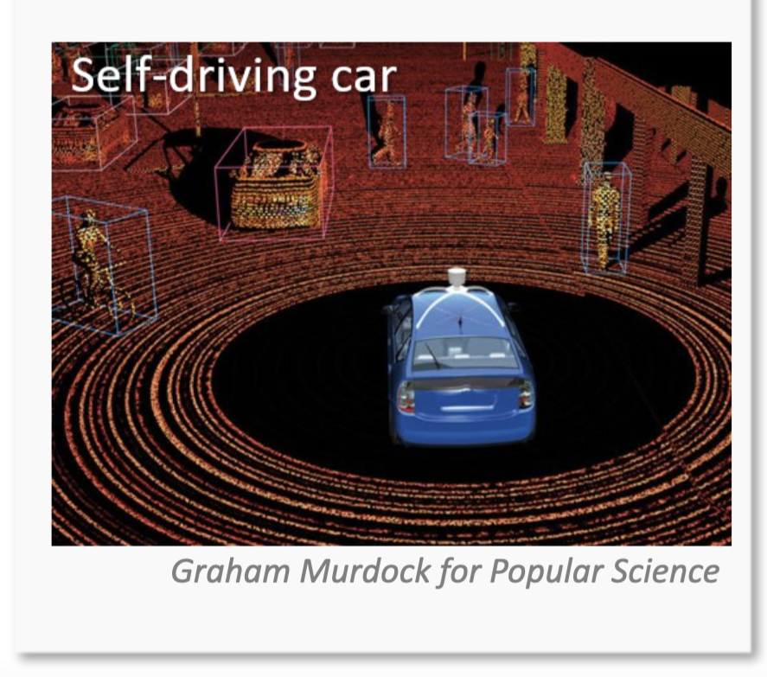
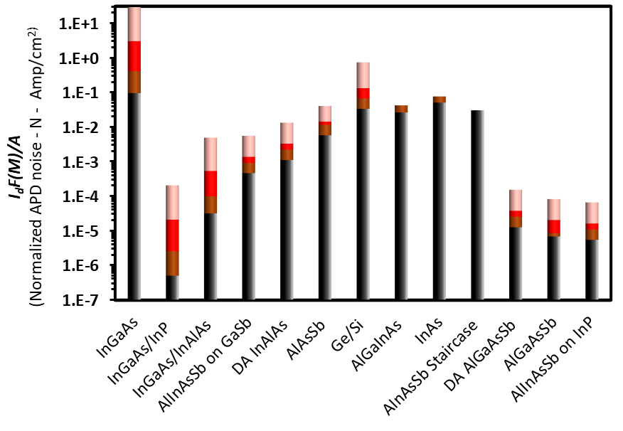
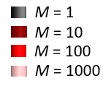
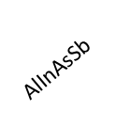
Background and Motivation: 2 µm LIDAR
$B:Bandwidth | I_{ph}:Photo current |{ I}_{d}:Dark current | F:$ Excess noise factor $\left| M:Gain \right|$
Limitation of APDs for short-wavelength applications
T=300K
Surface limited
Ref [1-22]
Detector noise
Circuit noise
$Noise=2qB(Iph+Id)F(M)+{2qBN}_{Amp}$/ $M^{2}$
$$Incumbent$$
$$Normalized APD noise \left(N\right)=IdF(M)/Area$$
$$Commercial$$
$$Our work$$
$$Emerging$$
Surface effect= High dark current+ limited gains, for short wavelength applications

Slide 3
Reduction in Surface Leakage Current
Passivation
Field Engineering
SiO₂
Double mesa
SiN_{x}
Triple mesa
ZnO
Planar design
Al₂O₃

Slide 4
Passivation and Field Engineering
Suppression
(Passivation)
Suppression
(Field engineering)
Passivation material | Static dielectric constant | Resistivity at 300K Ohm*cm | ΔG At 300K (kJ/mol)
SiO₂ | 3.9 | 1E14-16 | -856.4
SiN_{x} | 7-8 | 1E14 | -111.8
ZnO | 8.2-9.3 | 1-100 | -320.5
Al₂O₃ | 9.1 | >1E16 | -1582.3
Design | Pros | Cons
Double mesa | Low surface current | Edge breakdown – low gains
Triple mesa | Lower surface current | Complex design and fabrication. Edge breakdown – low gains
Planar design | Eliminated surface current Gains > 100 | Diffusion/Implantation optimization

Slide 5
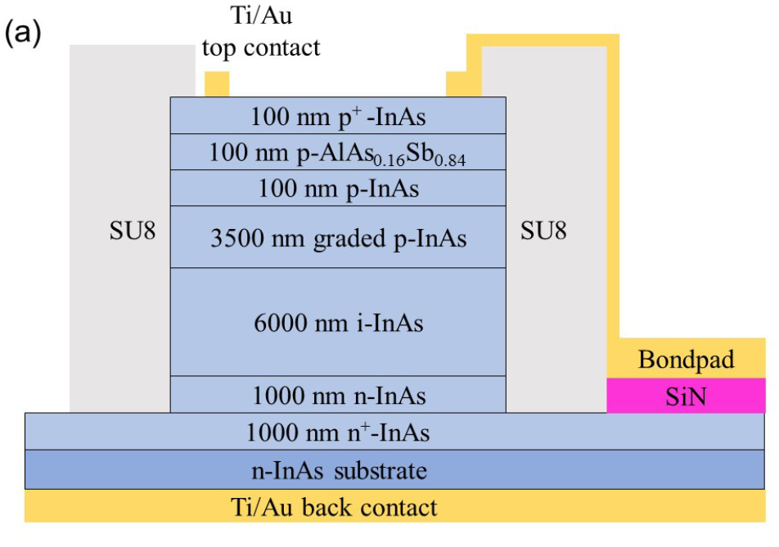
InAs Design with AlAsSb Barrier Layer
Layer | Material | Thickness | Doping | Objective
1 | InAs | 20 nm | P+, 1e19 | Low Ohmic Resistance
2 | AlAs_{0.16}Sb_{0.84} | 100 nm (baseline) (50, 150, 200 test thicknesses) | P, (doping study: 1e16 undoped, 5e16, 1e17, 1e18, 5e18) | Barrier Layer – Suppress electron diffusion current ~1.22eV
3 | InAs | 100 nm | P, 1e18 | Suppress dark current
4 | InAs | 3500 nm | P, 1e18→1e16 | Linearly grading layer, thickness to ensure pure electron injection, prevent breakdown
5 | InAs | 6000 nm | UID | Suppress tunneling and achieve high avalanche gain
6 | InAs | 1000 nm | N, 1e16 (1e17, 1e18) | Reduce hole diffusion current
7 | InAs | 1000 nm | N+, 1e19 | Reduce hole diffusion current
Reduce dark current to increase gains and increase operating temperatures
Thick multiplication region
Low background doping
Grading structure to reduce peak electric field
Tan CH, Velichko A, Lim LW, Ng JS. Few-photon detection using InAs avalanche photodiodes. Opt Express. 2019 Feb 18;27(4):5835-5842. doi: 10.1364/OE.27.005835. PMID: 30876178.

Slide 6
InAs Barrier Structure Current-Voltage Measurement

Slide 7
Planar Structure and Diffusion
Diffusant: Zn
Diffusing medium: ZnO
Diffusion Process through thermal annealing
Pros | Cons
Eliminate surface leakage current High gain (>100) | Diffusion/Implantation optimization

Slide 8
Summary
InAs is a material system of interest for 2 µm APDs
The primary driver of dark current in InAs APDs is surface leakage and can be reduced through barrier engineering and planar structures
AFRL and OSU are working in collaboration on optimizing the diffusion process for InAs APDs

Slide 9
References (Noise comparison)
[1] Rockwell, A. K., Ren, M., Woodson, M., Jones, A. H., March, S. D., Tan, Y., Yuan, Y., Sun, Y., Hool, R., Maddox, S. J., Lee, M. L., Ghosh, A. W., Campbell, J. C. and Bank, S. R., “Toward deterministic construction of low noise avalanche photodetector materials,” Appl. Phys. Lett. 113(10), 102106 (2018)
[2] Goh, Y. L., Ng, J. S., Tan, C. H., Ng, W. K. and David, J. P. R., “Excess noise measurement in In0.53Ga0.47As,” IEEE Photonics Technol. Lett. 17(11), 2412–2414 (2005)
[3] Ng, J. S., Tan, C. H., David, J. P. R., Hill, G. and Rees, G. J., “Field dependence of impact ionization coefficients in In/sub 0_53/Ga/sub 0_47/As,” IEEE Trans. Electron Devices 50(4), 901–905 (2003).
[4] Hwang, S., Shim, J. and Yoo, K., “A 10-Gb/s planar InGaAs/InP avalanche photodiode with a thin multiplication layer fabricated by using recess-etching and single-diffusion processes,” J. Korean Phys. Soc. 49(1), 253–260 (2006)
[5] Zhao, Y. and He, S., “The experimental investigation on dark current for InGaAs–InP avalanche photodiodes,” Microelectron. Eng. 98, 19–23 (2012).
[6] Woodson, M. E., Ren, M., Maddox, S. J., Chen, Y., Bank, S. R. and Campbell, J. C., “Low-noise AlInAsSb avalanche photodiode,” Appl. Phys. Lett. 108(8), 081102 (2016)
[7] Cook, L. W., Bulman, G. E. and Stillman, G. E., “Electron and hole impact ionization coefficients in InP determined by photomultiplication measurements,” Appl. Phys. Lett. 40(7), 589–591 (1982).
[8] Li, N., Sidhu, R., Li, X., Ma, F., Zheng, X., Wang, S., Karve, G., Demiguel, S., Holmes, A. L. and Campbell, J. C., “InGaAs/InAlAs avalanche photodiode with undepleted absorber,” Appl. Phys. Lett. 82(13), 2175–2177 (2003).
[9] Yuan, Y., Zheng, J., Tan, Y., Peng, Y., Rockwell, A.-K., Bank, S. R., Ghosh, A. and Campbell, J. C., “Temperature dependence of the ionization coefficients of InAlAs and AlGaAs digital alloys,” Photon. Res., PRJ 6(8), 794–799 (2018).
[10] Zheng, X. G., Hsu, J., Hurst, J. B., Li, X., Wang, S., Sun, X., Holmes, A. L., Campbell, J. C., Huntington, A. S. and Coldren, L. A., “Long-wavelength In/sub 0.53/Ga/sub 0.47/As-In/sub 0.52/Al/sub 0.48/As large-area avalanche photodiodes and arrays,” IEEE J. Quantum Electron. 40(8), 1068–1073 (2004).
[11] M. E. Woodson, M. Ren, S. J. Maddox, Y. Chen, S. R. Bank, and J. C. Campbell, “Low-noise AlInAsSb avalanche photodiode,” Appl. Phys. Lett., vol. 108, no. 8, p. 081102, Feb. 2016, doi: 10.1063/1.4942372.
[12] Zheng, J., Yuan, Y., Tan, Y., Peng, Y., Rockwell, A. K., Bank, S. R., Ghosh, A. W. and Campbell, J. C., “Digital Alloy InAlAs Avalanche Photodiodes,” J. Lightwave Technol., JLT 36(17), 3580–3585 (2018).
[13] Yi, X., Xie, S., Liang, B., Lim, L. W., Cheong, J. S., Debnath, M. C., Huffaker, D. L., Tan, C. H. and David, J. P. R., “Extremely low excess noise and high sensitivity AlAs0.56Sb0.44 avalanche photodiodes,” Nature Photonics 13(10), 683–686 (2019).
[14] Y. Kang et al., “Epitaxially-grown Ge/Si avalanche photodiodes for 1.3 μm light detection,” Opt. Express, vol. 16, no. 13, pp. 9365–9371, 2008, [Online]. Available: https://www.osapublishing.org/abstract.cfm?uri=oe-16-13-9365
[15] H.-D. Liu et al., “Avalanche photodiode punch-through gain determination through excess noise analysis,” J. Appl. Phys., vol. 106, no. 6, p. 064507, Sep. 2009, doi: 10.1063/1.3226659.
[16] Lee, S., Winslow, M., Grein, C. H., Kodati, S. H., Jones, A. H., Fink, D. R., Das, P., Hayat, M. M., Ronningen, T. J., Campbell, J. C. and Krishna, S., “Engineering of impact ionization characteristics in In0.53Ga0.47As/Al0.48In0.52As superlattice avalanche photodiodes on InP substrate,” Scientific Reports 10(16735) (2020).
[17] W. Sun et al., “High-Gain InAs Avalanche Photodiodes,” IEEE J. Quantum Electron., vol. 49, no. 2, pp. 154–161, Feb. 2013, doi: 10.1109/JQE.2012.2233462.
[18] W. Sun, S. J. Maddox, S. R. Bank, and J. C. Campbell, “Record high gain from InAs avalanche photodiodes at room temperature,” in 72nd Device Research Conference, Jun. 2014, pp. 47–48. doi: 10.1109/DRC.2014.6872293.
[19] S. D. March, A. H. Jones, J. C. Campbell, and S. R. Bank, “Multistep staircase avalanche photodiodes with extremely low noise and deterministic amplification,” Nat. Photonics, vol. 15, no. 6, pp. 468–474, May 2021, doi: 10.1038/s41566-021-00814-x.
[20] O. Gravrand et al., “HgCdTe detectors for space and science imaging: General issues and latest achievements,” J. Electron. Mater., vol. 45, no. 9, pp. 4532–4541, Sep. 2016.
[21] S. Lee et al., “Low noise Al0.85Ga0.15As0.56Sb0.44 avalanche photodiodes on InP substrates,” Appl. Phys. Lett., vol. 118, no. 8, p. 081106, Feb. 2021, doi: 10.1063/5.0035571.
[22]S. H. Kodati et al., “AlInAsSb avalanche photodiodes on InP substrates,” Appl. Phys. Lett., vol. 118, no. 9, p. 091101, Mar. 2021, doi: 10.1063/5.0039399.

