Slide 1




AN EXPERIMENTAL INVESTIGATION INTO THE EFFECTS OF INLET SWIRL ON THE COMPRESSION SYSTEM OF A JET ENGINE
Student:
Student Email:
Faculty:
Faculty Email:
AFRL Sponsor:
AFRL Directorate:
Marcus Acton
acton.12@wright.edu
Dr. Mitch Wolff
mitch.wolff@wright.edu
Dr. Mike List
RQ – Aerospace Systems
PA #:
AFRL-2022-5435
Distribution Statement A: Approved for Public Release; Distribution is unlimited.

Slide 2
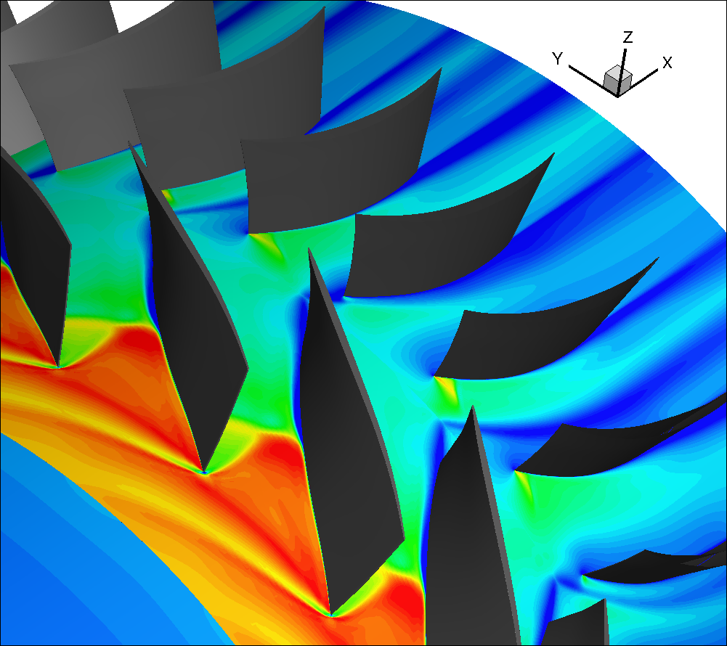
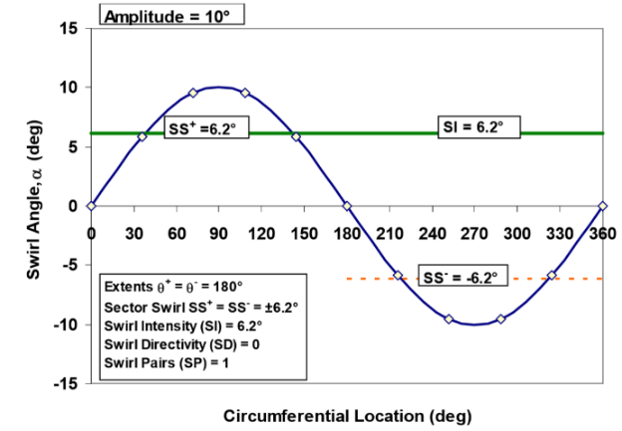
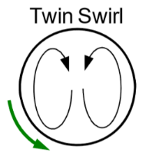

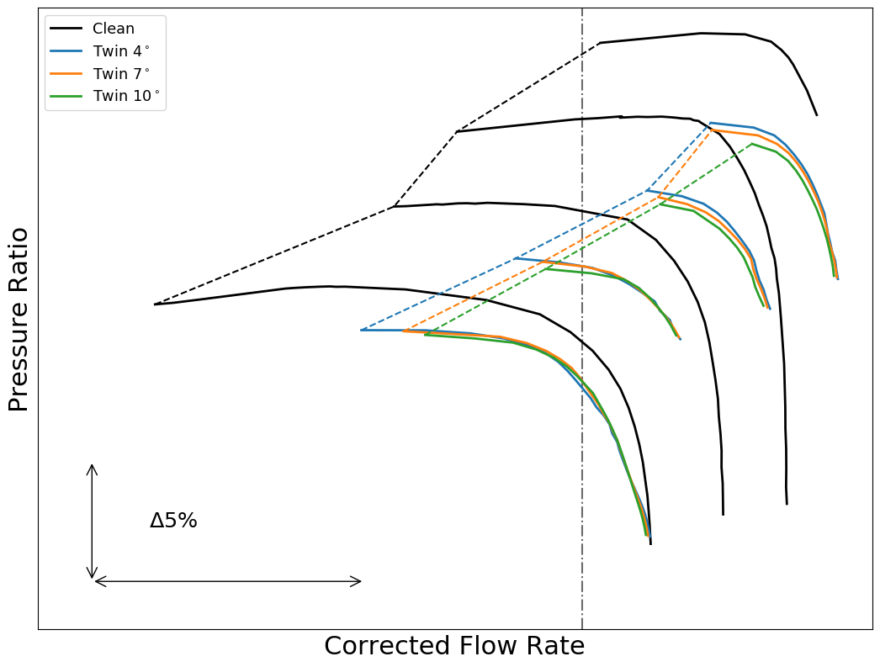
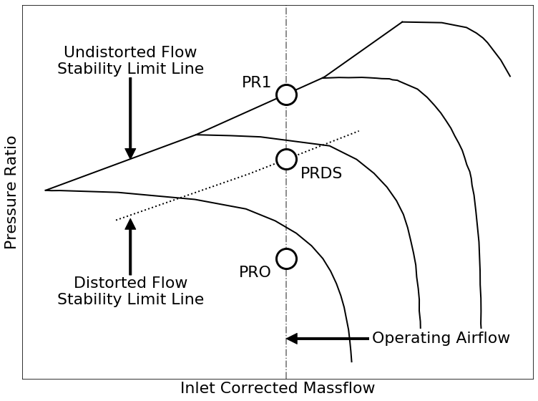
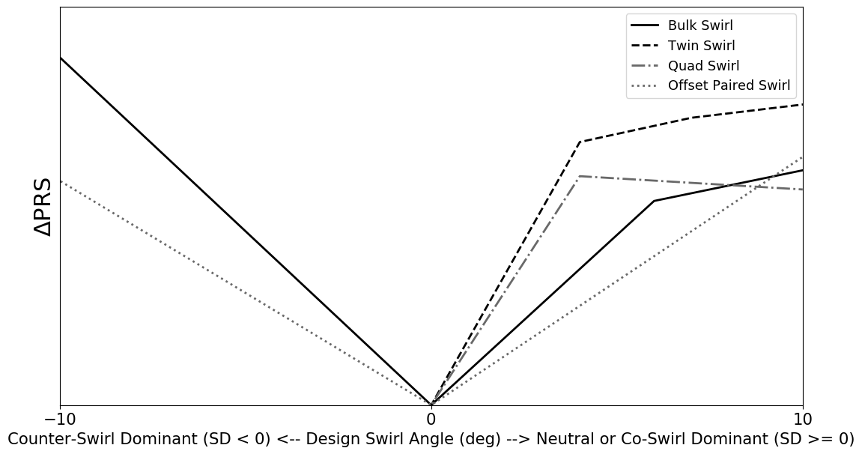
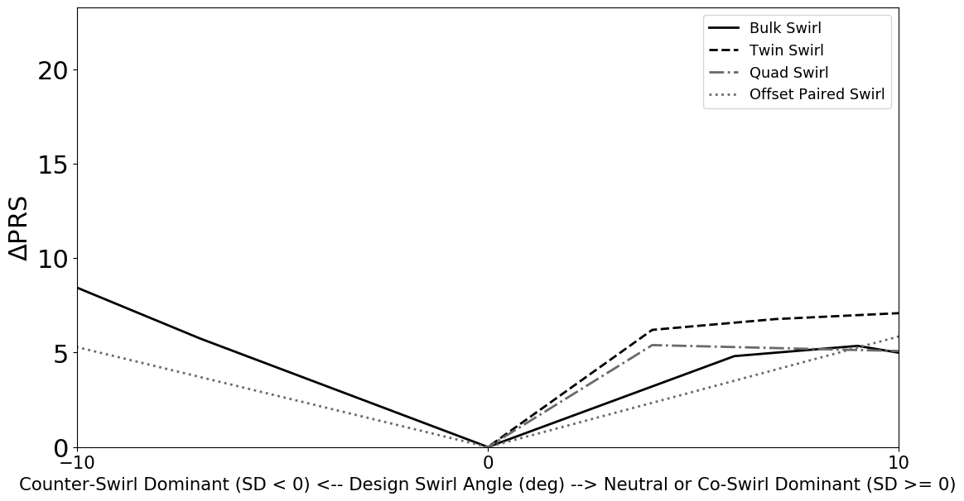
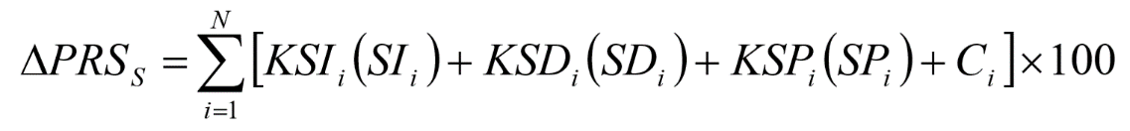
S-16 Swirl Methodology
Computational Work
Simulate multiple speedlines to generate the stability pressure ratio loss data for each swirl pattern. The patterns include multiple strength bulk swirls and twin swirls along with offset and partial extent paired swirls. Each pattern was simulated in ADS Code Leo, a finite-volume RANS solver designed for turbomachinery. The Frozen Rotor simulation (top figure) provided a good approximation of the resulting pressure ratio. Multiple simulations were ran to generate speedlines (middle figure). The speedlines were compared to the clean inlet to determine the loss for each pattern (bottom figure).
Describe swirl patterns with S-16 swirl descriptors
Collect fan stability pressure ratio data
Determine descriptor sensitivities by matching experimental data to S-16 recommended equation including stability loss from total-pressure
PA #:
AFRL-2022-5435
Distribution Statement A: Approved for Public Release; Distribution is unlimited.

Slide 3
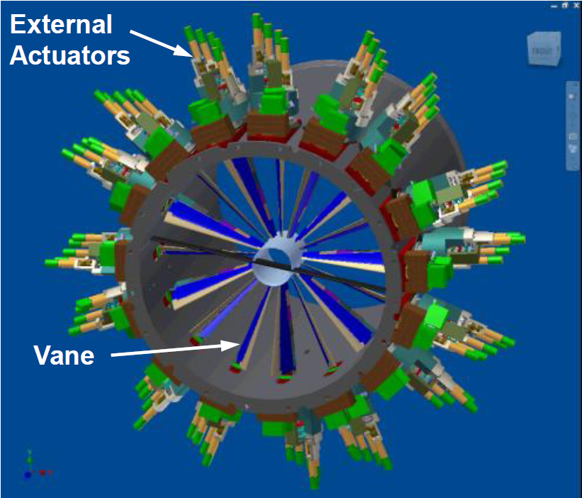
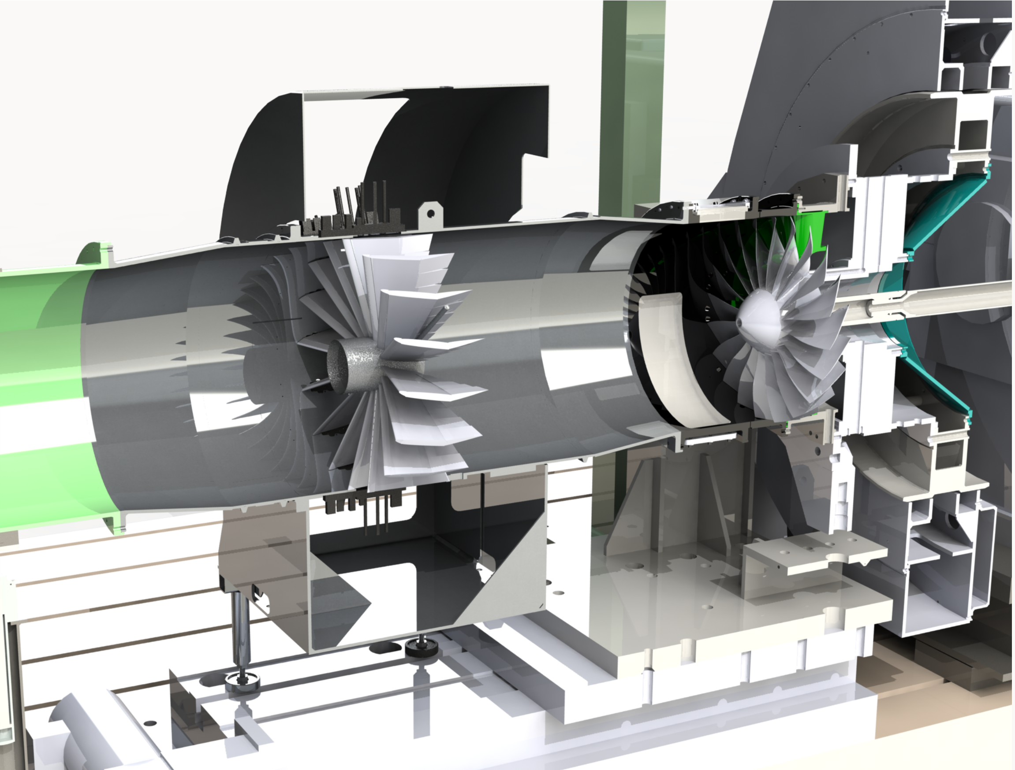
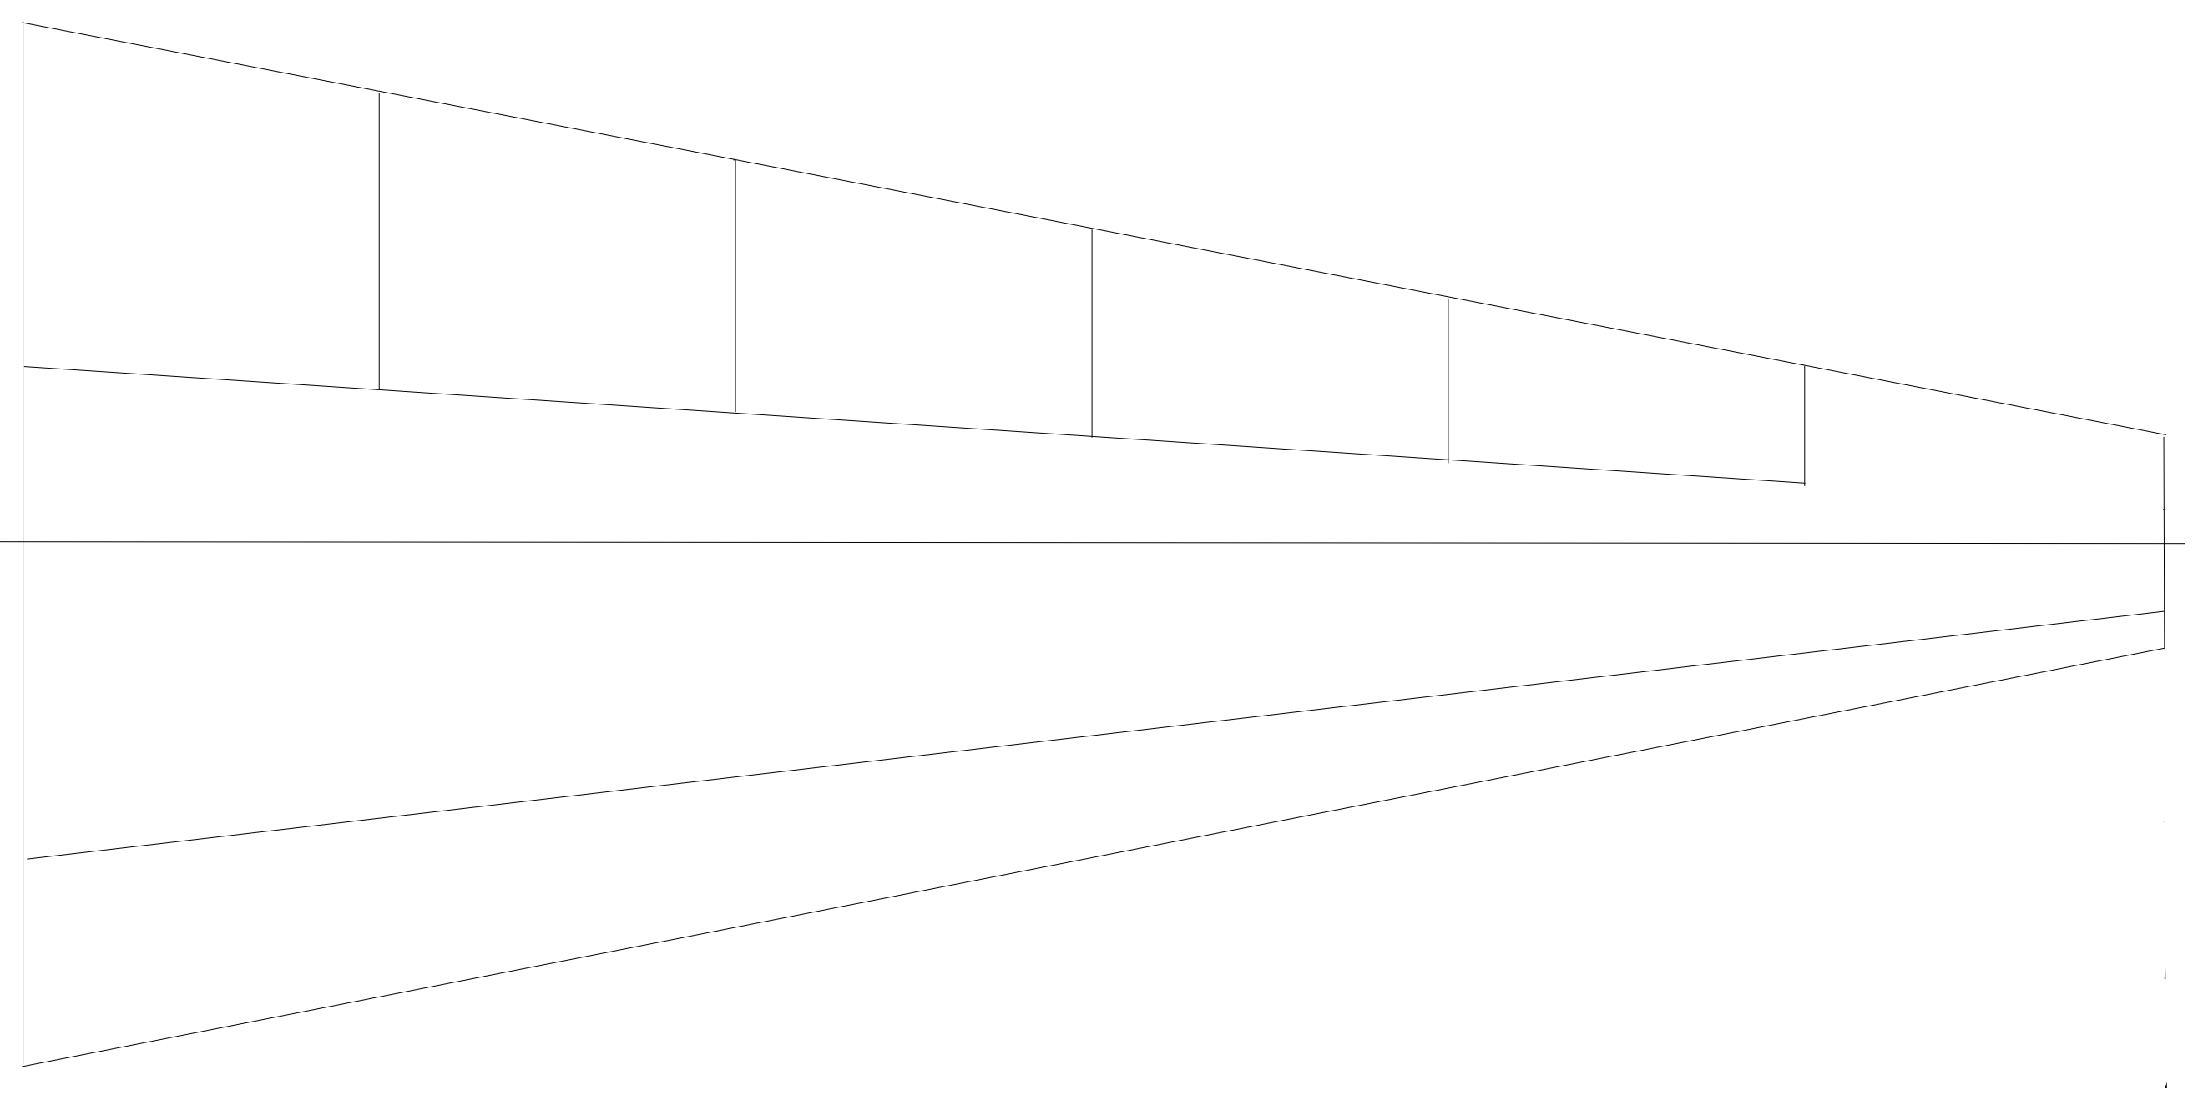
Swirl Generator
The swirl patterns will ultimately be placed in front of an engine fan. To generate the swirl patterns, a swirl generator is needed. The swirl generator used (right top figure) was made by AEDC for use on a F109 engine. The generator has 16 independent turning vanes with 5 independently controlled trailing edge flaps and an adjustable leading edge (right bottom figure). The swirl generator is capable of producing bulk swirls in the +/- 32-degree range and twin swirls in the +/- 20-degree range. The generator will also produce the offset and partial extent paired swirls needed.
To measure the stability pressure ratio loss, the swirl generator will operate in front of a fan housed in the AFRL CARL Compressor Facility (left figure). The Compressor Facility houses a high-speed, transonic fan staged attached to a 6,000hp motor capable of 4,500-22,500rpm.
Trailing edge
Airflow
Leading edge
PA #:
AFRL-2022-5435
Distribution Statement A: Approved for Public Release; Distribution is unlimited.

Slide 4
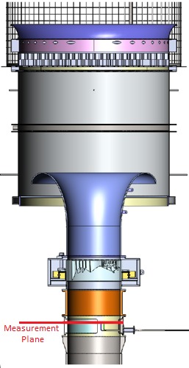
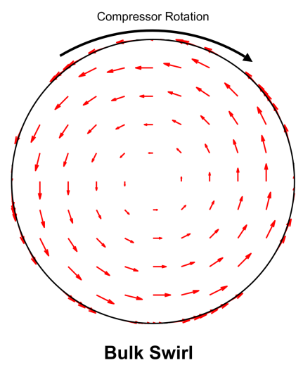

ACF
Calibrating in the CARL Facility
The Swirl Generator is first calibrated on the Annular Cascade Facility (ACF). The ACF is a vertical inflow facility capable of drawing 70 lbm/s air that has been used for research relating to airframe-propulsion integration*. Calibrating the vane and flap movements to the swirl distortion generated allows for a more precise movement to produce a required swirl distortion (i.e. and 10-deg movement does not necessarily mean a 10-deg swirl). The swirl angle measurements are made using a 5-hole probe. The 5-hole probe compares 5 pressure taps located around the head of the probe to calculate the speed and the angularity of the incoming flow. The 5-hole probe is then traversed to different depths into the flow to produce a view of the entire pattern at the measurement plane.
In-Flow
Flow-Conditioning
Barrel
Bulk Swirl List
A design of experiments is used to determine the patterns for calibration. The experimentation requires the full range of the swirl generator including both positive and negative bulk swirls. With the capability of both vane and flap movements, measuring the effect of each as well as in combination is critical. Various degree movements, both positive and negative, between zero and 20 degrees, with both vane-only movements and vane-flap movements are needed.
5-Hole Probe
*Facility Factsheet: Compressor Aero Research Lab (CARL), Air Force Research Laboratory, Wright-Patterson Air Force
Base, Dayton, OH, retrieved 16 May 2020.
PA #:
AFRL-2022-5435
Distribution Statement A: Approved for Public Release; Distribution is unlimited.

Slide 5
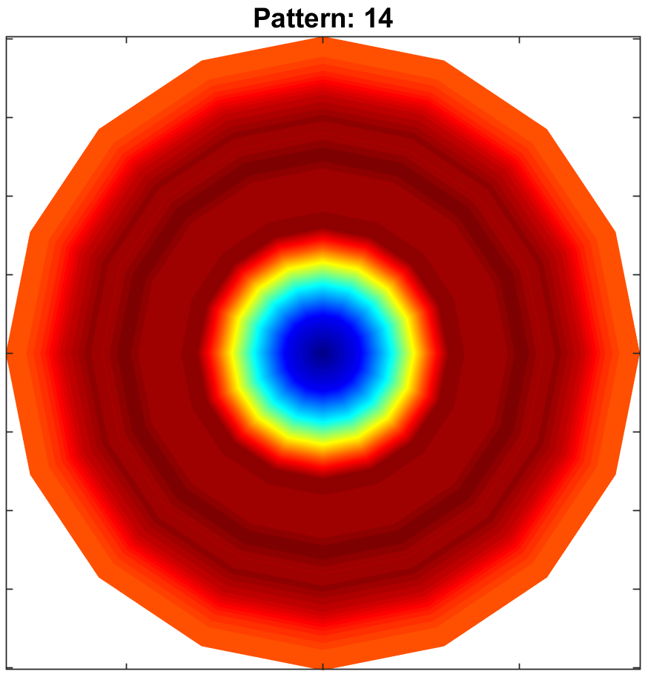
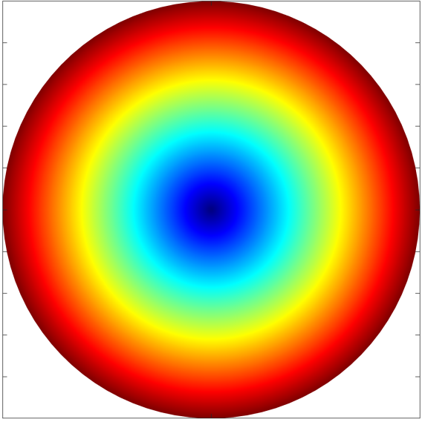
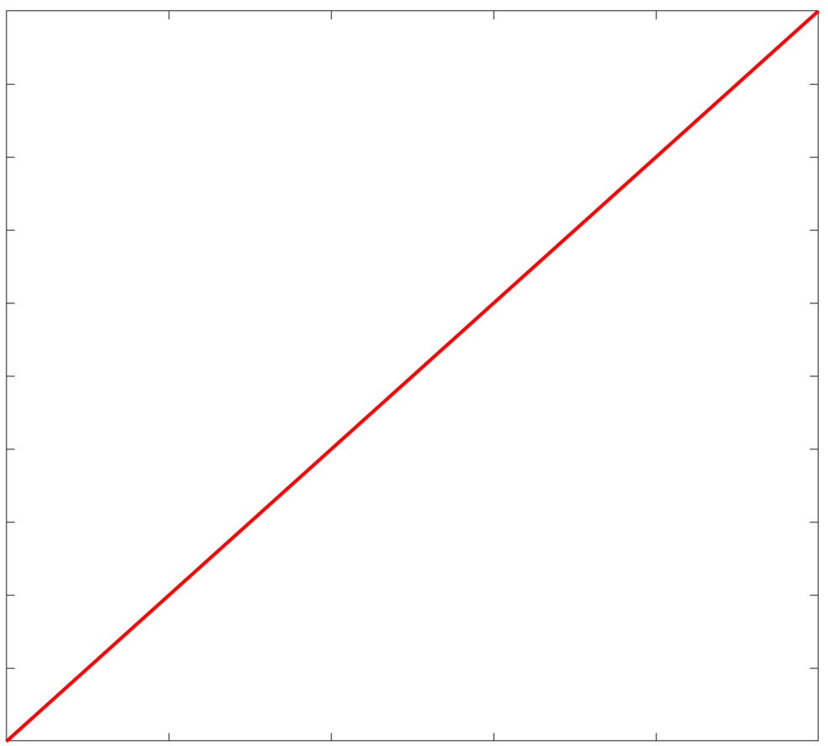
Bulk Swirl Result
The results of calibrating bulk swirl movements proved discouraging. The goal was to find a movement that was close to the ideal bulk swirl profile and was able to be scaled to different patterns. The closest match was Pattern 14. This pattern with maxed-out flap settings most closely matched the goal of 20-degrees of turning with the most “linear” profile. The profile is seen to have 3 parts, an expanded center region, constant max swirl angle, and decreasing boundary layer. These 3 regions are due to the area transition needed to combine the larger diameter Swirl Generator to the smaller CARL facility ducts.
Ideal Bulk Swirl
Ideal Bulk Swirl Profile
PA #:
AFRL-2022-5435
Distribution Statement A: Approved for Public Release; Distribution is unlimited.

Slide 6
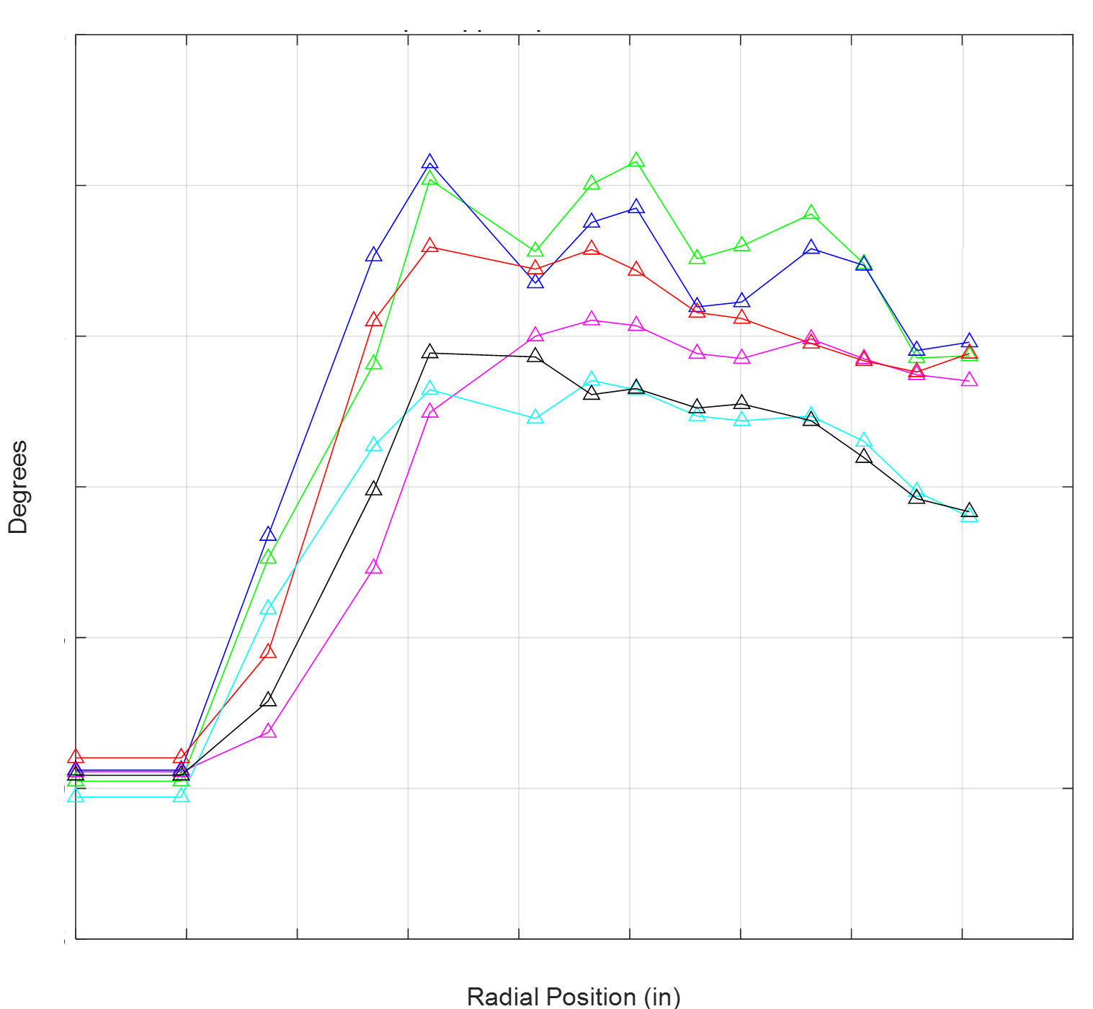
Mach Independence and Directivity Change
The bulk swirls were tested for Mach independence as well as Vane direction insensitivity. The plots of the same color represent the same bulk swirl pattern at different Mach number flows. Each set fairly agrees within its own set and can be concluded that the profiles are Mach independent within measurement error. The plots of different colors are the same vane setting magnitudes of different signs, one representing a positive swirl and the other representing the negative swirl. These values are within a couple of degree difference and fairly represent the other when the direction is taken into account. From this, it can be concluded that the opposite sign vane settings produce the opposite direction swirl.
Multiple Bulk Swirl Comparisons
To the left is a plot showing multiple bulk swirls ranging from 14-deg to 25-deg of turning. Pattern 4 from above is shown in black while Pattern 14 is shown in pink. This shows Pattern 14 increasing the furthest from center and remaining constant compared to other bulk swirls tested.
PA #:
AFRL-2022-5435
Distribution Statement A: Approved for Public Release; Distribution is unlimited.

Slide 7
Future Work
Calibrate more patterns including twin, partial extent, and offset swirls.
Characterize swirls by their swirl descriptors
Experimentation on Compressor Facility
Demonstrate the S-16 Swirl Methodology from collected data
Contact Information
Marcus Acton
acton.12@wright.edu
PA #:
AFRL-2022-5435
Distribution Statement A: Approved for Public Release; Distribution is unlimited.

