Slide 1
Ferroelectric Oxides For Neuromorphic Computing and Hardware Assurance
Student:
Student Email:
Faculty:
Faculty Email:
AFRL Sponsor:
AFRL Directorate:
Joshua Mayersky
mayersjd@mail.uc.edu
Dr. Rashmi Jha
jhari@ucmail.uc.edu
Dr. Amber Reed
AFRL/RX
PA #:
AFRL-2022-3269

Slide 2
Material Characterization – Methods
PA #:
AFRL-2022-3269
BTO was deposited via pulsed laser deposition.
10 mTorr O₂, 750 °C, with a 20 °C/min ramp.
Substrates used were single-side polished 5x5 mm² and 10x10 mm² Nb:STO wafers.
Sample | Pulse Counts | Laser Energy (mJ) | Annealing Type | Temp (°C) | Time (hr) | Annealing Environment
BTO 1 | 3000 | 300 | - | - | - | -
BTO 3 | 3000 | 300 | Post-deposition (film) | 850 | 0.5 | 100 Torr, O₂
BTO 4 | 3000 | 300 | Post-deposition (film) | 850 | 1 | 100 Torr, O₂
BTO 5 | 3000 | 300 | Post-deposition (film) | 850 | 2 | 100 Torr, O₂
BTO 6 | 1500 | 300 | Post-deposition (film) | 850 | 1 | 100 Torr, O₂
BTO 7 | 1000 | 300 | Post-deposition (film) | 850 | 1 | 100 Torr, O₂
BTO 8 | 3000 | 200 | Post-deposition (film) | 850 | 1 | 100 Torr, O₂
BTO 9 | 3000 | 150 | Post-deposition (film) | 850 | 1 | 100 Torr, O₂
Post deposition (film):
Increase O₂ flow rate to achieve desired pressure, then shut off.
Ramp up from 750 °C to 850 °C and hold.
Ramp back down to room temperature at 10 °C/minute.

Slide 3
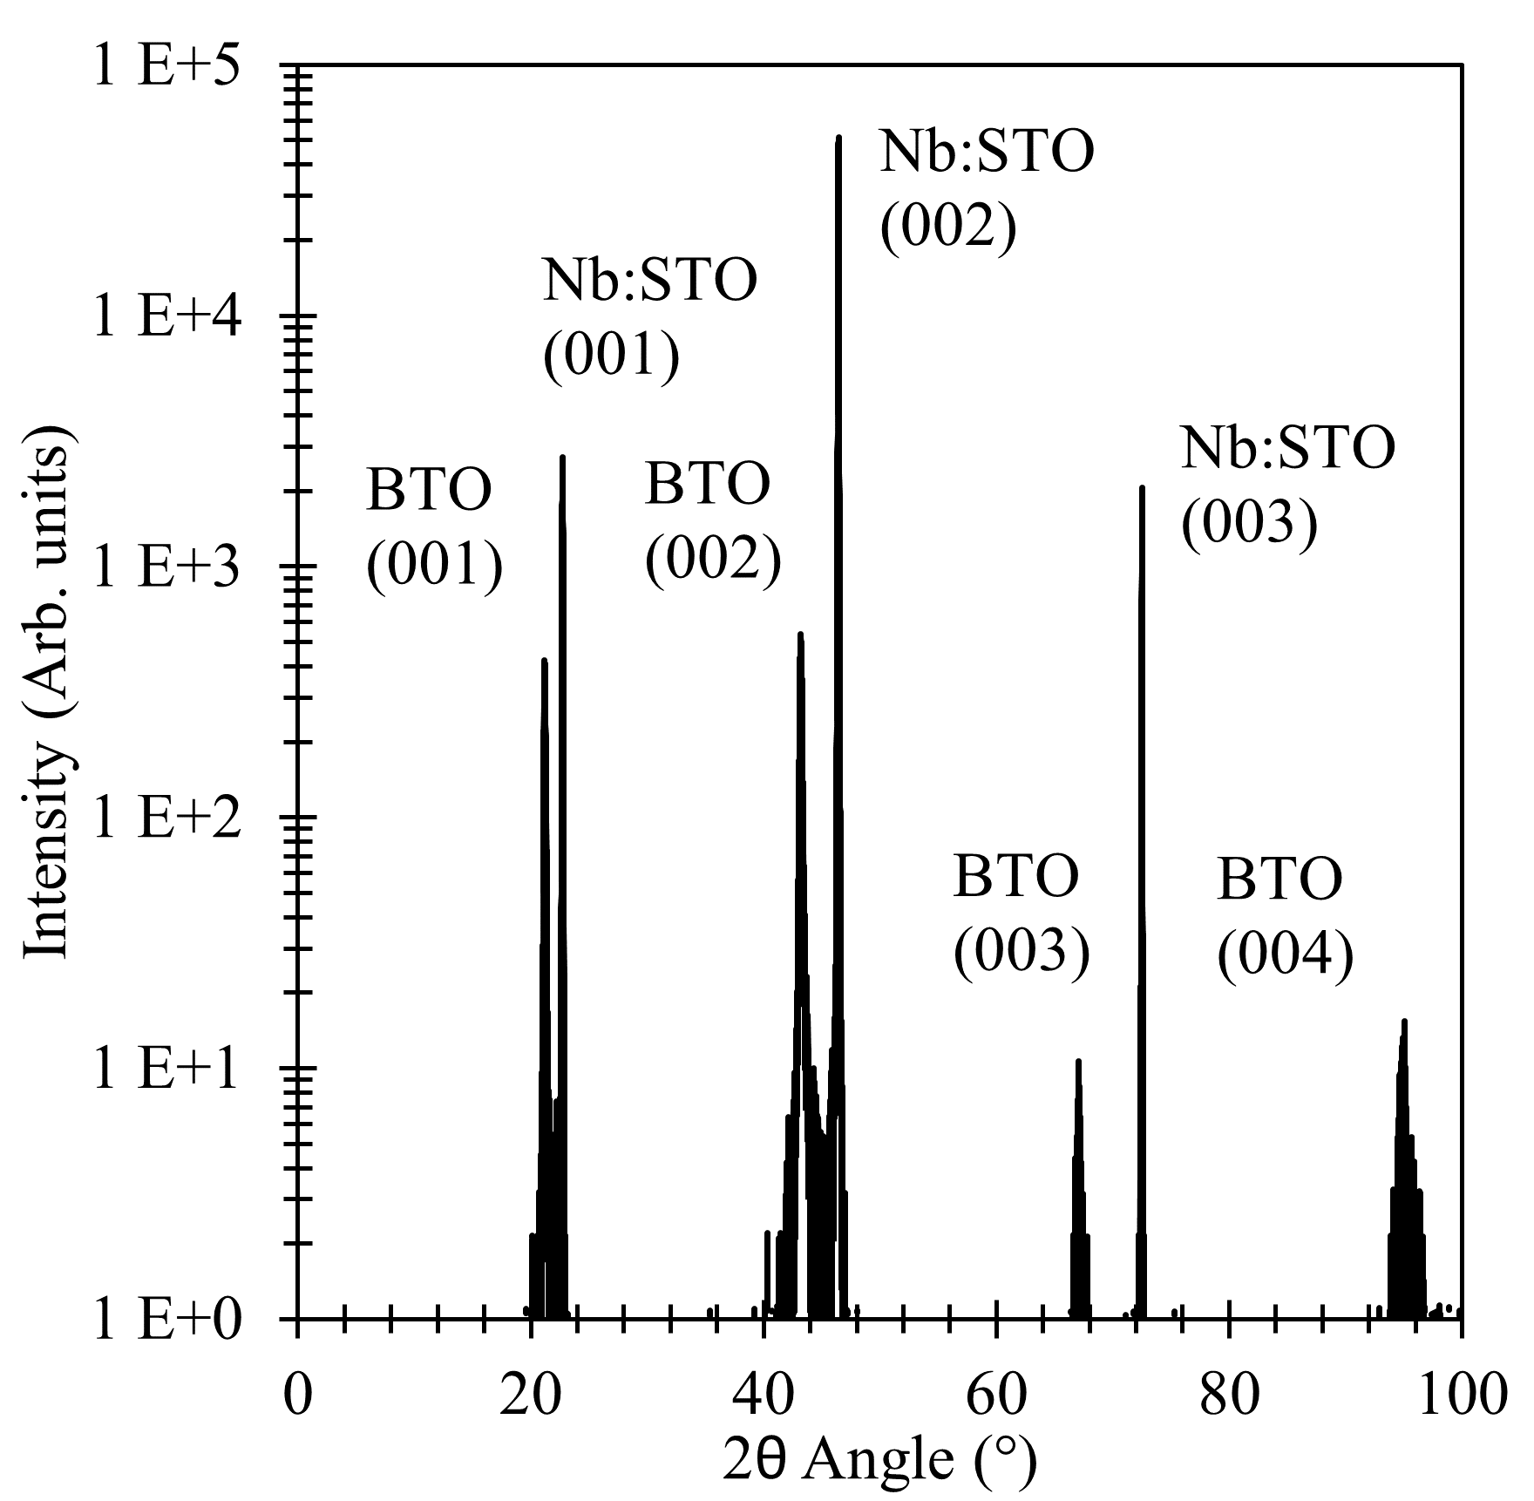
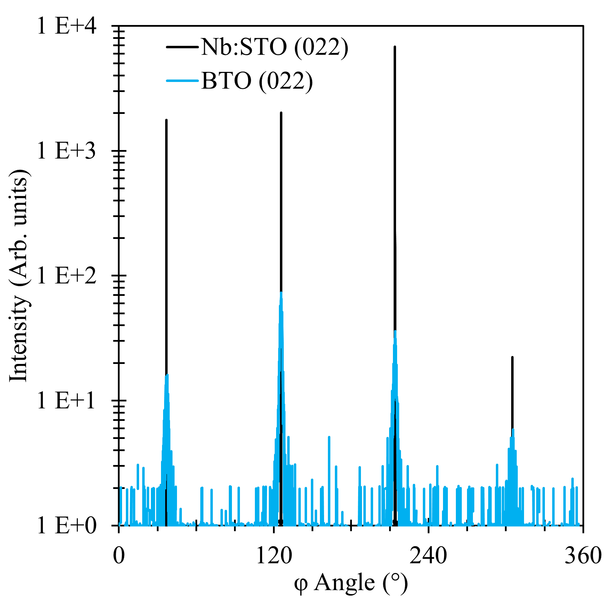
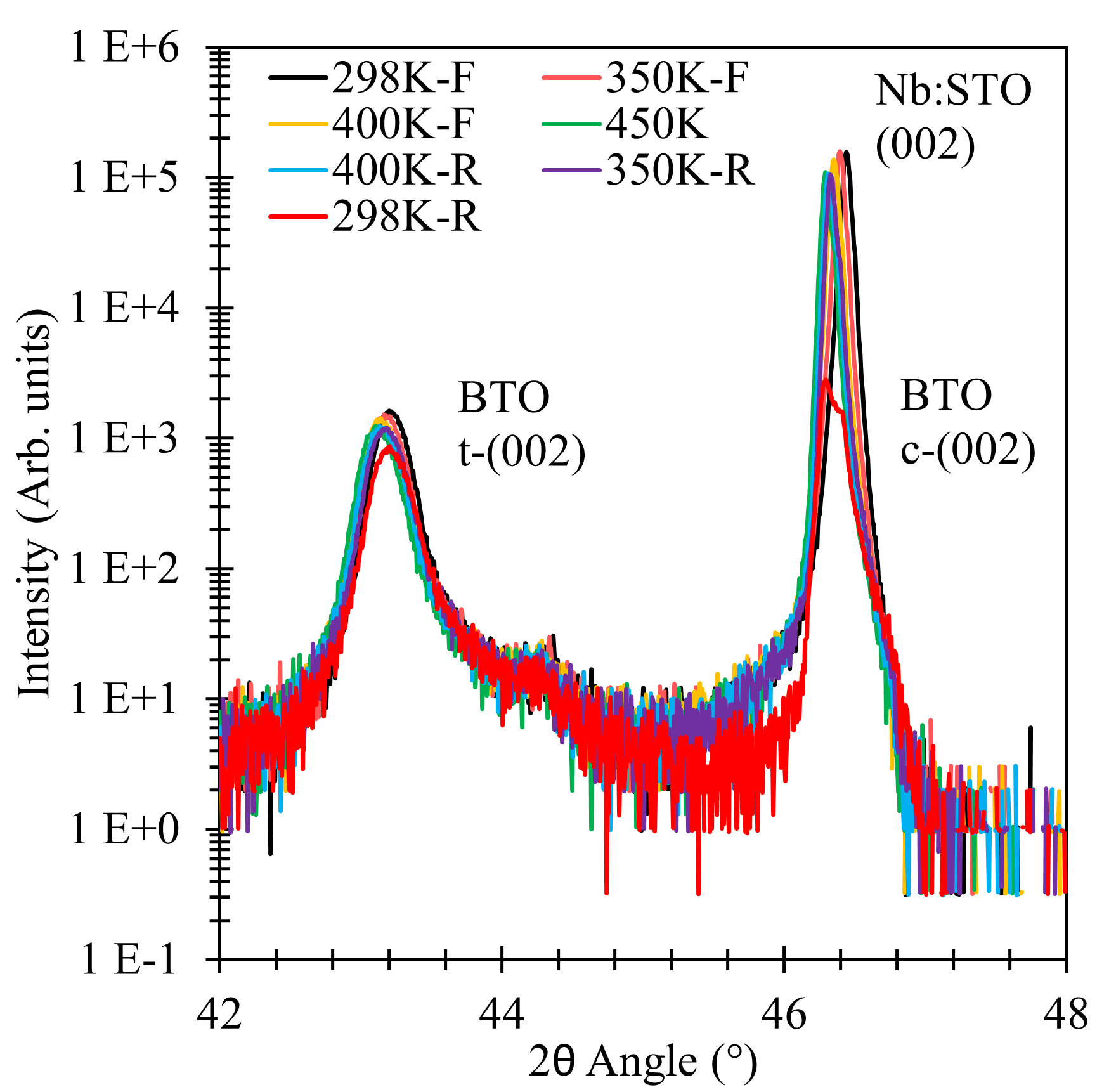
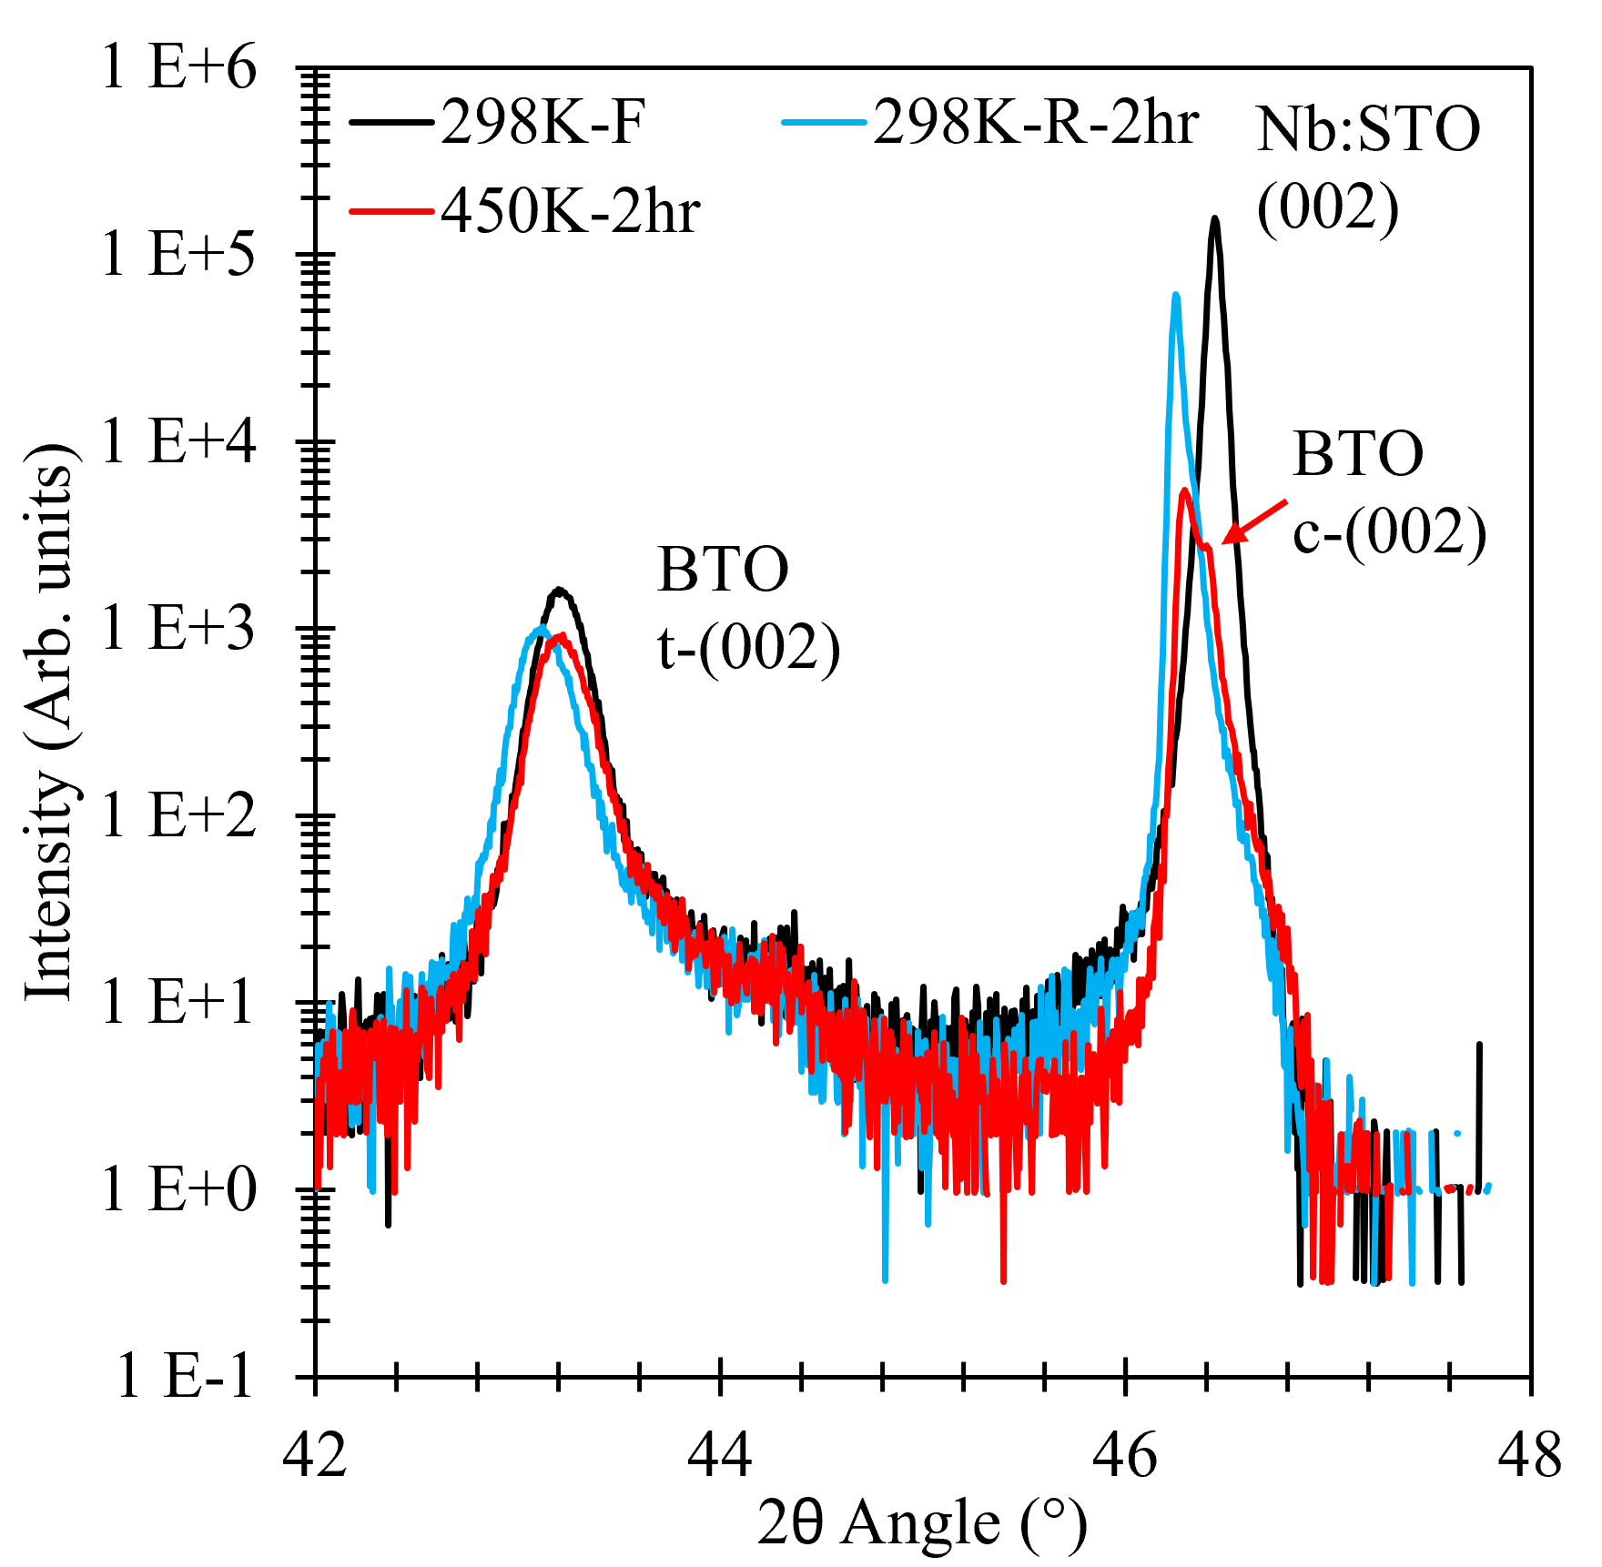
Material Characterization – XRD
PA #:
AFRL-2022-3269
5 minute hold times
120 minute hold times
BTO sample was subjected to coupled 2θ-ω scans, φ scans, and temperature dependent coupled 2θ-ω scans from RT to 450 K.
BTO and Nb:STO have a single out-of-plane orientation.
In-plane relationship between BTO and Nb:STO is [022]_{Film}/[022]_{Substrate} (single in-plane orientation).
In the temperature scans, the sample was heated/cooled to a set point at 10K/minute, held at the setpoint for either 5 minutes or 2 hours, the measurement made, then heated or cooled to the next set point. After reaching the maximum of 450 K, the sample was cooled back down to RT to observe any hysteresis.
Holding past the Curie temperature (~400K) for 2 hours begins to introduce cubic phase transition in coupled scans.

Slide 4
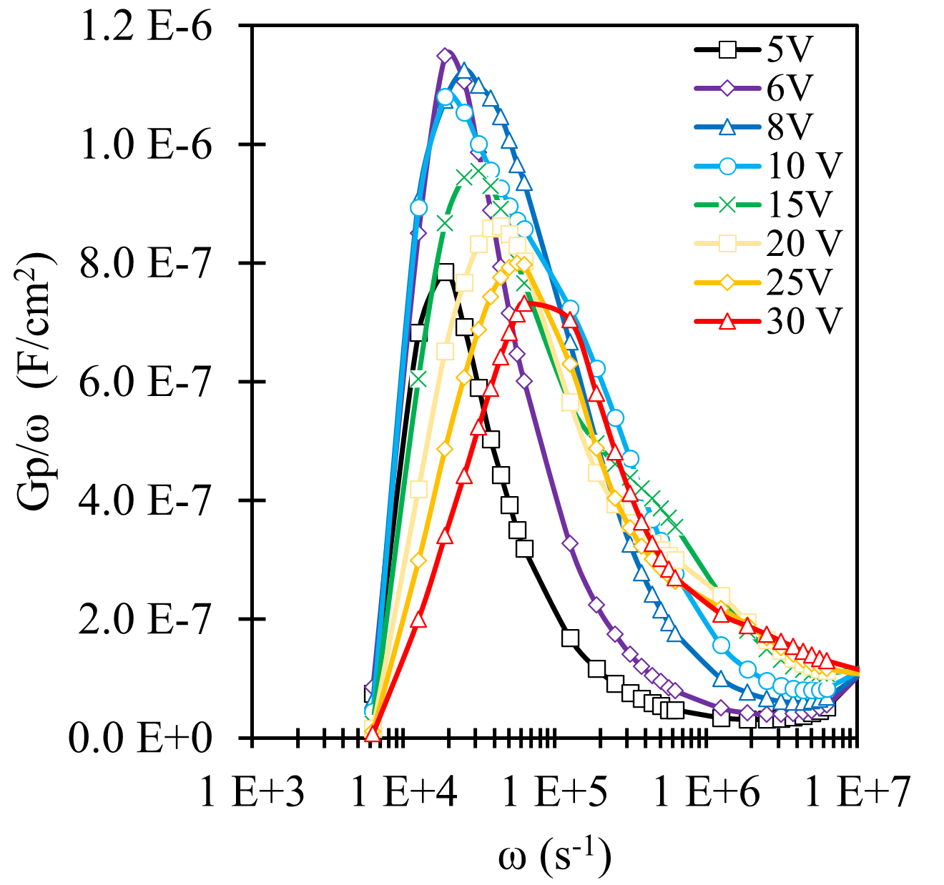
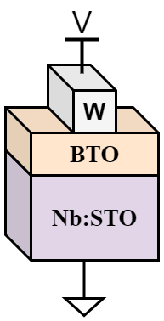
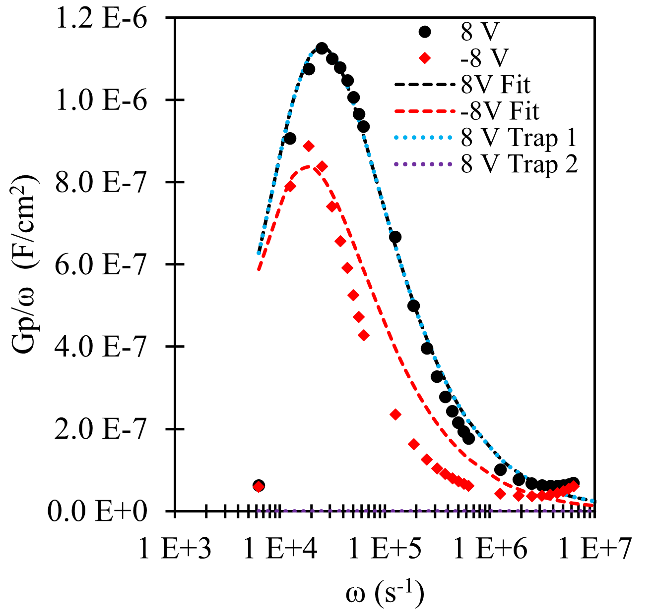
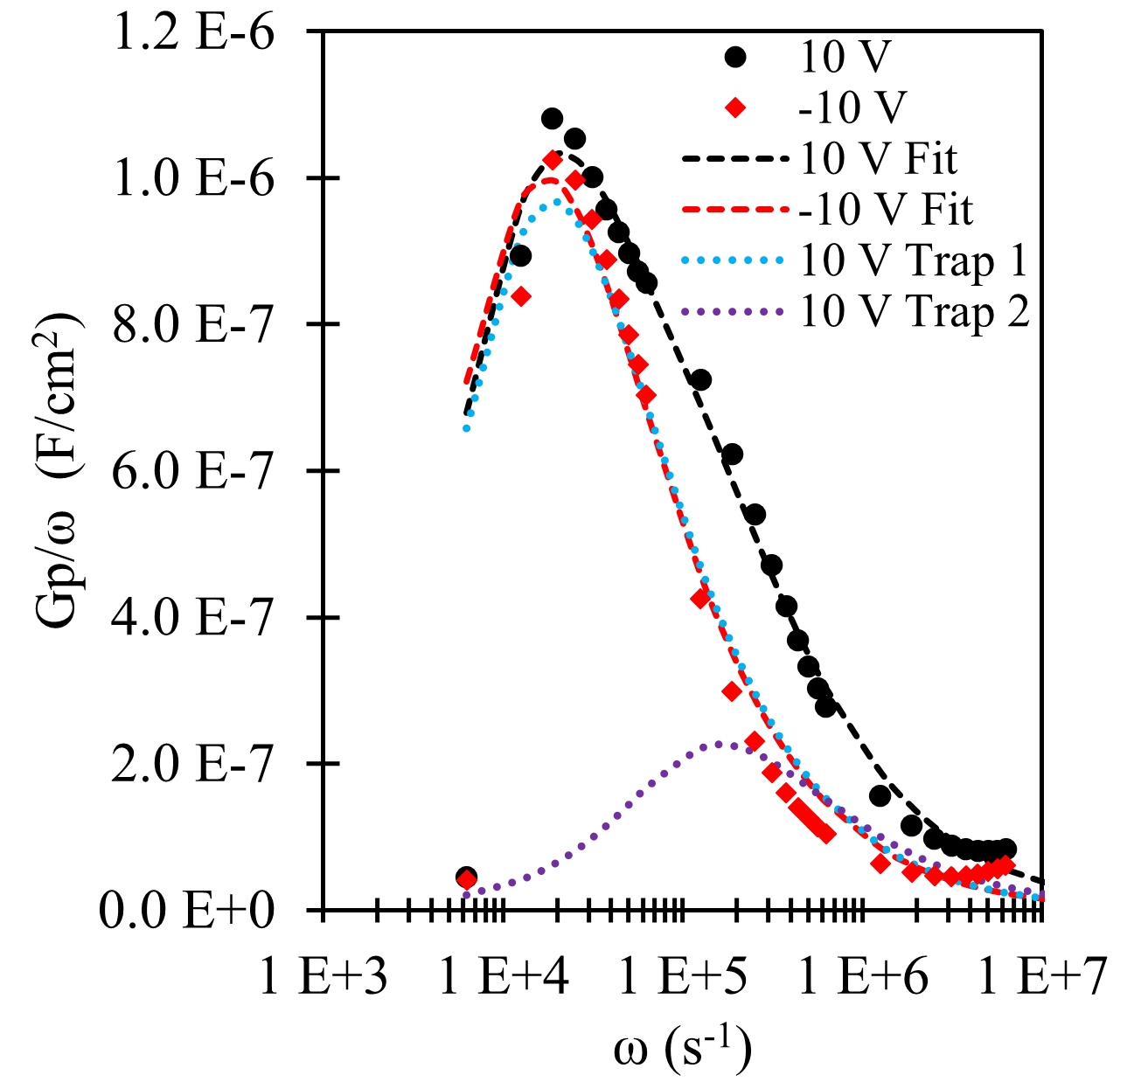
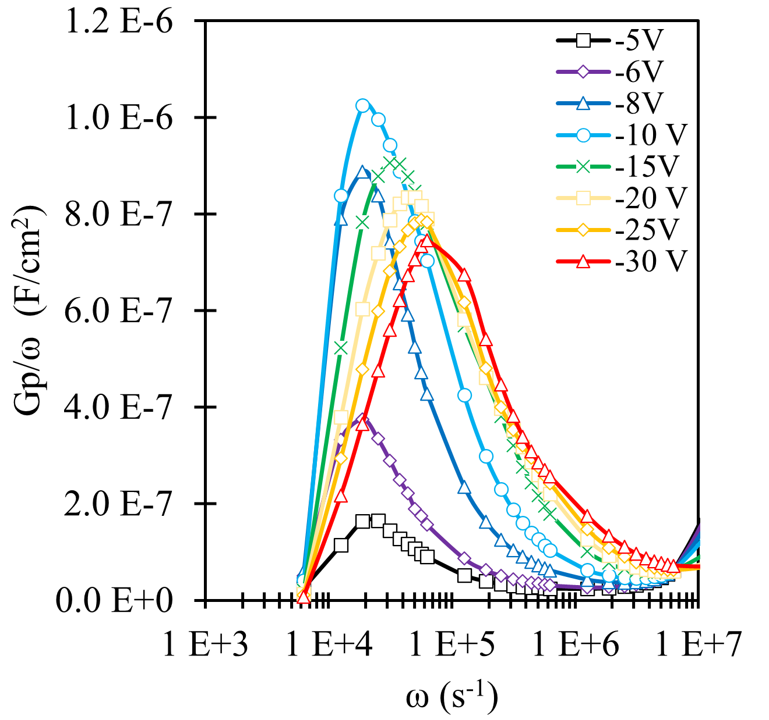
Material Characterization – Electrical
PA #:
AFRL-2022-3269
$$\frac{G_{P}}{ω}=\frac{ωG_{m}{C_{ox}}^{2}}{{G_{m}}^{2}+ω^{2}{(C_{ox}−C_{m})}^{2}}$$
Trap site at higher frequency is at the BTO/Nb:STO interface. Traps are distributed throughout the Nb:STO bandgap.
Lower frequency site is accumulated charge from trap assisted polarization switching
$$\frac{G_{P}}{ω}=\frac{qD_{T}}{2ωτ_{T}}ln⁡(1+{{(ωτ}_{T})}^{2}$$

Slide 5
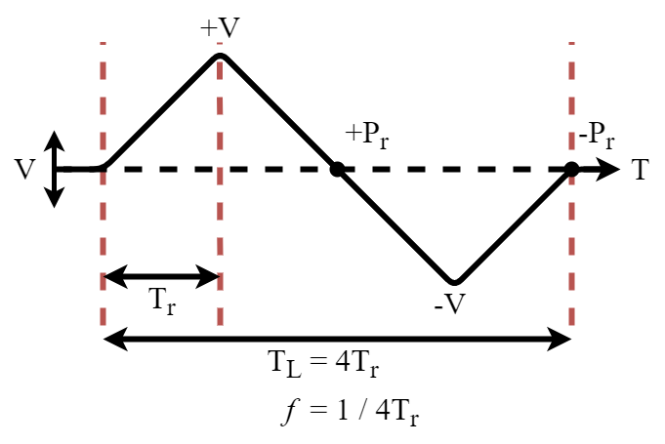
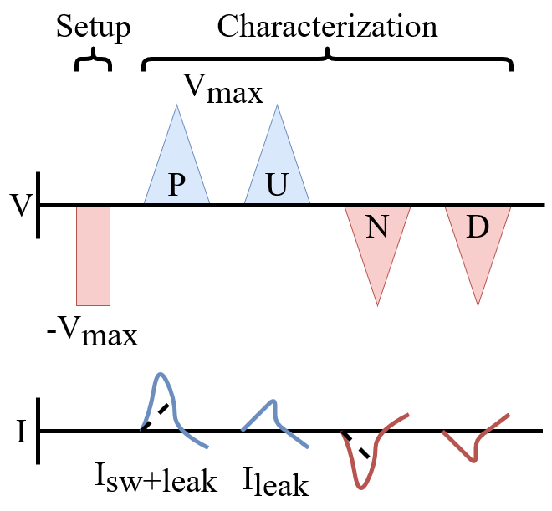
Material Characterization – Electrical
PA #:
AFRL-2022-3269
Devices can be characterized using a triangular hysteresis (HYS) sweep.
Polarization is calculated as the integration of current with respect to time
Double wave method (DWM) is used to eliminate non-ferroelectric switching contributions from the integrated current.
HYS
$$P=\int{J(t) dt}$$
DWM

Slide 6
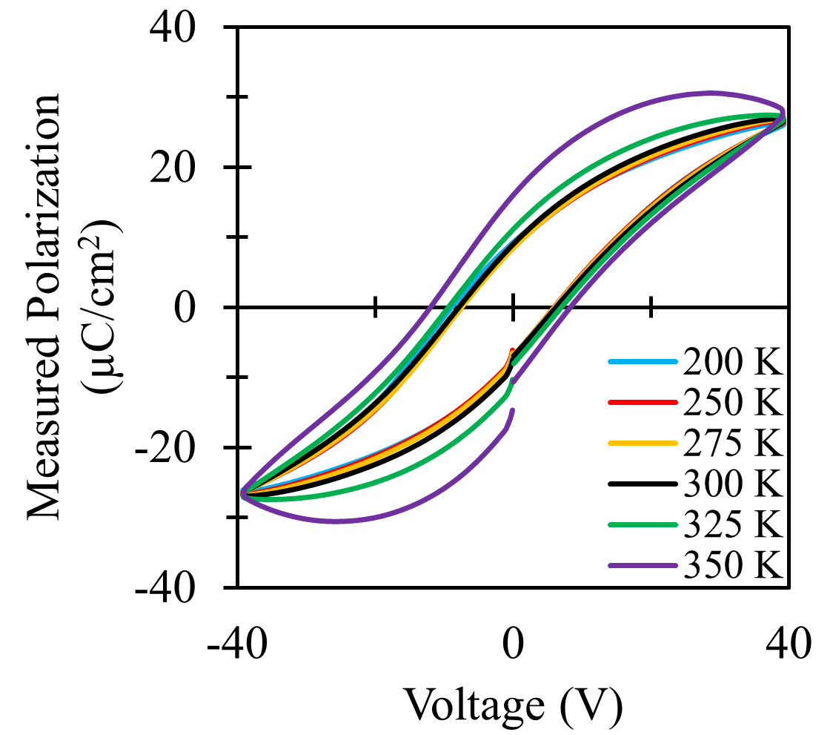
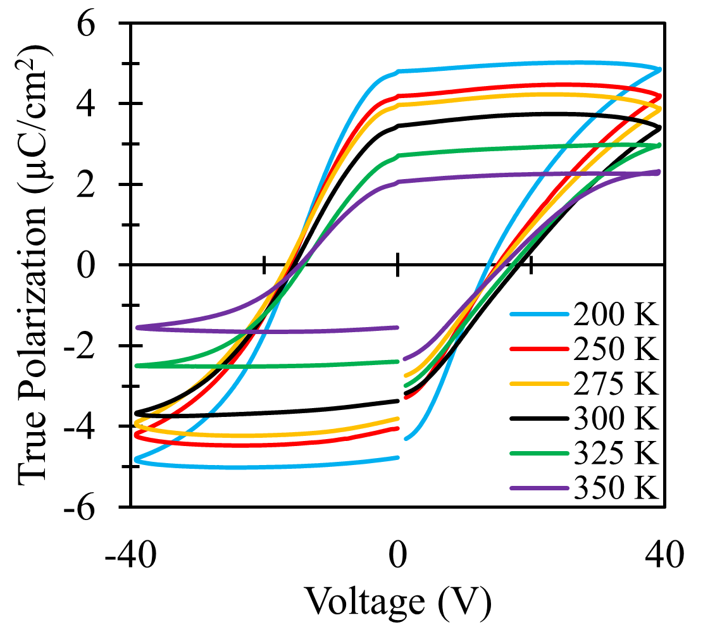
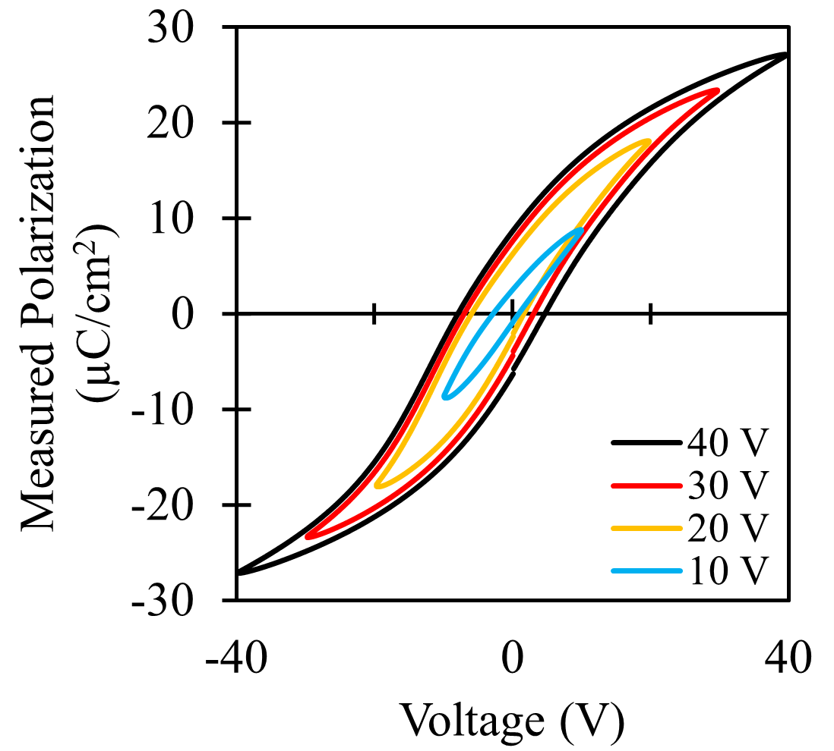
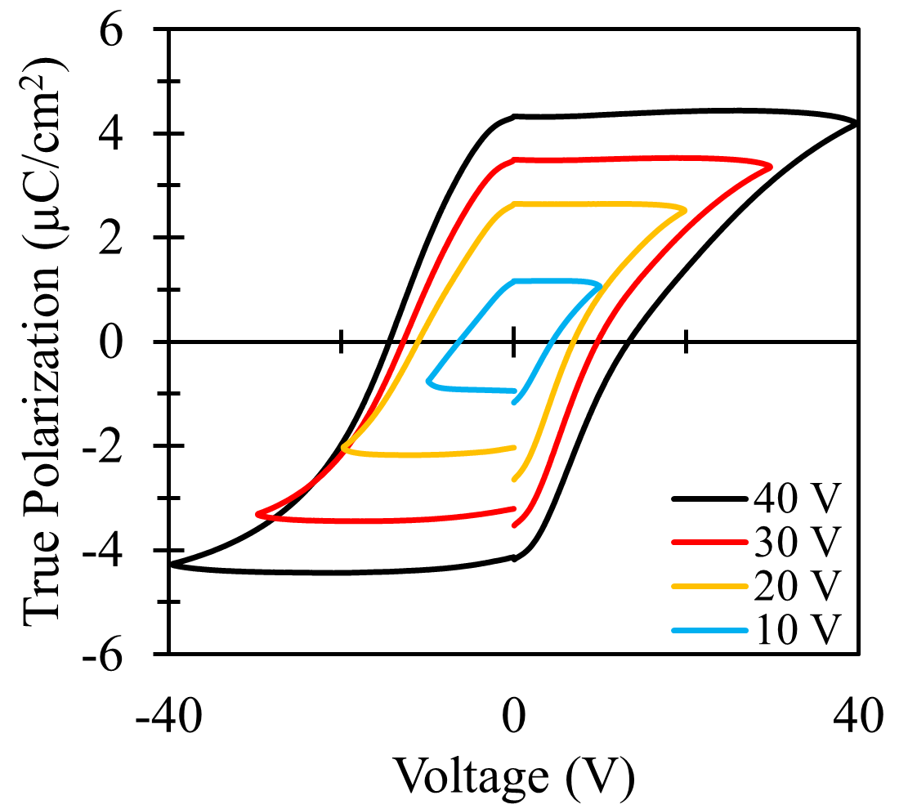
Material Characterization – Electrical
PA #:
AFRL-2022-3269
2 terminal measurements performed on 1 hour annealed, 3000 pulse counts, 300 mJ BTO sample.
Measured Polarization graphs are direct integrations using the HYS method.
True Polarization graphs use the DWM current integration.
Reduction of P_{R} with increasing temperature for true hysteresis.
Attributed to phase change of BTO as it approaches the curie temperature (393-403 K).
Trends in P_{r} reduction with decreasing biases remains the same with the DWM.
Indicative of multi-domain switching.

Slide 7
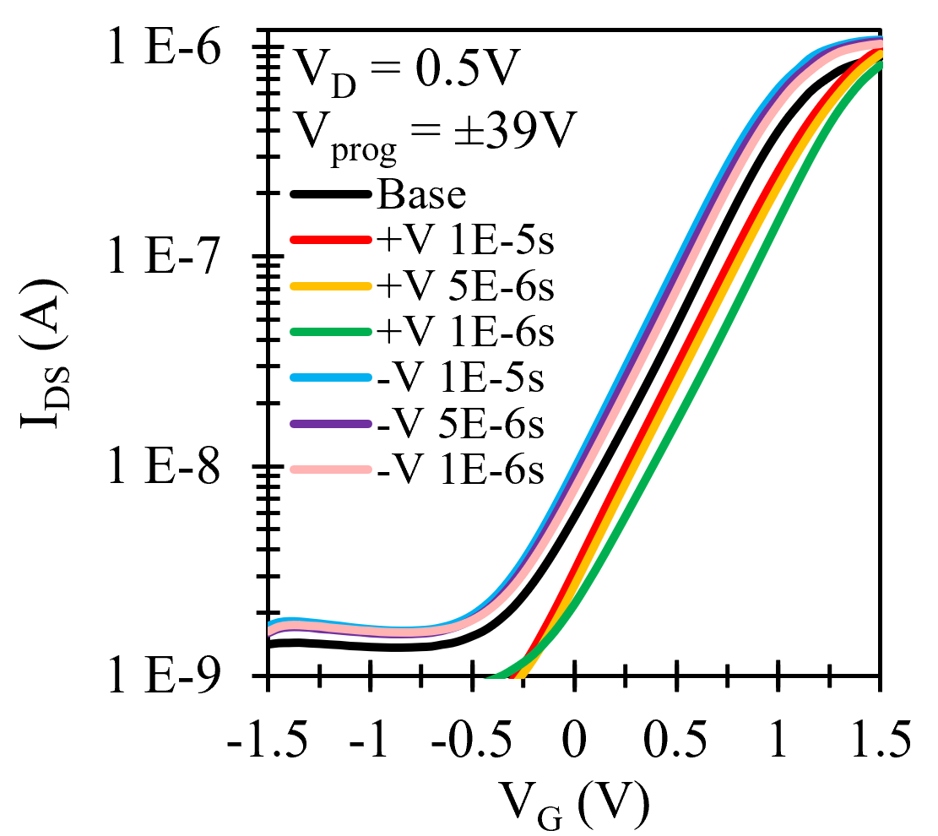
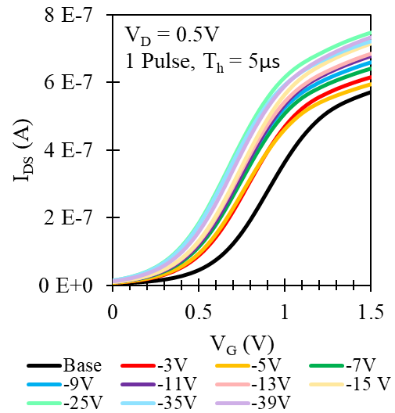
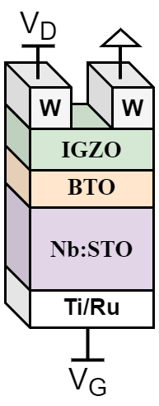
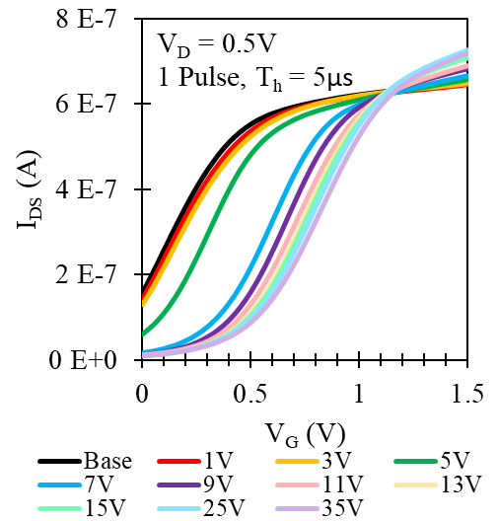
Material Characterization – Electrical
PA #:
AFRL-2022-3269
Baseline ID-VG measurements were taken by applying 10 pulses of 39 V (a) and -39 V (b), with a pulse length of 5 µs.
Subsequent programming biases were 1 pulse with a length of 5 µs.
Base curve (c) was measured after depolarizing the BTO using 30 triangular pulses of subsequently decreasing amplitude.
Subsequent programming biases were 1 pulse of increasing pulse length
(c)
(a)
Voltage (V) | Pulse Length | SS (V/dec) | V_{T} (V)
Base | - | 0.55 | 0.69
+39 | 1µs | 0.57 | 0.98
+39 | 5µs | 0.52 | 0.94
+39 | 10µs | 0.51 | 0.89
-39 | 1µs | 0.53 | 0.63
-39 | 5µs | 0.52 | 0.62
-39 | 10µs | 0.51 | 0.61
70 nm of amorphous indium gallium zinc oxide was used as a semiconducting channel.
Deposited at 25 °C via PLD.
(b)
$$D_{it}=\frac{C_{ox}}{q}(\frac{SSlog(e)}{kT/q}−1)$$
D_{it} = 3.06 *10¹² cm⁻²ev⁻¹
Depole
…

