Slide 1




Maturation of Generalized Finite Element Technology for Multi-Scale Solid and Fluid Mechanics Applications
Student:
Student Email:
Faculty:
Faculty Email:
AFRL Sponsor:
AFRL Directorate:
Javier Avecillas
javiera5@Illinois.edu
Carlos Armando Duarte
caduarte@illinois.edu
Ravi Chona
RQHF
Distribution Statement A: Approved for public release;
Distribution is unlimited. PA# AFRL-2022-4594 .

Slide 2
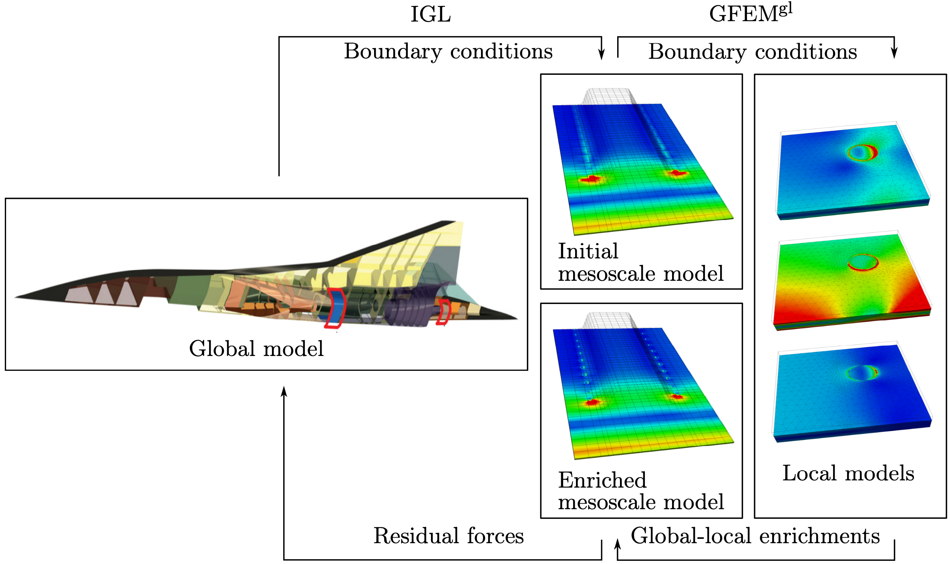

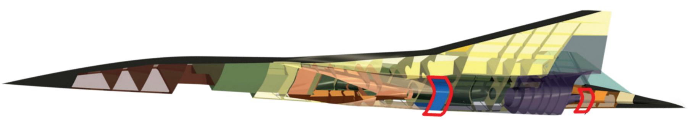
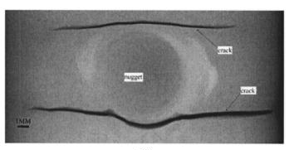
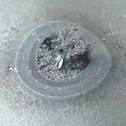
Goal and challenges
Strategy: Non-intrusive multi-scale structural framework
Goal: Develop a computational framework able to capture localized 3-D mechanical fields on structural components.
Multiple spatial scales: From structural scale, to sub-assembly scale, panel scale, stiffener scale, spot welds and cracks.
Lockheed Martin HTV-3X
[AFRL-RB-WP-TR-2010-3069]
Iterative Global-Local (IGL) couples structural and 3D models.
Non-intrusive feature of IGL: Combines two solvers that implement different mathematical models (shells and solids).
GFEM^{gl} captures localized 3-D effects on a coarse mesh.
Denoted as IGL-GFEM^{gl}
To reduce computational time, a staggered IGL-GFEM^{gl} scheme is used where GFEM^{gl} is applied only after IGL converges.

Slide 3
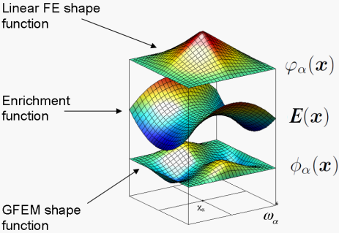
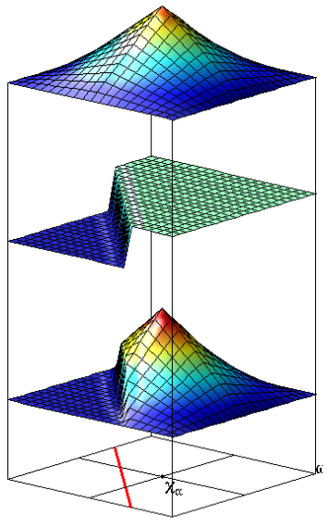
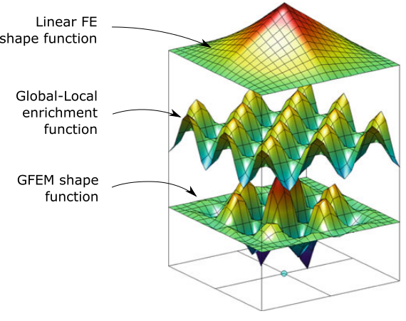
Generalized Finite Element Method (GFEM)
Bridging scales with global-local enrichment functions
Enrichment functions are provided by the solution of auxiliary local boundary value problems: Global-Local enrichments functions.
Idea: Use available numerical solution to build shape functions for next step (quasi-static, transient, non-linear, etc.)
Enrichment functions are produced numerically on-the-fly through a global-local analysis.
Use a coarse mesh enriched with Global-Local (GL) functions.
GFEM^{gl}: GFEM with global-local enrichments.
[Babuska et al., 1994; Duarte & Oden 1995]
Discontinuous enrichment
[Moes et al., 1999]
Enrichment = Numerical solutions of BVP
Allows the construction of shape functions incorporating a-priori knowledge about the solution.

Slide 4
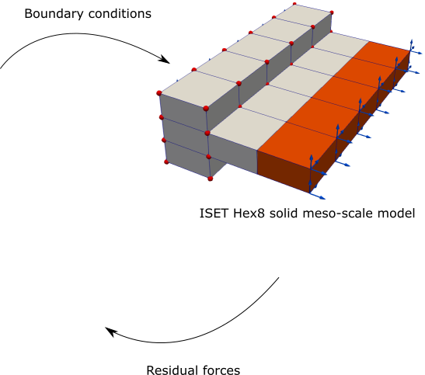
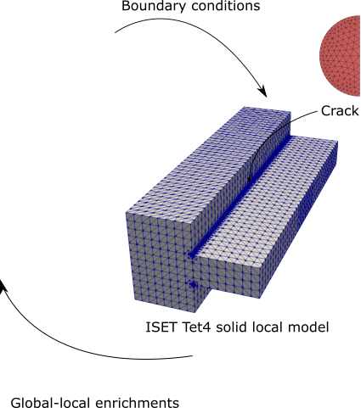
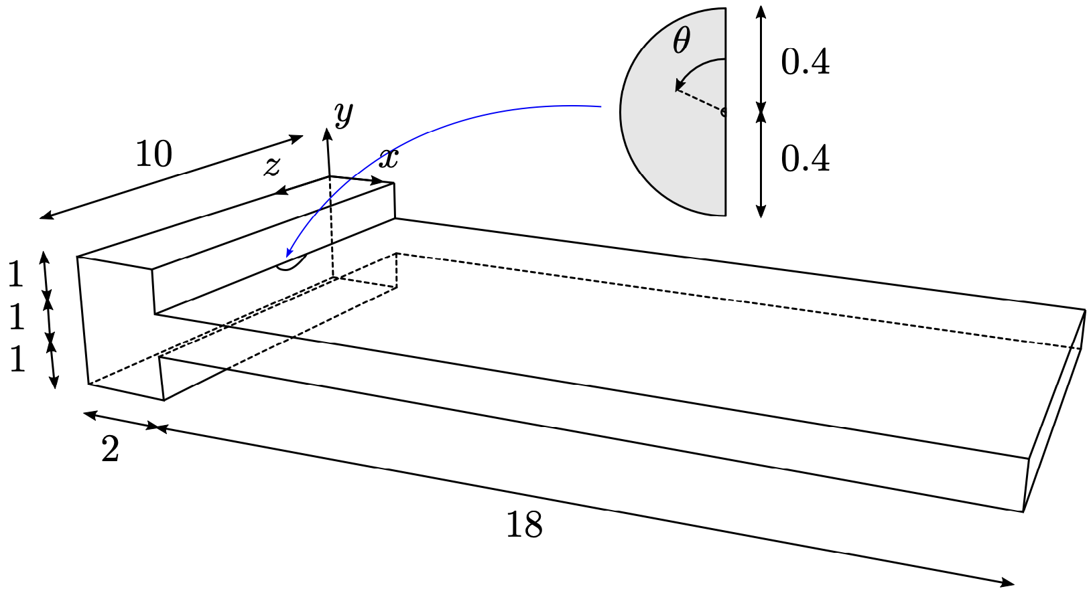
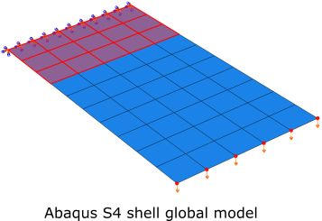
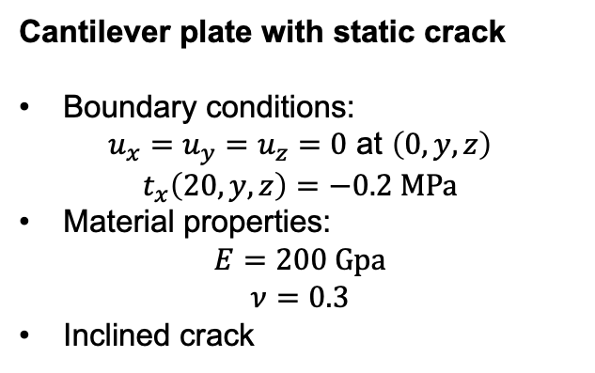
IGL-GFEM^{gl}: Cantilever plate with static crack
Cantilever plate with static crack
Boundary conditions:
$u_{x}=u_{y}=u_{z}=0$ at $\left(0,y,z\right)$
$$t_{x}\left(20,y,z\right)=−0.2 MPa$$
Material properties:
$$E=200 Gpa$$
$$ν=0.3$$
Inclined crack
IGL-GFEM^{gl}:
Global (Abaqus): S4 with full integration. No reinforcement at support, no crack.
Meso: HEX8, enriched with quadratic polynomials. Red nodes have global-local enrichments. Includes reinforcement at support but no crack.
Local: TET4, enriched with linear polynomials. Heaviside, and singular branch functions used to model the crack.
Meso-scale: 1980 dofs
The reinforcement at the support is not included in the shell model.
IGL
GFEM^{gl}
Problem dimensions (unit: mm)
Global (Abaqus): 396 dofs
Local: 247842 dofs

Slide 5
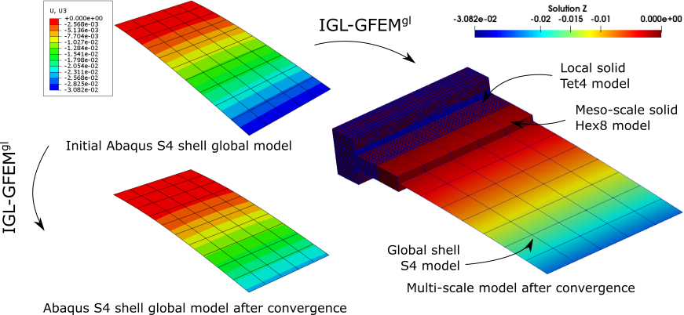
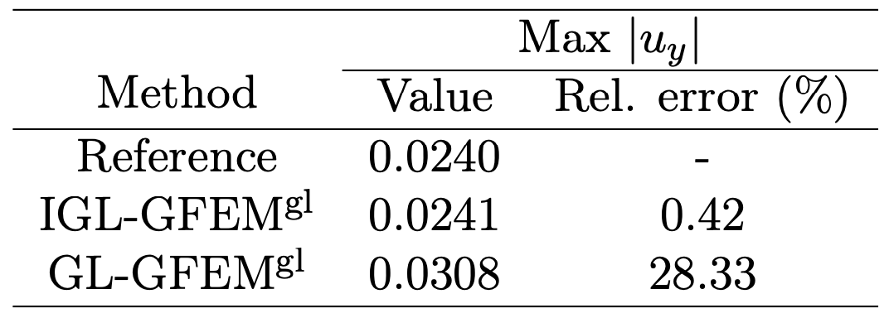
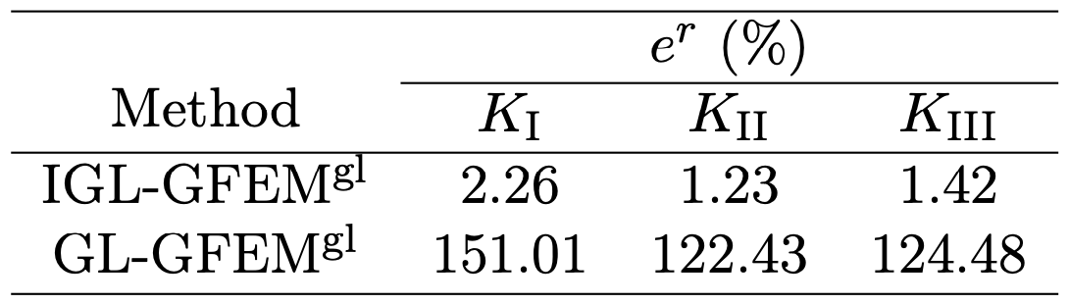
IGL-GFEM^{gl}: Cantilever plate with static crack
IGL-GFEM^{gl} shell-solid coupling
Excellent agreement between reference solution (DGFEA) and IGL-GFEM^{gl} simulation.
Sub-modelling (GL-GFEM^{gl}) overestimates the maximum displacement.

Slide 6
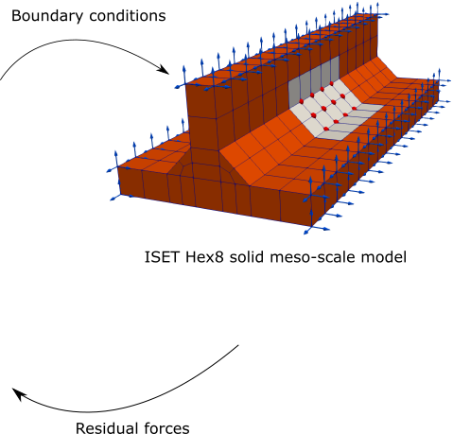
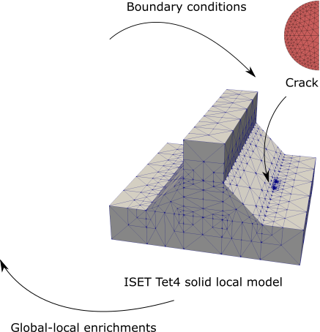
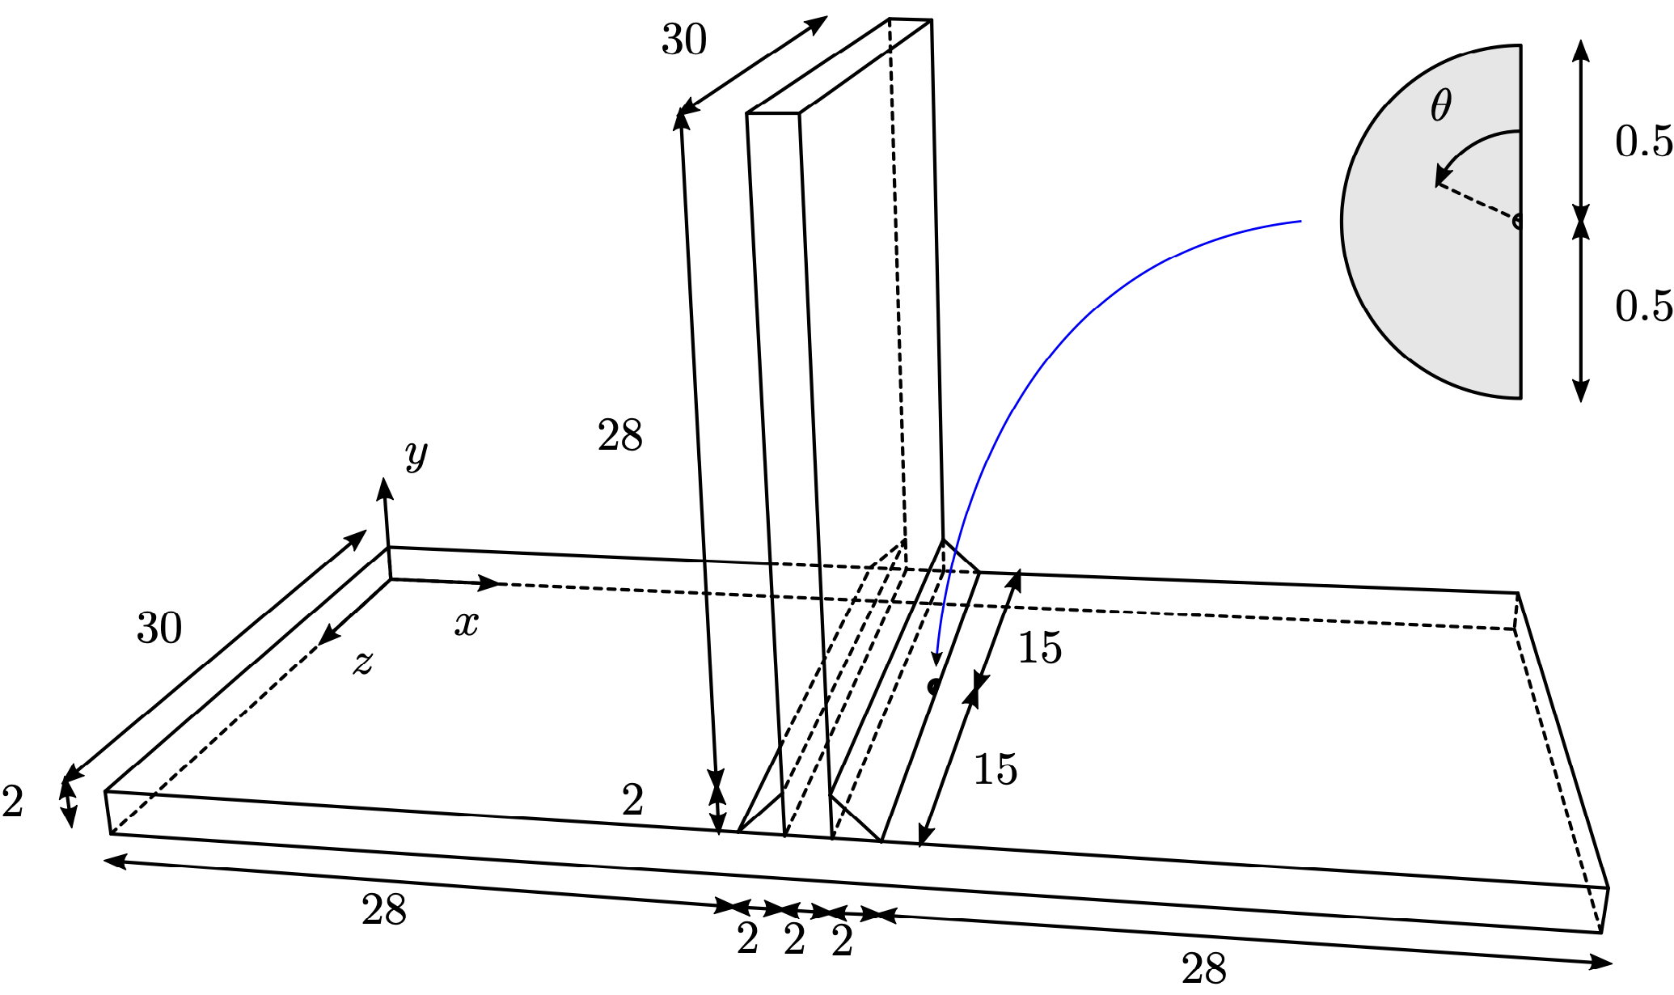
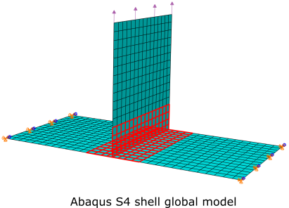

IGL-GFEM^{gl}: T-joint with static crack
T-Joint with static crack
Boundary conditions:
$u_{x}=u_{y}=u_{z}=0$ at $\left(0,y,z\right)$ and $\left(62,y,z\right)$
$$t_{y}\left(x,32,z\right)=5 ksi$$
Material properties:
$$E=29000 ksi$$
$$ν=0.3$$
IGL-GFEM^{gl}:
Global (Abaqus): S4 with full integration. No welds.
Meso: HEX8, enriched with quadratic polynomials. Red nodes have global-local enrichments. Includes welds but no crack.
Local: TET4, enriched with quadratic polynomials, Heaviside, and singular branch functions used to model the crack.
Meso-scale: 13008 dofs
IGL
GFEM^{gl}
The welds are not included in the shell model.
Global (Abaqus): 4704 dofs
Local: 243795 dofs
Problem dimensions (unit: in)

Slide 7
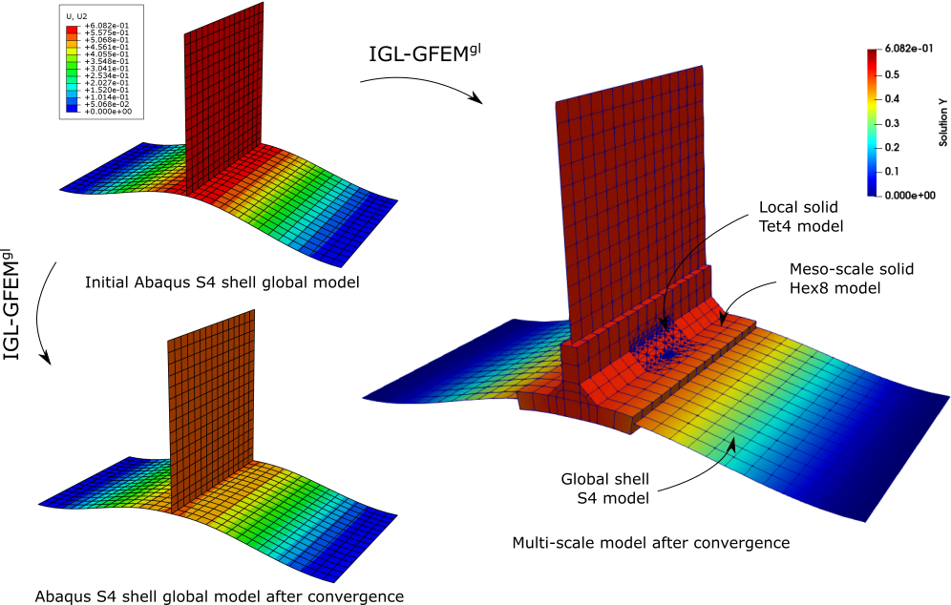
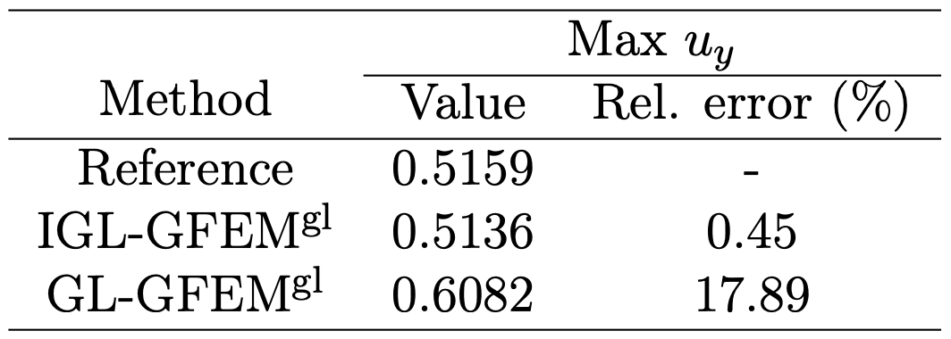
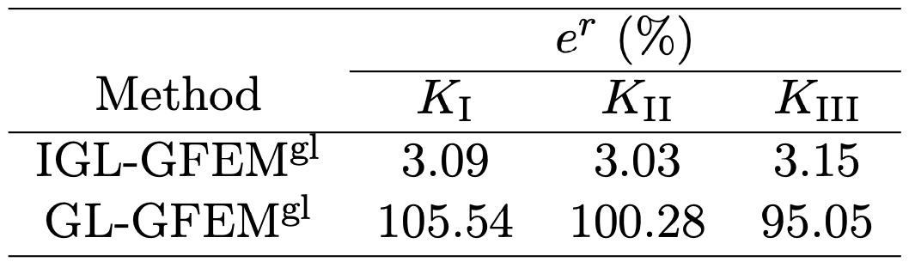
IGL-GFEM^{gl}: T-joint with static crack
IGL-GFEM^{gl} shell-solid coupling
Good agreement between reference solution and IGL-GFEM^{gl} simulation.
Sub-modelling (GL-GFEM^{gl}) overestimates the maximum displacement.

Slide 8
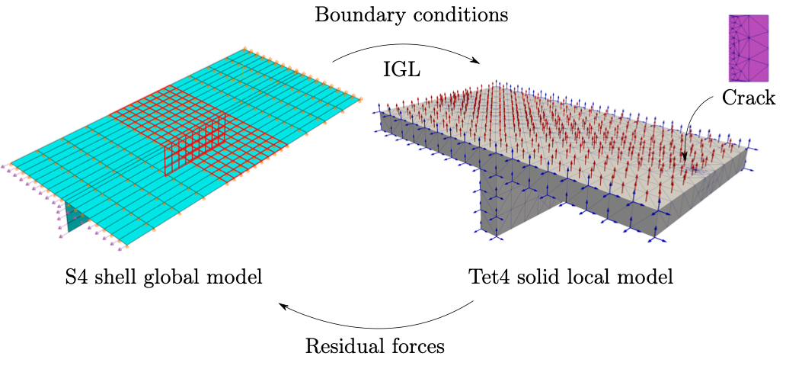
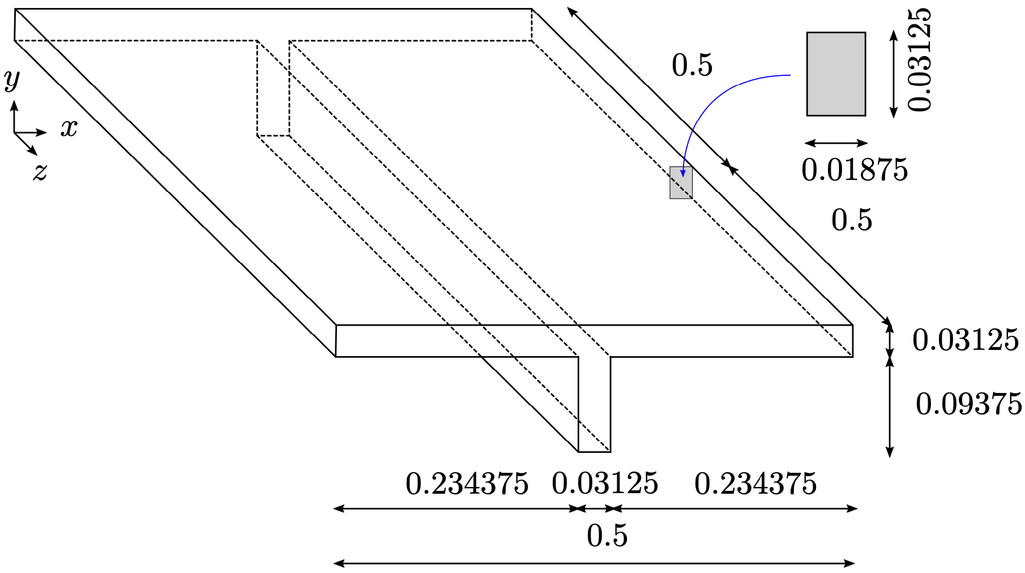
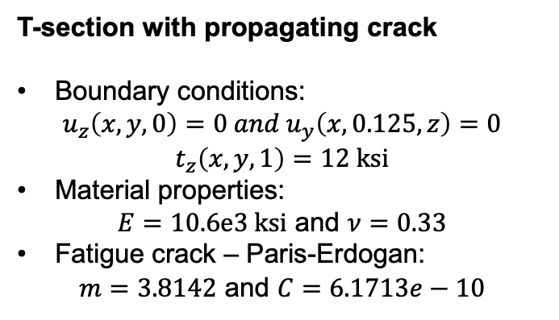
IGL-GFEM: Crack propagation and branching in a T-section beam
T-section with propagating crack
Boundary conditions:
$$u_{z}\left(x,y,0\right)=0 and u_{y}\left(x,0.125,z\right)=0$$
$$t_{z}\left(x,y,1\right)=12 ksi$$
Material properties:
$E=10.6e3 ksi$ and $ν=0.33$
Fatigue crack – Paris-Erdogan:
$m=3.8142$ and $C=6.1713e−10$
IGL-GFEM:
Global (Abaqus): S4 with full integration. No crack.
Local: TET4, enriched with quadratic polynomials, Heaviside, and singular branch functions used to model the crack.
There is no need for a mesoscale model. The overall structural response is captured by the global shell model while the crack propagation is performed at the local scale.
The crack is not included in the shell model.
Global (Abaqus): 2376 dofs
Local: 249594 dofs
Problem dimensions (unit: in)

Slide 9
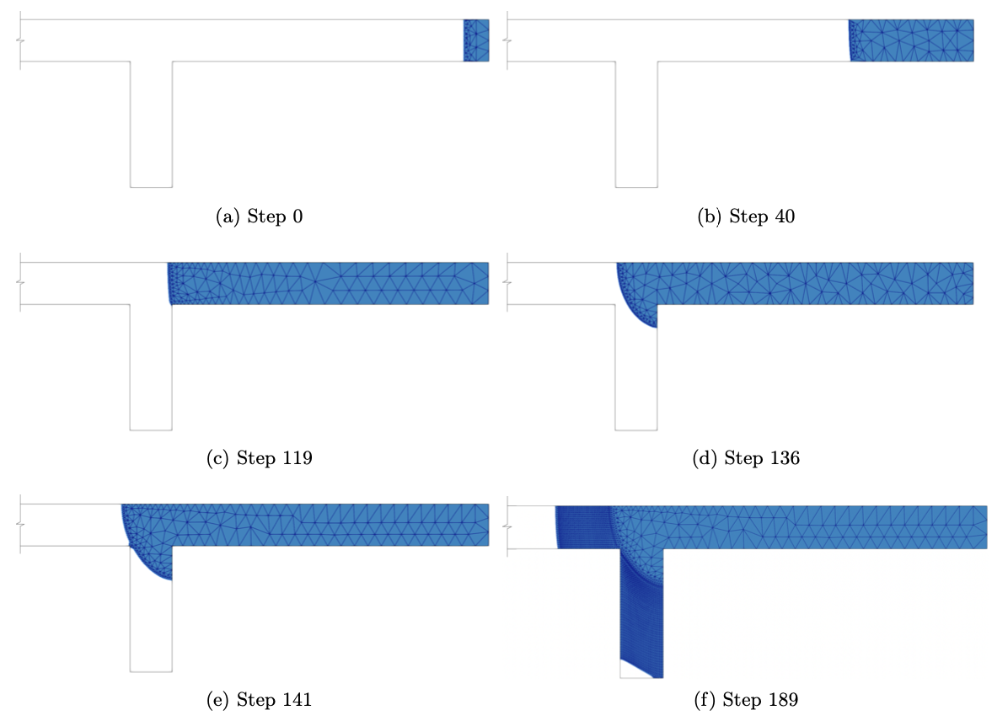
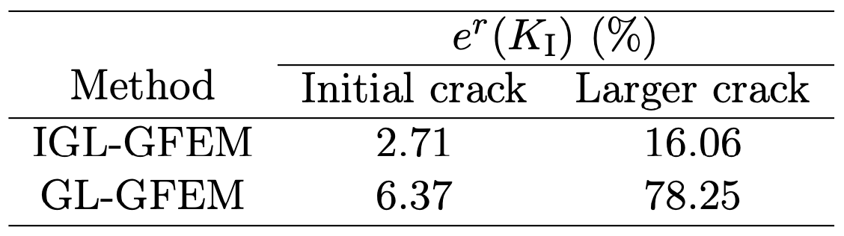
IGL-GFEM: Crack propagation and branching in a T-section beam
Stress Intensity Factors (SIFs) along the crack front
Crack surface at different steps
Small cracks have small influence on the overall stiffness of the T-section beam.
Conversely, larger cracks do change the stiffness of the problem.
The crack advances with a straight front.
Then, the front propagates in a shape that resembles a quarter of an ellipse.
Finally, the crack branches and continues propagating.

Slide 10
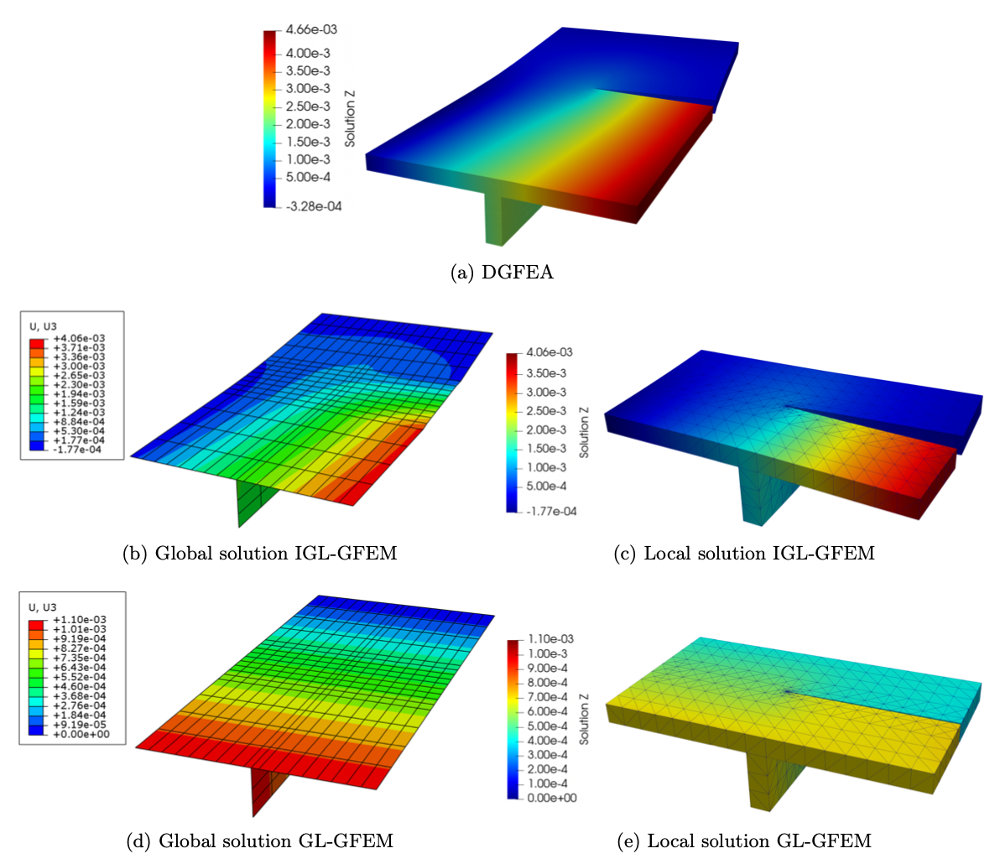

IGL-GFEM: Crack propagation and branching in a T-section beam
Deformed configuration and $u_{z}$:
Additional metrics at the mid-height of the beam horizontal plate
IGL-GFEM captures the drop in K_{I}. Also, the fatigue life is reasonably predicted.
Submodeling (GL-GFEM) overestimates the total life of the structure.
Conclusions
IGL addresses the challenge of connecting shells and solids elements.
Global model simulated by commercial code such as Abaqus with coarse meshes.
It is critically important to consider a two-way coupling between structural scales.
IGL-GFEM captures the non-symmetric z−displacement field.
GL-GFEM yields a symmetric z-displacement field.

