Slide 1





Control Techniques for Aircraft Energy Management
Student:
Student Email:
Faculty:
Faculty Email:
AFRL Sponsor:
AFRL Directorate:
Jacob Jadischke
jadischke.2@wright.edu
Mitch Wolff
mitch.wolff@wright.edu
Jon Zumberge
AFRL/RQ
PA #:
AFRL-2022-4772
Notes:
Jacob Jadischke – PhD student at WSU
Advisor Dr. Wolff
AFRL Sponsor Dr. Zumberge
Topic is Control Techniques for Aircraft Energy Management.

Slide 2
Route Planning and Energy Management
Hybrid Vehicle – Gas/Electric
Green Zone – Restrict Engine to be off
What is the Optimal Route/How to find it?
Notes:
The setup that I am considering is a gas/electric hybrid vehicle, or HV. For this setup, the engine used to recharge battery. In order to operate, must have a route plan, and a power management plan for the vehicle.
Problem is complicated when a green zone is introduced. Essentially, regions in the environment where engine must have an off state.
Consider the graphs below. We’ll start at the blue box and go to the red one. Suppose we can only travel through three boxes before engine must be turned on to recharge the battery.
Graph on left, optimal route is straight line. Right, the green zones restrict engine on, so it must go around. Must consider route planning and energy management simultaneously.
Research objective that is two-fold. First, defining what an optimal route is, and second how do we find it. We’ll start with the latter of the two.

Slide 3







Solution Algorithms
Established Algorithms
Proposed Algorithms
Q-Learning
Dynamic Programming
A*/Dijkstra’s
Environment
Environment
Agent
$$x_{1}$$
$$x_{k}$$
$$x_{2}$$
$$h(x_{2})$$
$$h(x_{1})$$
Notes:
This problem is an optimization problem, meaning we are minimizing some cost function.
Some well-established algorithms to solve this problem are QL and DP
Q-L: Agent explores an environment randomly to learn an optimal policy
DP: A value function is propagated back from the target state to the starting state. Also called Value Iteration.
Both involve iteration and slower as a result. This may take too long for closed loop applications.
To solve this problem, I am proposing the use of A*/Dijkstra’s algorithm in order to speed up the computation time.
Based off a heuristic cost to go function, allows us to identify all potential next states and choose the one with the lowest estimated cost to get to the goal.
Because of this, it is known as a greedy algorithm, and generally takes less computation time than the other two algorithms.

Slide 4









Defining Optimality
Minimize total energy consumption.
Add soft constraint for violating Green Zone.
Motion
Charging Battery
Restarting Engine
Overcharging Battery
$$j_{motion}=1$$
$$j_{charge}=0.05$$
$$j_{start}=0.2$$
$$j_{over}=1$$
A*: $h\left(x\right)=\sqrt{{\left(X−X_{target}\right)}^{2}+{\left(Y−Y_{target}\right)}^{2}}$
Dijkstra’s: $h\left(x\right)=0$
Notes:
As I mentioned, for an optimization problem some objective function must be minimized. I have chosen to minimize the total energy consumption over the route.
Choose this because it allows the distance traveled to be related to hybrid management system. Might not seem intuitive at first, but energy must be consumed to move a vehicle, which is why we have to keep filling up the gas tank in a car, and similar energy consumptions are present within the hybrid engine.
I have identified four modes of energy consumption, those being the motion of the HV, the inefficiencies in the battery charging, any energy burned to restart the engine, and the energy lost trying to overcharge the battery past its maximum level. Additionally, a soft constraint is added for the violation of a green zone.
With this, the heuristic functions for A*/Dijkstra’s were defined. For A*, this is energy consumption of motion to go, which is taken as simply the product of the motion cost and the distance between a state and the target. For Dijkstra’s, this value is always set at zero.

Slide 5
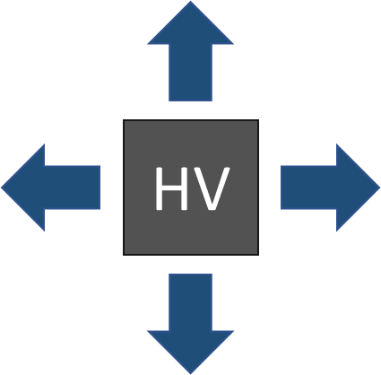

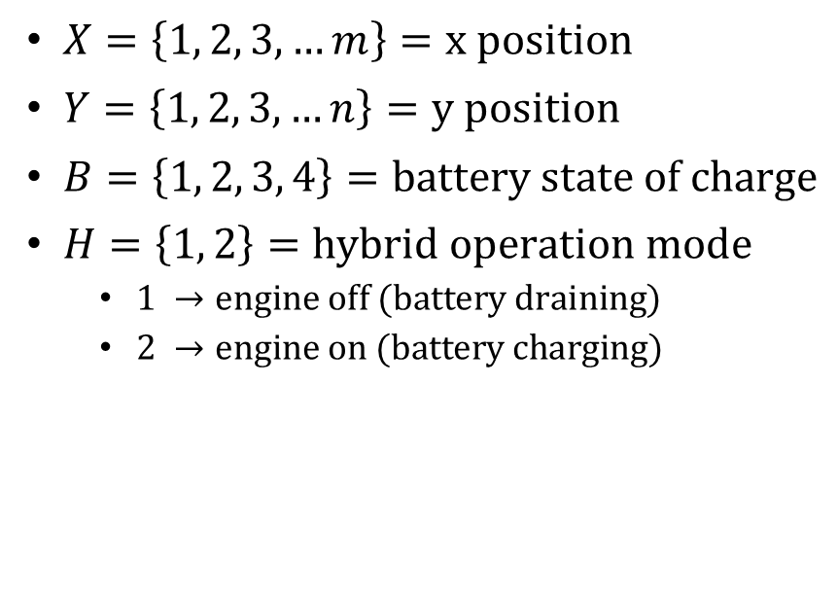

Hybrid Vehicle Model
State Definition: ${\left[X, Y, B, H\right]}^{T}$
Transitions
$X=\left\{1, 2, 3,…m\right\}=x position$
$Y=\left\{1, 2, 3, …n\right\}=y position$
$B=\left\{1, 2, 3, 4\right\}=battery state of charge$
$H=\left\{1, 2\right\}=hybrid operation mode$
  $1 →engine off (battery draining)$
  $2 →engine on (battery charging)$
Motion
  N/S/E/W
Hybrid Action
  Engine Off
    $B^{′}=B−1$
    $H^{′}=1$
  Engine On
    $B^{′}=B+1$
    $H^{′}=2$
Notes:
With optimality defined, and several algorithms identified, all that is needed to obtain a solution is a model of the HV. To start, this is kept as very simple, but will be complicated in future work.
Define four state variables, x-y grid points, battery state of charge, and engine on/off (aka hybrid operation mode)
For the state transitions, the HV is restricted to moving one grid space in each of the four cardinal directions (N/S/E/W). Every motion is taken with a hybrid action of either engine on, or engine off. For the engine off case, the Battery state of charge decreases by one unit, and for the engine on case, the state of charge increases by one unit.
With model, cost function, and algorithms, a solution is easily obtained for this problem.

Slide 6
Results
Notes:
Here is a set of solutions for an example map. You can see the solution obtained for each of the four algorithms I mentioned. I will call your attention to the legend on the right, where you can see the battery level is represented by the color of the grid point, and the engine on/off action is represented by the line color. Blue corresponds to engine on, while green is engine off.
The goal of this map was to demonstrate that the proposed setup could avoid running the engine in the green zone. As is seen from all four graphs, this goal was satisfied, as green actions were taken to enter and move through the green zones. The engine was only turned on after leaving the zone (green zone exists at the point in the center of the box, not at the whole box).
The battery was consistently charged/discharged, though different routes and charging schemes were proposed. However, it can be shown that each route/energy management scheme has the same energy cost, meaning they are all optimal solutions, and we will go ahead and take a look at this next.
Redo

Slide 7
Algorithm Performance
Notes:
As I just mentioned, from the graph on the left, the route cost for each solution is displayed for the algorithm used. Dynamic Programming (or value iteration as it is called here) is taken as the true optimal solution, and as all other algorithms produced the same cost, they all achieved optimality.
You may have noticed there is a fifth Iterative A* algorithm present in this graph. This essentially was a slight modification of A*. It is necessary that the heuristic function slightly underestimate the cost to go to perform correctly, so the iterative A* just iteratively reduced the scale of the heuristic function to ensure that optimality was achieved. That is all that algorithm is.
As far as practical applications go, the graph on the right shows the computation time. QL took the longest by far, but all A* variants performed very quickly, in approximately 2/3 the time as DP.
These results validate the use of A* algorithms, as we achieved optimality in much less time than the established algorithms. Of course, more testing is required, and an easy extension is to a larger map size.
Redo

Slide 8
Large Map Testing
Notes:
As can be seen, the A* algorithm was able to obtain a solution for a larger map. All considered algorithms were able to do this, but for the sake of visibility only A* is shown here.
With large maps, the curse of dimensionality comes into play and requires more computation at higher rates than size increase. As you can see, the computation time took about 8 times longer for the A* algorithm. However, DP increased more than 8 times, meaning that for larger maps, it is even more advantageous to use the A* algorithms.
Redo

Slide 9
Observations
Optimal Route/Energy Management
Algorithm Performance
Avoided running engine in green zone.
Used full discharge/recharge cycles whenever possible.
Avoided overcharging the battery.
Complex maze solving.
All achieved optimal solutions.
A*/Dijkstra’s algorithms all perform faster than Dynamic Programming.
The larger the map, the faster in comparison A*/Dijkstra’s algorithms are to Dynamic Programing and Q-Learning
Notes:
General musings, just follow pretty much what I saw from everything.
Redo

Slide 10
Future Work
More complex system dynamics.
Larger grids.
Additional control actions.
Additional hybrid operation modes.
Questions?
  Email: jadischke.2@wright.edu
Notes:
Briefly go through goals for future analysis.
Redo

