Slide 1
Topology Optimization of Aerospace Structures with Geometric Primitives
Student:
Student Email:
Faculty:
Faculty Email:
AFRL Sponsor:
AFRL Directorate:
Hollis Smith
hollis.smith@uconn.edu
Julián Norato
julian.norato@uconn.edu
Joshua Deaton
AFRL/RQ
PA #:
AFRL-2022-5600

Slide 2
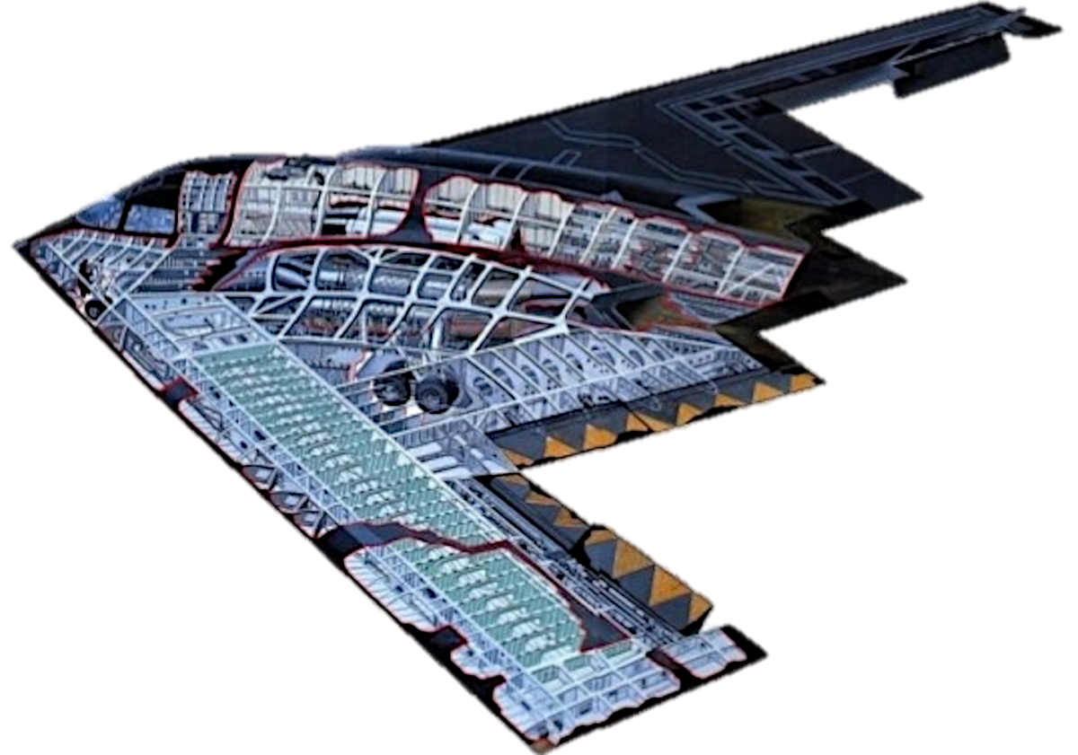
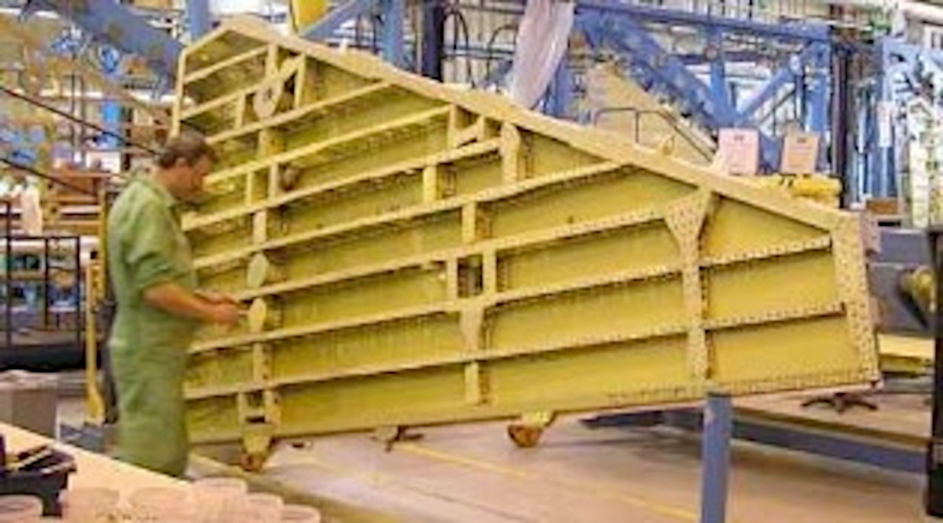
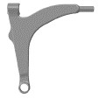
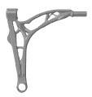
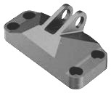
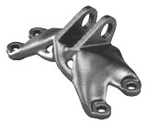
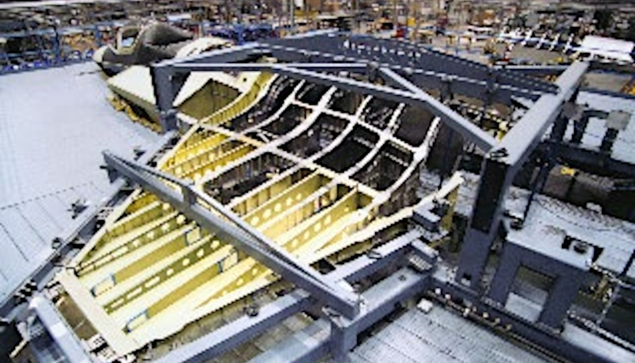
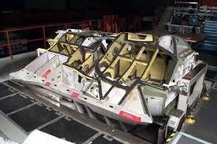
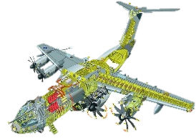
Motivation
Geometry Projection
Methods and Results
Conclusions
Aerospace Structural Requirements
Current/Commercial TO Capability
Preliminary Design (Sizing)
Displacement, stress, skin buckling aeroelastic divergence, and controls for >100 load conditions
Flutter, vibration, dynamic effects Tight-aeroelastic coupling Thermal effects (hot and cold)
Additional Requirements
Fatigue (airworthiness)
Load-path redundancy, robustness to damage Actuator & store attachments
Fuel (storage & wet structure)
System Requirements
Subsystem/component/wiring attachment Cutouts, maintenance
Manufacturing processes
Topology Optimization methods achieve stiff and lightweight structures.
However, current methods:
are ideal for single components.
require manual interpretation. neglect manufacturing limitations.
struggle with thin features and many loads. have rudimentary stress treatment.
have limited support for composite materials.
remove structural redundancy and stability. have limited capability for aeroelasticity.
PA #:
AFRL-2022-5600

Slide 3
Motivation
Geometry Projection
Methods and Results
Conclusions
A Geometry Projection Approach
Geometry projection enables topology optimization to:
design assemblies of multiple components made of stock materials.
automatically produce a parametric CAD geometry.
Our research leverages the geometry projection technique to develop new computational design methods that can design for manufacturing constraints, composite materials, redundancy, and stability.
PA #:
AFRL-2022-5600

Slide 4
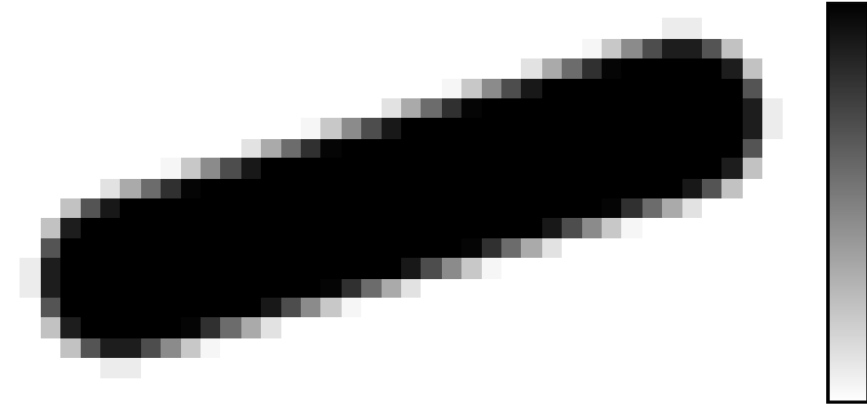
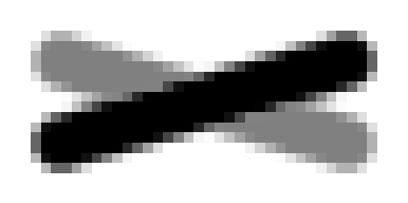
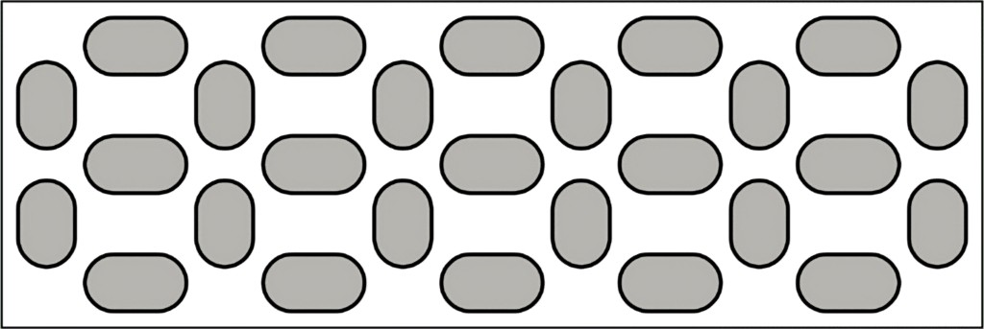
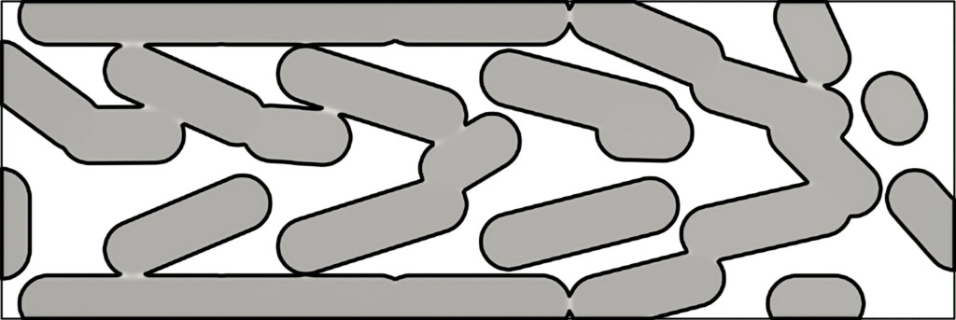
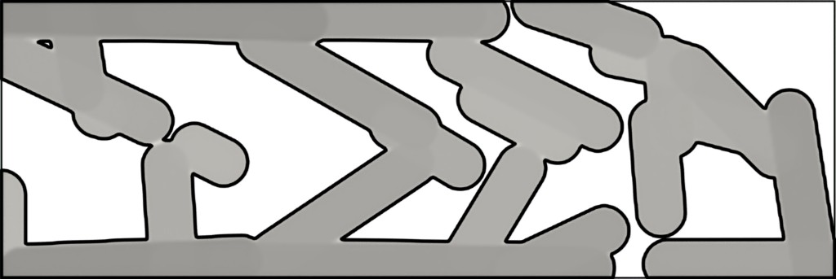
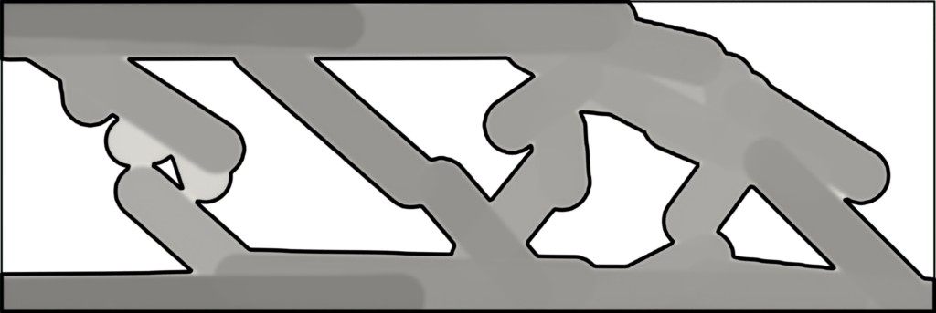
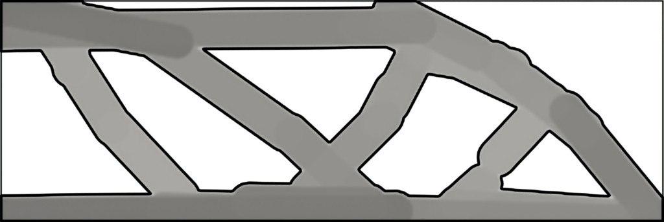
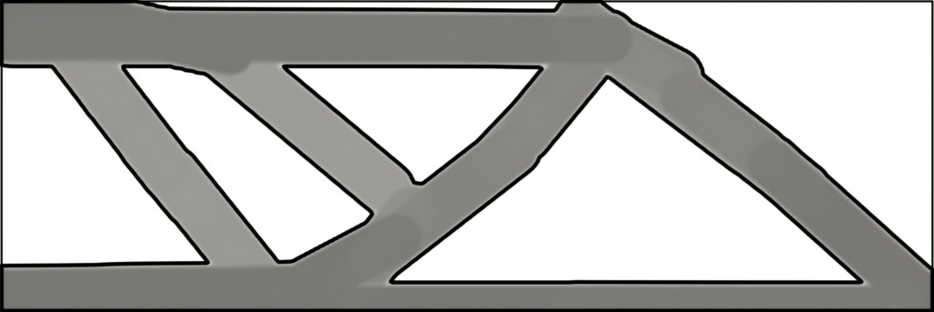
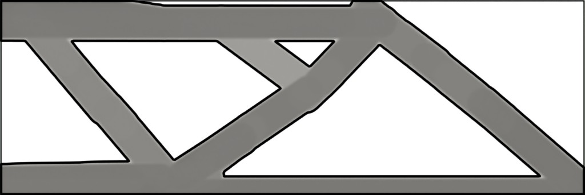
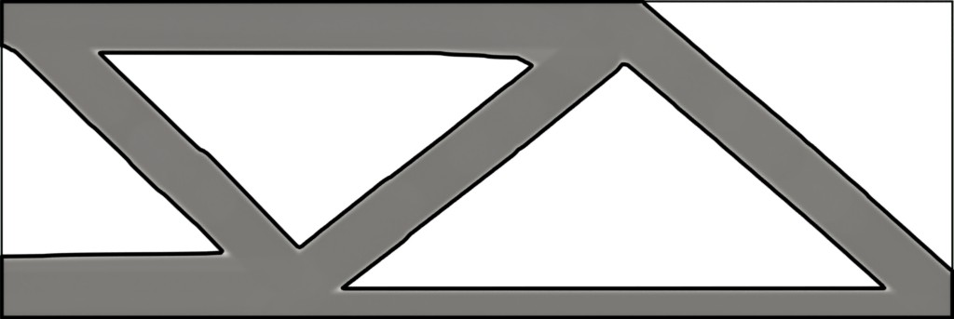
Motivation
Geometry Projection
Methods and Results
Conclusions
Geometry Projection Mapping
Each component is mapped to a pixel/voxel
density representation
Component densities are combined, allowing variable membership in the design
1
1
^{x}2b
α_{b} = 0.5
α_{b} = 1
r_{b}
b
0.5
0.5
Ω
b
x₁
∂Ω
b
0
0
ρ_{b}
ρ
The combined density defines the solid fraction of each pixel/voxel’s volume. Finite element analysis is performed on the fixed pixel/voxel grid.
Design Evolution
PA #:
AFRL-2022-5600

Slide 5
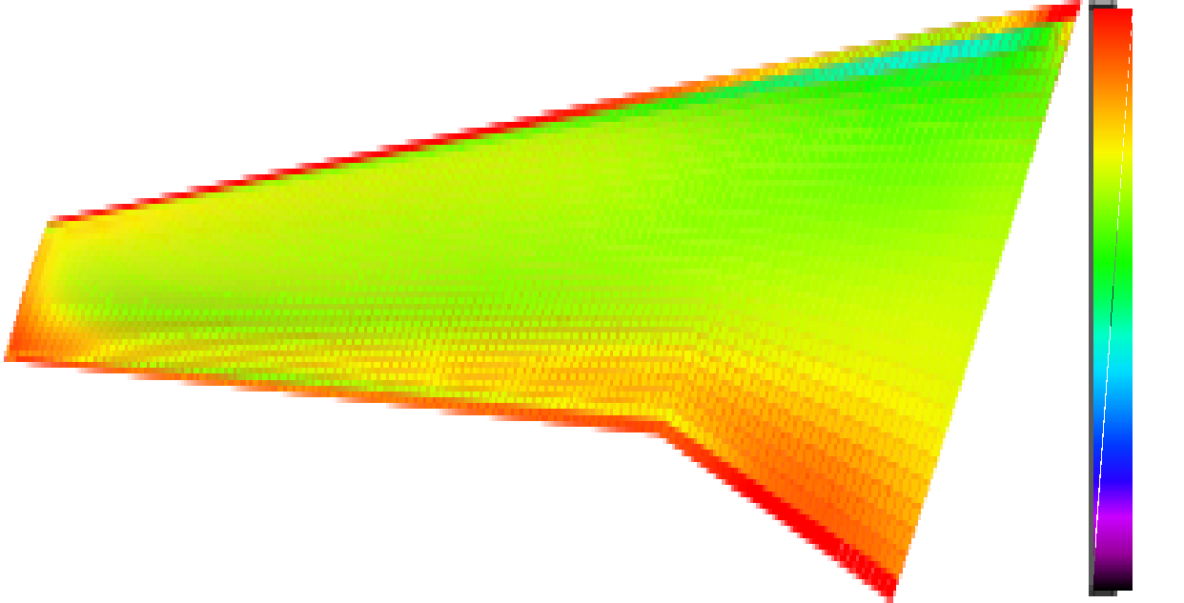
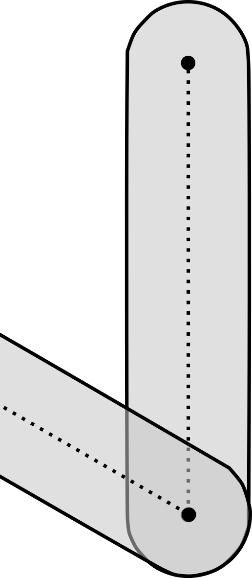
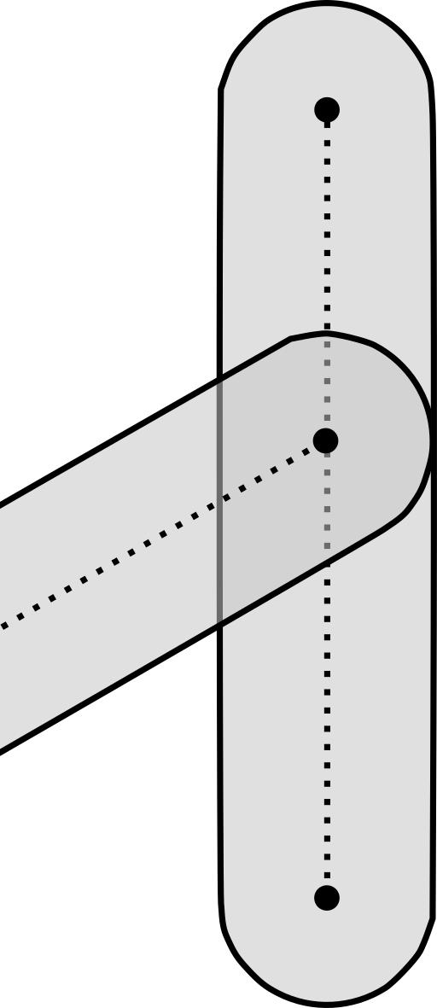
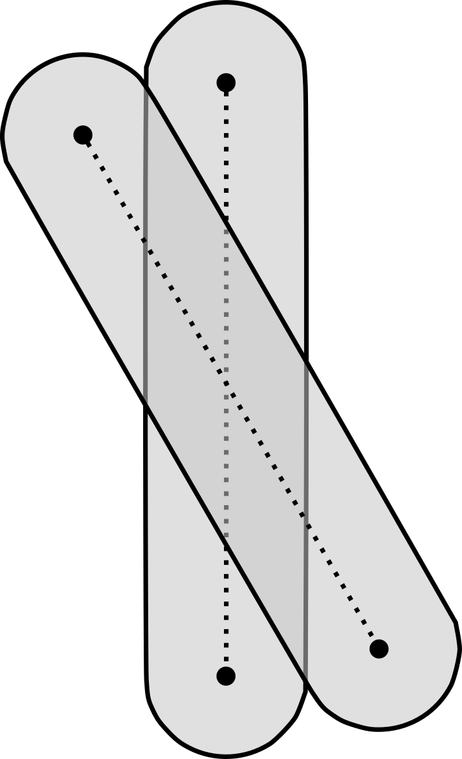
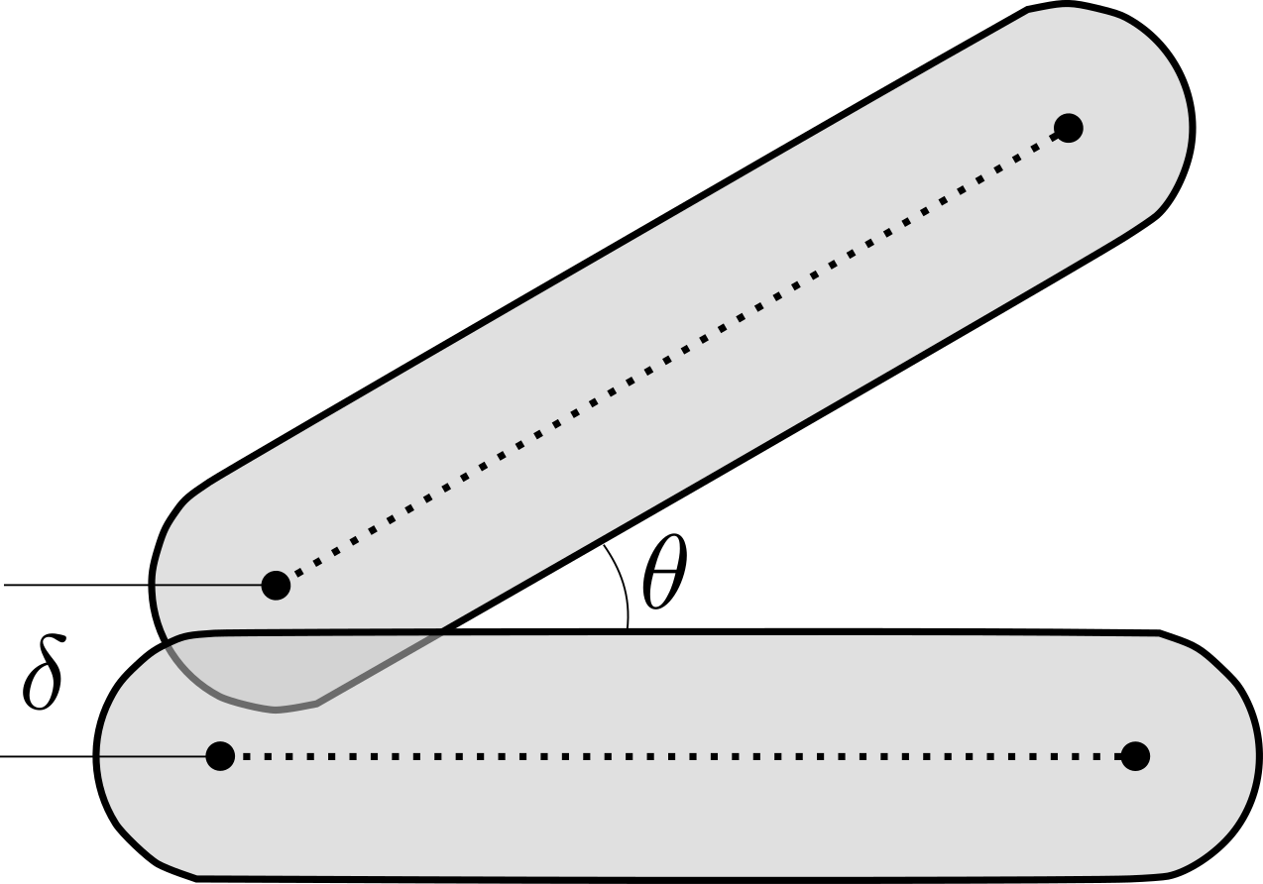
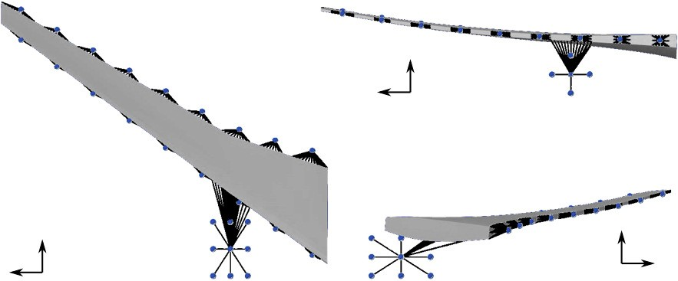
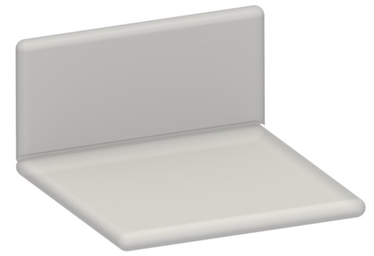
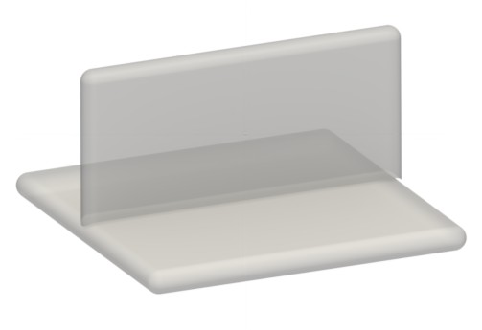
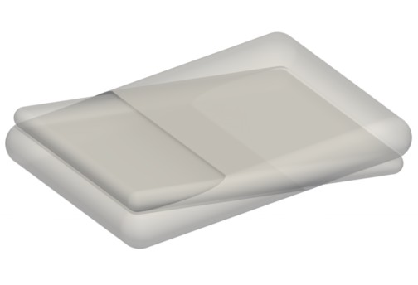
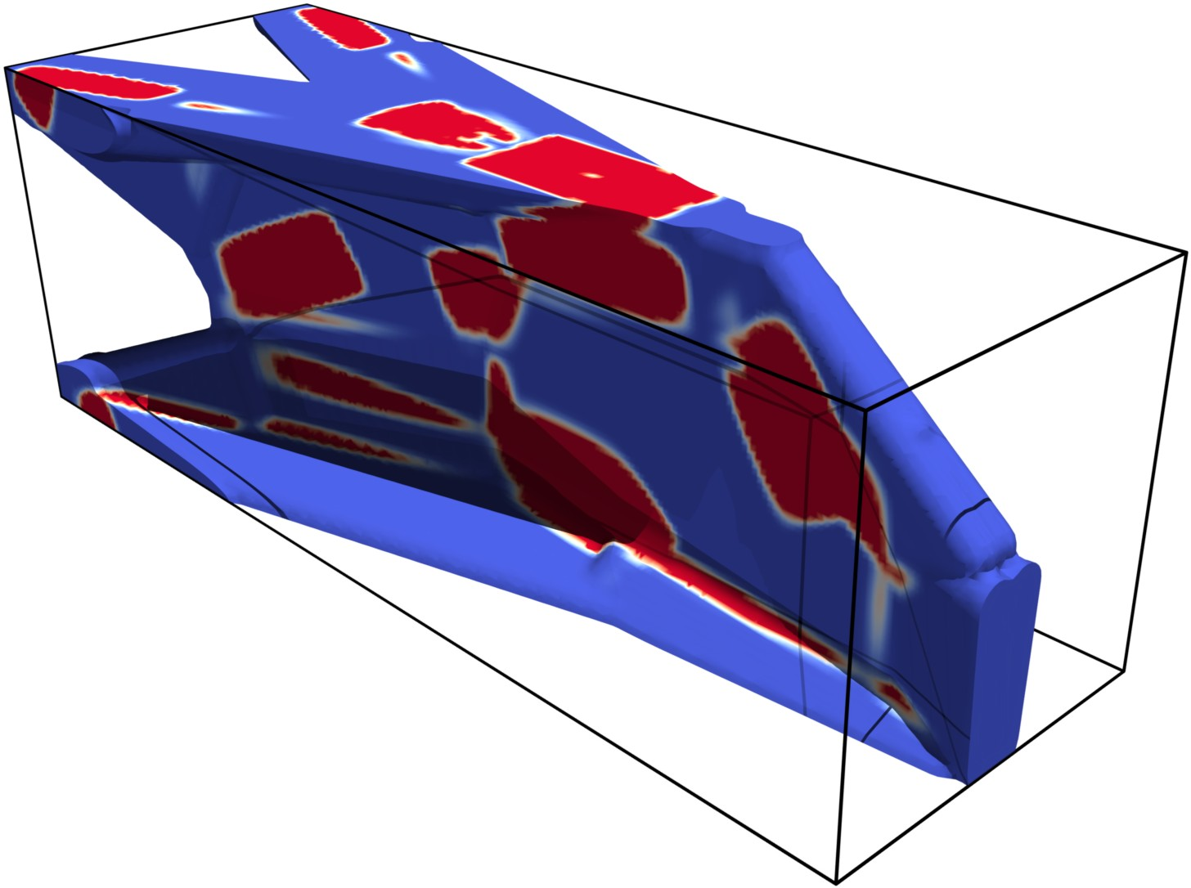
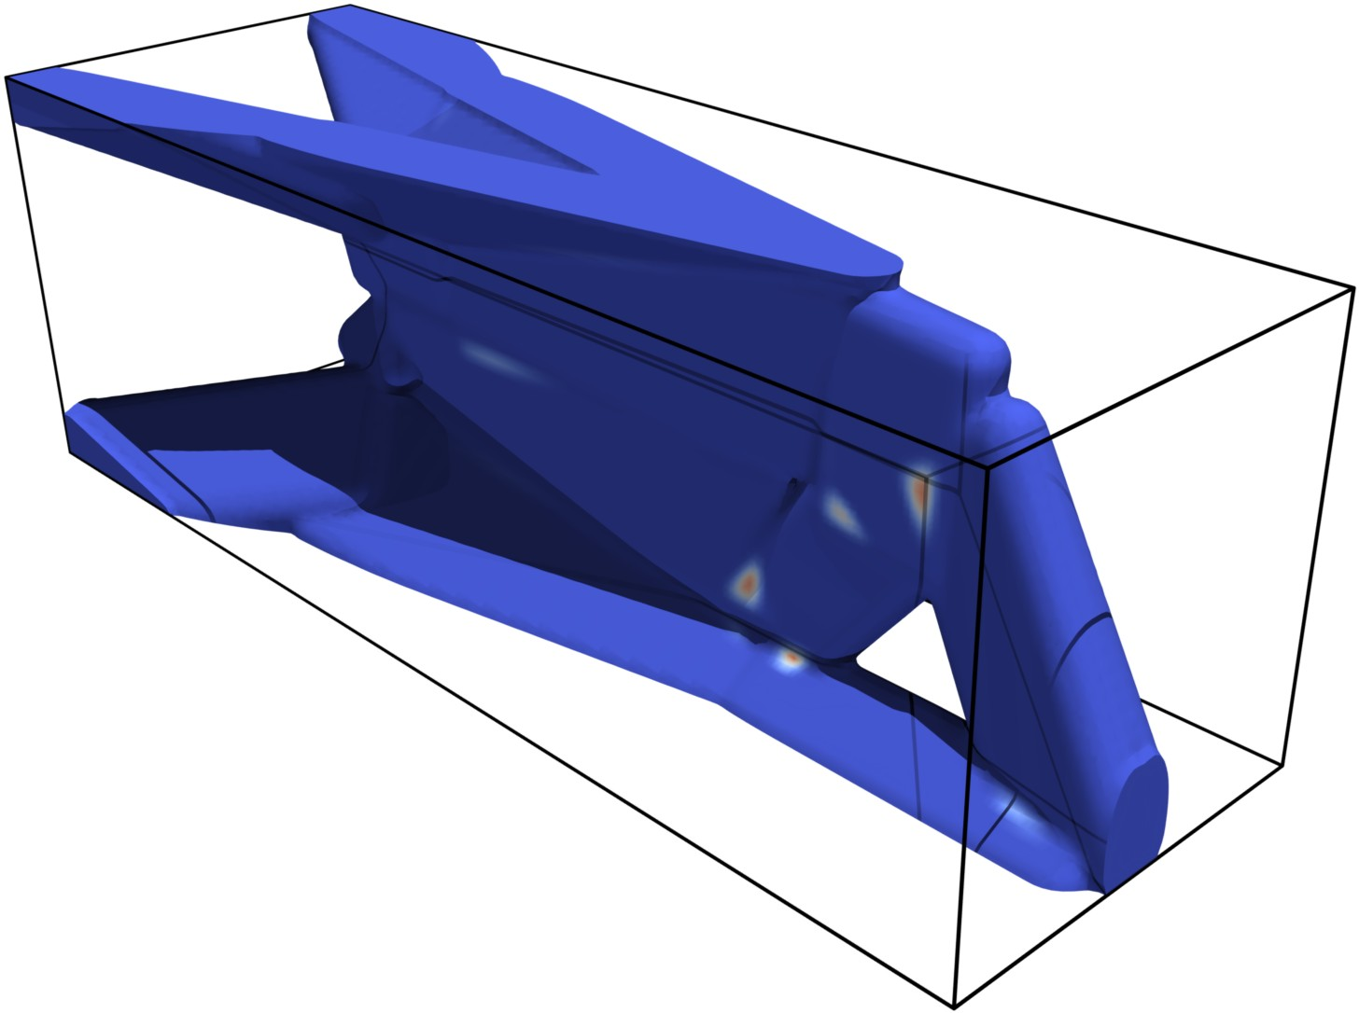
Motivation Geometry Projection
Preliminary Wingbox Design and Manufacturing Constraints
Methods and Results
Conclusions
Preliminary Wingbox Design
Manufacturing Constraints
0
-0.5
-1
-1.5
Angle and overlap constraint for bars
✓ ✓
×
Pressure coefficients
z
y
Overlap constraint for plates
✓ ✓
x
z
y
x
×
Lumped masses
Stiffness optimized design
Overlaps highlighted in red
PA #:
AFRL-2022-5600

Slide 6
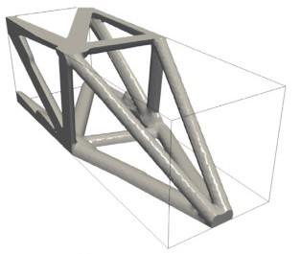
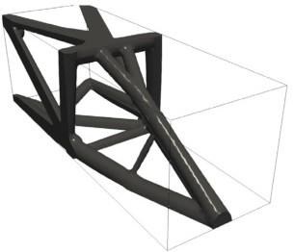
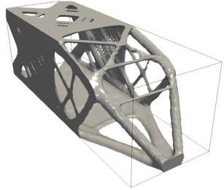
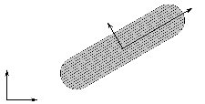
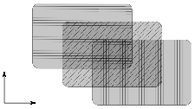
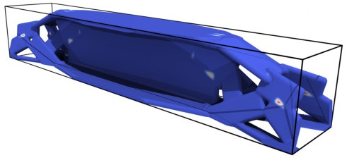
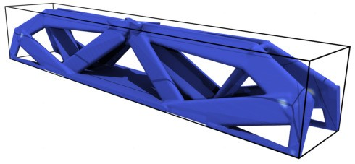
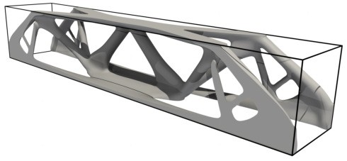
Motivation
Geometry Projection
Methods and Results
Conclusions
Fiber-Reinforced Composite Components
We demonstrate a significant potential to reduce weight by optimizing the layout of fiber-reinforced components compared to naively replacing aluminum components with fiber-reinforced material.
y x Unidirectional bars
Aluminum bars Composite bars Aluminum freeform
′
′
x
y
θ1
θ2
_{y}′
θ3
_{x}′
Laminated plates
Aluminum plates
Composite plates
Aluminum freeform
PA #:
AFRL-2022-5600
6 / 9

Slide 7
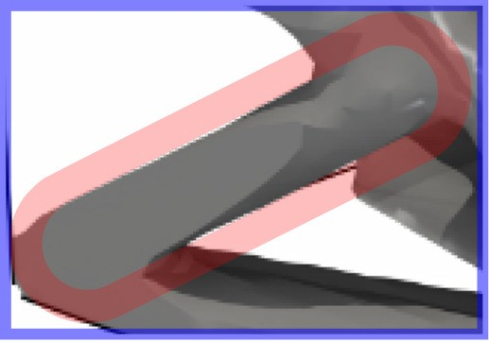
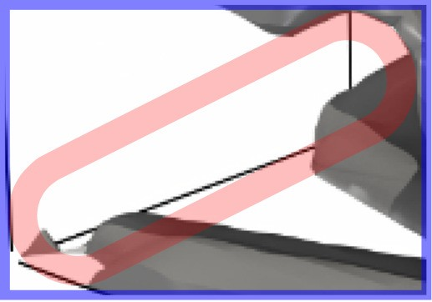
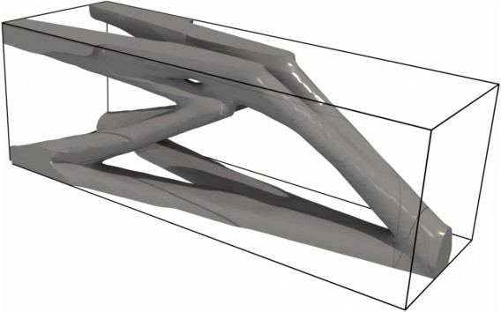
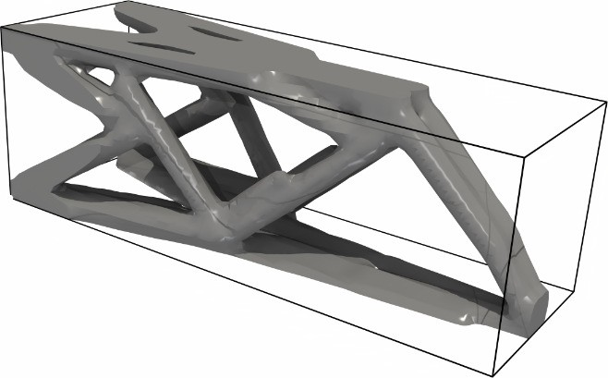
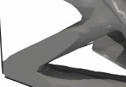
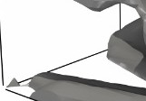
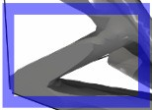
Motivation
Geometry Projection
Methods and Results
Conclusions
Redundancy—Robustness to Damage
Redundancy—Robustness to Damage
Damage scenario = remove component from design
Nominal design Failsafe design
Undamaged Damaged
Our approach maintains consistency with fail-safe design practices;
it avoids an arbitrary damage size and location;
and it enables tractable fail-safe topology optimization in 3D.
PA #:
AFRL-2022-5600

Slide 8
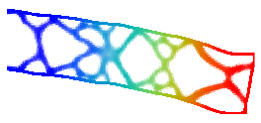
Motivation
Geometry Projection
Methods and Results
Conclusions
Stability—Robustness to Buckling
Stability—Robustness to Buckling
In addition to physics-based buckling constraints, geometry projection enables geometry-based constraints between components to prevent e.g., skin buckling.
Initial freeform design
Optimal freeform design
Critical mode (freeform)
Critical mode (bars) with geometry-based constraint to prevent skin-buckling
Initial bar design
Optimal bar design
Critical mode (bars)
PA #:
AFRL-2022-5600

Slide 9
Motivation
Geometry Projection
Methods and Results
Conclusions
Conclusions and Future Outlook
Our techniques enable the imposition of manufacturing constraints on the topology optimization of structural assemblies.
We produced the first topology optimization method to design assemblies of long fiber-reinforced components with primitive geometries.
We formulated efficient and consistent methods to design for fail-safety and stability.
PA #:
AFRL-2022-5600

