Slide 1
Context Aware Malware Detection using GAN’s
Student:
Student Email:
Faculty:
Faculty Email:
AFRL Sponsor:
AFRL Directorate:
David Wood
woodd6@udayton.edu
Dr. Keigo Hirakawa
khirakawa1@udayton.edu
Dr. David Kapp (RYWA)
RY
PA #:
AFRL-2022-5644

Slide 2
Problem Statement
Identification of malware within the supply chain of a signal/sensor system.
Goal: Design a binary classifier to detect malware from system behavior (Context)
Challenges:
We want to be prepared for detecting novel trojan malware.
Signature based malware detection will fail.
Approach:
Anomaly detection (without malware signatures)
Use limited examples of valid system data
Use GAN to promote the clustering of the normal system behavior in feature space.

Slide 3
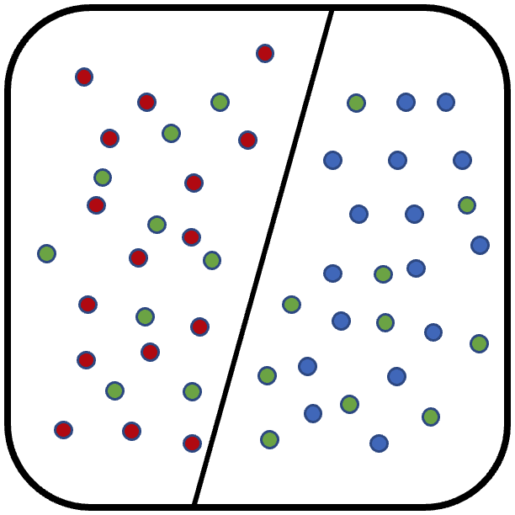
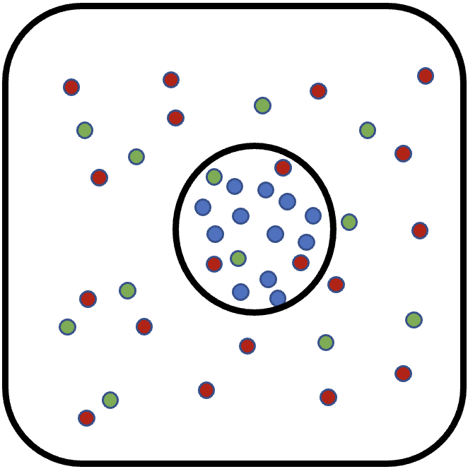
Binary Classifier (Signature-Based)
Train on the normal and compromised system behaviors
Pros
Can cluster the normal system and known malware
Cons
Does not cluster unknown malware
False Negatives (FN) can be high.
Train on only compromised system behaviors
Pros
Can cluster known malware
Cons
Does not cluster unknown malware
False Negatives (FN) can be high.
Does not cluster normal system behavior
False Positives (FP) from misclassification of System

Slide 4
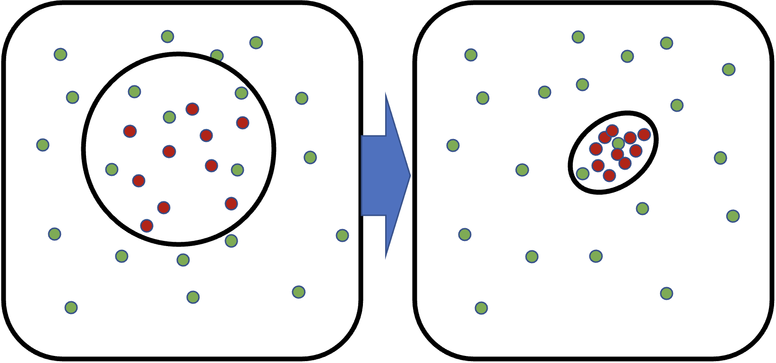
Our Goal: Anomaly Detection
Trains on normal system behavior
Pros
Can still detect unknown malware
Clusters the normal system behavior
Low false positives (FP)
Cons
Does not cluster unknown malware
False negatives, maliciousness low
In signal systems…
Small perturbations can be thought of as noise
Large perturbations are attacks with consequence.

Slide 5
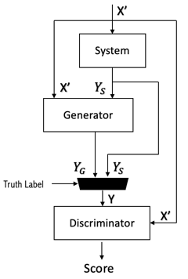
Our Solution: Generative Adversarial Network (GAN)
Generator (Proxy Malware)
Is used to produce fakes that alters the system behavior: Yg =gen(X,Ys).
Wants to produce fakes that behave like malware, in the form of hiding, so it’s given input/output of the real system.
Discriminator…
Learns to detect fake samples from real samples.
Forces the generator to continue to produce fakes close to the real system or they will be detected.
Eventually the fake and real samples will be so similar that the impact of the fakes would be negligible to the the real performance.
Is now trained as a detector.
Impact: The discriminator has more samples to learn the possible feature space of the normal system and detect compromised systems, and anomalies.

Slide 6
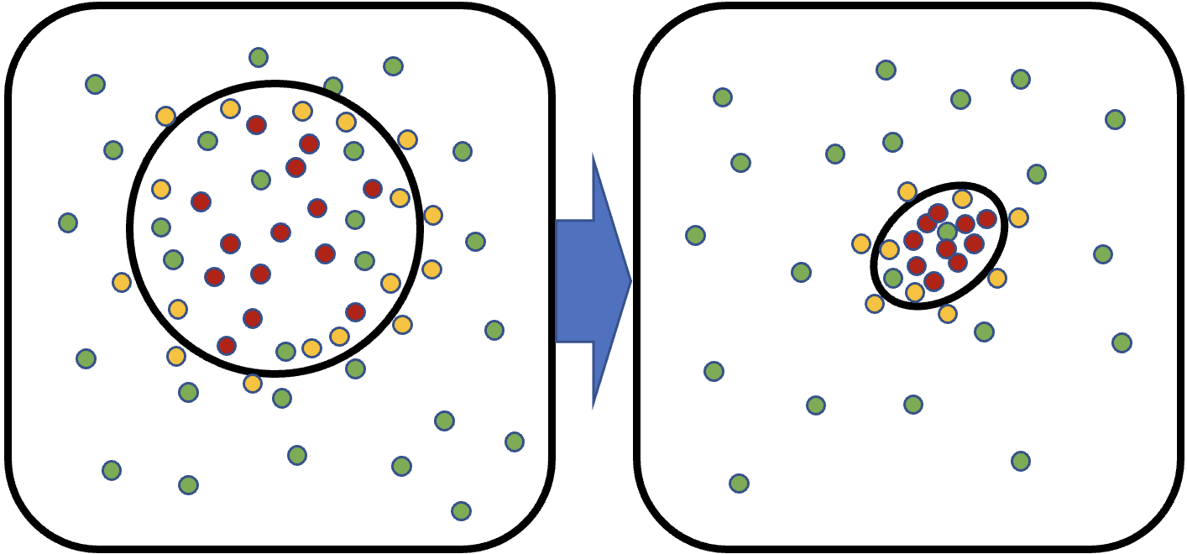
Our Solution: Generative Adversarial Network (GAN)
To promote clustering...
Generator designed to learn the classification boundary
Discriminator learns to classify normal system and generator behavior
The classification boundary will tighten over time.
In signal Systems…
The Trojan is ineffective outside the classification boundary
The Trojan is ineffective at center of the cluster
The Trojan is most effective just inside the classification boundary (maximize attack while hiding)
The generator is mimicking ideal Trojan attack

Slide 7
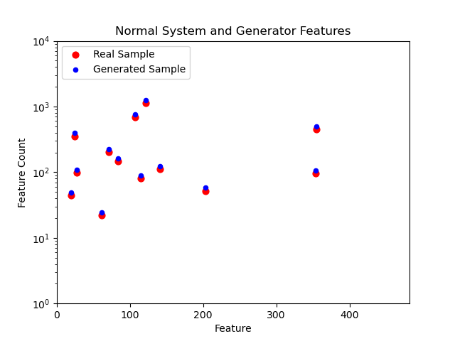
VirusShare Dataset
VirusShare – Dynamic malware dataset provided by UCI Machine Learning Repository
Dynamic features of VirusShare Executables Data Set
Malicious executables ran on Cuckoo Sandbox for 1 min, recording all system calls.
Each sample is provided with a maliciousness score from the Cuckoo Sandbox Score[1]
107888 samples, with a maliciousness score of 0.0 to 1.0,
482 measurements (measured occurrences of system calls) per sample
The 482 measurements are what the generator will train on, trying to recreate similar samples and calls that happen for that sample group.
Counts
Measurements
Plot showing the performance of the generator successfully learning the Normal System Features.
[1] Huynh, Ngoc Anh, Wee Keong Ng, and Kanishka Ariyapala. "A new adaptive learning algorithm and its application to online malware detection." International Conference on Discovery Science. Springer, Cham, 2017.

Slide 8
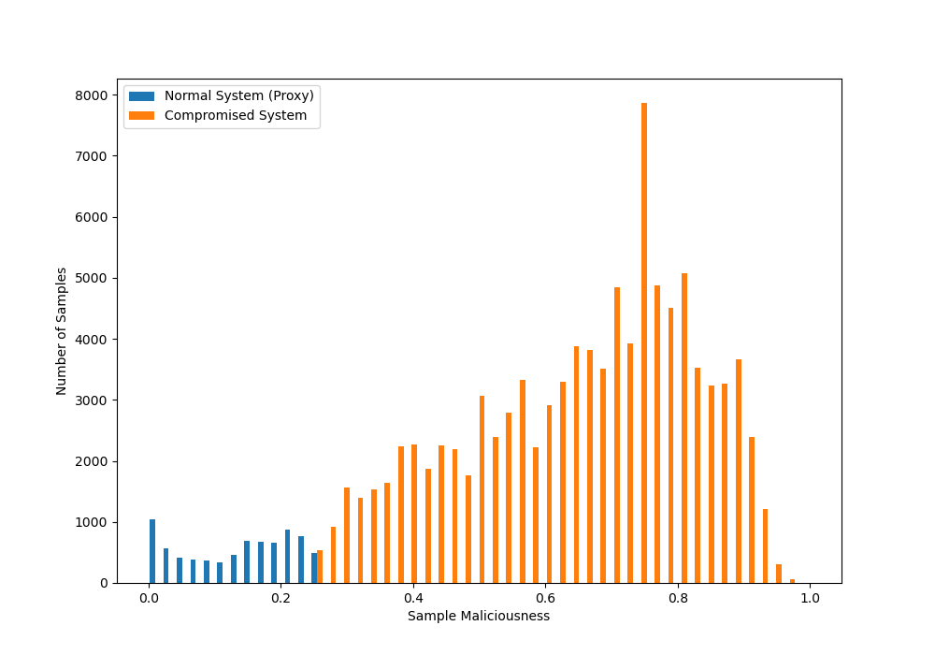
Designing the Experiment
Normal System (Proxy)
VirusShare lacks a clean dataset of calls made in a 1 min interval without any malware being run.
Low maliciousness (blue) will be treated as a normal system proxy with maliciousness scores ranging from 0 to .25.
This group will be split into a training set and a test set.
The training set is the set the generator will try to mimic.
Compromised System
For the first test set, only high malicious samples will be used to test the model with scores from 0.75 to 1.0
Histogram showing the distributions of samples from the the VirusShare dataset, based on their maliciousness scores.

Slide 9
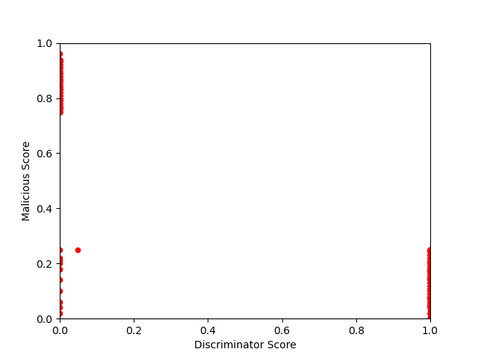
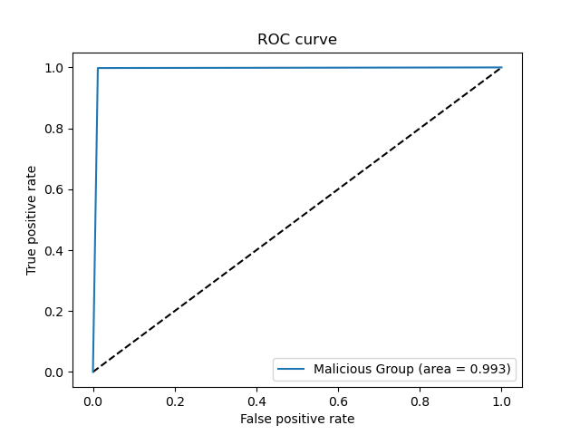
Discriminator Performance
True Neg
Validation was done by taking 1000 samples from the normal system group, and 1000 samples from the malicious system group and using the Discriminator model to predict their labels.
Score vs Maliciousness
As predicted the model did very well at detecting malicious malware and labeling it as outside of the group (0).
The testing set was almost entirely classified as part of the system set, with a few false positive (0 instead of 1)
ROC Curve
The AUC of the ROC plot was .993 meaning that the model was almost completely successful in classifying every label correctly.
False Neg
True Pos

Slide 10
Conclusion
Contributions
Proposed Minimax GAN
The generator as a proxy for malware, trains to find the boundary.
The discriminator is our anomaly detector.
Trains only on normal system behavior.
Verified the Minimax GAN using real world malware data.
Can detect unknown malware.
Corresponds well to maliciousness score.
This is a more resilient method for defending against new and unknown malware attacks.
Future Work
Optimized network architecture.
Provide interpretability to the discriminator.
Work to study different sets of malware data, with benign system signal data.

