Slide 1




Multiscale Modeling of Composite Materials with the Generalized Finite Element Method
Student:
Student Email:
Faculty:
Faculty Email:
AFRL Sponsor:
AFRL Directorate:
Bryce Mazurowski
brycepm2@Illinois.edu
Prof. C. Armando Duarte
caduarte@Illinois.edu
Dr. Patrick O’Hara
AFRL/RQHF
Distribution Statement A: Approved for public release;
Distribution is unlimited. PA# AFRL-2022-4599 .

Slide 2
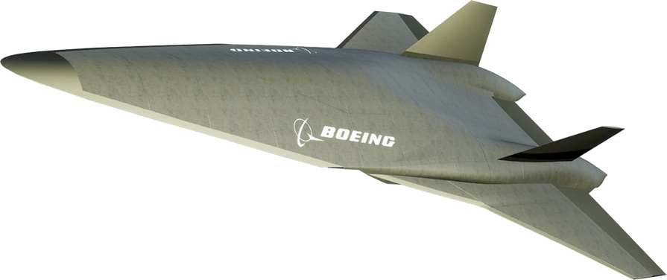
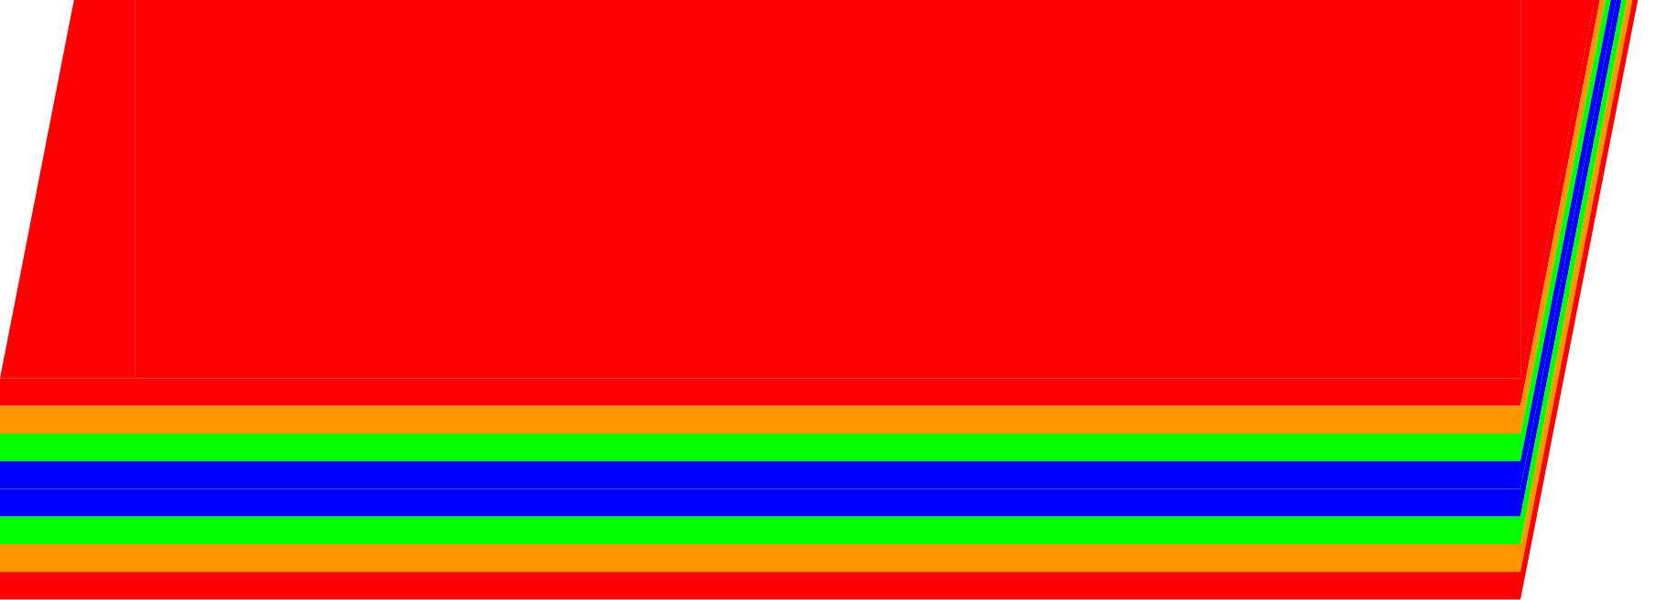
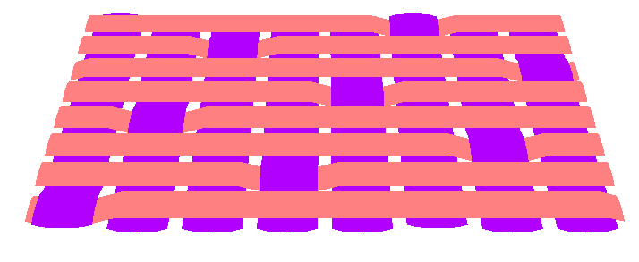
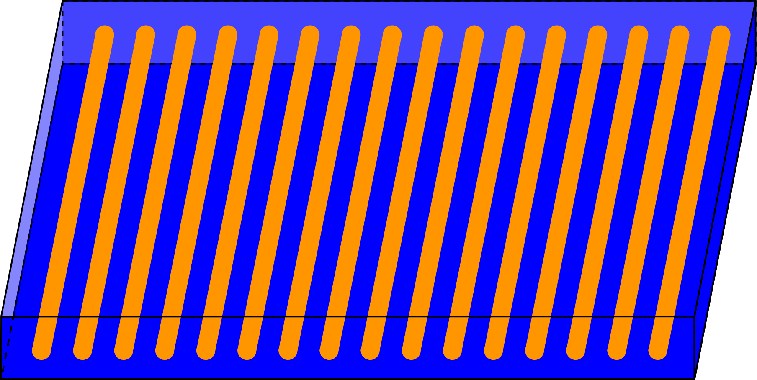
Ceramic Matrix Composites
Valkyrie – Boeing hypersonic concept vehicle
Pros
High strength-to-weight ratio
Temperature resistant
Stable mechanical properties
Ductile behavior
Cons
Very heterogeneous material
Seeded with defects
No separation of length scales at hot spots
How to incorporate heterogeneity into global structure behavior efficiently?

Slide 3
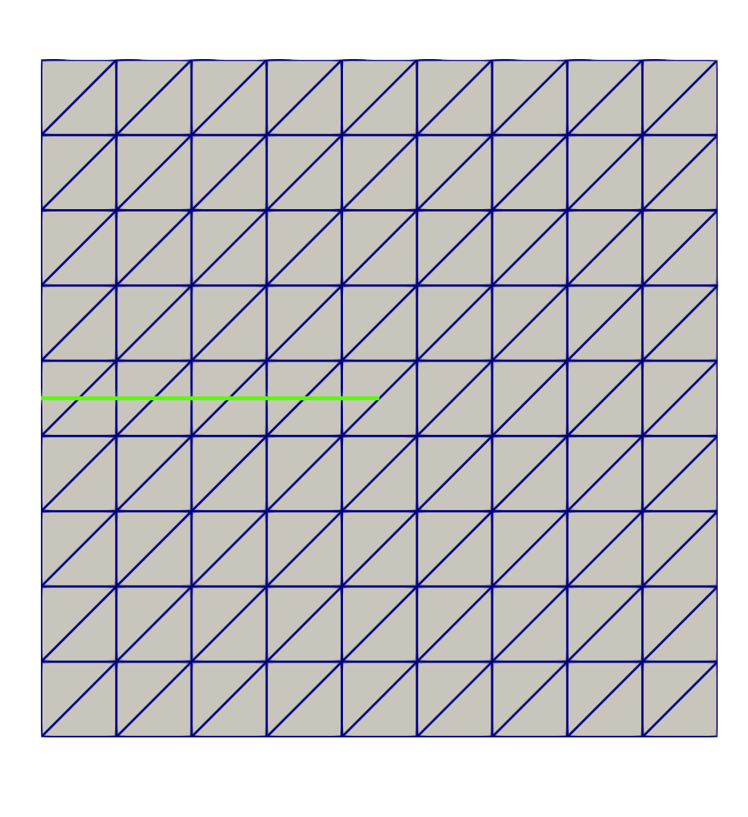
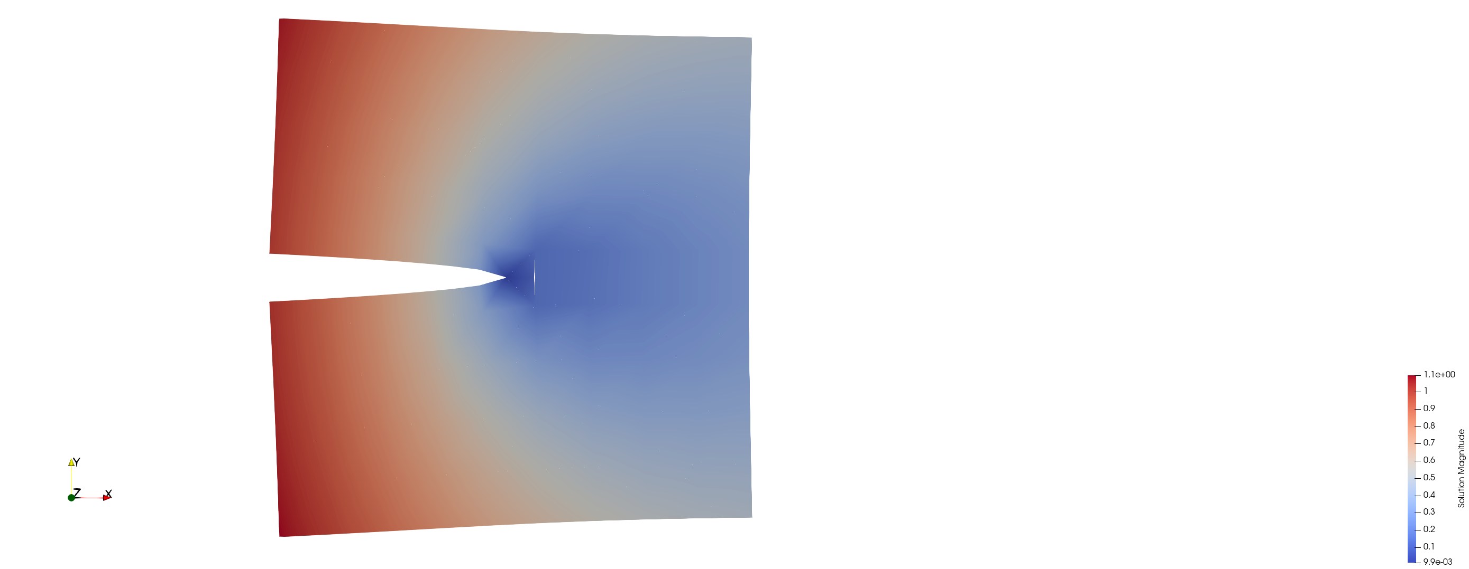
Generalized FEM
Augment standard FEM space with enrichment functions
Introduce solution features directly to approximation space
Remove meshing restrictions
GFEM Applications
  Fracture Mechanics
  Material discontinuities
  Contact
  Porous media

Slide 4
Proposed GFEM^{gl}
Global:
Coarse solid mesh
Homogenized material
Local:
Fine solid mesh
Heterogeneous material
Microstructure-informed damage models
GFEM^{gl} establishes two-way communication between the global and local scale
Material heterogeneity and nonlinearity incorporated only at localized hot spots

Slide 5
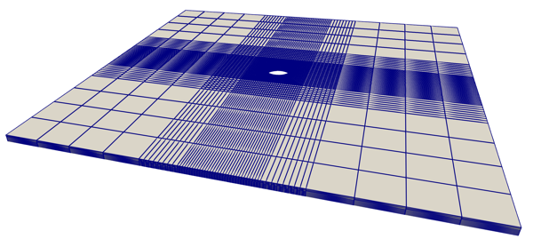
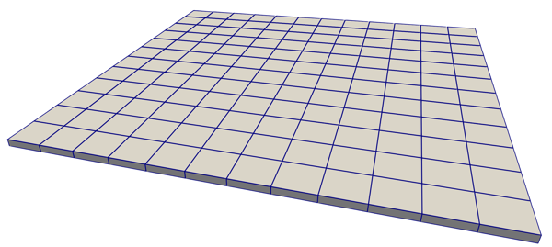
Example Problem Geometry - Plate With a Hole
Reference Mesh
GFEM^{gl} Global Mesh
Goal: Recover same fidelity in local region as fine reference mesh using coarse global mesh

Slide 6
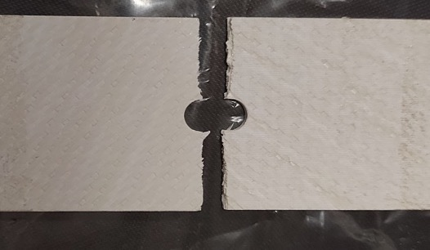




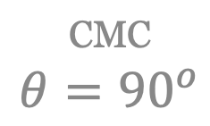
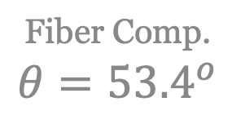
Plate With a Hole Under Tension
CMC
$$θ={90}^{o}$$
Plots of stress concentration through-the-thickness
$$x_{3}$$
$$θ$$
$$x_{1}$$
Fiber Comp.
$$θ={53.4}^{o}$$
Expected failure
GFEM^{gl} recovers local measures accurately
Submodeling does not
Fiber Comp.
$$θ={126.6}^{o}$$

Slide 7
Plate With a Hole Under Tension
GFEM^{gl} recovers global measures accurately
Submodeling modeling does not
$$θ$$
Error of strain energy in local region, relative to reference solution

Slide 8
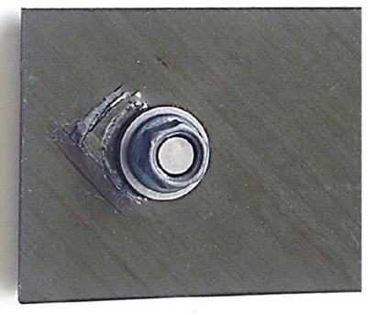
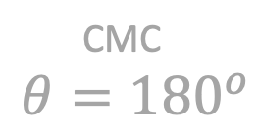
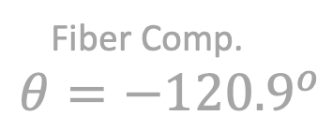


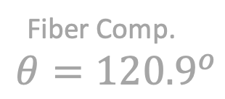
Plate With a Hole Under Bearing Load
Plots of stress concentration through-the-thickness
CMC
$$θ={180}^{o}$$
$$x_{3}$$
$$x_{1}$$
Fiber Comp.
$$θ={−120.9}^{o}$$
Expected failure
GFEM^{gl} recovers local measures accurately
Submodeling does not
Fiber Comp.
$$θ={120.9}^{o}$$

Slide 9
Plate With a Hole Under Bearing Load
GFEM^{gl} recovers global measures accurately
Submodeling does not
Error of strain energy in local region, relative to reference solution

Slide 10
Conclusions
Model material heterogeneity in localized region only
  Accurate local measures
  Accurate global measures
Define loading via local problem
Considerably more accurate than GL-FEM
More representative than fully homogenized model

Slide 11
Future Work
Microstructure-informed damage
IGL-GFEM^{gl}
Other composites

Slide 12




