Slide 1
An Investigation of Detonation Diffraction, Reinitiation, and Amplification
Student:
Student Email:
Faculty:
Faculty Email:
AFRL Sponsor:
AFRL Directorate:
Benjamin Millard
millarbm@mail.uc.edu
Dr. Daniel Cuppoletti
cuppoldr@ucmail.uc.edu
Dr. Timothy Ombrello
AFRL/RQ
PA #:
AFRL-2022-4748

Slide 2
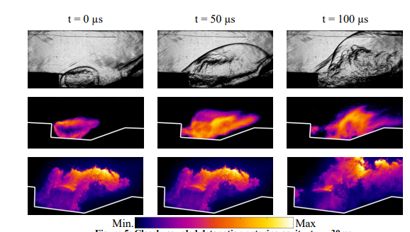
Introduction
Continuing work into pulsed detonation ignition devices conducted by Dr. Ombrello
Exploration of a detonation amplification behavior as a potential means to augment a given detonation ignitor performance
End goal is to integrate into a scramjet combustor to achieve more reliable ignition for low residence time and low enthalpy conditions
Rosato et. al

Slide 3
Testing
Project consisted of two stages
The first stage consisted of characterizing the dependence between the amplification behavior and the detonation cell size
This was achieved by controlling the reaction mixture equivalence ratio and testing with three different fuels, CH₄, C₂H₄, C₃H₈
Detonation propagation capture using pressure and ion probes to measure the propagation of the shock front and flame front respectively
The second stage follows up on the first by using high-speed imagery to spatially resolve the detonation amplification process
An optically accessible detonation chamber was designed and manufactured to facilitate Schlieren and Chemiluminescence Imagery of the detonation phenomenon

Slide 4
Stage 1
The initial testing found 3 unique detonation behavior
The first is a spike amplification behavior where the detonation amplifies in the middle of the detonation chamber that is accompanied by a spike in pressure impulse
The second had the same middle of the chamber amplification but without a significant spike in pressure at the initial amplification event
The third is an end wall amplification event where the detonation is amplified due to effects from the end wall of the detonation chamber resulting in a heavily amplified outlet

Slide 5
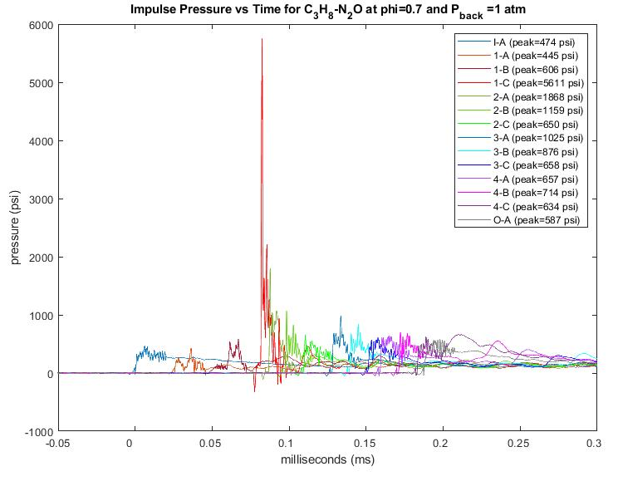
Spike Amplification
Amplified Spike
Decoupled Detonation
Rapid Attenuation
Localized Wall Reinitiation
Still-Amplified Outlet
Inlet Pressure

Slide 6
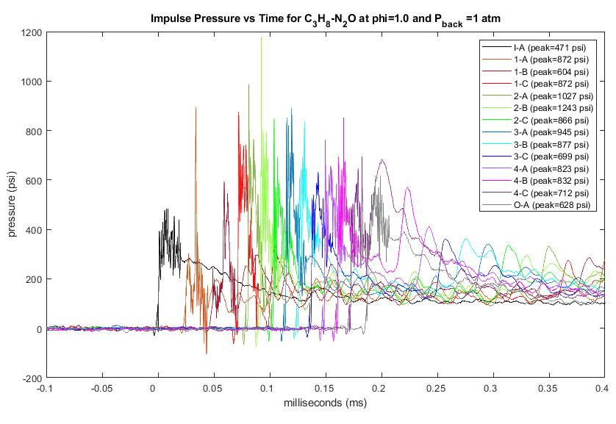
Steady Amplification
Slower Attenuation
Recoupling Spike
Still-Amplified Outlet
Inlet Pressure

Slide 7
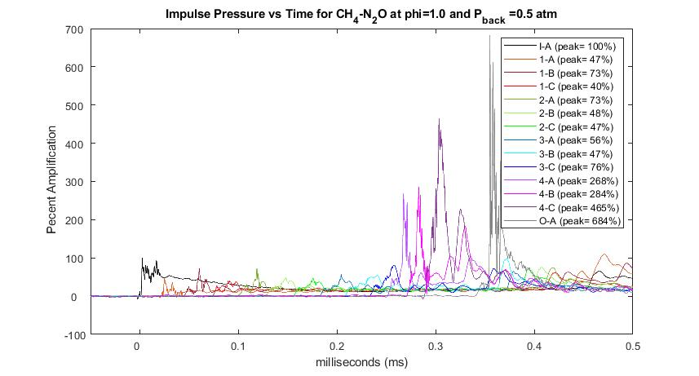
Endwall Amplification
Highly Amplified Outlet
Double Spike Indicating A Decoupled Detonation
Inlet Pressure

Slide 8
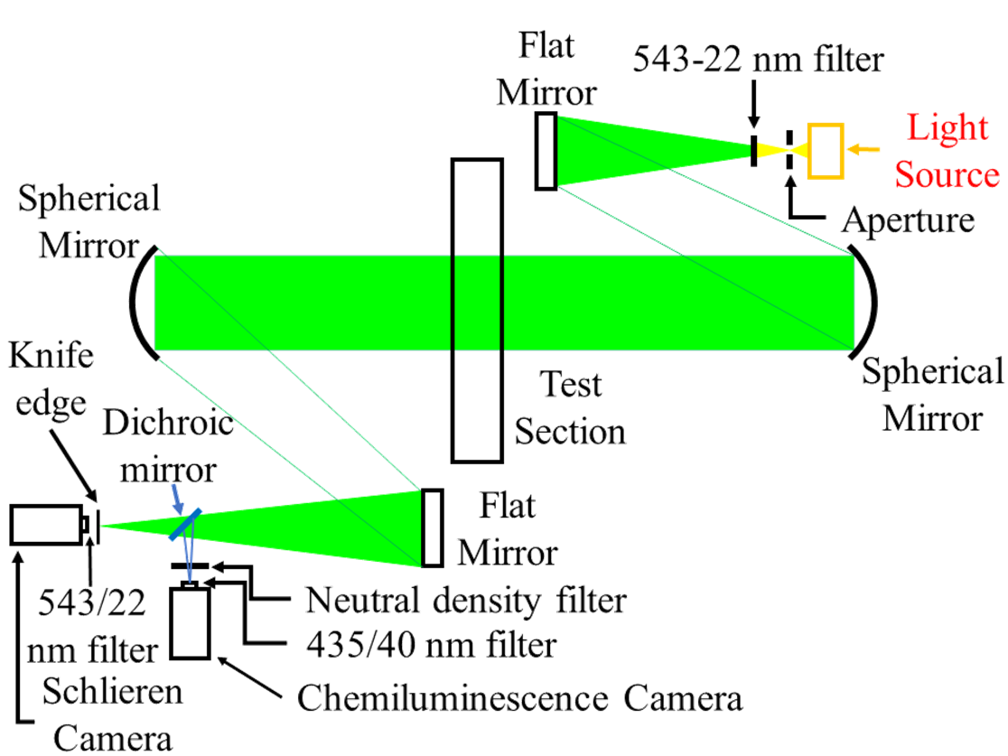
Stage 2
Stage two involved developing an optical accessible 2 in. square detonation chamber capable of withstanding an amplified detonation
The mechanism behind two of the three behaviors documented in stage 1 where captured
The steady amplification behavior was not able to be reproduced due to the large area of the 2 in. square section
Schlieren and CH* Chemiluminescence imagery was taken in the same field of view using two Shimadzu HPV-X2 camera’s
Camera operated at 500,000 FPS with a frame size of 400 by 250 pixels

Slide 9
Spike Amplification
C₂H₄-N₂O Equivalence Ratio=1.0

Slide 10
Endwall Amplification
CH₄-N₂O Equivalence Ratio=1.0

