Slide 1




Hypersonic Vehicle Design Framework Using Machine Learning with Multi-Fidelity Data Under Uncertainty
Student:
Student Email:
Faculty:
Faculty Email:
AFRL Sponsor:
AFRL Directorate:
Atticus Beachy
beachy.10@wright.edu
Dr. Harok Bae
harok.bae@wright.edu
Dr. Josè Camberos
WPAFB/RQHV
Distribution A
Cleared for public release
11/2/2022
PA #:
AFRL-2022-5291

Slide 2
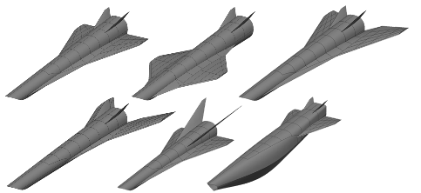
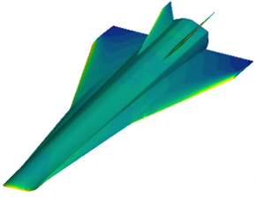
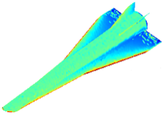
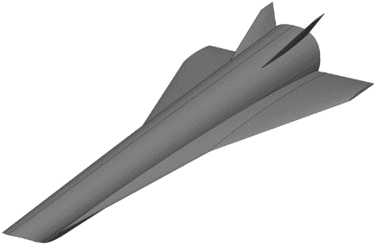

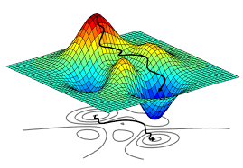
Multi Fidelity Adaptive Learning Framework
High-Fidelity
e.g., RANS
Design Space
Machine Learning to Determine Mapping between LF and HF
Low-Fidelity
Design Configuration
RANS
e.g., Vortex-Lattice
Determine Final Multi-Fidelity Model
Vortex-Lattice
Optimize acquisition metric
HF data
LF data
LF model
HF data
LF model
MF model

Slide 3







Rapid NN (RaNN) Training
Neural Network training is slow (minutes to hours)
  function complexity, number of points, and number of dimensions
Ensembles increase training time unless NNs are trained in parallel
$$x_{1}$$
$$x_{2}$$
$$y$$
Method
All weights and biases are set to random values except for the last layer.
Last layer weights are calculated directly using various types of linear regression, such as ridge regression or LASSO
$$⋮$$
$$⋮$$
$$⋮$$
$$x_{d}$$
Advantages
Hundreds to thousands of times faster than back-propagation
Disadvantages
Requires more neurons for an accurate fit
Random
Random
Linear Regression

Slide 4
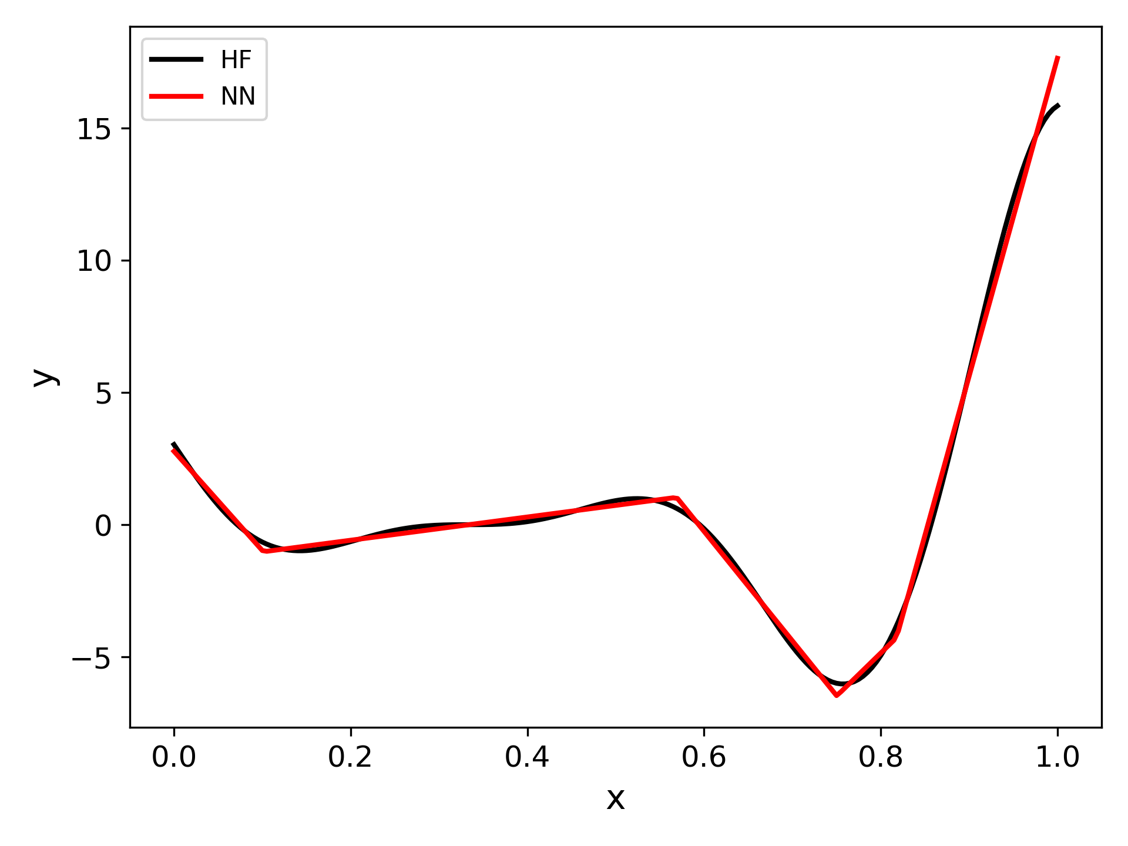
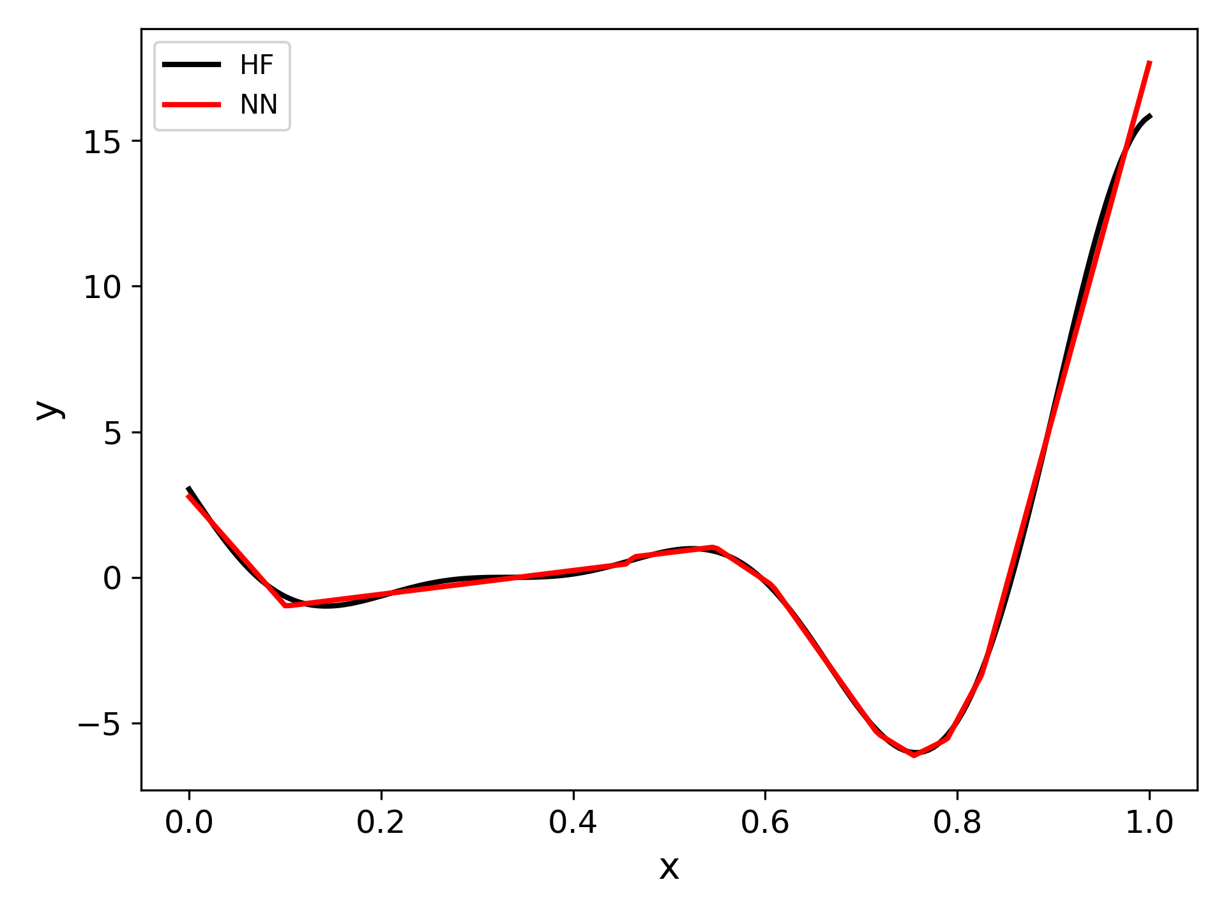
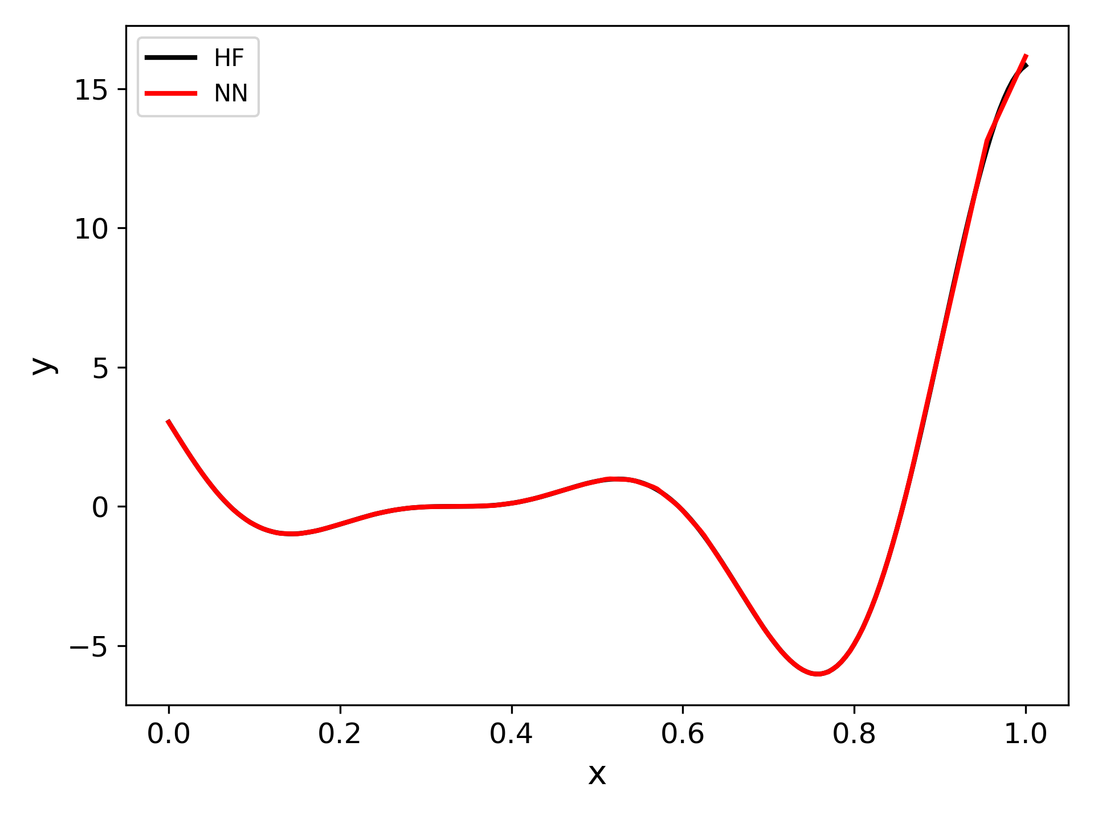
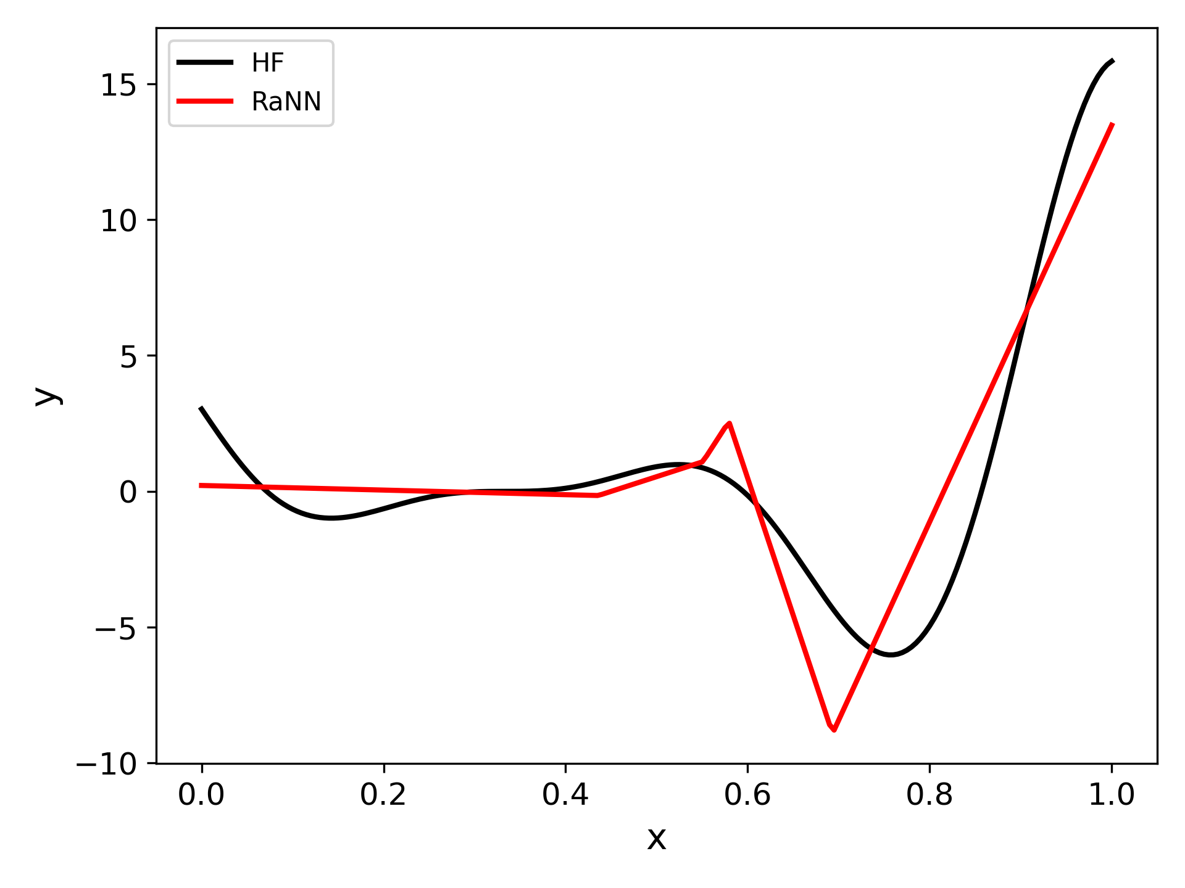
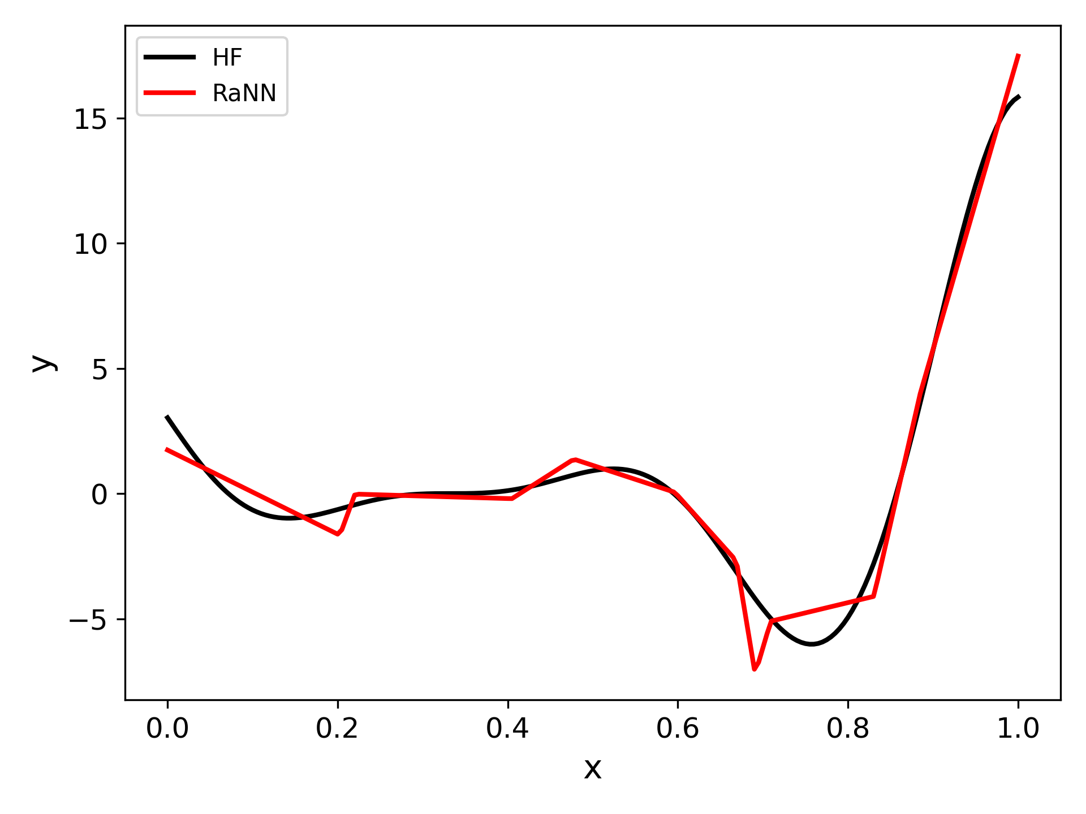
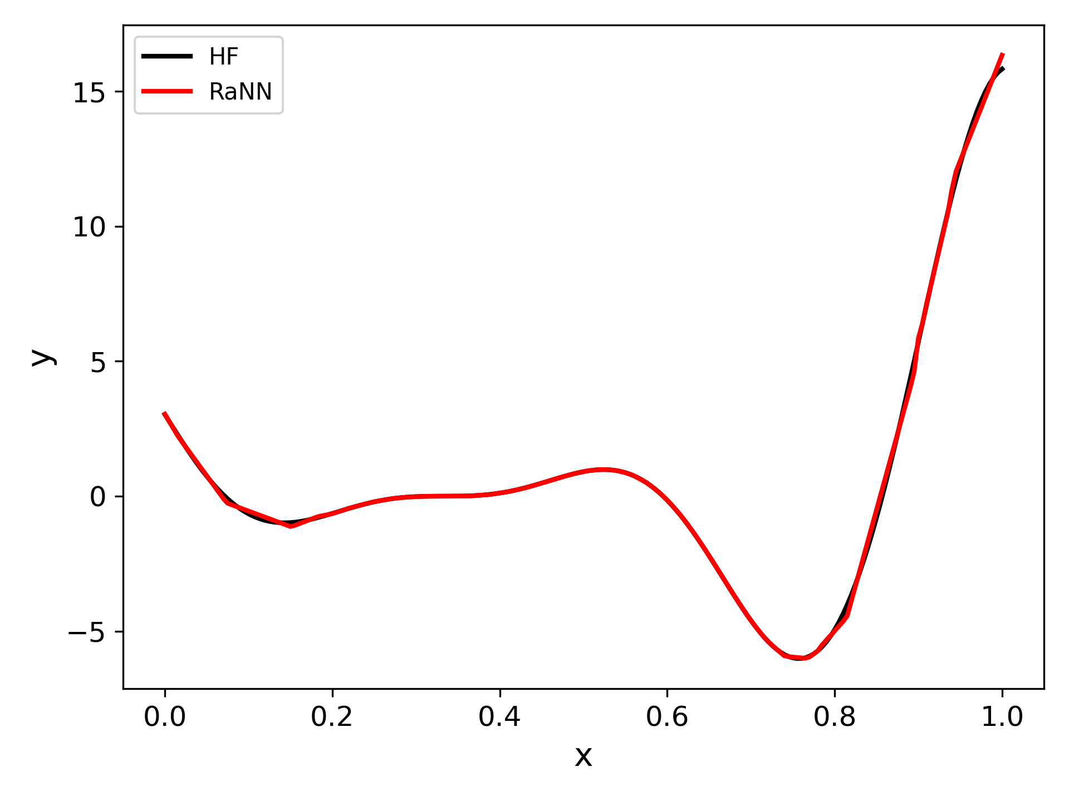



Universal Approximation Theorem
$$x$$
$$y$$
A NN with one hidden layer can capture any continuous function
Examples use one hidden layer with ReLU activation functions
$$⋮$$
5 Neuron
10 Neuron
100 Neuron
Backpropagation training
(slow)
5 Neuron
10 Neuron
100 Neuron
RaNN
(fast)
(over 100x speedup)

Slide 5












E2NN (Emulator Embedded NN)
Emulator $1$
Multi-fidelity Neural Network
  Emulators intrusively embedded into Neural Network structure
  Emulators can represent LF models or prior knowledge
Flexibility of E2NN
  Any number of LF models of any type can be included as emulators
  Emulators can be included anywhere in the NN architecture
  Simplest to include all emulators in all hidden layers
$$⋮$$
Emulator $m$
$$⋯$$
$$X$$
$$x_{1}$$
$$x_{2}$$
$$y$$
$$⋮$$
$$⋮$$
$$⋮$$
$$x_{d}$$
Reference:
Beachy, A., Bae, H., Boyd, I., and Grandhi, R. “Emulator Embedded Neural Networks for Multi-Fidelity Conceptual Design Exploration of Hypersonic Vehicles.” Structural and Multidisciplinary Optimization, 2021. https://doi.org/10.1007/s00158-021-03005-y.
Input
Hidden layers
Output

Slide 6
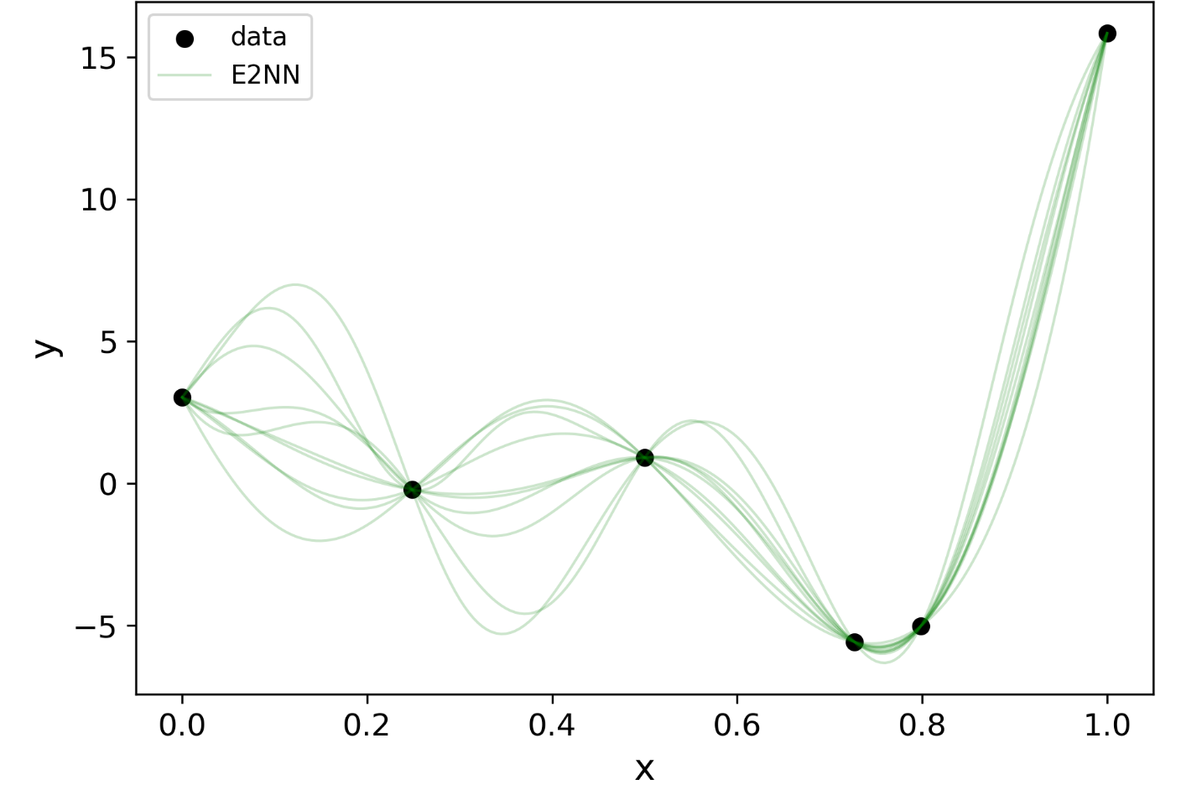
Ensemble E2NN Uncertainty Estimation
Uncertainty estimation needed for Adaptive Learning
Fundamental Idea
Multiple E2NN models are trained and combined in an ensemble
Individual models will differ based on their random initializations
The epistemic uncertainty is estimated based on the aleatoric uncertainty of the NN models

Slide 7




Expected Improvement (EI)
EI is used for Efficient Global Optimization (EGO) of black-box functions
Adaptively samples a kriging model using the prediction pdfs
Excepted Improvement – The amount by which a sample is expected to improve over the current optimum
$$EI\left(x\right)=\int_{−∞}^{∞}{pdf\left(y\right)⋅\max\left(y_{current opt}−y, 0\right)⋅dy}$$
$$y$$
Current optimum
Integrated region
$$x$$
We use an E2NN Ensemble instead of a kriging model.
This necessitates using a t-distribution instead of a normal distribution

Slide 8
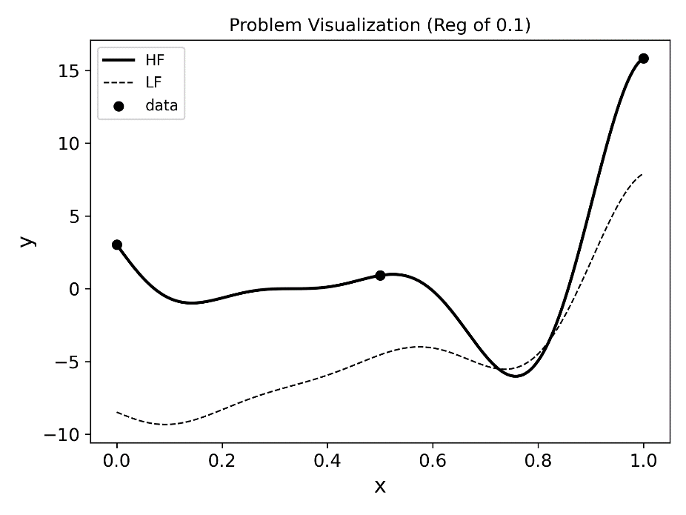
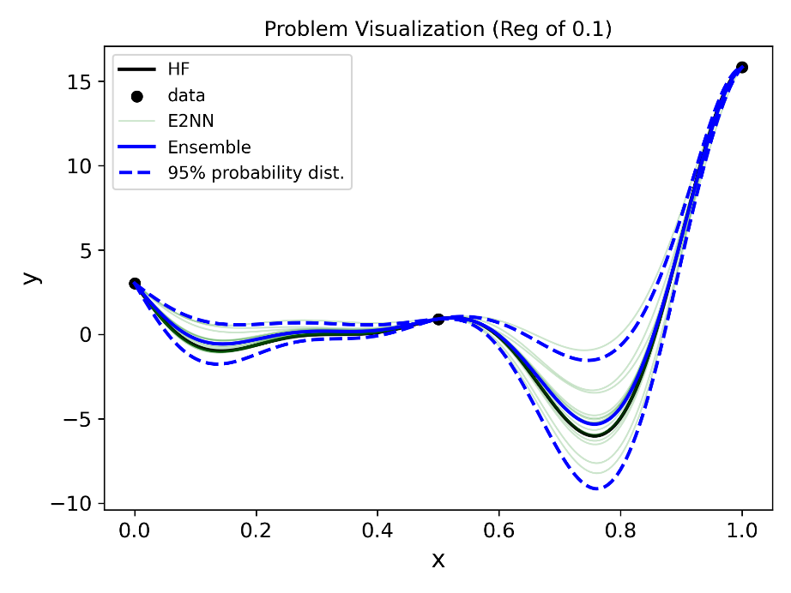
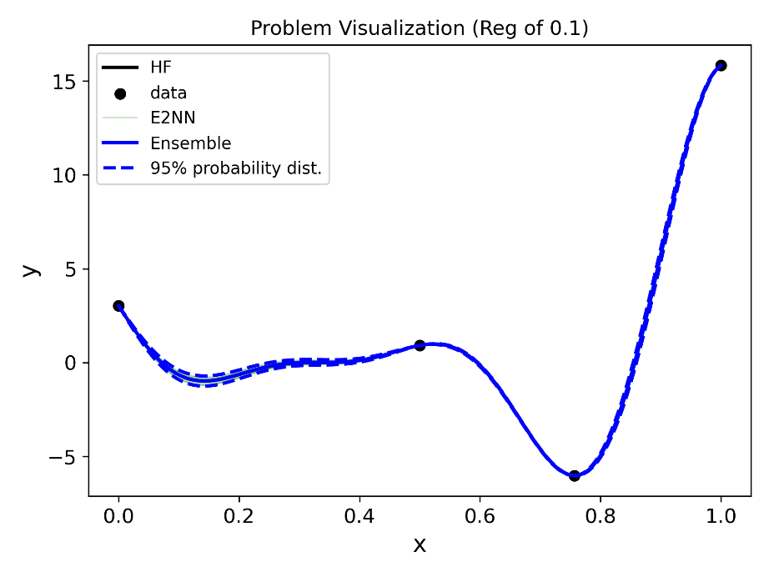
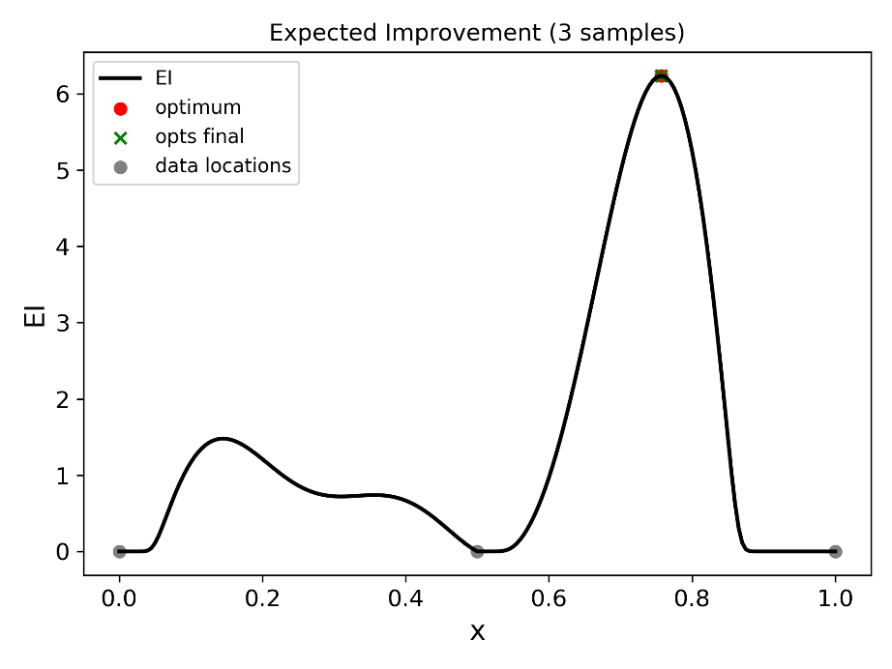






E2NN Active Learning 1D Example
Optimum discovered with one adaptive sample
$$x_{opt}=0.757249$$
$$x_{samp}=0.756956$$
$${err}_{x}=0.000293$$
$$y_{opt}=−6.02074$$
Adaptive sample
Max EI
$$y_{samp}=−6.02069$$
$${err}_{y}=5⋅{10}^{−5}$$

Slide 9
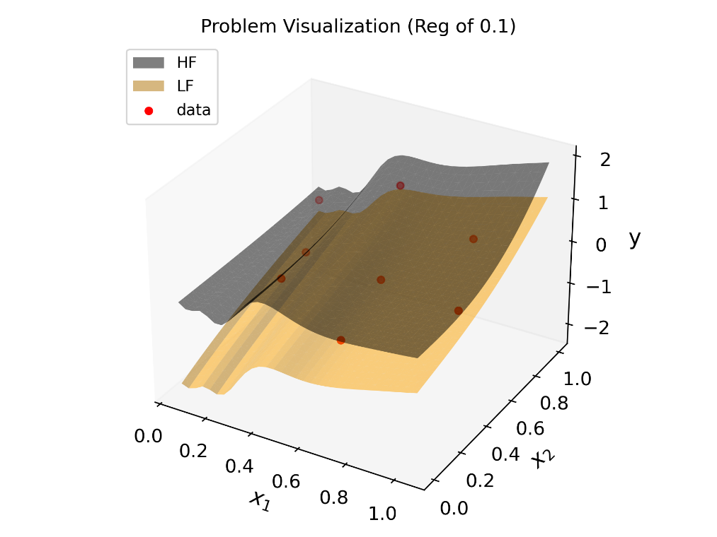
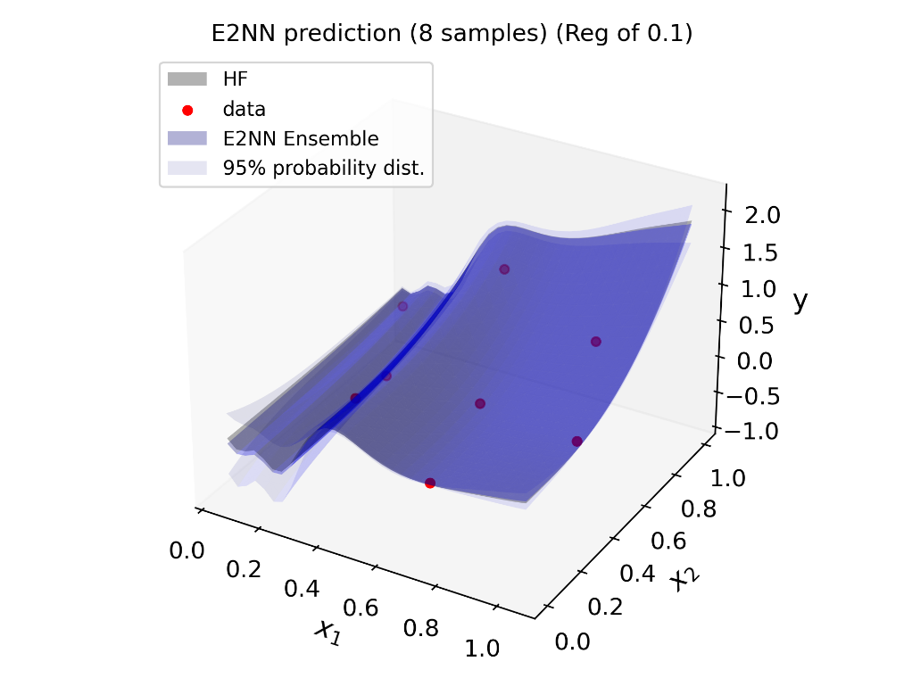
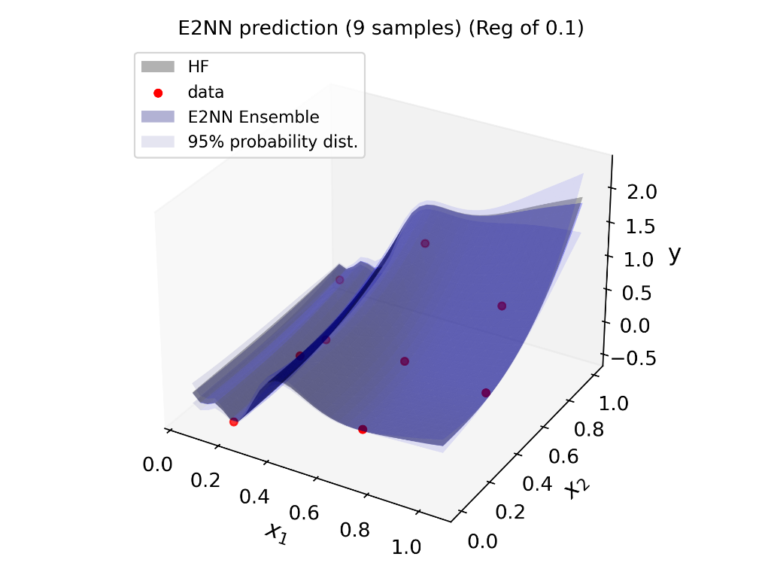
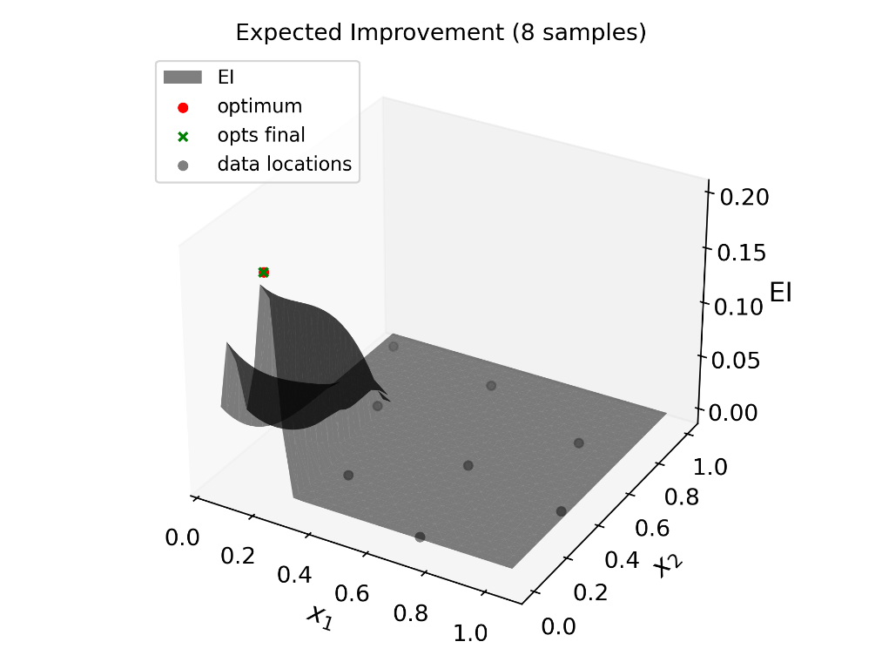
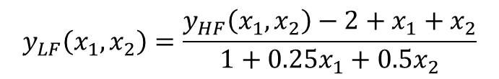
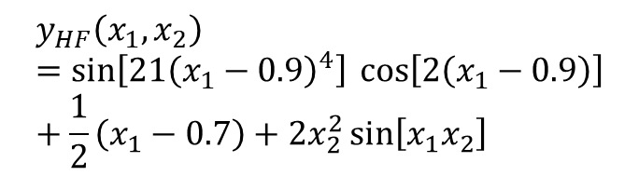
E2NN Active Learning 2D Example
Optimum discovered with one adaptive sample
Non-stationary function with LF nonlinearly deviated from HF
$$y_{HF}\left(x_{1},x_{2}\right)=\sin\left[21{\left(x_{1}−0.9\right)}^{4}\right] \cos\left[2\left(x_{1}−0.9\right)\right]+\frac{1}{2}\left(x_{1}−0.7\right)+2x_{2}^{2}\sin\left[x_{1}x_{2}\right]$$
$$y_{LF}\left(x_{1},x_{2}\right)=\frac{y_{HF}\left(x_{1},x_{2}\right)−2+x_{1}+x_{2}}{1+0.25x_{1}+0.5x_{2}}$$
Max EI
Adaptive sample

Slide 10
Method Summary
Goal: Develop a Machine Learning framework for cost-effective modeling of expensive, high-dimensional functions for aerospace design exploration
Method
Goal
NN model
Enables
Surrogate scalability to many dimensions
Rapid Neural Network Training
Enables
Accelerated NN training
E2NN
Enables
Leveraging multiple information sources
Ensemble
Enables
Modeling epistemic uncertainty
Expected Improvement
Enables
Intelligent sampling of HF model
Together these methods form the core of a new framework for aerospace design.

