Slide 1




Periodic Vortical Gust Encounter and Mitigation Using Closed Loop Control
Student:
Student Email:
Faculty:
Faculty Email:
AFRL Sponsor:
AFRL Directorate:
Andrew Killian
killiana4@udayton.edu
Dr. Sid Gunasekaran
gunasekarans1@udayton.edu
Dr. Albert Medina
AFRL/RQ
PA #:
AFRL-2022-5166
Replace with University Logo

Slide 2
Motivations
Vortical gusts represent one subset of the flow disturbances common in unsteady environments broadly referred to as gusts
Vortical gusts can alter the bound circulation of aerodynamic devices causing large and sudden changes in forces
Consequently, the performance and stability of aerodynamic devices that operate in unsteady environments could be greatly improved by mitigating gusts
By understanding the flow physics on a fundamental level, future control and mitigation techniques can be specifically tailored for affecting flow features

Slide 3
Introduction
Work by Mongin et. al. has been done previously to develop a closed loop control system in UD’s water tunnel
  This work focused on “virtual gusts” where the flat plate tracks a sinusoidal C_{L}
  Two controllers (Full State Feedback and PID) were developed
  Have since improved the tuning of the PID controller for this work
Latest experiments have been PIV measurements “physical gust” mitigation using closed loop control
The goal of this work is to understand the flow physics present in successful mitigation

Slide 4
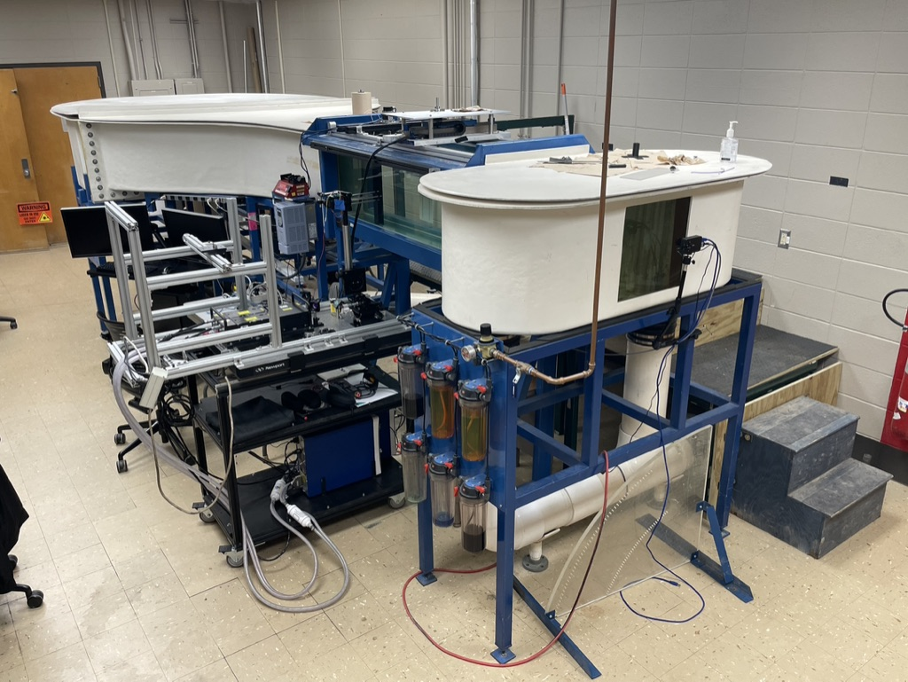
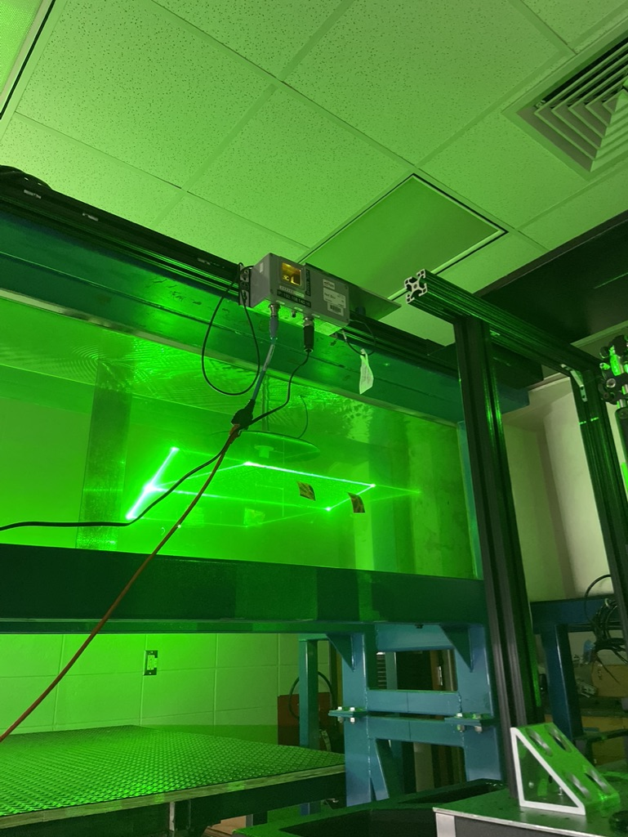
Experimental Setup – UD Water Tunnel
Eidetics Model 1520 water tunnel
6:1 Contraction
38cm x 46 cm Test section
0.28 m/s freestream for these experiments
Using a 3” chord, Re≈24,000
Time resolved PIV data was captured using:
  A 2.42 W 532nm continuous laser
  PCO dimax high speed camera
  60μm polyamide seeding particles
PIV data was synchronized with force and position measurements

Slide 5
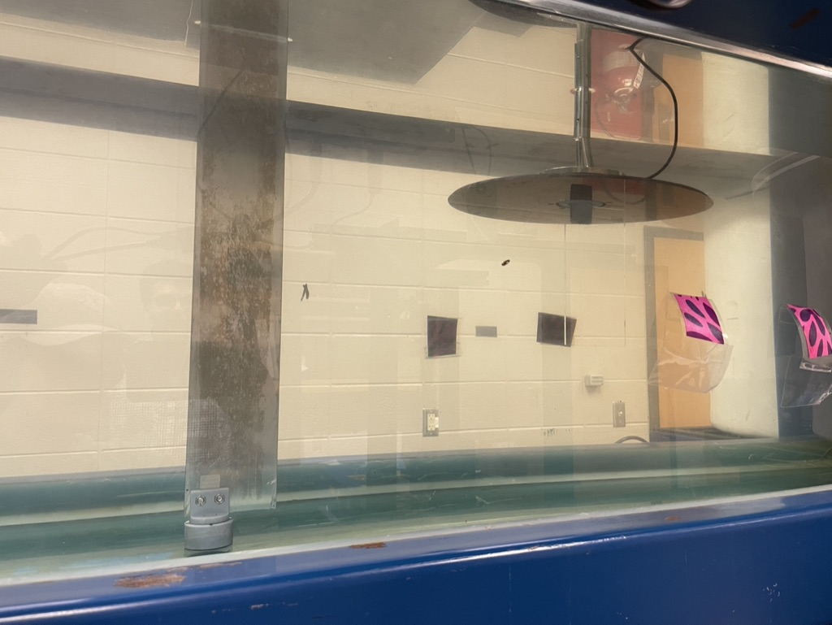
Experimental Setup –
Gust Generator & Flat Plate
A 3” chord aluminum flat plate gust generator was placed 5c upstream of the sensing wing
  The gust generator was pitched in sinusoidal profiles to generate vortical gusts
A 3”x6” borosilicate glass flat plate was mounted to an ATI Mini 40 force transducer downstream
  This wing is able to sense the forces on it and react to them in closed loop
5c, 15”
Gust generator outline
Glass flat plate outline

Slide 6
Test Matrix
Type | RF | GG Amplitude | α hold | CL Hold
Gust characterization | 0.3,0.2,0.1,0.05 | 30,15 | N/A | N/A
Open loop | 0.3,0.2,0.1 | 30,16 | 0, 6 | N/A
Closed loop | 0.3,0.2,0.1 | 30,17 | N/A | 0, 0.35
For each test point 10 periods of data were collected to be phase averaged based on the gust generator oscillation frequency

Slide 7
Initial Results – Mitigation
Mitigation at RF 0.3, A=30°
For these initial results I will focus on one case
  RF=0.3 (highly unsteady)
  A=30° (gust generator pitching amplitude)
Force data has shown that around 40-50% mitigation of the C_{L} peaks caused by the vortical gust is possible

Slide 8
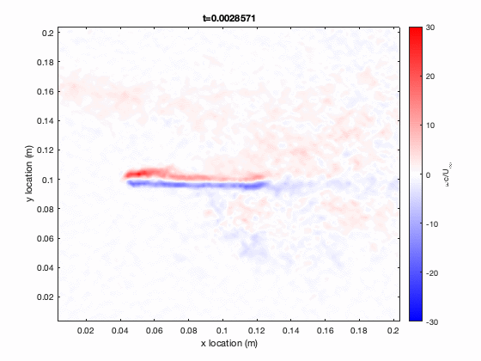
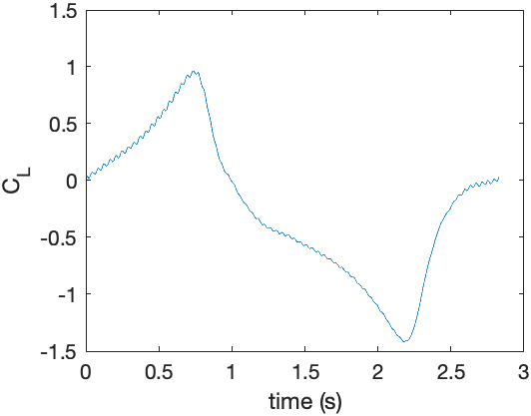
Initial Results – Open Loop
In this open loop experiment, the flat plate is holding a constant 0° AoA
The wing is located at the center of the frame between the red blue vorticity on its top and bottom surfaces
C_{L} peaks of +0.96 and -1.42
There is an increase in vorticity on the opposite side of the wing as the gust passes over
This increase in vorticity corresponds to an increase in C_{L} magnitude

Slide 9
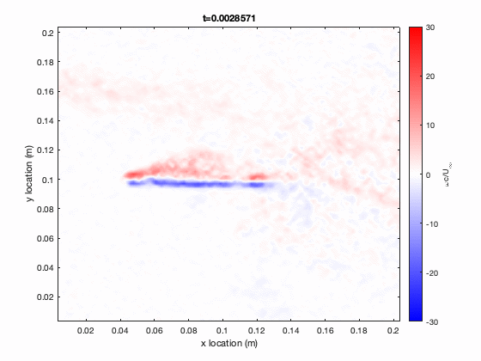
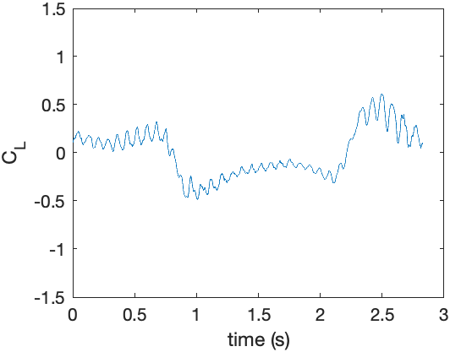
Initial Results – Closed Loop
In the corresponding closed loop experiment the controller is commanded to achieve a constant C_{L} of 0
C_{L} peaks of +0.61 and -0.49
As expected, mitigation of C_{L} peaks is about 50% on average
Here there is an increase in vorticity on the same side as the gust
  Lift peak here comes later than open loop
  Likely due to controller lag
Analysis of slower cases will yield an increased understanding of where the controller performs best and worst

Slide 10
Conclusions
Early data looks very promising for being able to detect coherent structures and flow patterns that contribute to successful gust mitigation.
More detailed analysis will continue in the coming months in preparation for the AIAA 2023 SciTech conference
More data and detailed discussion of findings will be coming soon from SciTech

